Slide 1
17. Tables
HTML tables allow web developers to arrange data into rows and columns.
網頁可以將資料用表格呈現。
https://www.w3schools.com/html/html_tables.asp

Slide 2
HTML Tables
HTML Tables
Table Borders
Table Sizes
Table Headers
Padding & Spacing
Colspan & Rowspan
Table Styling
Table Colgroup

Slide 3
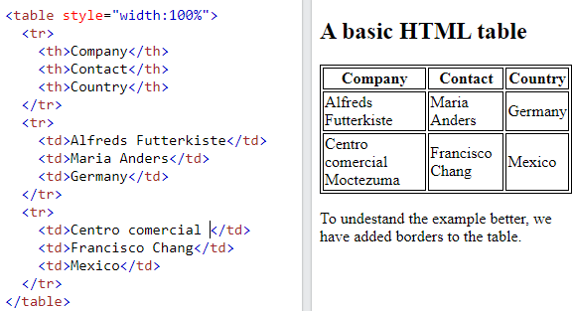
Example <tr>有幾橫行 <th>有幾直列
<table>
<tr>
<th> </th>
</tr>
<tr>
<td> </td>
</tr>
<tr>
<td> </td>
</tr>
</table>

Slide 4
Define an HTML Table
A table in HTML consists of table cells inside rows and columns
1.tr
2.th
tag | description
tr | table row
th | table header (置中)
td | table data (靠左)
1.tr
3.td
1.tr
3.td
1.tr
3.td

Slide 5
Example <tr>有幾橫行 <th>有幾直列
<table>
<tr>
<th> </th>
<th> </th>
<th> </th>
</tr>
<tr>
<td> </td>
<td> </td>
<td> </td>
</tr>
</table>

Slide 6
Example
<table>
<tr>
<th> </th>
</tr>
<tr>
<td> </td>
</tr>
<tr>
<td> </td>
</tr>
</table>

Slide 7
Table Cells(最基本單位，表格實質內容)
Each table cell is defined by a <td> and a </td> tag.
td stands for table data.
Everything between <td> and </td> are the content of the table cell.
Note: table data elements are the data containers of the table. They can contain all sorts of HTML elements; text, images, lists, other tables, etc.

Slide 8
Example
<table>
<tr>
<th> </th>
</tr>
<tr>
<td> </td>
</tr>
<tr>
<td> </td>
</tr>
</table>
<table> <tr> <td>Emil</td> <td>Tobias</td> <td>Linus</td> </tr> </table>

Slide 9
Table Rows
Each table row starts with a <tr> and end with a </tr> tag.
tr stands for table row.
You can have as many rows as you like in a table, just make sure that the number of cells are the same in each row.

Slide 10
Example
<table> <tr> <td>Emil</td> <td>Tobias</td> <td>Linus</td> </tr> <tr> <td>16</td> <td>14</td> <td>10</td> </tr> </table>
<table>
<tr>
<th> </th>
</tr>
<tr>
<td> </td>
</tr>
<tr>
<td> </td>
</tr>
</table>

Slide 11
Table Headers
Sometimes you want your cells to be headers, in those cases use the <th> tag instead of the <td> tag:
By default, the text in <th> elements are bold and centered, but you can change that with CSS.

Slide 12
Let the first row be table headers:
<table> <tr> <th>Person 1</th> <th>Person 2</th> <th>Person 3</th> </tr> <tr> <td>Emil</td> <td>Tobias</td> <td>Linus</td> </tr> <tr> <td>16</td> <td>14</td> <td>10</td> </tr> </table>
<table>
<tr>
<th> </th>
</tr>
<tr>
<td> </td>
</tr>
<tr>
<td> </td>
</tr>
</table>

Slide 13
HTML Table Tags
Tag | Description
<table> | Defines a table
<th> | Defines a header cell in a table
<tr> | Defines a row in a table
<td> | Defines a cell in a table
<caption> | Defines a table caption

Slide 14
HTML Table Tags
Tag | Description
<colgroup> | Specifies a group of one or more columns in a table for formatting
<col> | Specifies column properties for each column within a <colgroup> element
<thead> | Groups the header content in a table
<tbody> | Groups the body content in a table
<tfoot> | Groups the footer content in a table

Slide 15
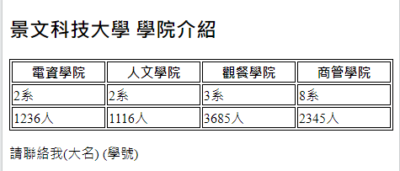
作業17_1
請在作業HW15a下面，加上如下圖的表格。

Slide 16
17a1. Table Borders
HTML tables can have borders of different styles and shapes.
表格框線的型態
https://www.w3schools.com/html/html_table_borders.asp

Slide 17
How To Add a Border (邊框)
When you add a border to a table, you also add borders around each table cell.
To add a border, use the CSS border property on table, th, and td elements.

Slide 18
Example (CSS) – boarder 簡寫
table, th, td { border: 1px solid black; }
粗細，實虛線，顏色
table, th, td通常一起定義。

Slide 19
Collapsed Table Borders (border-collapse)
To avoid having double borders like in the example above, set the CSS border-collapse property to collapse.
This will make the borders collapse into a single border:

Slide 20
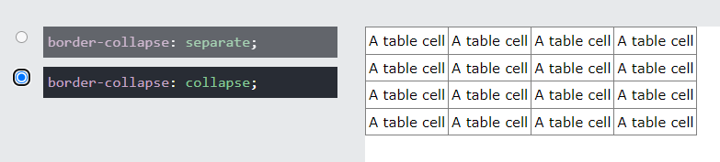
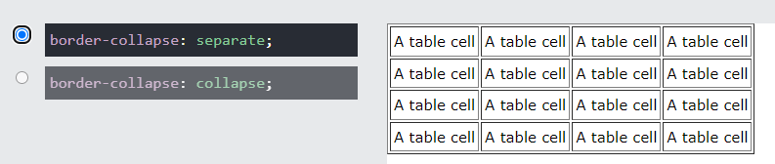
separate & collapse
table, th, td { border: 1px solid black; border-collapse: collapse; }

Slide 21
Style Table Borders(background-color)
If you set a background color of each cell, and give the border a white color (the same as the document background), you get the impression of an invisible border:
table, th, td { border: 1px solid white; border-collapse: collapse; } th, td { background-color: #96D4D4; }

Slide 22

Round Table Borders (border-radius)
With the border-radius property, the borders get rounded corners:
註：包含三種都要圓弧角：table, th, td
table, th, td { border: 1px solid black; border-radius: 10px; }

Slide 23
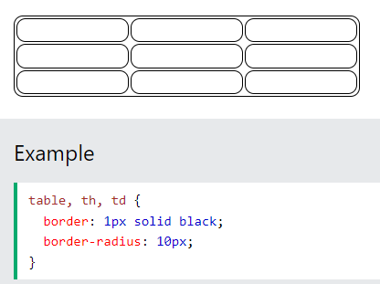
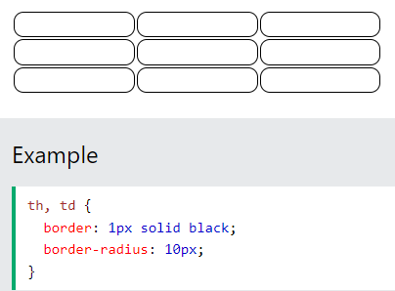
example
Skip the border around the table by leaving out table from the css selector:

Slide 24
Dotted Table Borders (border-style)
With the border-style property, you can set the appearance of the border.

Slide 25
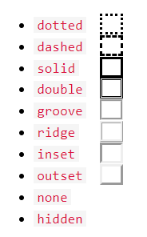
Border-style
The following values are allowed:
th, td { border-style: dotted; }

Slide 26
Border Color (border-color)
With the border-color property, you can set the color of the border.
th, td { border-color: #96D4D4; }

Slide 27
Summary
border: 1px solid black;
border-collapse: collapse; (separate)
background-color: #96D4D4;
border-radius: 10px;
border-style: dotted;(dashed, double, insert)
border-color: #96D4D4;

Slide 28
作業17_2
請在作業HW17-1三種border(table,th td)，請選擇separate後，再採用不同的框線粗細、框線格式、框線顏色、框線四角弧度、背景顏色。請分別用右方設定的方式。
table {
border:1px solid black;
border-collapse:separate;
background-color: #96D4D4;
border-radius: 10px;
border-style: dotted;(dashed, double, insert)
border-color: #96D4D4;
}
th {
border:1px solid black;
border-collapse:separate;
background-color: #96D4D4;
border-radius: 10px;
border-style: dotted;(dashed, double, insert)
border-color: #96D4D4;
}

Slide 29
17a2. Table Sizes
HTML tables can have different sizes for each column, row or the entire table.
Use the style attribute with the width or height properties to specify the size of a table, row or column.
網頁表格的每一個cell，都可調整長度與寬度。
https://www.w3schools.com/html/html_table_sizes.asp

Slide 30
HTML Table Width
To set the width of a table, add the style attribute to the <table> element:
Note: Using a percentage as the size unit for a width means how wide will this element be compared to its parent element, which in this case is the <body> element.

Slide 31
Example- Set the width of the table to 100%
<table style="width:100%"> <tr> <th>Firstname</th> <th>Lastname</th> <th>Age</th> </tr> <tr> ………………………
</table>

Slide 32
HTML Table Column Width
To set the size of a specific column, add the style attribute on a <th> or <td> element:

Slide 33
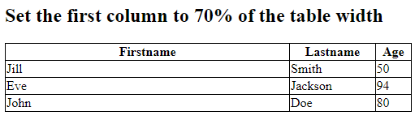
Example- Set the column of the table to 70%
<table style="width:100%"> <tr> <th style="width:70%">Firstname</th> <th>Lastname</th> <th>Age</th> </tr> <tr> ………………………
</table>

Slide 34
HTML Table Row Height
To set the height of a specific row, add the style attribute on a table row element:

Slide 35
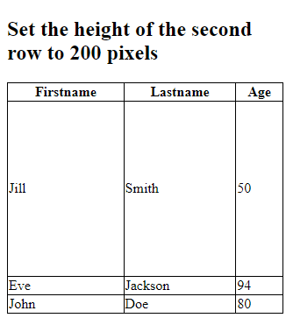
Example- Set the height of the 2nd raw to 200 pixels
<table style="width:100%"> <tr> <th>Firstname</th> ……………………… </tr> <tr style="height:200px"> <td>Jill</td> ………………………
</table>

Slide 36
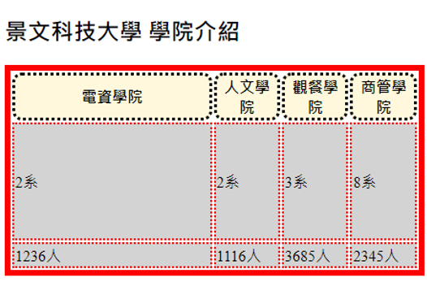
作業17
1.請利用前面網頁，將電資學院寬度加大至40%。
2.在最後一行，加入各學院照片一張(請到學校官網下載圖片)。
3.在第一行，調整可以連結到各院的首頁。
4.做完之後，請上傳到自己網站。

