Slide 1
17C1. Table Styling
Use CSS to make your tables look better.
利用CSS美化表格顏色。
https://www.w3schools.com/html/html_table_styling.asp

Slide 2
本節重點
如何讓表格橫排、或直行有底色：偶數與奇數。
當表格有底色橫排與直行重疊時，權益作法：彼此透明度增加。
以底線取代背景。
游標滑過時的變化。

Slide 3
HTML Table - Zebra Stripes
If you add a background color on every other table row, you will get a nice zebra stripes effect.
To style every other table row element, use the :nth-child(even) selector like this.
Note: If you use (odd) instead of (even), the styling will occur on row 1,3,5 etc. instead of 2,4,6 etc.

Slide 4
HTML Table - Vertical Zebra Stripes
To make vertical zebra stripes, style every other column, instead of every other row.
Note: Put the :nth-child() selector on both th and td elements if you want to have the styling on both headers and regular table cells.

Slide 5
Example
tr:nth-child(even) { background-color: #D6EEEE; }
紫色框- tr:橫的
th/td:直的
藍色框- even(偶數列)
odd(奇數列)

Slide 6
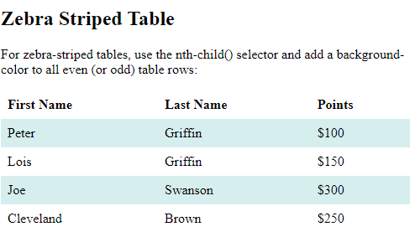
Example -tr(橫的、偶數)
tr:nth-child(even) { background-color: #D6EEEE; }

Slide 7
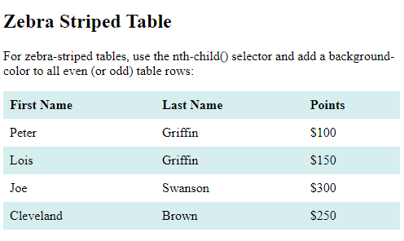
Example –tr(橫的、奇數)
tr:nth-child(odd) { background-color: #D6EEEE; }

Slide 8
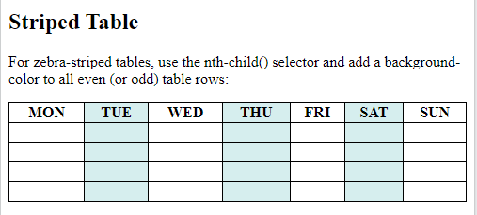
Example - th / td (直的、偶數)
td:nth-child(even), th:nth-child(even) { background-color: #D6EEEE; }

Slide 9
Combine Vertical and Horizontal Zebra Stripes
You can combine the styling from the two examples above and you will have stripes on every other row and every other column.
If you use a transparent color you will get an overlapping effect.
Use an rgba() color to specify the transparency of the color:

Slide 10
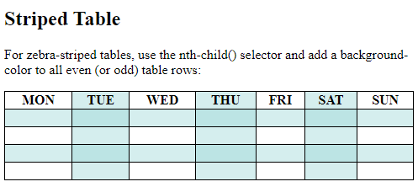
Example
tr:nth-child(even) { background-color: rgba(150, 212, 212, 0.4); } th:nth-child(even),td:nth-child(even) { background-color: rgba(150, 212, 212, 0.4); }

Slide 11
Horizontal Dividers
If you specify borders only at the bottom of each table row, you will have a table with horizontal dividers.
Add the border-bottom property to all tr elements to get horizontal dividers:

Slide 12
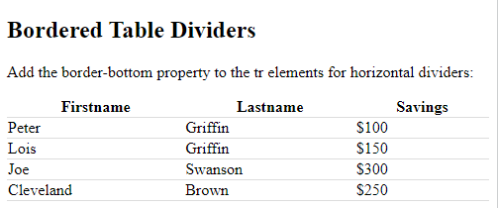
Example
tr { border-bottom: 1px solid #ddd; }

Slide 13
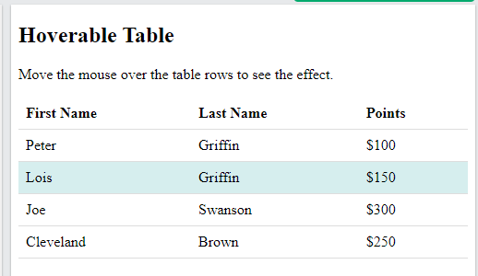
Hoverable Table
Use the :hover (徘徊) selector on tr to highlight table rows on mouse over。
tr:hover {background-
color: #D6EEEE;}

Slide 14
Summary
tr:nth-child(even) { background-color: yellow;} 【橫排有底色】
th,td:nth-child(odd){ background-color: blue); } 【直行有底色】
tr,th,td:nth-child(odd){ background-color: rgba(150, 212, 212, 0.4); 【橫排與直行重疊時，以透明銜接】
tr { border-bottom: 1px solid #ddd; } 【底線有顏色】
tr:hover {background-color: #D6EEEE;} 【滑鼠移到有顏色】

Slide 15
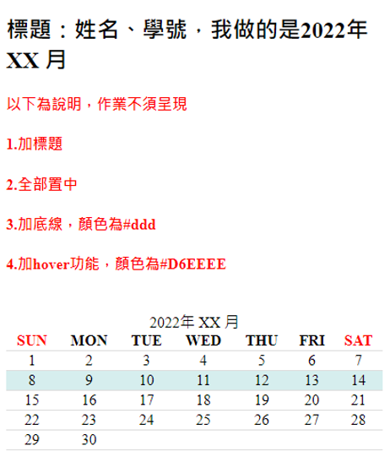
作業17C1
依前例，請製作如圖的網頁，將此兩個月曆呈現在一個網頁中即可。
1.加標題
2.全部置中
3.加底線，顏色為#ddd
4.加hover功能，顏色為#D6EEEE

Slide 16
作業補充
檔名為HW本週檔名(例如HWXX.htm)，請上傳到學校網站。
請在google表單，填入可鏈結網址：例如http://fs2.just.edu.tw/~s123456789/hwxx.htm
上傳截止時間：上課後第二天晚上11.00前。
google表單https://forms.gle/k2w9fWn6vT7JR1Z97
上傳方式介紹：http://fs3.just.edu.tw/~cc/04_teach/doc/useFTP.htm

Slide 17
17.c2. Table Colgroup
The <colgroup> element is used to style specific columns of a table.
對於表格特定部分的美化
https://www.w3schools.com/html/html_table_colgroup.asp

Slide 18
HTML Table Colgroup
If you want to style the two first columns of a table, use the <colgroup> and <col> elements.
The <colgroup> element should be used as a container for the column specifications.
Each group are specified with a <col> element.
The span attribute specifies how many columns that gets the style.
The style attribute specifies the style to give the columns.
Note: There is a very limited selection of legal CSS properties for colgroups.

Slide 19
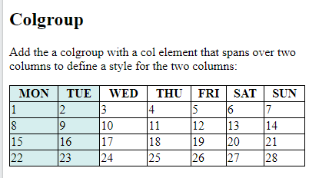
Example
Note: The <colgroup> tag must be a child of a <table> element and should be placed before any other table elements, like <thead>, <tr>, <td> etc., but after the <caption> element, if present.
<table> <colgroup> <col span="2" style="background-color: #D6EEEE"> </colgroup> <tr> <th>MON</th>
…………

Slide 20
Legal CSS Properties
There are only a very limited selection of CSS properties that are allowed to be used in the colgroup:
width property visibility property background properties border properties
All other CSS properties will have no effect on your tables.

Slide 21
Multiple Col Elements
If you want to style more columns with different styles, use more <col> elements inside the <colgroup>:

Slide 22
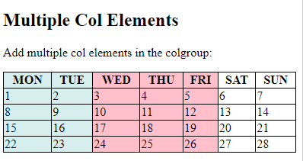
Example
<table> <colgroup> <col span="2" style="background-color: #D6EEEE"> <col span="3" style="background-color: pink"> </colgroup> <tr> <th>MON</th> <th>TUE</th>

Slide 23
Empty Colgroups
If you want to style columns in the middle of a table, insert a "empty" <col> element (with no styles) for the columns before:

Slide 24
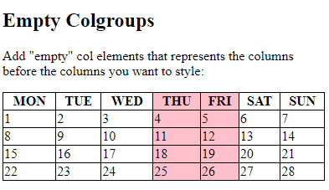
Example
<table> <colgroup> <col span="3"> <col span="2" style="background-color: pink"> </colgroup> <tr> <th>MON</th> <th>TUE</th> <th>WED</th> <th>THU</th> ...

Slide 25
Hide Columns
You can hide columns with the visibility: collapse property:

Slide 26
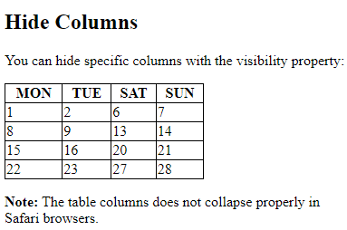
Example (第3~5行消失)
<table> <colgroup> <col span="2"> <col span="3" style="visibility: collapse"> </colgroup> <tr> <th>MON</th> <th>TUE</th> <th>WED</th> <th>THU</th> ...

Slide 27
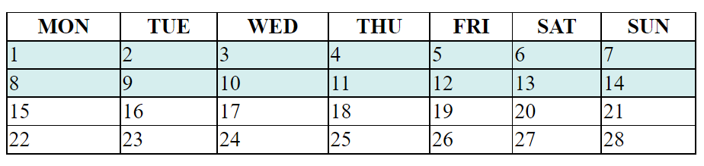
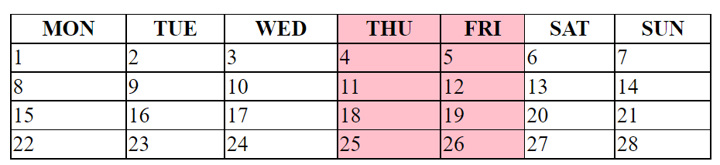
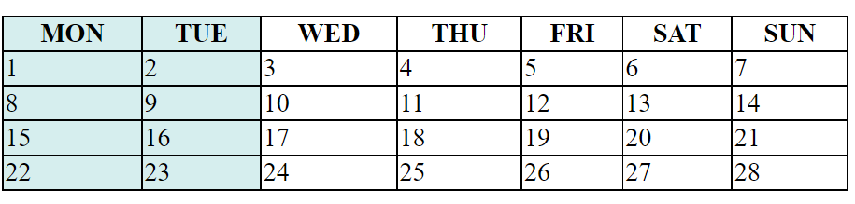
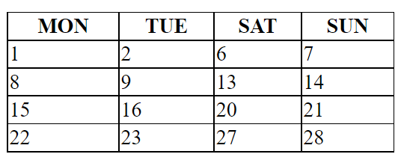
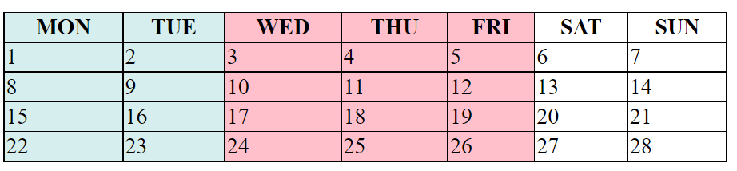
作業17_C2(改成邊框、th置中、td置左)
background-color: #D6EEEE
background-color: pink

