Slide 1
18. Lists
HTML lists allow web developers to group a set of related items in lists.
HTML的清單，可以有多種排序或無排序方式呈現。
https://www.w3schools.com/html/html_lists.asp

Slide 2
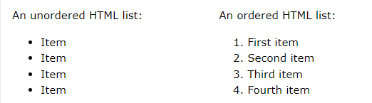
Unordered & ordered list
unordered list
<ul>+<li>
ordered list
<ol>+<li>

Slide 3
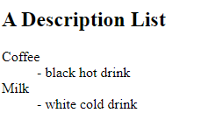
Description list
<dl>+<dt>+<dd>

Slide 4
1.Unordered HTML List
An unordered list starts with the <ul> tag. Each list item starts with the <li> tag.
The list items will be marked with bullets (small black circles) by default:
<ul>
<li>Coffee</li>
<li>Tea</li>
<li>Milk</li>
</ul>

Slide 5
2.Ordered HTML List
An ordered list starts with the <ol> tag. Each list item starts with the <li> tag.
The list items will be marked with numbers by default:
<ol>
<li>Coffee</li>
<li>Tea</li>
<li>Milk</li>
</ol>

Slide 6
3.Description Lists
HTML also supports description lists.
A description list is a list of terms, with a description of each term.
The <dl> tag defines the description list
The <dt> tag defines the term (name)
The <dd> tag describes each term (data)

Slide 7
Example
<dl>
<dt>Coffee</dt>
<dd>- black hot drink</dd>
<dt>Milk</dt>
<dd>- white cold drink</dd>
</dl>

Slide 8
HTML List Tags
Tag | Description
<ul> | Defines an unordered list
<ol> | Defines an ordered list
<li> | Defines a list item
<dl> | Defines a description list
<dt> | Defines a term in a description list
<dd> | Describes the term in a description list

Slide 9
18a. Unordered Lists
The HTML <ul> tag defines an unordered (bulleted) list.
未有順序的清單，起始點可有不同的符號。
https://www.w3schools.com/html/html_lists_unordered.asp

Slide 10
Unordered HTML List
An unordered list starts with the <ul> tag. Each list item starts with the <li> tag.
The list items will be marked with bullets (small black circles) by default:
<ul>
<li>Coffee</li>
<li>Tea</li>
<li>Milk</li>
</ul>

Slide 11
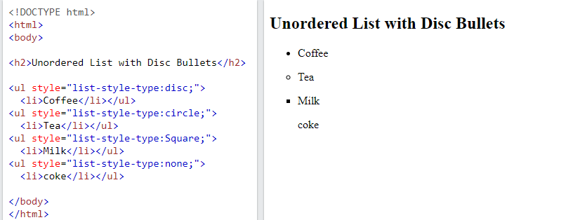
Choose List Item Marker
The CSS list-style-type property is used to define the style of the list item marker. It can have one of the following values:
<ul style="list-style-type:disc;">
style=
"list-style-type: AAA“
AAA=
disc
square
circle
none

Slide 12
HTML List Tags
Value | Description
disc | Sets the list item marker to a bullet (default)
circle | Sets the list item marker to a circle
square | Sets the list item marker to a square
none | The list items will not be marked

Slide 13
Example
Disc：<ul style="list-style-type:disc;">
Circle: <ul style="list-style-type:circle;">
Square： <ul style="list-style-type:square;">
None：<ul style="list-style-type:none;">
預設是從上到下

Slide 14
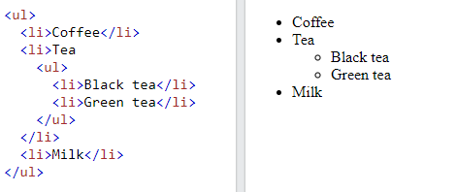
Nested HTML Lists

Slide 15
Horizontal List with CSS
HTML lists can be styled in many different ways with CSS.
One popular way is to style a list horizontally, to create a navigation menu:

Slide 16
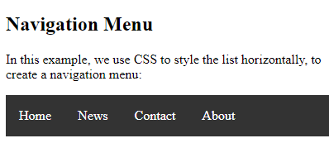
Example - CSS
ul {
list-style-type: none;
margin: 0;
padding: 0;
overflow: hidden;
background-color: #333333;
}
li {
float: left;
li a {
display: block;
color: white;
text-align: center;
padding: 16px;
text-decoration: none;
}
li a:hover {
background-color: #111111;
}

Slide 17
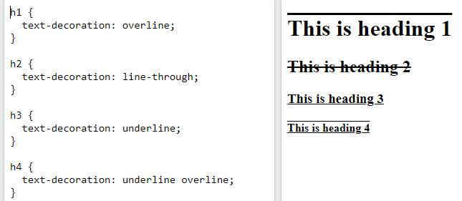
Text-decoration

Slide 18
Summary 1
Use the HTML <ul> element to define an unordered list
Use the HTML <li> element to define a list item
Use the CSS list-style-type property to define the list item marker(including disc, square, circle, and none)
Lists can be nested
List items can contain other HTML elements
Use the CSS property float:left to display a list horizontally

Slide 19
Summary 2 – unordered list
<ul> + <li></li> + <li></li> + <li></li> + </ul>
<ul style="list-style-type:disc;">
  (including disc, square, circle, and none)
Lists can be nested (巢狀結構，分多層LIST)
一般list多為垂直呈現，但可用CSS語法(float:left)，讓list水平呈現。
text-decoration可以加線條，美化文字。

Slide 20
作業18a
請列出本學期所修的課程。(至少3門)
請列出本學期所修的每一門課程至少3的單元。(例如：響應式網頁： 表格製作、超連結、顏色變化)
以上共有2層巢狀結構。
各層分別用unordered list的不同符號表示(例如方塊或實心圓表示)。

Slide 21
作業補充
檔名為HW本週檔名(例如HW18a.htm)，請上傳到學校網站。
請在google表單，填入可鏈結網址：例如http://fs2.just.edu.tw/~s123456789/hw18a.htm
上傳截止時間：上課次日晚上11.00前。
google表單https://forms.gle/k2w9fWn6vT7JR1Z97
上傳方式介紹：http://fs3.just.edu.tw/~cc/04_teach/doc/useFTP.htm

Slide 22
18b. Ordered Lists
The HTML <ol> tag defines an ordered list. An ordered list can be numerical or alphabetical.
有順序的清單，起始點可有不同的數字或字母排序符號。
https://www.w3schools.com/html/html_lists_ordered.asp

Slide 23
Ordered HTML List
An ordered list starts with the <ol> tag. Each list item starts with the <li> tag.
The list items will be marked with numbers by default:
<ol>
<li>Coffee</li>
<li>Tea</li>
<li>Milk</li>
</ol>

Slide 24
The Type Attribute
The type attribute of the <ol> tag, defines the type of the list item marker:
Type | Description
type="1" | The list items will be numbered with numbers (default)
type="A" | The list items will be numbered with uppercase letters
type="a" | The list items will be numbered with lowercase letters
type="I" | The list items will be numbered with uppercase roman numbers
type="i" | The list items will be numbered with lowercase roman numbers

Slide 25
Example
Numbers:<ol type="1">
Uppercase Letters:<ol type="A">
Lowercase Letters:<ol type="a">
Uppercase Roman Numbers:<ol type="I">
Lowercase Roman Numbers:<ol type="i">

Slide 26
Control List Counting
By default, an ordered list will start counting from 1. If you want to start counting from a specified number, you can use the start attribute:
<ol start="50">
<li>Coffee</li>
<li>Tea</li>
<li>Milk</li>
</ol>

Slide 27
Nested HTML Lists
Lists can be nested (list inside list):
<ol>
<li>Coffee</li>
<li>Tea
<ol>
<li>Black tea</li>
<li>Green tea</li>
</ol>
</li>
<li>Milk</li>
</ol>
Note: A list item (<li>) can contain a new list, and other HTML elements, like images and links, etc.

Slide 28
Summary 1
Use the HTML <ol> element to define an ordered list
Use the HTML <li> element to define a list item
Use the HTML type attribute to define the numbering type
Lists can be nested
List items can contain other HTML elements

Slide 29
Summary 2 – ordered list
<ol> + <li></li> + <li></li> + <li></li> + </ol>
<ul type=“1” start=“50”> (type 可以是 1, A, a, I, 或 i)
Lists can be nested (巢狀結構，分多層LIST)
List後面可以是圖形或連結

Slide 30
作業18b
請修正作業18a，用ordered list表示。
第1層順序為1、2、3。
第2層順序分別用A、B、C或I、II、III(含小寫)表示 (至少用3種) 。
大二的課程，用11開始編號。

Slide 31
作業補充
檔名為HW本週檔名(例如HW18b.htm)，請上傳到學校網站。
請在google表單，填入可鏈結網址：例如http://fs2.just.edu.tw/~s123456789/hw18b.htm
上傳截止時間：上課次日晚上11.00前。
google表單https://forms.gle/k2w9fWn6vT7JR1Z97
上傳方式介紹：http://fs3.just.edu.tw/~cc/04_teach/doc/useFTP.htm

Slide 32
18c. Other Lists
HTML also supports description lists
清單也可單一用標題來表示
https://www.w3schools.com/html/html_lists_other.asp

Slide 33
HTML Description Lists
A description list is a list of terms, with a description of each term.
The <dl> tag defines the description list, the <dt> tag defines the term (name), and the <dd> tag describes each term:

Slide 34
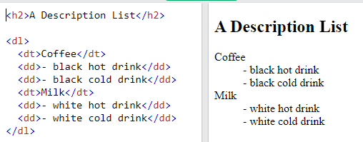
Example

Slide 35
Summary 1
<dl> to define a description list
<dt> to define the description term
<dd> to describe the term in a description list

Slide 36
Summary 2 (架構)
<dl>
<dt> A </dt>
<dd> A1 </dd>
<dd> A2 </dd>
<dt> B </dt>
<dd> B1 </dd>
<dd> B2 </dd>
</dl>

Slide 37
作業18c(以下範例僅供參考)
請列出大一到現在，你所修習的課程。
大一上學期、大一下學期、大二上學期等用ordered list(要用3種不同的數字或字母，並且有一個要從7開始)。
第2層為修課清單用unordered list ，必修與選修用不同符號表示(例如方塊或實心圓表示，要用3種不同的符號，並且要有巢狀結構)
另外用description list，介紹每一學期兩門課學習心得或教授內容。

Slide 38
作業補充
檔名為HW本週檔名(例如HW18c.htm)，請上傳到學校網站。
請在google表單，填入可鏈結網址：例如http://fs2.just.edu.tw/~s123456789/hw18c.htm
上傳截止時間：上課次日晚上11.00前。
google表單https://forms.gle/k2w9fWn6vT7JR1Z97
上傳方式介紹：http://fs3.just.edu.tw/~cc/04_teach/doc/useFTP.htm

