Slide 1
20. Class Attribute
The HTML class attribute is used to specify a class for an HTML element.
Multiple html elements can share the same class.
定義每種Class有不同的格式，每個元素指定為該種Class，就可以呈現該格式。
https://www.w3schools.com/html/html_classes.asp

Slide 2
Using The Class Attribute
The class attribute is often used to point to a class name in a style sheet. It can also be used by a JavaScript to access and manipulate elements with the specific class name.
In the following example we have three <div> elements with a class attribute with the value of "city". All of the three <div> elements will be styled equally according to the .city style definition in the head section:

Slide 3
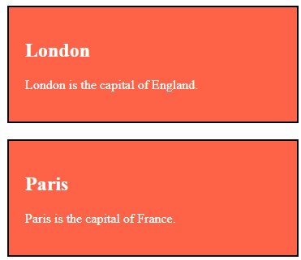
Example- class應用於整個區域
<style> .city { background-color: tomato; color: white; border: 2px solid black; margin: 20px; padding: 20px; } </style>
<div class="city"> <h2>London</h2> <p>London is the capital of England.</p> </div> <div class="city"> <h2>Paris</h2> <p>Paris is the capital of France.</p> </div>

Slide 4
Class Attribute
Tip: The class attribute can be used on any HTML element.
Note: The class name is case sensitive!
In the following example we have two <span> elements with a class attribute with the value of "note". Both <span> elements will be styled equally according to the .note style definition in the head section:

Slide 5
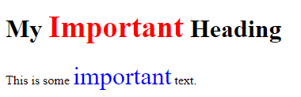
Example- class僅應用於整個元素或文字
<style> .note1 { font-size: 120%; color: red; }
.note2 { font-size: 200%; color: blue; }
</style> <h1>My <span class="note1">Important</span> Heading</h1> <p>This is some <span class="note2">important</span> text.</p>

Slide 6
The Syntax For Class
To create a class:
(1) write a period (.) character
(2) followed by a class name
(3) define the CSS properties within curly braces {}.
在style之下宣告。

Slide 7
Class
<style> .city { background-color: tomato; color: white; border: 2px solid black; margin: 20px; padding: 20px; } </style>
<div class="city"> <h2>London</h2> <p>London is the capital of England.</p> </div> <div class="city"> ………….
</div> <div class="city"> ………….
</div>

Slide 8
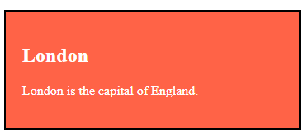
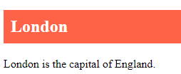
比較
<div class="city"> <h2>London</h2> <p>London is the capital of E...</p> </div>
<h2 class="city">London</h2> <p>London is the capital of E...</p>

Slide 9
Multiple Classes
HTML elements can belong to more than one class.
To define multiple classes, separate the class names with a space, e.g. <div class="city main">. The element will be styled according to all the classes specified.
In the following example, the first <h2> element belongs to both the city class and also to the main class, and will get the CSS styles from both of the classes:

Slide 10
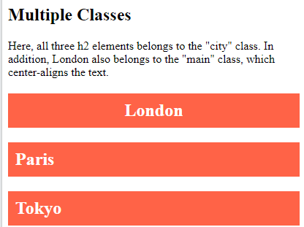
Example
.city {
background-color: tomato;
color: white;
padding: 10px;
}
.main {
text-align: center;
}
<h2 class="city main">London</h2> <h2 class="city">Paris</h2> <h2 class="city">Tokyo</h2>

Slide 11
Different Elements Can Share Same Class
Different HTML elements can point to the same class name.
In the following example, both <h2> and <p> points to the "city" class and will share the same style:

Slide 12
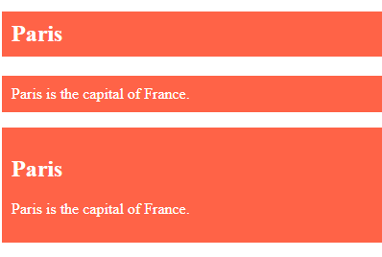
Example
<h2 class="city">Paris</h2> <p class="city">Paris is …</p>
<div class="city">
<h2>Paris</h2> <p>Paris is …</p>
</div>

Slide 13
Summary
The HTML class attribute specifies one or more class names for an element
Classes are used by CSS and JavaScript to select and access specific elements
The class attribute can be used on any HTML element
The class name is case sensitive
Different HTML elements can point to the same class name

Slide 14
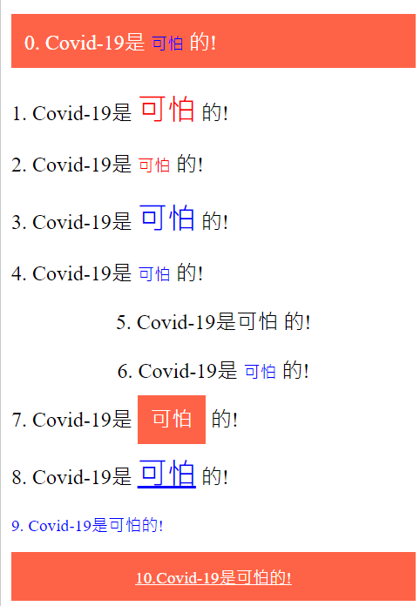
作業20
請利用下一頁程式碼，做出與右邊一樣的網頁：
(交到moodle)

Slide 15
<!DOCTYPE html>
<html>
<head>
<style>
.sample1 {
font-size: 140%;
color: red;
}
.sample2 {
font-size: 80%;
color: red;
}
.sample3 {
font-size: 140%;
color: blue;
}
.sample4 {
font-size: 80%;
color: blue;
}
.format1 {
text-align: center;
}
.format2 {
background-color: tomato;
color: white;
padding: 10px;
}
.format3 {
text-decoration:underline;
}
</style>
</head>
<body>
<p class="format2">0. Covid-19是 <span class="sample4">可怕</span> 的!</p>
<p>1. Covid-19是 <span class="sample1">可怕</span> 的!</p>
</body>
</html>

