Slide 1
HTML Responsive Web Design (RWD)
Responsive web design is about creating web pages that look good on all devices!
A responsive web design will automatically adjust for different screen sizes and viewports.
RWD響應式網頁可以依照你觀賞載具的不同，將畫面做最適當的調整。
https://www.w3schools.com/html/html_responsive.asp

Slide 2
What is Responsive Web Design?
Responsive Web Design is about using HTML and CSS to automatically resize, hide, shrink, or enlarge, a website, to make it look good on all devices (desktops, tablets, and phones):

Slide 3
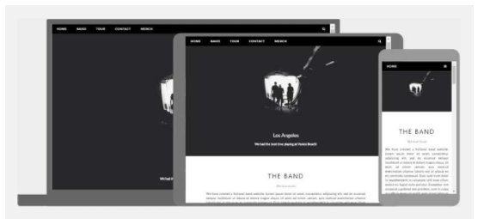
Example

Slide 4
1. Setting The Viewport
To create a responsive website, add the following <meta> tag to all your web pages:
<meta name="viewport" content="width=device-width, initial-scale=1.0">
This will set the viewport of your page, which will give the browser instructions on how to control the page's dimensions and scaling.

Slide 5
2. Responsive Images
Responsive images are images that scale nicely to fit any browser size.
Using the width Property
If the CSS width property is set to 100%, the image will be responsive and scale up and down:
<img src="img_girl.jpg" style="width:100%;">

Slide 6
Responsive Images
Using the max-width Property
If the max-width property is set to 100%, the image will scale down if it has to, but never scale up to be larger than its original size:
<img src="img_girl.jpg" style="max-width:100%;height:auto;">

Slide 7
3. Show Different Images Depending on Browser Width
The HTML <picture> element allows you to define different images for different browser window sizes.
Resize the browser window to see how the image below change depending on the width:

Slide 8
Show Different Images Depending on Browser Width
<picture> <source srcset="img_smallflower.jpg" media="(max-width: 600px)"> <source srcset="img_flowers.jpg" media="(max-width: 1500px)"> <source srcset="flowers.jpg"> <img src="img_smallflower.jpg" alt="Flowers"> </picture>
若 螢幕寬度最大為600px，則出現：img_smallflower。
若 螢幕寬度最大為1500px，則出現：img_flower。
其餘，則出現：flower。
注意：預設值為最小圖片，且上面的順序不得更改。

Slide 9
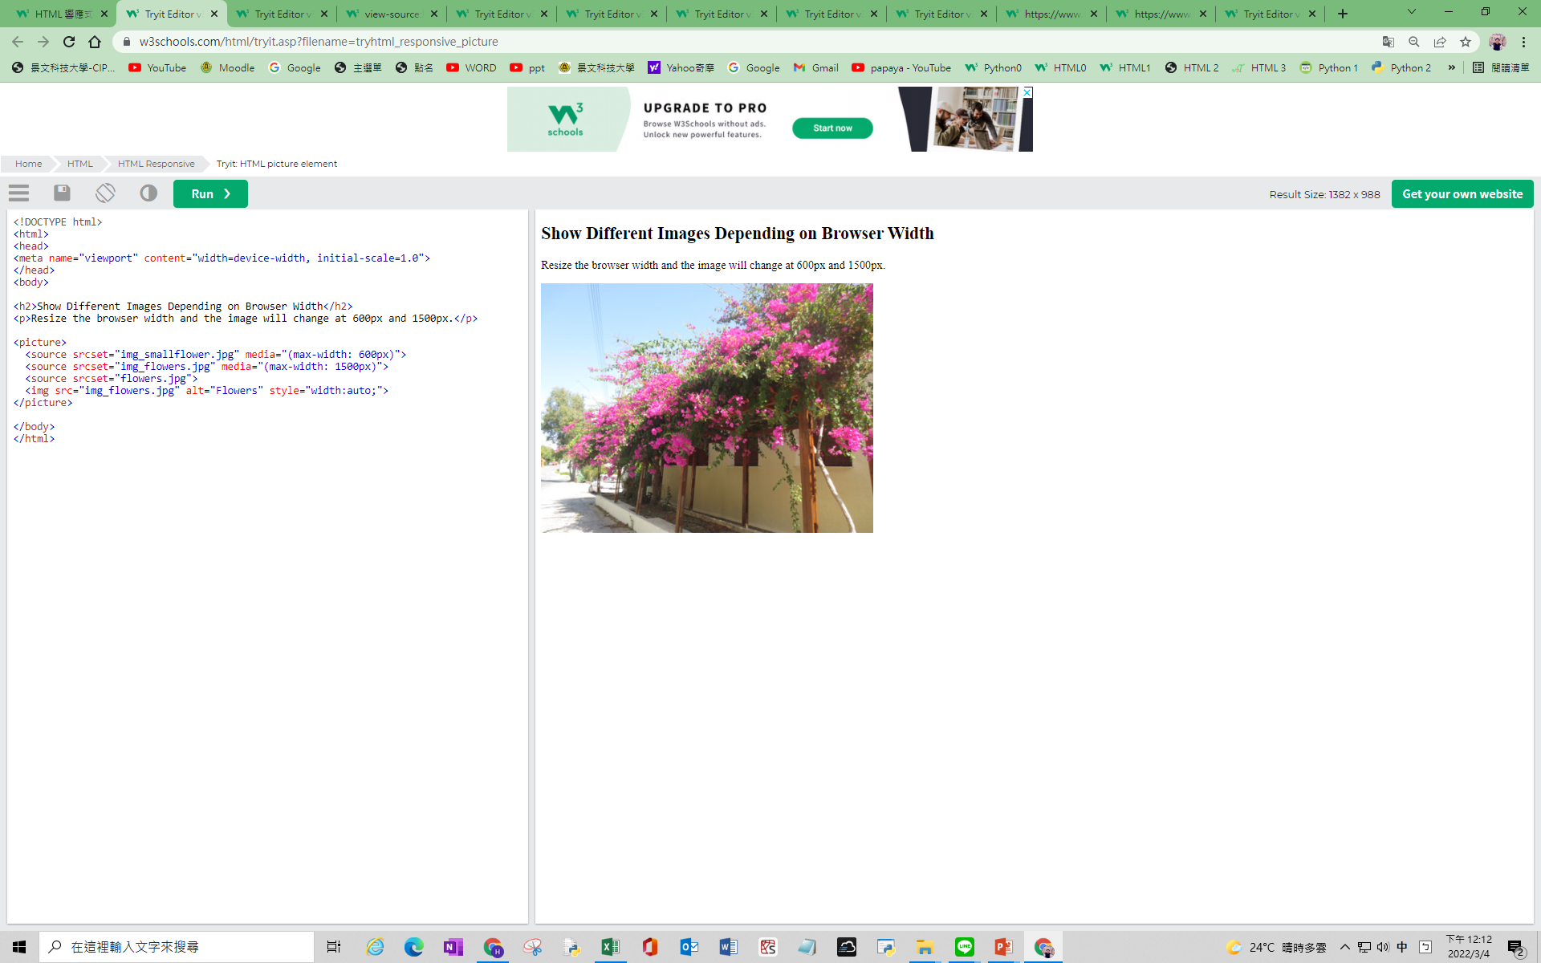
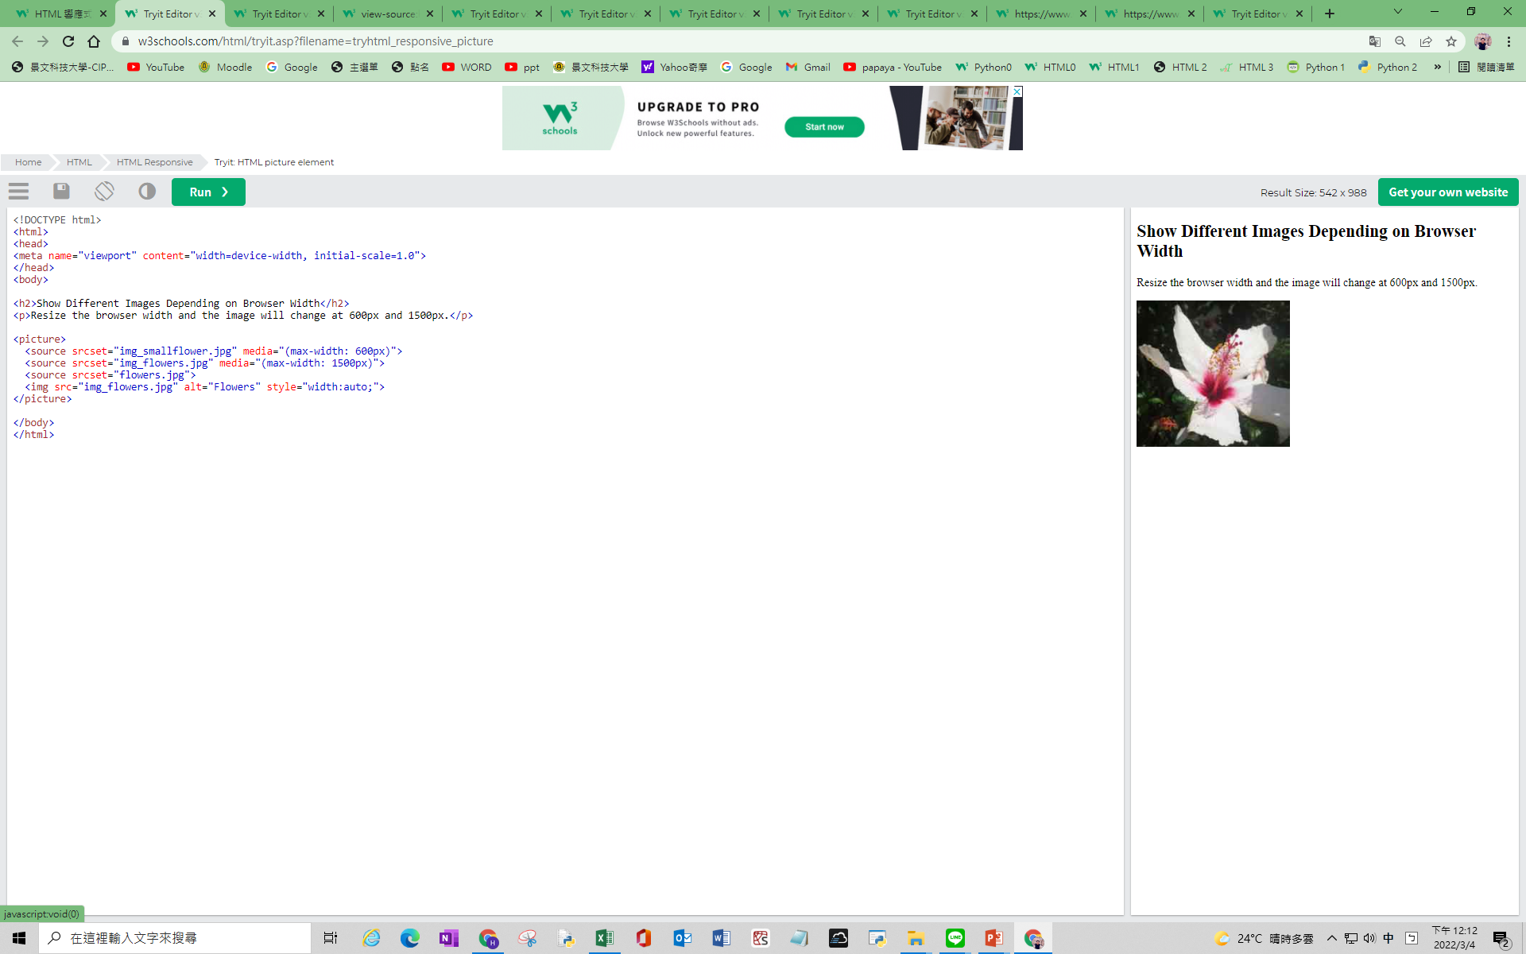
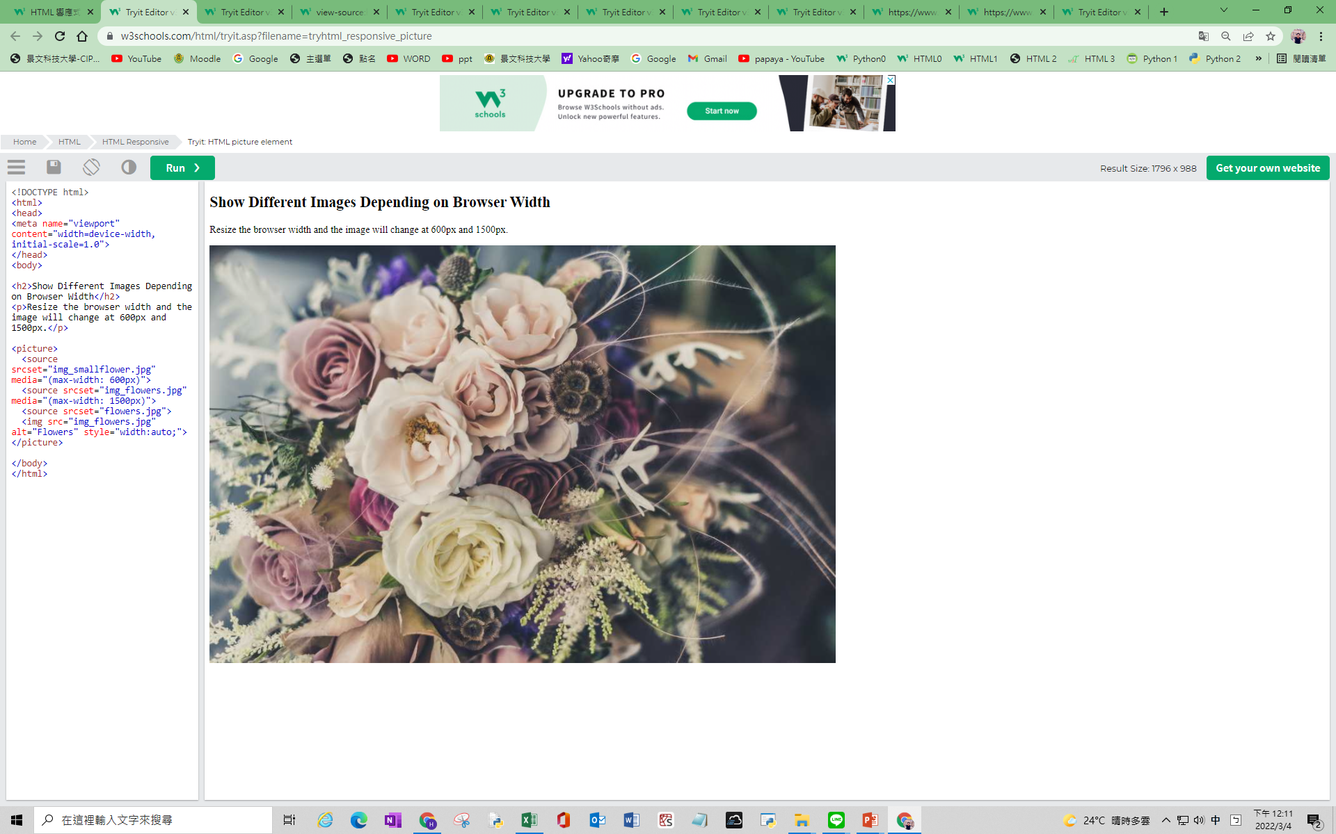
Example

Slide 10
RWD 圖片1
以下必寫
<head>
<meta name="viewport" content="width=device-width, initial-scale=1.0">
</head

Slide 11
RWD 圖片2
圖片維持原尺寸
<img src="img_girl.jpg" >
圖片隨著device大小，讓圖片寬度為device螢幕的100%
<img src="img_girl.jpg" style="width:100%;">
圖片隨著device大小，讓圖片寬度為device螢幕的80%
<img src="img_girl.jpg" style="width:80%;">

Slide 12
RWD 圖片3
圖片隨著device大小，讓圖片寬度為device螢幕的100%，但最大寬度為原圖片的100%
<img src="img_girl.jpg" style="max-width:100%;height:auto;">

Slide 13
RWD 圖片4 – 圖片依device螢幕大小而替換不同圖片
<picture> <source srcset="img_smallflower.jpg" media="(max-width: 600px)"> <source srcset="img_flowers.jpg" media="(max-width: 1500px)"> <source srcset="flowers.jpg"> <img src="img_smallflower.jpg" alt="Flowers"> </picture>
若 螢幕寬度最大為600px，則出現：img_smallflower。
若 螢幕寬度最大為1500px，則出現：img_flower。
其餘，則出現：flower。
注意：預設值為最小圖片，且上面的順序不得更改。

Slide 14
4.Responsive Text Size
The text size can be set with a "vw" unit, which means the "viewport width".
That way the text size will follow the size of the browser window:

Slide 15
Responsive Text Size
<h1 style="font-size:10vw">Hello World</h1>
字體大小設定為螢幕寬度某的比例
Viewport is the browser window size. 1vw = 1% of viewport width. If the viewport is 50cm wide, 1vw is 0.5cm.

Slide 16
RWD 文字
<h1 style="font-size:10vw">Hello World</h1>
字體大小設定為螢幕寬度的比例
1vw =螢幕寬度1%
若螢幕寬度=50cm，則 1vw= 0.5cm.
未標示者，字體大小不會改變。

Slide 17
5. Media Queries
In addition to resize text and images, it is also common to use media queries in responsive web pages.
With media queries you can define completely different styles for different browser sizes.
Example: resize the browser window to see that the three div elements below will display horizontally on large screens and stacked vertically on small screens:

Slide 18
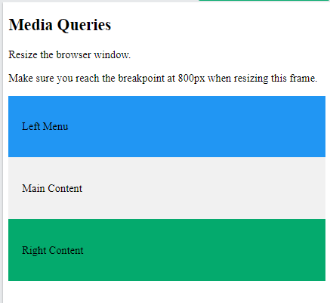
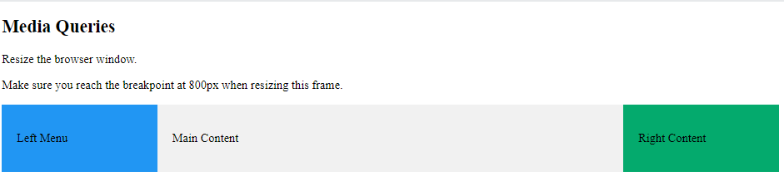
Media Queries
/* The width is 100%, when the viewport is 800px or smaller */
@media screen and (max-width: 800px) {
.left, .main, .right {
width: 100%; }
}
/* The width is 20、60、20%, when the viewport is larger than 800px */

Slide 19
RWD 區塊
利用class，區分各區塊(例如：.left(20%), .main(60%), .right(20%) )
一行從左到右依序寬度比為20%、60%、20%。
@media screen and (max-width: 800px) {
.left, .main, .right {
width: 100%; }
}
若螢幕寬度小於800px時，三個區塊(left、main、right)均變成螢幕100%，且上下堆疊。

Slide 20
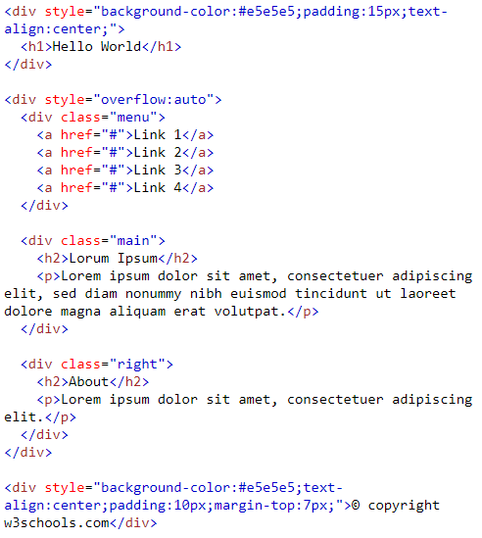
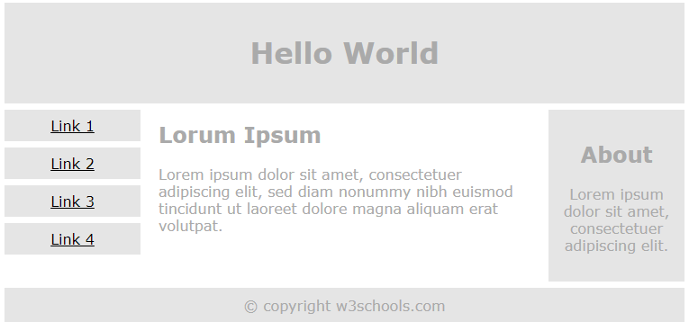
<body>: 1.利用div，分上中下(ABC)三區
A1
A1
B1：class=menu
B
B3
B3：class=right
C1
B1：menu
B2：main
B3：right
C1

Slide 21
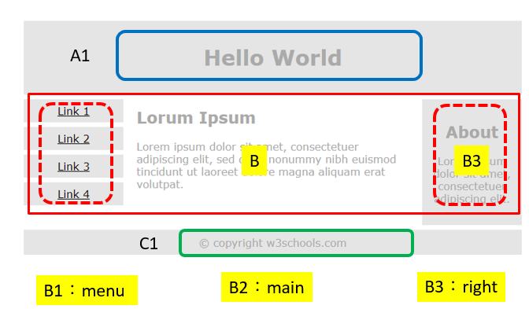
<head>2.再利用class，分B1~B3三區
<style>
* {
box-sizing: border-box;
}
.menu {
float: left;
width: 20%;
}
.menu a {
display: block;
width: 100%;
}
.main {
float: left;
width: 60%;
}
.right {
float: left;
width: 20%;
}

Slide 22
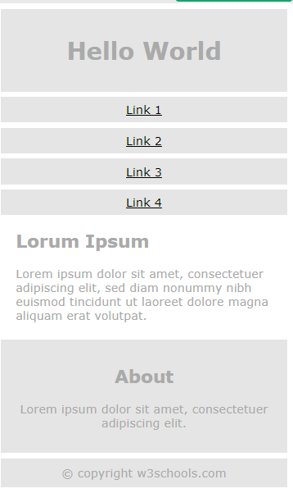
<head> 3. 利用Media Queries調整大小
<head>
<meta name="viewport" content="width=device-width, initial-scale=1.0">
<style>
右邊
@media only screen and (max-width: 620px)
/* For mobile phones: */
.menu, .main, .right {
width: 100%;
}
}
</style>
</head>
* {
box-sizing: border-box;
}
.menu {}
.menu a {}
.main {}
.right {}

Slide 23
作業27
請上傳三張照片，實際值從小到大，依序分別為a, b, c：
未有預設值，呈現這三張照片
預設值寬度為螢幕100%，呈現這三張照片
預設值最大寬度為原圖100%，呈現這三張照片
若 螢幕寬度最大為600px，則出現：a。若 螢幕寬度最大為1500px，則出現：b。其餘，則出現：c

Slide 24
overflow
overflow:auto; 預設會自動使用 x, y 捲軸
overflow:visible; 顯示的文字或圖片會直接超出範圍，不使用捲軸。
overflow:hidden; 自動隱藏超出的文字或圖片。
overflow:scroll; 自動產生捲軸。
overflow:inherit; 繼承自父元素的可見性

