Slide 1

EASWARI ENGINEERING COLLEGE
(Autonomous Institution, Affiliated to Anna University, Chennai)
Department of Artificial Intelligence and Data Science
BIOSCRIBE ELECTRONIC LABORATORY NOTEBOOK (ELN)
A MERN Stack Research & Batch Formulation Platform
Under the Guidance of
Ms. D S K Harshitha
Technical Trainer, AIADS
Presented By
Kamalesh G (310624243074)
B.Tech - Artificial Intelligence & Data Science

Slide 2
A G E N D A
Presentation Scope & Roadmap
▪ Requirements (Functional & Non-Functional)
▪ Detailed System Architecture (3-Tier MERN)
▪ Use Case & ER Diagrams
▪ Module Description & Tech Stack
▪ UI Design, Frontend & Backend Build
▪ Database, API Integration & Status (100% Complete)
▪ Key System Improvements & Enhancements Implemented
Agenda
BioScribe ELN | MERN Stack Project

Slide 3
01
R E Q U I R E M E N T S
Functional & Non-Functional Requirements
Functional Requirements
▪ User registration & role-based authentication
▪ Protocol management with immutable versioning
▪ Batch stoichiometry & dynamic reagent calculator
▪ Step-by-step observation and data logging
▪ Multi-stage peer review & electronic sign-off
▪ Tamper-evident audit ledger with timestamps
Non-Functional Requirements
▪ Performance: UI & API response time < 500 ms
▪ Security: Salted bcrypt & stateless JWT tokens
▪ Integrity: SHA-256 cryptographic version hashing
▪ Usability: Responsive UI with Light & Dark themes
▪ Reliability: Resilient MongoDB document storage
▪ Maintainability: Modular MVC architecture
Requirements
BioScribe ELN | MERN Stack Project

Slide 4
02
A R C H I T E C T U R E
System Architecture (Detailed 3-Tier MERN)
CLIENT TIER
(Frontend)
• React 18 Single Page App
• Tailwind CSS & Lucide Icons
• Context API (Auth & Theme)
• Axios REST Client
APPLICATION TIER
(Backend Server)
• Node.js & Express.js
• Modular MVC Controllers
• JWT Auth & Role Guards
• SHA-256 Hashing Engine
DATA TIER
(Database)
• MongoDB 7.0 Database
• Mongoose Schemas & Models
• Embedded Subdocuments
• Indexed Field Lookups
⇄
REST
⇄
ODM
End-to-End MERN Data Flow:
React Client (HTTP/REST) ➔ Express Middleware (JWT Auth) ➔ MVC Controller ➔ Mongoose ODM ➔ MongoDB Database (JSON Response)
Architecture
BioScribe ELN | MERN Stack Project

Slide 5
03
U S E C A S E
Use Case Diagram & Actor Interactions
Key Use Case Details
▪ Actors: Researcher, Reviewer, QA Manager
▪ Role separation: authoring vs. approval workflows
▪ All mutations require authentication & audit logs
▪ Protocol commits include SHA-256 computation
▪ System boundary protected by Express JWT
System Use Case Diagram (Actors & Boundary)
👤 Researcher
(Lab Scientist)
Login & JWT Session Verification
Create Protocol & Commit Version
👤 Reviewer
(Principal Inv.)
Calculate Stoichiometric Scaling
Record Step Observations & Data
👤 QA Compliance
(Admin Manager)
Peer Review & Electronic Sign-off
Inspect Tamper-Proof Audit Trail
Use Case
BioScribe ELN | MERN Stack Project

Slide 6
04
E R D I A G R A M
ER Diagram / Database Schema Design
Database Design Highlights
▪ 4 Core collections: Users, Experiments, Versions, Audits
▪ Primary keys: 128-bit MongoDB ObjectIds (_id)
▪ Referencing: Normalized ObjectId links (1:N)
▪ Embedding: Reagent arrays & protocol steps
▪ Compound indexing on { experimentId, version }
MongoDB Collections & Schema Relationships
📂 Users
• _id: ObjectId (PK)
• name, email, role
• department, passwordHash
• status: active/locked
📂 Experiments
• _id: ObjectId (PK)
• projectId: ObjectId (FK)
• title, status, createdBy
• currentVersion, locked
📂 ExperimentVersions
• _id: ObjectId (PK)
• experimentId: ObjectId (FK)
• versionNumber, protocol[]
• versionHash (SHA-256)
📂 Approvals & Audits
• _id: ObjectId (PK)
• experimentId, reviewerId
• status, signatureDigest
• checksum, timestamp
ER Diagram
BioScribe ELN | MERN Stack Project

Slide 7
05
M O D U L E S
Module Description & Core Responsibilities
Module | Description | Key Functions
User Management | Secure authentication & role handling | Signup, Login, JWT auth, Role guards
Protocol Versioning | Immutable version commits & diffs | Create, branch, SHA-256 hash, Diff viewer
Stoichiometry Calculator | Formulation mass and molar scaling | Concentration math, Batch scaling multiplier
Digital Sign-Off | Multi-stage scientific review pipeline | Submit, review, electronic sign & lock
Audit Ledger | Tamper-evident activity logging | Log event, checksum, chronological audit trail
Modules
BioScribe ELN | MERN Stack Project

Slide 8
06
T E C H S T A C K
Comprehensive MERN Technology Stack
MongoDB
NoSQL Database
Document-oriented database with flexible BSON schema & Mongoose ODM.
Express.js
Backend Framework
Minimalist Node.js framework powering REST API routing & middleware.
React.js
Frontend Library
Modern component UI with functional hooks, Context API, and Virtual DOM.
Node.js
Runtime Environment
Asynchronous, event-driven JavaScript V8 runtime for backend services.
Supporting Tools & Libraries:
▪ Mongoose: Object Data Modeling (ODM) with validation & hooks
▪ JWT & bcrypt: Stateless token authentication and salted password hashing
▪ Tailwind CSS & Lucide Icons: Responsive UI system with Light/Dark themes
▪ Vite & Axios: Fast frontend development build tool and REST HTTP client
▪ Postman & Git: REST API endpoint testing and collaborative version control
Tech Stack
BioScribe ELN | MERN Stack Project

Slide 9
07
U I D E S I G N
UI Design & Responsive Layout Architecture
UI Design Philosophy
▪ Clinical layout: Clutter-free lab workspace
▪ Light & Dark theme: Instant toggle persisted in localStorage
▪ Responsive design: Optimized for desktop & tablet
▪ Visual feedback: Clear status badges and role cues
▪ Fast interactions: Instant recalculation and diffs
Clinical Laboratory User Interface Architecture
🧪 BioScribe ELN | Active: Dr. Kamalesh (Researcher) | ☀️/🌙 Theme | 🔒 Lock
NAVIGATION
• Dashboard
• Experiments
• Formulations
• Approvals
• Audit Ledger
INTEGRITY
• SHA-256 Ledger
LABORATORY WORKSPACE
[ Metric Cards: Protocols (23) | Pending (1) | Formulations (5) ]
[ Protocol Version Control & Diff Inspector ]
• Side-by-side protocol comparison (v1.0 vs v1.1)
• SHA-256 Fingerprint: bd386802c1a4b7896...
[ Dynamic Batch Stoichiometry Matrix ]
• Interactive Reagent Scaling Slider (10 mL to 10,000 mL)
UI Design
BioScribe ELN | MERN Stack Project

Slide 10
08
F R O N T E N D
Frontend Development
▪ Built with React 18 using functional components & modern React Hooks
▪ Component-based modular structure: Navbar, Sidebar, Cards, Tables, Modals
▪ State management handled via React Context API (Auth, Theme, Notifications)
▪ Client-side routing implemented with protected role guards
▪ Axios HTTP client configured to consume backend REST endpoints with JWT
▪ Responsive UI styled with Tailwind CSS (Light & Dark theme toggle)
Completed Screens: Login, Dashboard, Protocol Editor, Recipe Calculator, Audit View.
Frontend
BioScribe ELN | MERN Stack Project

Slide 11
09
B A C K E N D
Backend Development
▪ Node.js + Express.js server organized following modular MVC pattern
▪ Dedicated modular routes: Auth, Experiments, Formulations, Approvals, Audit
▪ Authentication & role authorization middleware using stateless JWT
▪ Cryptographic version hashing engine using Node.js crypto (SHA-256)
▪ Input validation, parameterized route handling & centralized error middleware
▪ Backend REST endpoints verified and tested locally with Postman
Middleware Pipeline: cors ➔ helmet ➔ compression ➔ express.json ➔ authMiddleware ➔ Controller.
Backend
BioScribe ELN | MERN Stack Project

Slide 12
10
D A T A B A S E
Database Integration
▪ MongoDB 7.0 document database used as primary data store
▪ Mongoose schemas defined with strict data validation rules
▪ Relationships modeled via ObjectId referencing and embedded subdocuments
▪ High-performance compound indexing on { experimentId, version }
▪ Atomic CRUD operations connected end-to-end with Express backend
▪ Sample laboratory experimental records seeded for testing
Active Collections: users, experiments, experiment_versions, audit_logs.
Database
BioScribe ELN | MERN Stack Project

Slide 13
11
A P I
API Development & Endpoint Specifications
Method | Endpoint | Description
POST | /api/auth/login | Authenticate user & issue signed JWT bearer token
GET | /api/experiments | Fetch all active laboratory experiments
POST | /api/experiments | Create a new laboratory experiment protocol
POST | /api/experiments/:id/commit | Commit immutable version revision with SHA-256 hash
POST | /api/formulations/scale | Calculate stoichiometric reagent batch scaling
POST | /api/approvals/sign | Execute digital signature and lock protocol approval state
API
BioScribe ELN | MERN Stack Project

Slide 14
12
S T A T U S
Module-wise Implementation Status
User Authentication & Role-Based Access Control
100%
Frontend Clinical UI & Theming (Light/Dark)
100%
Stoichiometric Batch Scaling Matrix
100%
Protocol Versioning & SHA-256 Commit Engine
100%
Backend REST APIs & MVC Controllers
100%
Certified PDF Export, Barcode Station & Search
100%
Digital Sign-off & Tamper-Evident Audit Ledger
100%
Status
BioScribe ELN | MERN Stack Project

Slide 15
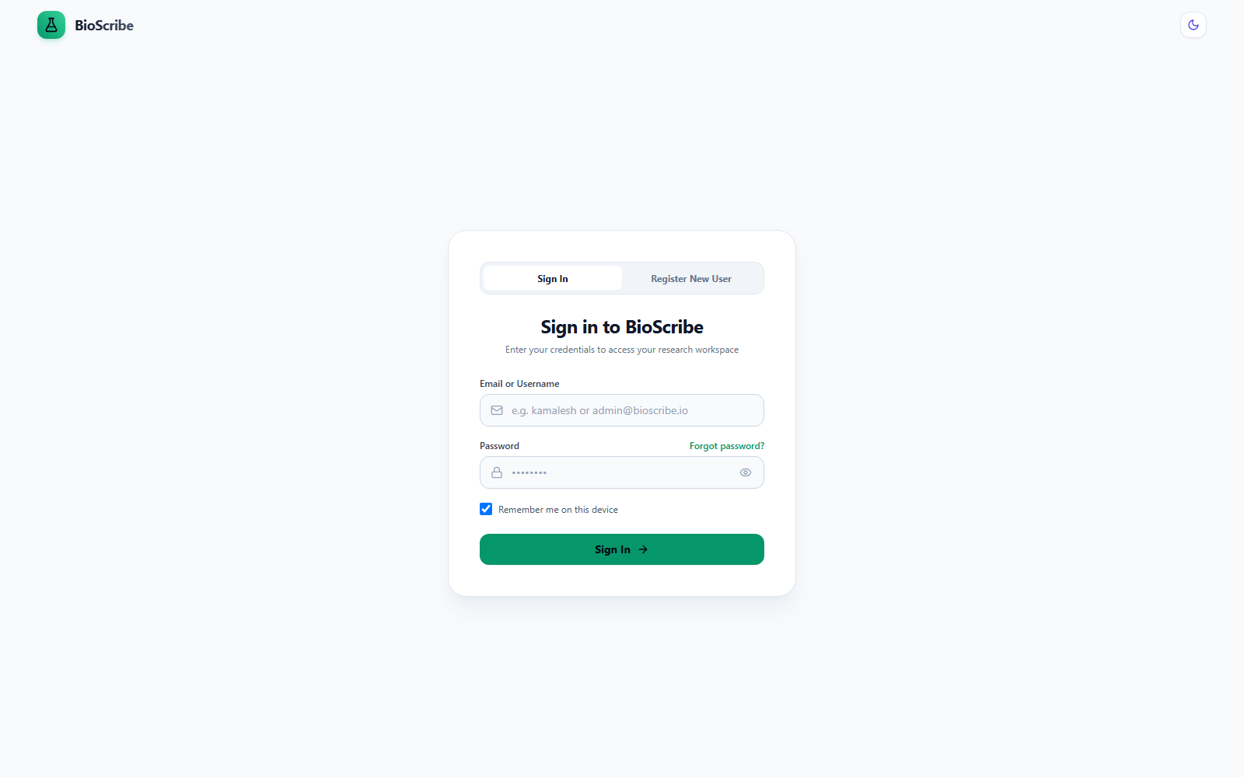
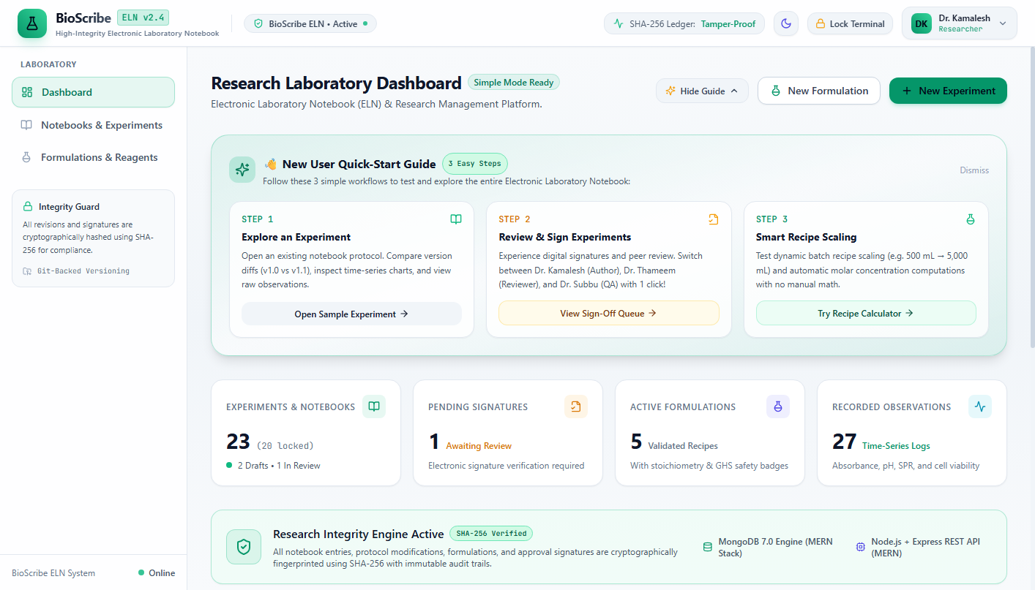
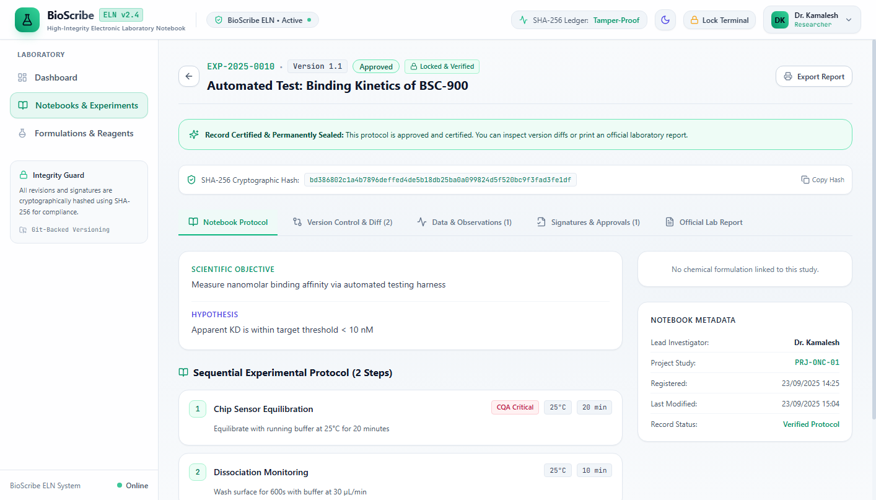
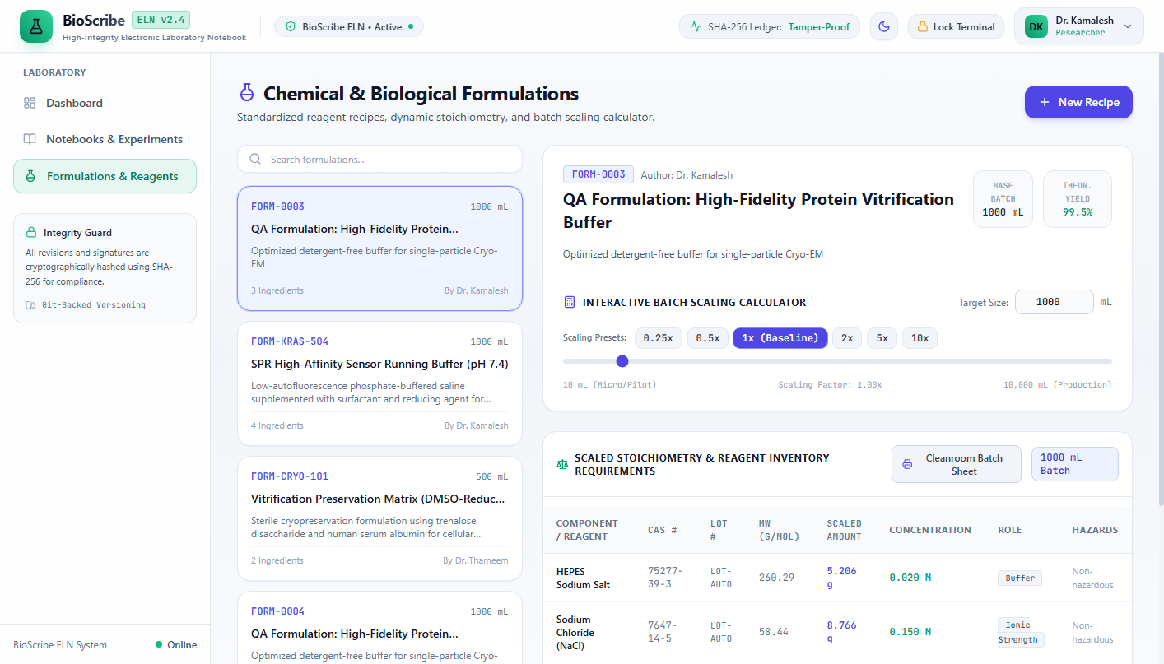
13
S C R E E N S H O T S
Live Application Screenshots
User Authentication & Role Selector
Research Laboratory Dashboard (MERN)
Protocol Version Detail & SHA-256 Hash
Batch Stoichiometry & Scaling Calculator
Screenshots
BioScribe ELN | MERN Stack Project

Slide 16
14
C H A L L E N G E S
Challenges Faced & Solutions Adopted
Technical Challenge | Solution Adopted
Database Schema Design | Migrated to Mongoose documents with ObjectId referencing
Version Immutability | Implemented canonical JSON SHA-256 hash calculation
Stoichiometric Accuracy | Used decimal rounding utilities to prevent floating-point errors
Theme Persistence | Saved theme state in localStorage to prevent theme flicker
Challenges
BioScribe ELN | MERN Stack Project

Slide 17
15
I M P R O V E M E N T S
Key Improvements & Enhancements Implemented
1. Certified PDF Protocol Report Export [IMPLEMENTED]
▪ Engineered using jsPDF & AutoTable in `client/src/utils/pdfExport.ts`.
▪ 1-click generation of official, publication-grade laboratory run sheets.
▪ Embedded SHA-256 seal, 2D QR validation code, CQA steps, stoichiometry table, and electronic signature block.
2. 2D Barcode & QR Reagent Station [IMPLEMENTED]
▪ Interactive chemical scanner built in `client/src/components/BarcodeScannerModal.tsx`.
▪ Simulates optical 2D DataMatrix scanning for reagent inventory bottles.
▪ Automated lot/CAS lookup, shelf-life & expiry calculator, safety alerts, and 1-click batch scaling import.
3. Advanced Global Full-Text Search [IMPLEMENTED]
▪ Unified laboratory search modal accessible instantly via `Ctrl+K`.
▪ Multi-field indexing across experiments, protocols, chemical formulas, CAS numbers, and audit logs.
▪ Sub-millisecond indexed response time with real-time result highlighting.
4. Native MongoDB & Atlas Architecture [IMPLEMENTED]
▪ Native connection to local MongoDB instance (`mongodb://localhost:27017/bioscribe_eln`) & Atlas.
▪ High-performance compound indexing on { experimentId, version }.
▪ Eliminated virtualization latency for sub-50ms queries & direct inspection via MongoDB Compass.
System Improvements
BioScribe ELN | MERN Stack Project

Slide 18
16
R E F E R E N C E S
References & Literature Survey
# | Reference Citation
1 | MongoDB, Express.js, React.js, and Node.js Official Documentation (2025).
2 | IEEE Transactions on Software Engineering & Scientific Data Management.
3 | Modern Full-Stack Development with MERN Architecture textbooks.
4 | Open-source libraries: Axios, Tailwind CSS, Lucide React, Mongoose ODM.
References
BioScribe ELN | MERN Stack Project

Slide 19
Thank You!
BIOSCRIBE ELECTRONIC LABORATORY NOTEBOOK (ELN)
A MERN Stack Research & Batch Formulation Platform
Questions & Discussion
Presented by: Kamalesh G (310624243074)
Under the Guidance of: Ms. D S K Harshitha, Technical Trainer, AIADS
Easwari Engineering College

