Slide 1
CS 423 – Operating Systems Design Lecture 22 – Power Management
Klara Nahrstedt and Raoul Rivas
Spring 2013

Slide 2
Overview
Administrative announcements
MP3 still going
Summary
ACPI
CPU Management
DVS, Sleep States
Wireless Management
Hard-Drive Management
Software Approaches

Slide 3
Importance of Power Management
Mobile Devices are ubiquitous
Laptops, iPads, Smartphones
Battery is the limiting factor of these devices
Power Management is driven by
More functionality
More processing
Longer battery lifetime
Smaller factor devices (weight and size)
Battery capacity is improving at much slower rate

Slide 4
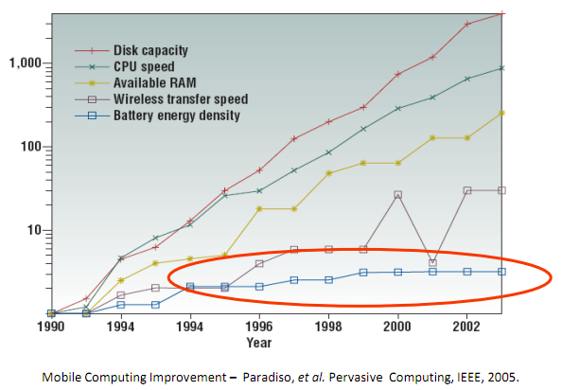
Mobile Computing Improvement

Slide 5
Approaches to Reduce Energy Consumption
Turn off parts of the computer when are not in use (mostly IO devices such as display)
Reduced responsiveness/performance
Which hardware/software component takes most energy?
Software Approaches
Reduced responsiveness/performance

Slide 6
Idle Power Consumption Breakdown

Slide 7
ACPI
Advanced Control Power Interface
Open Standard for device configuration and power management
By Intel, Microsoft, Toshiba – 1996
Interface between OS and Hardware
Defines Power States
Global System (G and S States)
Device (D-State), Processor (C-State)
Defines Performance States (P-States)
Device, Processor

Slide 8
ACPI States
Device Power States
Suspend to Disk
Global States
Suspend to RAM
CPU Power
States
CPU Performance
States

Slide 9
CPU Power States
Used when CPU is idle for some time
Power State Approaches
Stop Core and Bus Clock
Clear Caches
Reduce Processor’s Voltage
Deeper States incur higher transition latency
Performance reduction
Effective only when sleeping for long time
Loss of Functionality
Unable to handle interrupts
Cold Cache after wake up

Slide 10
CPU Performance States
Used when the CPU is not fully idle
Implemented using Dynamic Voltage Scaling
Reduce CPU’s Voltage and Frequency
AMD Cool’n Quiet, Intel SpeedStep
Manufacturers try to minimize transition latency
Performance is degraded
Assumption is that CPU Bandwidth is larger than currently required
OS implements Adaptive Schemes
Adjust based on short term statistical CPU utilization

Slide 11
CPU Power Consumption
Dynamic Power
Short Circuit Power
Leakage Power
Dynamic Power: Power consumed by charging and discharging the capacitance at each gate
A: % of gates switching each clock
C: Total capacitance of all gates (Store Energy)
V: Voltage
f: Frequency

Slide 12
CPU Power Consumption
Dynamic Power
Short Circuit Power
Leakage Power
Short Circuit Power: Flow of energy between the supply voltage and ground while the CMOS gates switch
A: % of gates switching each clock
I_{short}: Current
t: Time
V: Voltage
f: Frequency

Slide 13
CPU Power Consumption
Dynamic Power
Short Circuit Power
Leakage Power
Leakage Power: Energy lost by powering the die
I_{leak}: Current
V: Voltage
Dynamic Power is the dominating term in this equation
Due to Hardware constraints if we reduce Voltage we must also reduce operating Frequency

Slide 14
Dynamic Voltage Scaling Example
Power (W) vs. Core Voltage (V) for Intel Pentium-M 1.6 Ghz. Source: Intel Corp.

Slide 15
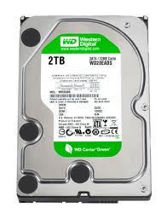
Hard-Drive Power Management
Spin-down platters
Higher Latency (Spin Up Time)
Increased Wake-Up Energy Consumption
Friction, Inertia
Slow-down platter rotation
Green Hard Drives
Lower Transfer Rate
Higher Seek Time

Slide 16
Wireless Power Management
Radio Listening is expensive
Can we turn off the antenna to save power?
Notify the Access Point
Turn off client antenna
AP buffers packets and periodically notify clients on who has packets
Client Polls the Access Point for stored Packets

Slide 17
Software Aproaches
Power Aware-Scheduling
Linux Power-aware Scheduler
Do not distribute the load across cores.
Aggregate all tasks in one core so other cores can sleep
GraceOS
Power-aware Real-time Scheduler
University of Illinois Research Project
Imprecise Computing
Reduce the precision of your computation so CPU sleeps more

Slide 18
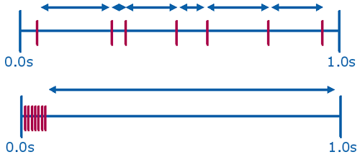
Software Aproaches
Group Timers
Aggregate multiple timers into one
One interrupt for many timers
Longer sleep time
Tickless Kernel
Do not use periodic timer to measure time
Update time when other event/interrupt occurs
Standard Timer
Group Timer

Slide 19
Grace OS
Power aware scheduler for Multimedia
Minimize Power Consumption
Trade-off between Quality and Power
Realtime Scheduler
Earliest Deadline First policy
Dynamic Voltage Scaling
Reduce CPU Speed as much as possible without missing any deadlines
Online Application Profiler
Adapt the CPU Reservation to the actual utilization of the application

Slide 20
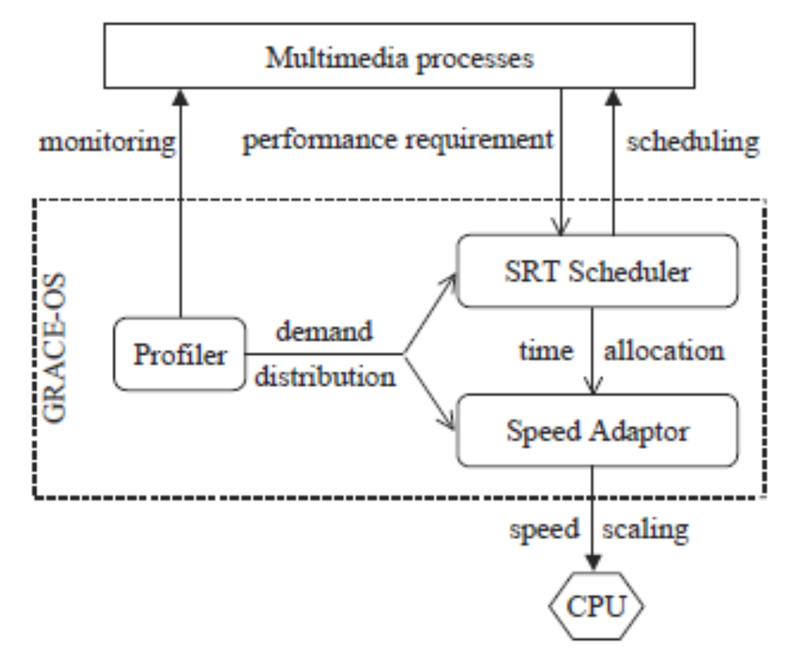
Grace OS Architecture

Slide 21
Summary
Power management is important
Battery, Cooling Costs, Environment
Power savings come at cost
Reduced Performance
Higher Latency
Basic Principles
Amdhal’s Law
Power off idle systems
Slow down underutilized systems

