Slide 1
GPIO
碩一 李柏毅
陳政澤

Slide 2
overview
Introduction
example
Structure of GPIO

Slide 3
introduction
General Purpose Input/Output (GPIO) is a generic pin on a chip whose behavior (including whether it is an input or output pin) can be controlled (programmed) by the user at run time.

Slide 4
four 32-bit configuration registers (GPIOx_MODER,
GPIOx_OTYPER, GPIOx_OSPEEDR and GPIOx_PUPDR),
two 32-bit data registers (GPIOx_IDR and GPIOx_ODR)
a 32-bit set/reset register (GPIOx_BSRR),
a 32-bit locking register (GPIOx_LCKR) and two 32-bit alternate function selection register (GPIOx_AFRH and GPIOx_AFRL).

Slide 5
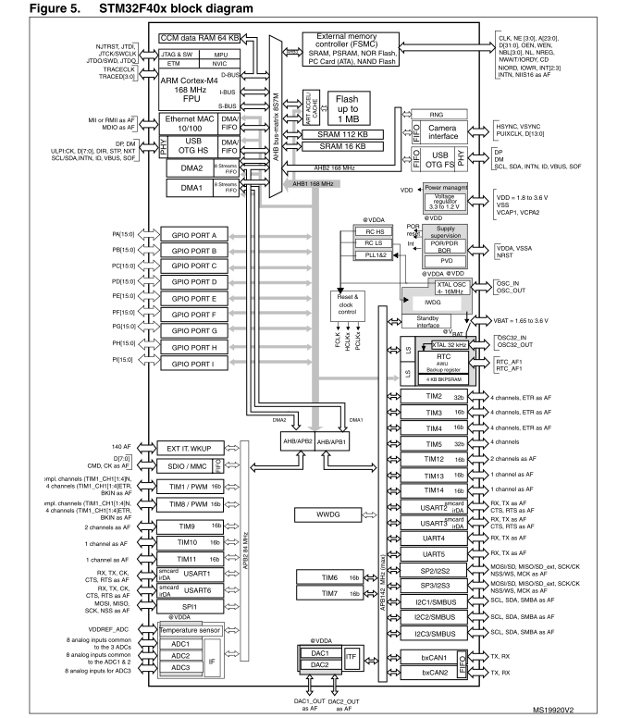

Slide 6
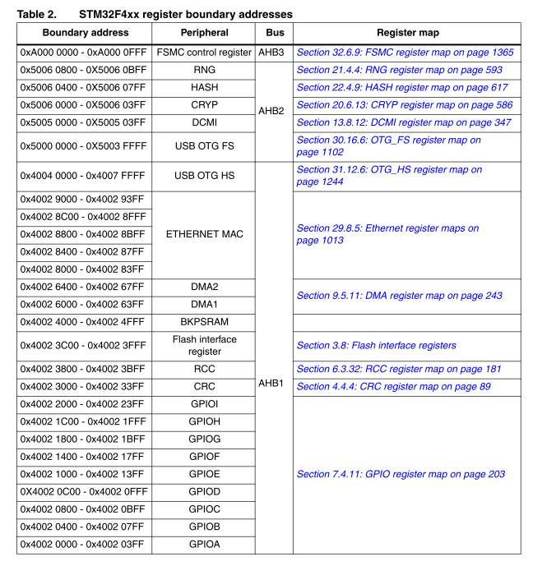

Slide 7
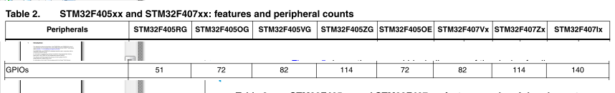
port數量

Slide 8
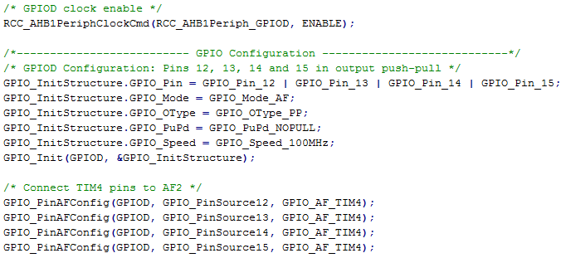
example

Slide 9
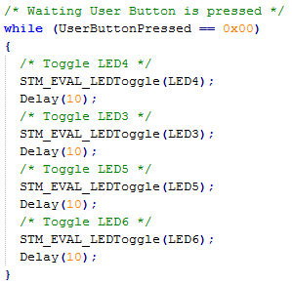




Slide 10
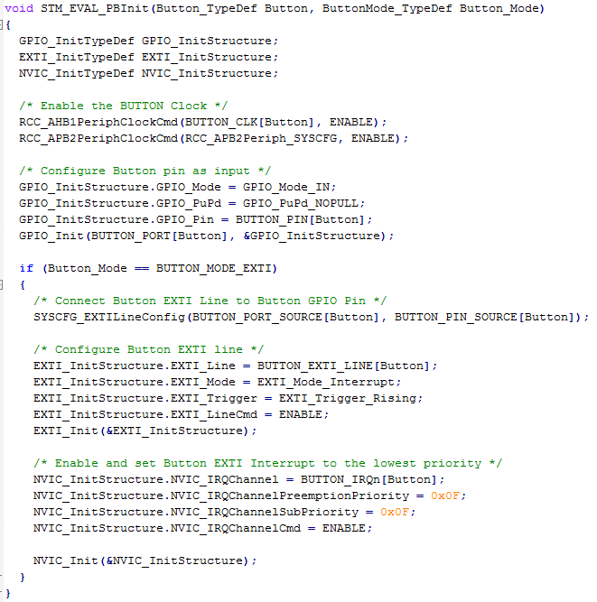


Slide 11
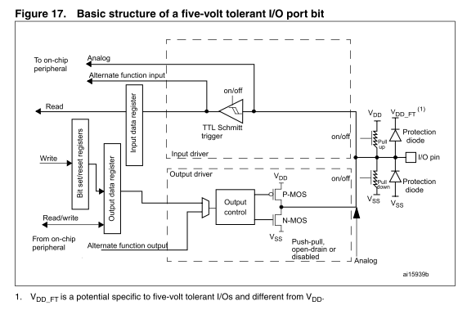
Basic structure

Slide 12
discussion
Output (push-pull / open-drain)
Input (floating / pull-up / pull-down)
Alternate function (push-pull / open-drain)
Analog

Slide 13
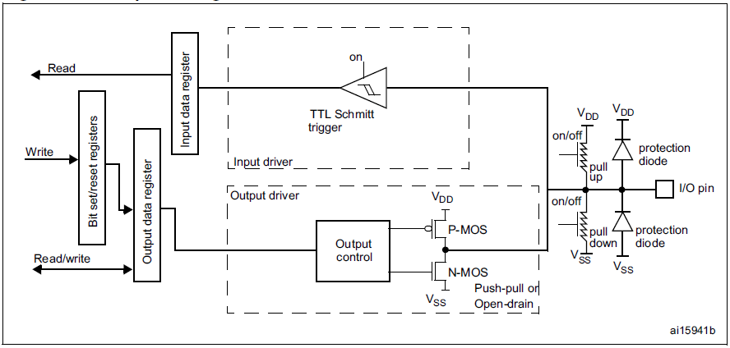
Output configuration

Slide 14
I/O port data registers
Each GPIO has two 16-bit memory-mapped data registers:
GPIOx_ODR stores the data to be output, it is read/write accessible.
The data input through the I/O are stored into the input data register (GPIOx_IDR), a read-only register.

Slide 15
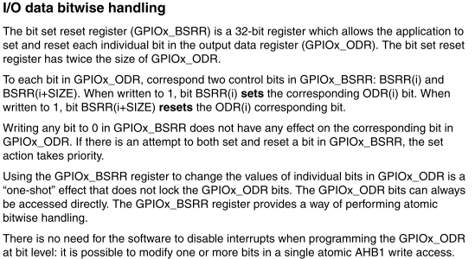
I/O data bitwise handling

Slide 16
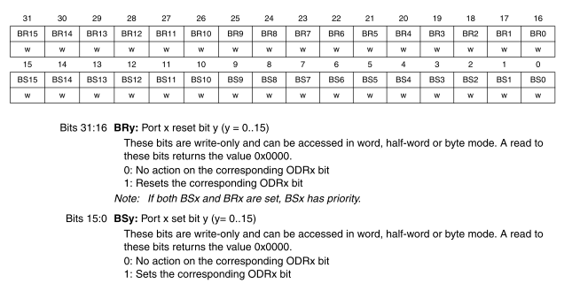

Slide 17
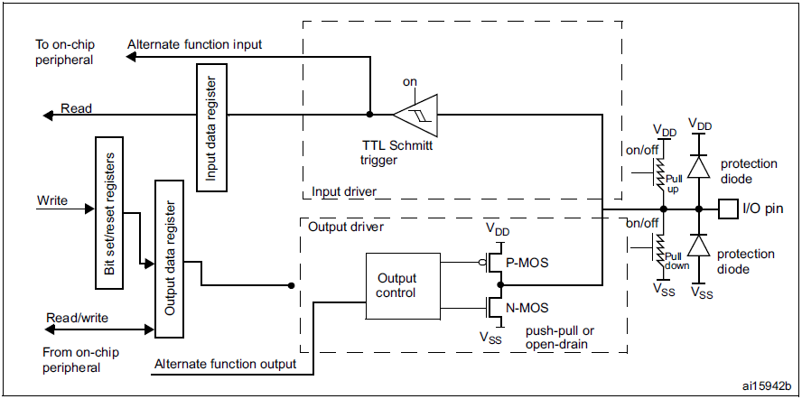
Alternate function configuration

Slide 18
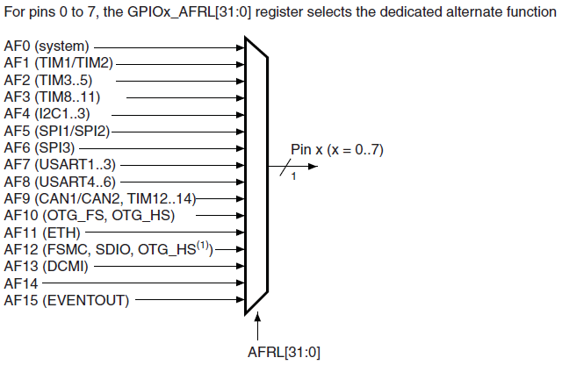
AF selection

Slide 19
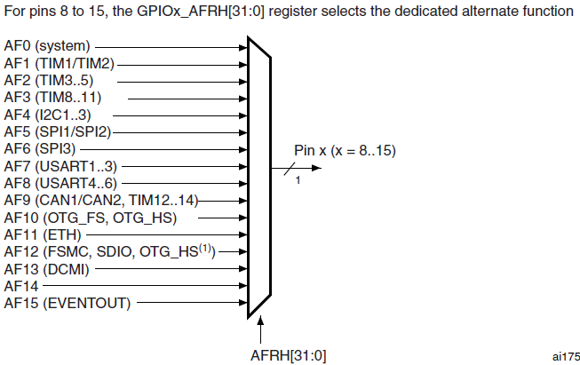

Slide 20
I/O pin multiplexer and mapping
The microcontroller I/O pins are connected to onboard peripherals/modules through a multiplexer that allows only one peripheral’s alternate function (AF) connected to an I/O pin at a time.
In this way, there can be no conflict between peripherals sharing the same I/O pin.
Each I/O pin has a multiplexer with sixteen alternate function inputs (AF0 to AF15) that can
be configured through the GPIOx_AFRL (for pin 0 to 7) and GPIOx_AFRH (for pin 8 to 15) registers:

Slide 21
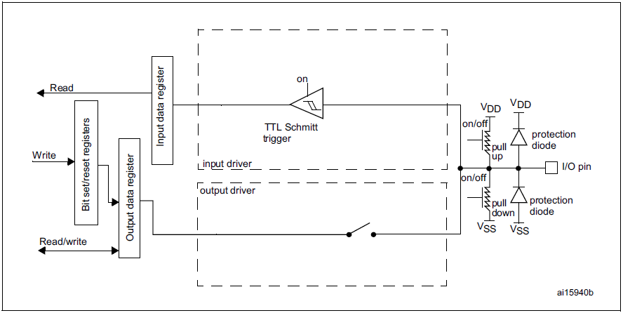
Input configuration

Slide 22
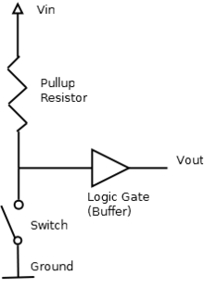
Pull up
Pull-up resistors are used in electronic logic circuits to ensure that inputs to logic systems settle at expected logic levels if external devices are disconnected or high-impedance.

Slide 23
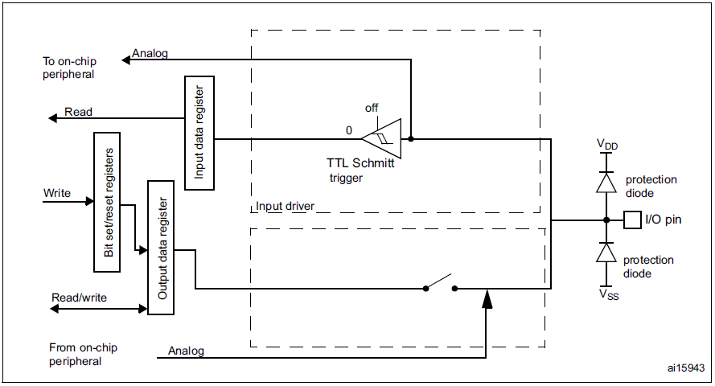
Analog configuration

Slide 24
/* Configure ADC3 Channel12 pin as analog input ******************************/
GPIO_InitStructure.GPIO_Pin = GPIO_Pin_2;
GPIO_InitStructure.GPIO_Mode = GPIO_Mode_AN;
GPIO_InitStructure.GPIO_PuPd = GPIO_PuPd_NOPULL ;
GPIO_Init(GPIOC, &GPIO_InitStructure);

Slide 26
Conclusion
牽涉到實體I/O的部分，絕非只是改變某些暫存器或是記憶體內容那麼單純。
  必須考慮實體電路的特性
每個Pin有其對應的作用，並非可以隨意使用任一個pin來完成想要的功能。
  查看datasheet很重要

