Slide 1
CPT204 Group Project
Course project presentation · AY2526
Urban Infrastructure
Inspection System.
A concise presentation of our sorting benchmark, shortest-path solution, object-oriented design, and project reflection for the Urban Infrastructure Inspection coursework.
Qi.Chen 2363203
Chenrui.Zhu 2361387
May 2026
2361387 · 2363203

Slide 2
CPT204 Group Project
Course project presentation
Overview
Part II
Task A
Sorting Algorithms & Benchmark Analysis
Part III
Task B
Graph Representation & Shortest Path Planning
Part IV
Task C
Object-Oriented System Design
Part V
Project Reflection
Collaboration, EDI & Future Development
Part I
Introduction
Project Background & Objectives
May 2026

Slide 3
Project background
03
Introduction & Backgrounds
Project Purpose
Build an urban infrastructure inspection planning system
Rank candidate inspection locations by priority
Find shortest inspection routes using graph algorithms
Compare algorithm performance under different datasets
Three candidate datasets
evaluate and rank candidate locations
compute the shortest route
select top-priority locations
map them into a weighted graph
May 2026
Urban Infrastructure Inspection System

Slide 4
04
Project background
Datasets & Weighted Graph
Key findings
Dataset | Characteristic
A | Nearly Sorted
B | Random
C | Reverse / Duplicate
Dataset A is nearly sorted, so Bubble Sort benefits from early termination.
Dataset B is random, so Quick Sort gains from balanced partitions.
Dataset C contains many duplicate values, so Insertion Sort works well.
Merge Sort is not always the fastest, but it is the most stable overall.
Each dataset contains 1000 candidate inspection locations with priority scores.
May 2026
Runtime results and main findings

Slide 5
Project background
05
Input Data and System Workflow
Input Files
• candidates_A.csv
• candidates_B.csv
• candidates_C.csv
• paths.csv
• Each candidate dataset contains location_id and priority_score.
• The graph file contains from_location, to_location, and weight.
Workflow
• 01 Load datasets and graph
• 02 Sort candidates using multiple algorithms
• 03 Select top 10 highest-priority locations
• 04 Build shortest-path query cases
• 05 Display and export results in the Swing desktop application
May 2026
Shortest-path outputs

Slide 6
Task A · sorting design
06
Task A Sorting Algorithms
Ranking rule
Algorithms
Benchmark fairness
Recorded Statistics
Sort candidate locations by priority score in descending order, and if two locations have the same priority score, sort them by location ID in ascending order.
We implemented Bubble Sort, Quick Sort, and Merge Sort as required, and added Insertion Sort for comparison.
We used warm-up runs, 100 formal runs, and a fresh copy of the dataset for each execution to reduce measurement noise.
Average runtime: overall efficiency of each algorithm
Median runtime: typical runtime, less affected by outliers
Minimum runtime: best observed performance
Maximum runtime: worst observed performance
Range: difference between minimum and maximum runtime
Standard deviation: stability and consistency of runtime
May 2026
Sorting algorithms and ranking rule

Slide 7
Task A · sorting design
07
Task A Sorting Algorithms
Bubble
for (int i = 0; i < n - 1; i++) {
boolean swapped = false;
for (int j = 0; j < n - 1 - i; j++) {
if (sorted.get(j).compareTo(sorted.get(j + 1)) > 0) {
Candidate temp = sorted.get(j);
sorted.set(j, sorted.get(j + 1));
sorted.set(j + 1, temp);
swapped = true;
}
}
if (!swapped) break;
}
Bubble Sort is applied by repeatedly comparing adjacent candidate locations and swapping them when they are not in the correct order according to the sorting rule. In this project, an early-termination mechanism is used through a swapped flag, so the algorithm can stop once no exchanges are needed. This makes Bubble Sort especially suitable for Dataset A, which is nearly sorted, because only a small number of comparisons and swaps are required.
May 2026
Sorting algorithms and ranking rule

Slide 8
Task A · sorting design
08
Task A Sorting Algorithms
Quick
private int partition(List<Candidate> candidates, int low, int high) {
Candidate pivot = candidates.get(high);
int i = low - 1;
for (int j = low; j < high; j++) {
if (candidates.get(j).compareTo(pivot) <= 0) {
i++;
swap(candidates, i, j);
}
}
swap(candidates, i + 1, high);
return i + 1;
}
Quick Sort is applied using a divide-and-conquer strategy. In this project, the last element of the list is selected as the pivot, and the dataset is partitioned so that locations with higher priority are placed on the left side and lower-priority locations on the right side. The same process is then repeated recursively for the sublists. This method performs very efficiently on random data such as Dataset B, but it becomes less effective on nearly sorted data because the fixed pivot strategy can create highly unbalanced partitions.
May 2026
Sorting algorithms and ranking rule

Slide 9
Task A · sorting design
09
Task A Sorting Algorithms
Merge
Merge Sort is applied by first dividing the dataset into smaller sublists until each sublist contains only one element, and then merging them back together in sorted order. During the merge process, the project follows the same ranking rule of priority score and location ID. Merge Sort is useful in Task A because its performance remains stable across different dataset characteristics, making it a reliable algorithm for consistent sorting results.
int middle = candidates.size() / 2;
return merge(left, right);
if (left.get(leftIndex).compareTo(right.get(rightIndex)) <= 0)
May 2026
Sorting algorithms and ranking rule

Slide 10
Task A · sorting design
10
Task A Sorting Algorithms
Insertion
Insertion Sort is applied by scanning the dataset from left to right and inserting each candidate location into its correct position in the already sorted part of the list. This approach is simple and efficient when the data is already close to the target order. In Task A, Insertion Sort performs well on nearly sorted or partially ordered datasets, such as Dataset A and Dataset C, because fewer shifts are needed to place elements in the correct order.
for (int i = 1; i < sorted.size(); i++) {
Candidate current = sorted.get(i);
int j = i - 1;
while (j >= 0 && sorted.get(j).compareTo(current) > 0) {
sorted.set(j + 1, sorted.get(j));
j--;
}
sorted.set(j + 1, current);
}
May 2026
Sorting algorithms and ranking rule

Slide 11
Task A · sorting design
11
Task A Sorting Algorithms
Algorithm | Best Time Complexity | Average Time Complexity | Worst Time Complexity | Extra Space Complexity
Bubble Sort | $O(n)$ with early termination | $$O(n²)$$ | $$O(n²)$$ | $$O(1)$$
Insertion Sort | $$O(n)$$ | $$O(n²)$$ | $$O(n²)$$ | $$O(1)$$
Quick Sort | $$O(n log n)$$ | $$O(n log n)$$ | $$O(n²)$$ | $$O(log n)$$ average
Merge Sort | $$O(n log n)$$ | $$O(n log n)$$ | $$O(n log n)$$ | $$O(n)$$
May 2026
Sorting algorithms and ranking rule

Slide 12
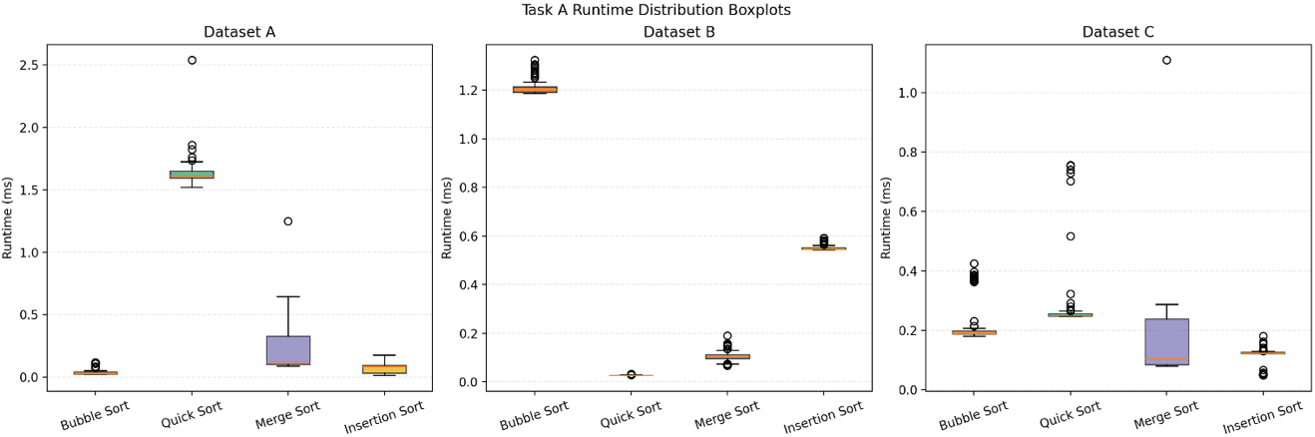
Task A · benchmark results
12
Sorting performance depends on dataset characteristics.
The benchmark data show that different datasets favor different algorithms. Bubble Sort was the fastest on Dataset A at 0.048 ms, Quick Sort performed best on Dataset B at 0.028 ms with the smallest standard deviation of 0.001 ms, and Insertion Sort achieved the best result on Dataset C at 0.117 ms. Although Merge Sort was not the fastest on any single dataset, its runtimes remained relatively stable across all three datasets, making it the most consistent overall algorithm.
Dataset | Bubble (ms) | Insertion (ms) | Quick (ms) | Merge (ms) | Best
A | 0.048 | 0.067 | 1.636 | 0.201 | Bubble
B | 1.210 | 0.550 | 0.028 | 0.104 | Quick
C | 0.224 | 0.117 | 0.280 | 0.160 | Insertion
The boxplots visually confirm the benchmark statistics: Bubble Sort and Insertion Sort perform well on nearly sorted data, Quick Sort performs best on random data, and Merge Sort shows the most balanced overall distribution across datasets, although it is not always the fastest.
May 2026
Runtime results and main findings

Slide 13
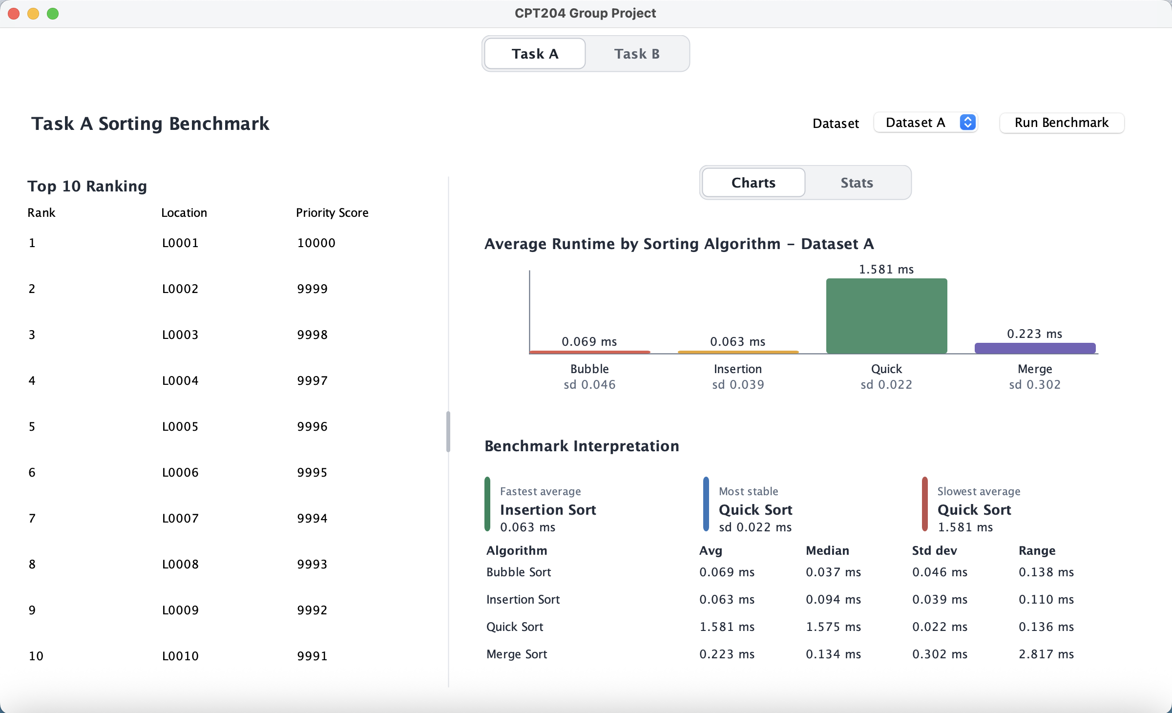
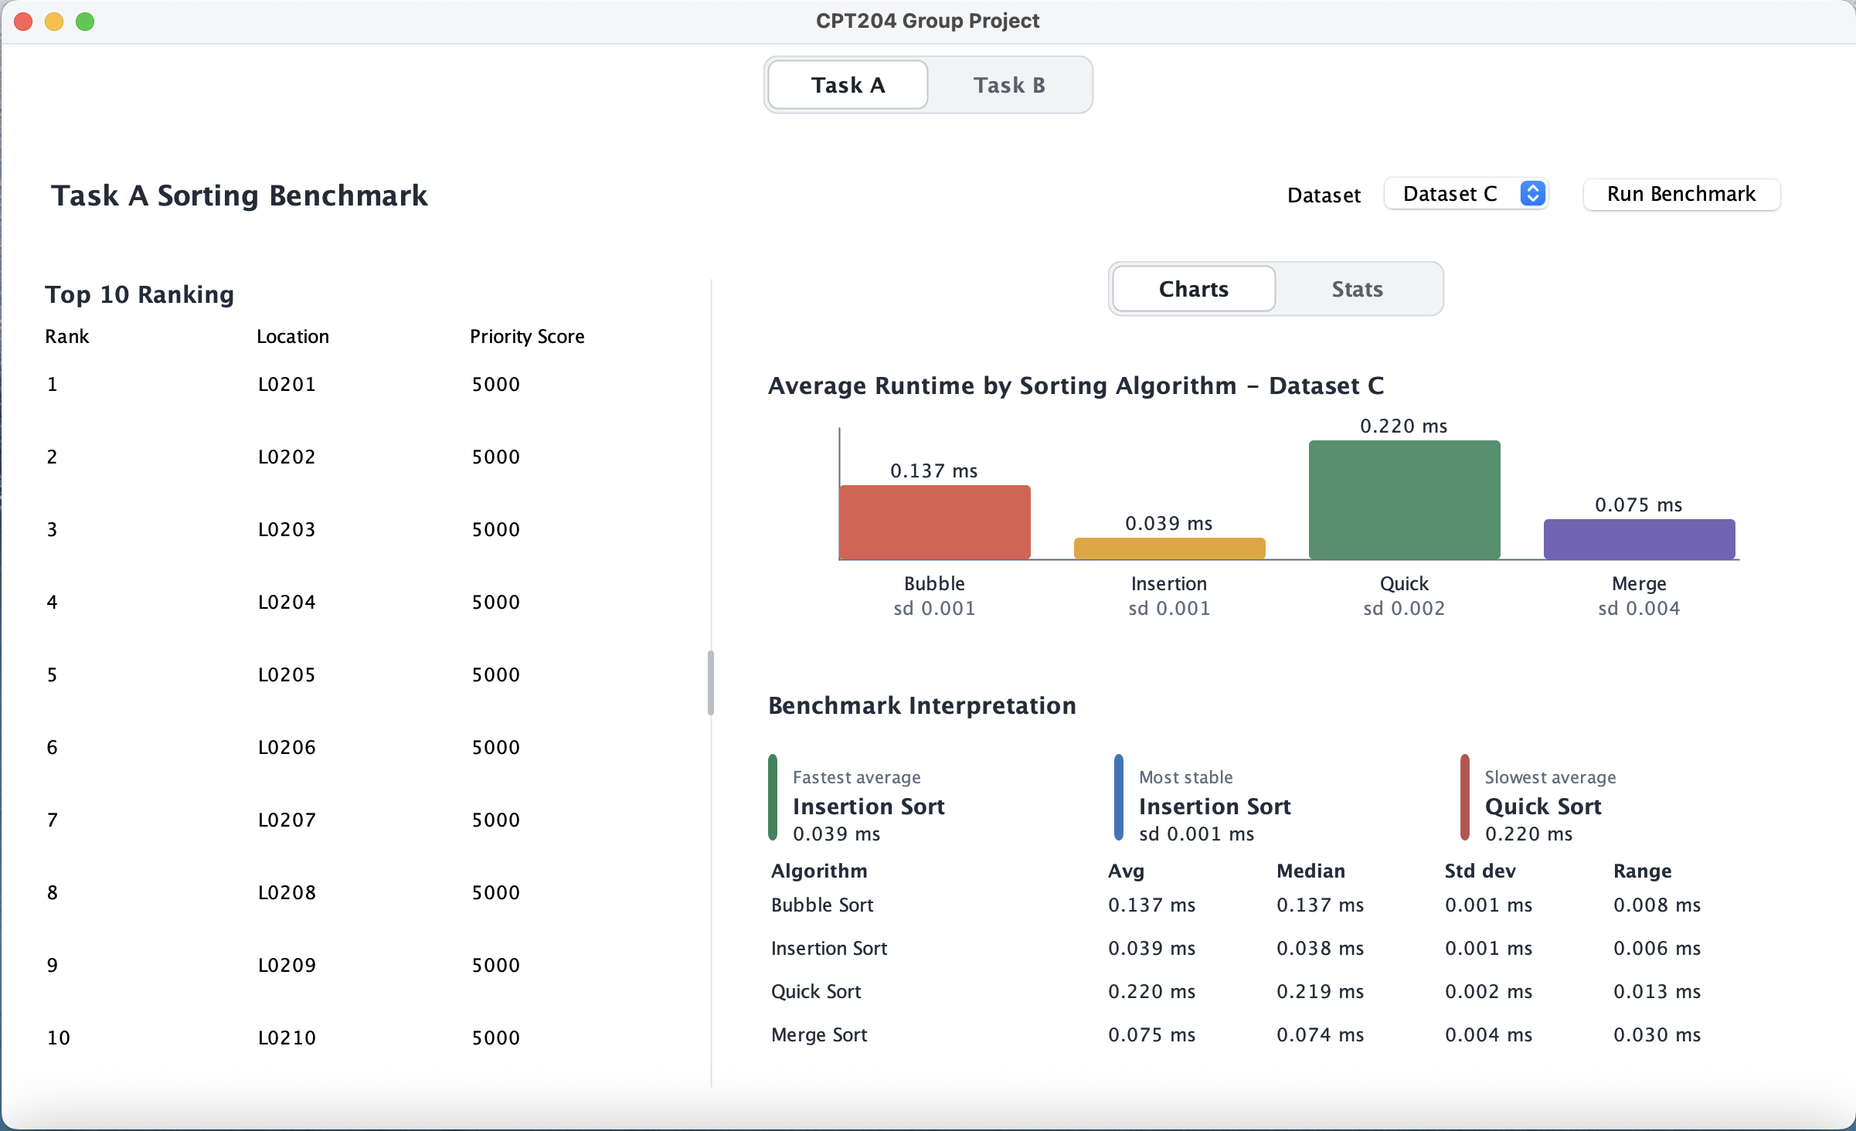
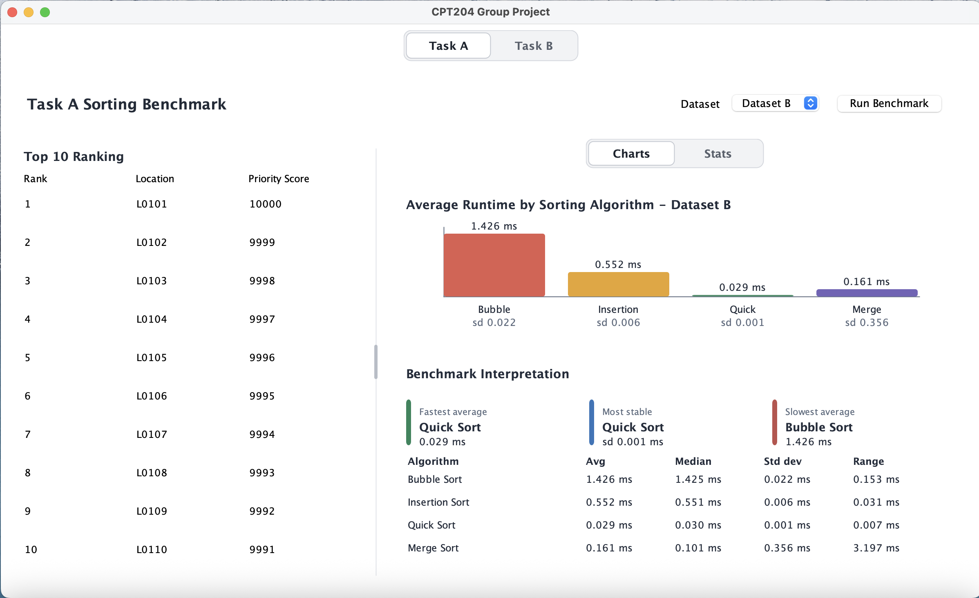
Task A · benchmark results
13
Sorting performance depends on dataset characteristics ——swing page.
May 2026
Runtime results and main findings

Slide 14
Task A · Results of Algorithm
14
Top 10 Selected Locations
Dataset A
Dataset B
Dataset C
L0001
L0002
L0003
L0004
L0005
L0006
L0007
L0008
L0009
L0010
L0101
L0102
L0103
L0104
L0105
L0106
L0107
L0108
L0109
L0110
L0201
L0202
L0203
L0204
L0205
L0206
L0207
L0208
L0209
L0210
May 2026
Top 10 selected locations

Slide 15
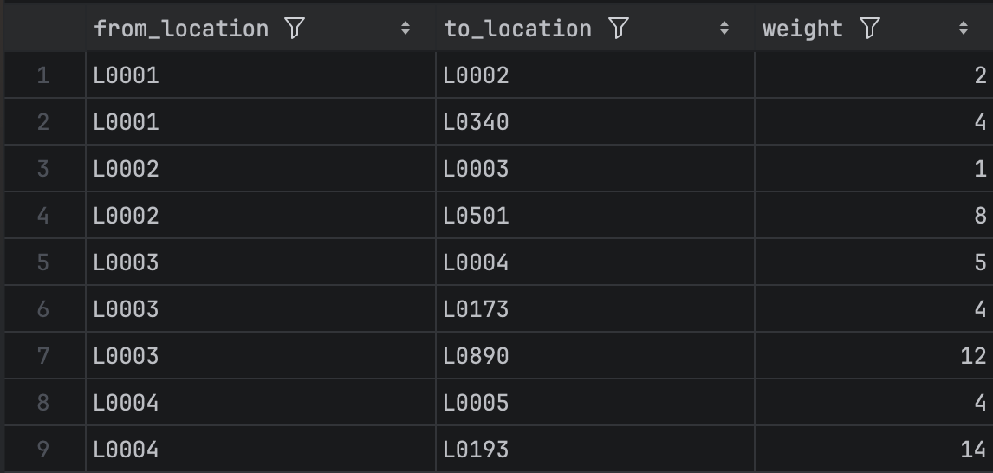
Task B · Graph Algorithm Design
public class Edge { private final Vertex from; private final Vertex to; private final int weight; public Edge(Vertex from, Vertex to, int weight) { this.from = from; this.to = to; this.weight = weight; } public Vertex getFrom() { return from; } public Vertex getTo() { return to; } public int getWeight() { return weight; } }
15
Vertex: stores the unique location ID
Overrides equals() and hashCode() based on id.
Enables correct lookup and comparison in HashMap.
Graph Model
Weighted Graph Representation
The location network is represented as a weighted graph.
Each inspection location is modeled as a vertex.
Each path between two locations is modeled as an edge.
The edge weight represents the distance or cost between connected locations.
The target locations used in Task B are selected from the Top 10 results of Task A
Graph: uses an adjacency list: Map<Vertex, List<Edge>>
Adjacency list Design
L0001
4
L0002
7
The path network is a sparse graph.
An adjacency list only stores existing paths.
It saves memory compared with an adjacency matrix.
It allows Dijkstra’s algorithm to quickly access neighboring locations.
L0003
May 2026
Graph model

Slide 16
Task B · Graph Algorithm Design
16
Dijkstra Algorithm
while (!queue.isEmpty()) {
Vertex current = queue.poll();
for (Edge edge : graph.getEdgesFrom(current)) {
Vertex neighbor = edge.getTo();
int candidateDistance =
distances.get(current) + edge.getWeight();
if (candidateDistance < distances.get(neighbor)) {
distances.put(neighbor, candidateDistance);
previousVertices.put(neighbor, current);
queue.remove(neighbor);
queue.offer(neighbor);
}
}
}
Extract the vertex that is closest to the starting point at present.
Design
A distances map records the current shortest known distance from the source to each vertex, while a PriorityQueue ensures that the vertex with the smallest distance is processed first.
For each processed vertex, the algorithm checks its outgoing edges and calculates a candidate distance for each neighbor. If the candidate distance is shorter than the recorded value, the distance is updated and the current vertex is stored in previousVertices. After reaching the target, previousVertices is used to reconstruct the final route from the target back to the source.
Update the shortest distance of its neighboring nodes
Complexity Analysis
Current implementation uses queue.remove(neighbor), which may take O(V).
Therefore, the time complexity is about O(EV).
Extra space: O(V) for distances, previousVertices, and queue.
Graph storage: O(V + E) using adjacency list.
May 2026
Dijkstra design

Slide 17
Task B · Graph Algorithm Design
17
EXTRA IMPLEMENTATION
Bellman-Ford Algorithm
for (int pass = 0; pass < vertexCount - 1; pass++) {
boolean updated = false;
for (Vertex current : graph.getVertices()) {
int currentDistance = distances.get(current);
if (currentDistance == Integer.MAX_VALUE) {
continue;
}
for (Edge edge : graph.getEdgesFrom(current)) {
Vertex neighbor = edge.getTo();
int candidateDistance =
currentDistance + edge.getWeight();
if (candidateDistance < distances.get(neighbor)) {
distances.put(neighbor, candidateDistance);
previousVertices.put(neighbor, current);
updated = true;
}
}
}
if (!updated) {
break;
}
}
Design
Similar to Dijkstra, it uses a distances map to record the current shortest known distance from the source vertex, and previousVertices to rebuild the final path. However, Bellman-Ford does not use a priority queue. Instead, it repeatedly checks all edges in the graph and relaxes them for up to V - 1 passes, where V is the number of vertices.
During each pass, the algorithm calculates a candidate distance for every reachable neighbor. If the candidate distance is smaller than the recorded distance, the distance is updated and the current vertex is stored as the previous vertex.
Complexity Analysis
Time complexity: O(VE)
Space complexity: O(V)
May 2026
Bellman-Ford design

Slide 18
Task B · Graph Algorithm Design
18
EXTRA IMPLEMENTATION
Floyd-Warshall Algorithm
for (int via = 0; via < vertexCount; via++) {
for (int from = 0; from < vertexCount; from++) {
for (int to = 0; to < vertexCount; to++) {
double candidateDistance =
distances[from][via] + distances[via][to];
if (candidateDistance < distances[from][to]) {
distances[from][to] = candidateDistance;
next[from][to] = next[from][via];
}
}
}
}
Design
Unlike Dijkstra and Bellman-Ford, which mainly calculate the shortest path from one source vertex to one target vertex, Floyd-Warshall calculates the shortest paths between all pairs of vertices.
The main idea of Floyd-Warshall is to check whether a path from one vertex to another can become shorter by passing through an intermediate vertex. For every possible intermediate vertex via, the algorithm compares the current distance from from to to with the candidate distance from -> via -> to. If the candidate distance is smaller, the distance matrix and path reconstruction matrix are updated.
Complexity Analysis
Time complexity: O(V³)
Extra space complexity: O(V²)
May 2026
Floyd-Warshall design

Slide 19
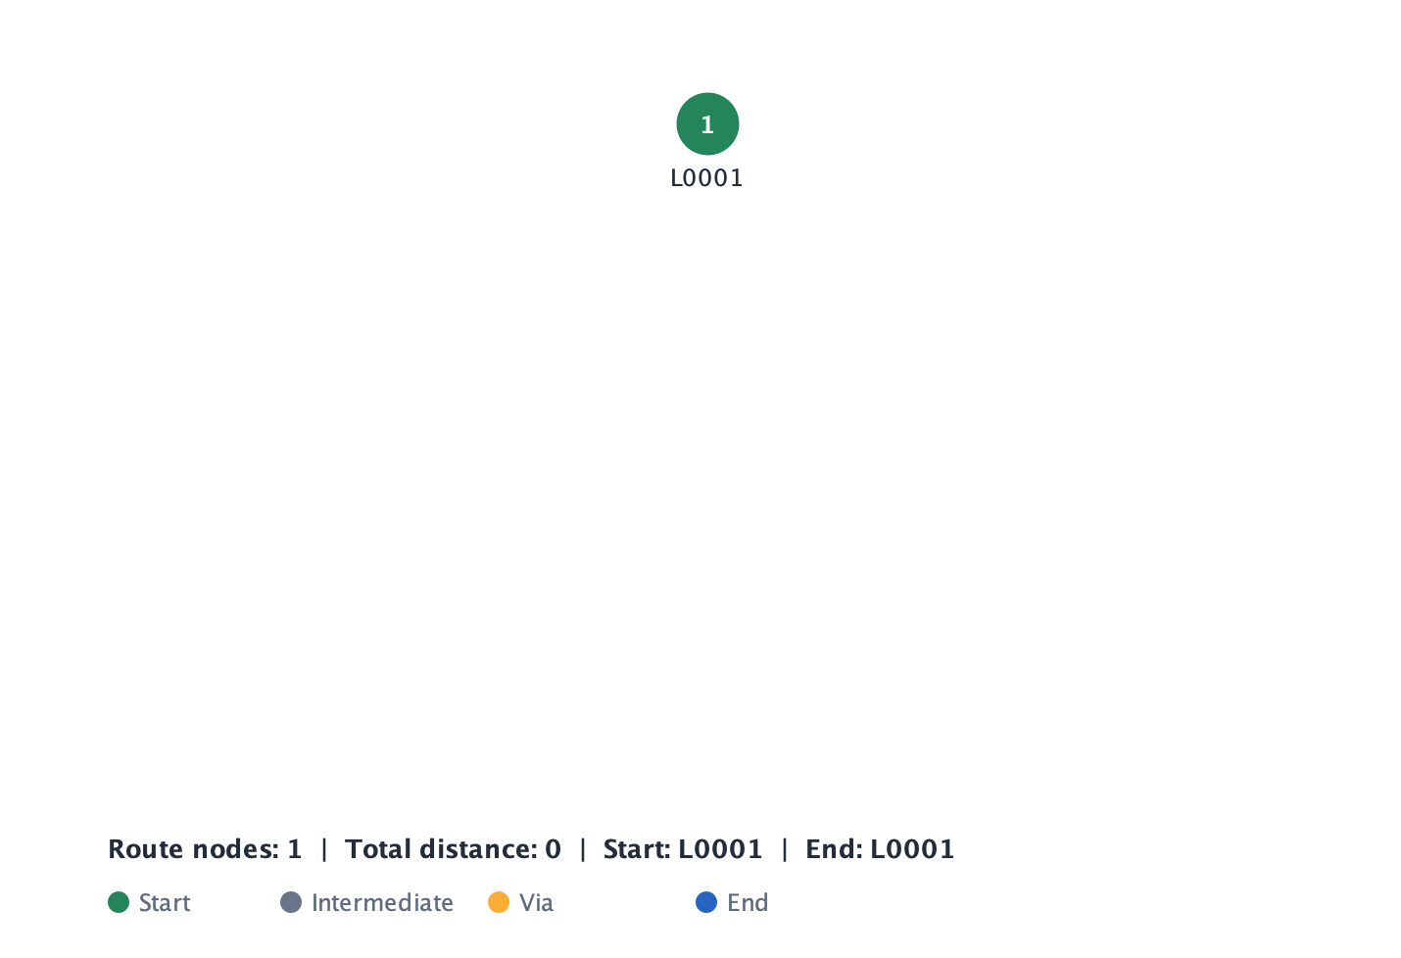
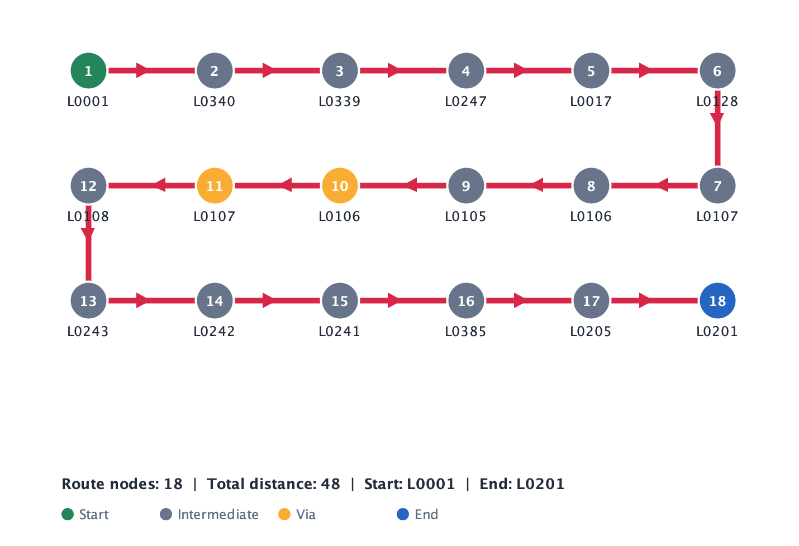
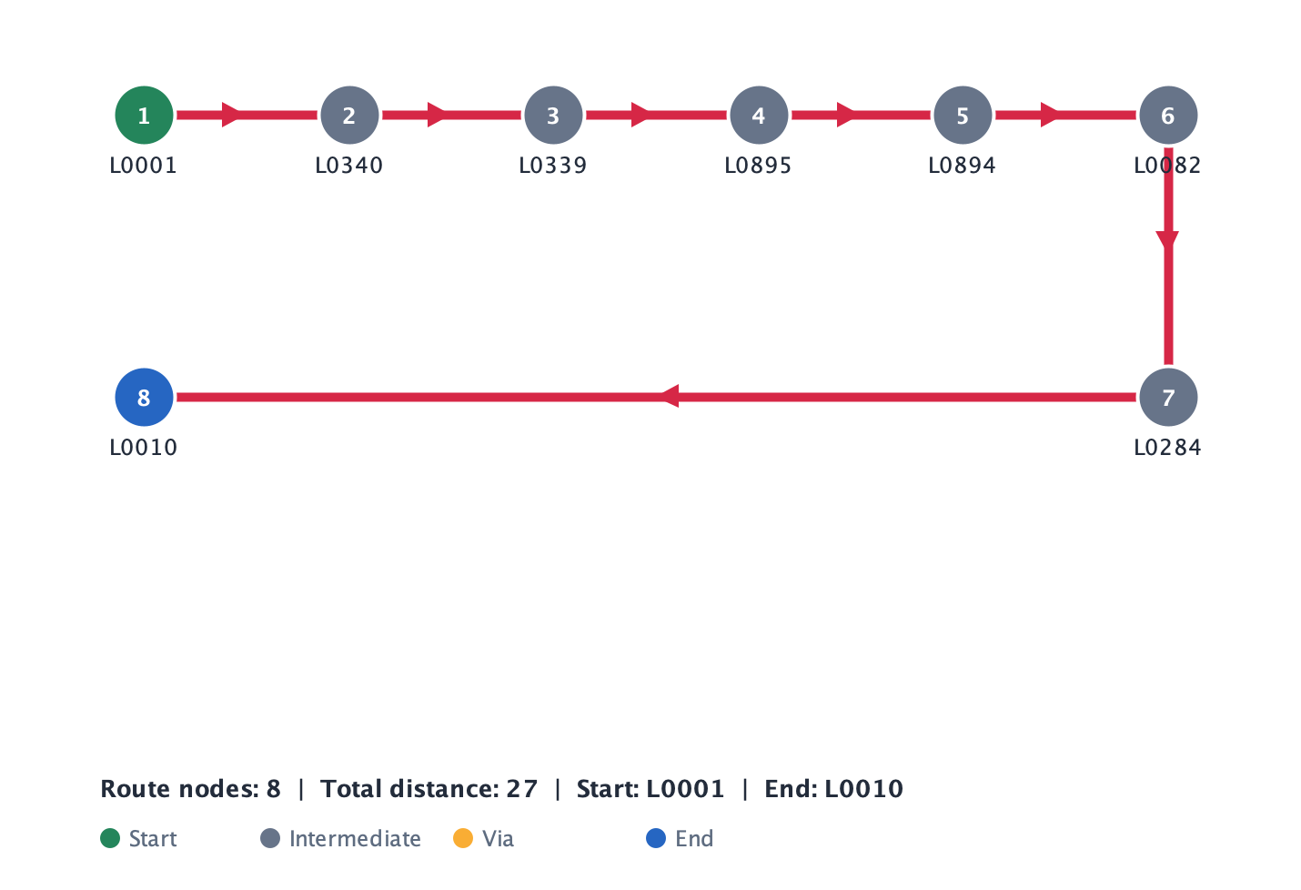
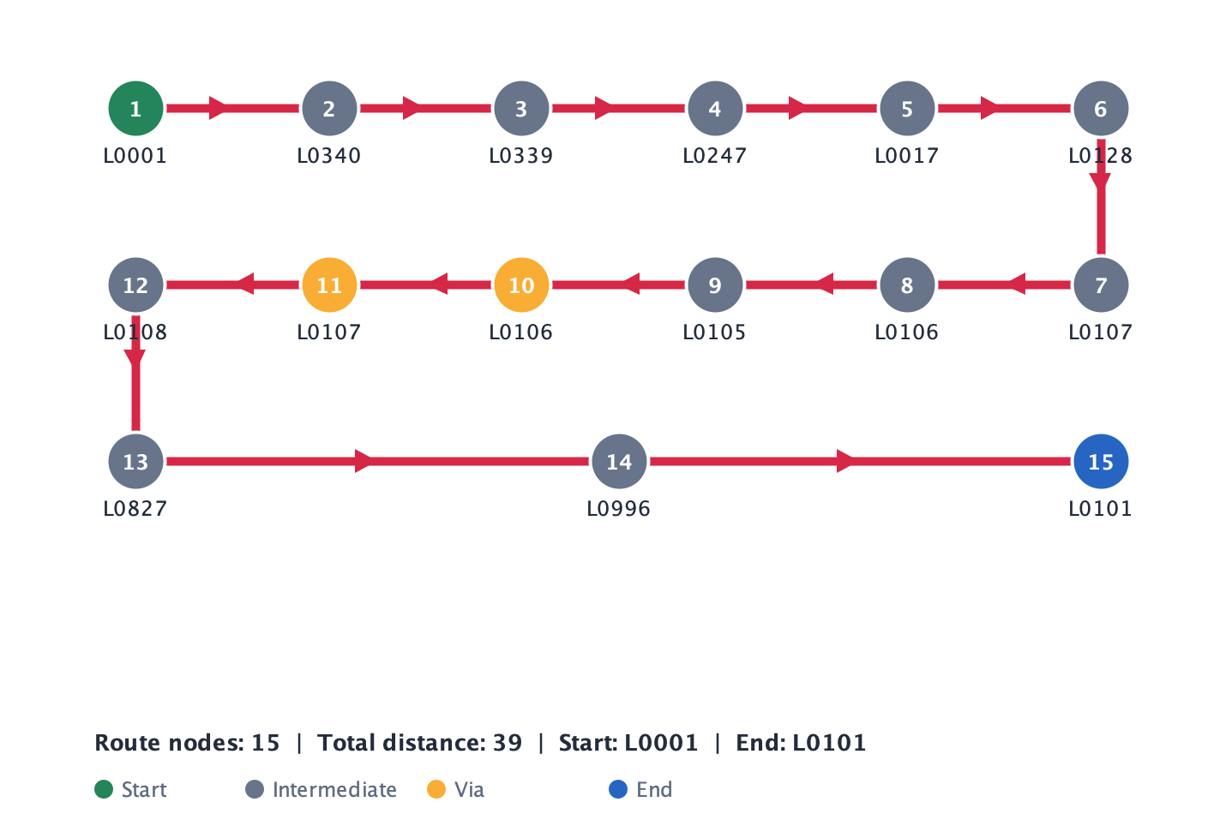
Task B · Graph Algorithm Design
19
Result Cases
Case | Definition
1 | A1 to A1
2 | A1 to A10
3 | A1 to B1 via B5
4 | A1 to C1 via B5 and C5
Checks whether the system correctly handles source = target.
Requires one intermediate stop, so the route is split into two segments
Calculates a normal shortest path between two selected locations.
Requires multiple stops, showing that the system can combine several shortest-path results.
May 2026

Slide 20
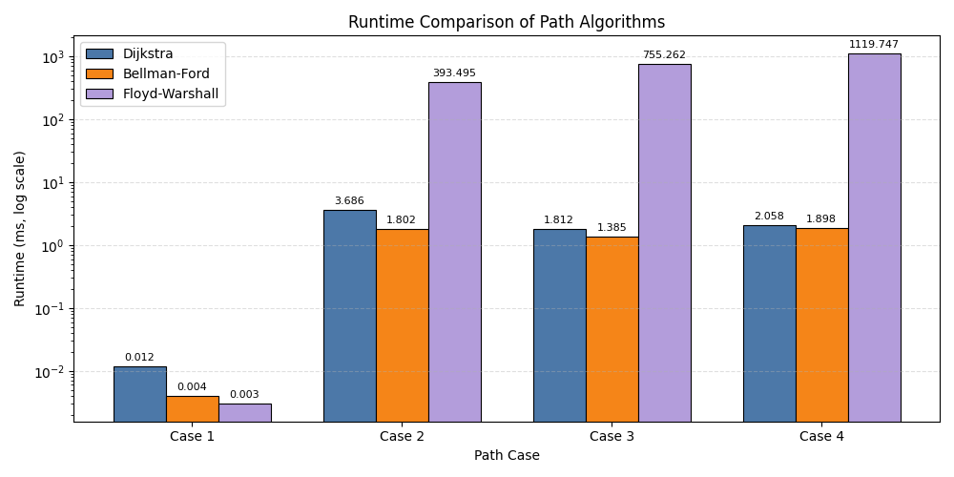
Task B · Graph Algorithm Design
20
Algorithm Comparison
However, from Case 2 to Case 4, Floyd-Warshall becomes much slower than the other two algorithms. This is because Floyd-Warshall computes shortest paths between all pairs of vertices, even though each case only needs a specific route query.
Algorithm | Time Complexity
Dijkstra | O(EV)
Bellman-Ford | O(VE)
Floyd-Warshall | O(V³)
Dijkstra and Bellman-Ford perform much better for the selected path cases. Bellman-Ford is slightly faster in these measured results, but its general time complexity is higher because it repeatedly relaxes all edges. Dijkstra is still selected as the main algorithm because the graph weights in this project represent distances or costs, which are non-negative.
The runtime comparison shows clear performance differences among the three path algorithms.
In Case 1, all algorithms finish very quickly because the source and target are the same, so almost no graph traversal is required.
May 2026
Algorithm comparison and selection

Slide 21
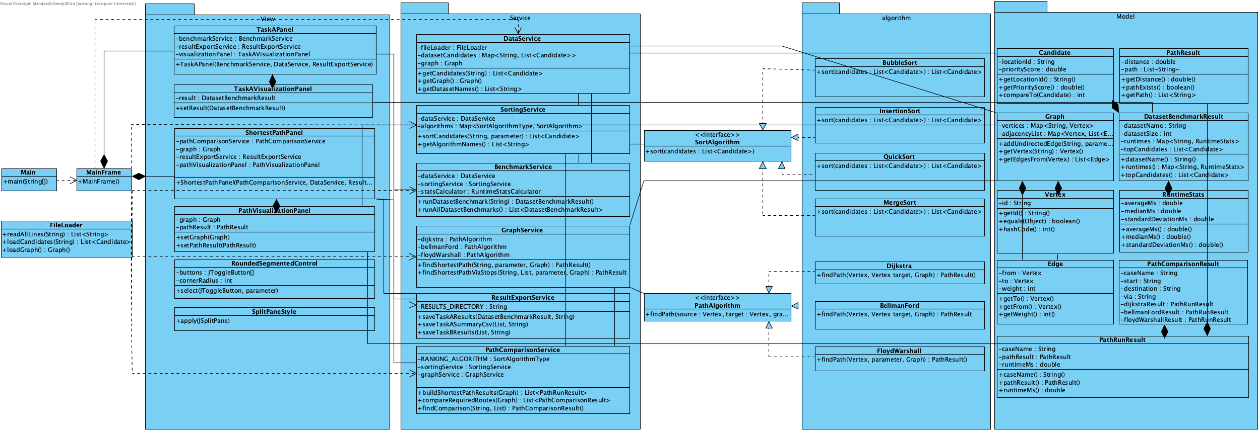
Task C · application design
21
Overall Program Design
May 2026
Overall program design

Slide 22
Task C · application design
22
Candidate & Graph Data Structure
CSV Row
→ Candidate Object
Fields:
- locationId
- priorityScore
Vertex
- id
Edge
- from
- to
- weight
Stored in:
List<Candidate>
Map<Vertex, List<Edge>>
Adjacency list improves efficiency for sparse graphs.
May 2026
Candidate and graph data structures

Slide 23
Task C · application design
23
Why Adjacency List?
Adjacency Matrix | Adjacency List
Requires n×n space | Stores only existing edges
Wastes memory in sparse graph | Space efficient
Slower neighbor traversal | Fast adjacent-node access
Since the inspection network is sparse, adjacency lists significantly reduce memory usage and improve Dijkstra traversal efficiency.
May 2026
Adjacency list design

Slide 24
Task C · application design
24
Class Design Overview
Layer | Classes
Model | Candidate, Vertex, Edge, Graph
Service | SortingService, BenchmarkService, GraphService
Algorithm | BubbleSort, MergeSort, Dijkstra
UI | MainFrame, TaskAPanel
The design separates data, business logic, algorithms, and UI for better maintainability.
May 2026
Class design overview

Slide 25
Task C · application design
25
Sorting Architecture
SortAlgorithm Interface
↑
┌────── + ──────┐
Bubble Quick Merge
SortingService
→ manages all algorithms
→ Map<SortAlgorithmType, SortAlgorithm>
May 2026
Sorting architecture

Slide 26
Task C · application design
26
GraphService & Pathfinding
Path-Finding Service Design
GraphService
↓
PathAlgorithm Interface
↓
Dijkstra / BFS
Main Functions
findShortestPath()
findShortestPathVia()
buildTaskBResults()
May 2026
GraphService and pathfinding

Slide 27
Task C · application design
27
OOP Principles
Object-Oriented Principles
Principle | Example in Project
Encapsulation | private fields in Candidate / Graph
Abstraction | SortAlgorithm & PathAlgorithm interfaces
Polymorphism | Different sorting implementations
Inheritance | Swing panels extending JFrame/JPanel
OOP principles improve scalability, maintainability, and code clarity.
May 2026
OOP principles

Slide 28
Task C · application design
28
Design Benefits / Conclusion
Importance of OOP Design
Benefits of Current Design
Modular architecture
Easy algorithm replacement
Clear separation of responsibilities
Reusable graph and sorting framework
Better maintainability and scalability
The current design achieves high cohesion and low coupling across the application.
May 2026
Design benefits and conclusion

Slide 29


Task D · reflection
29
Task D
Collaboration and planning
EDI considerations
Future improvements
EDI considerations were reflected in our system design by ensuring fair access to system functions, recognising users with different backgrounds and technical abilities, and improving accessibility for practical inspection work scenarios. We considered users such as elderly workers, visually impaired users, and staff working in outdoor environments, so the system aims to be simple, accessible, and adaptable to different user needs. Future improvements may include text-to-speech support, multilingual interfaces, and adjustable UI settings to further enhance equality, diversity, and inclusiveness.
In the future, we hope to make the system more practical by adding richer route-planning functions, more flexible priority adjustment, and customizable inspection start and end points. We also plan to further improve the interface based on EDI principles so that the system can better reflect real-world value in urban management.
In this project, we used Jira to divide Tasks A and B into smaller tasks such as sorting, path finding, and interface development, which helped us assign responsibilities, track progress, and improve communication. Although Jira made teamwork more organized, it also required extra time for task creation and maintenance, and for a small project some features felt overly complex compared with direct communication. We also used
Git for code collaboration.
May 2026
Collaboration, EDI, and future work

Slide 30




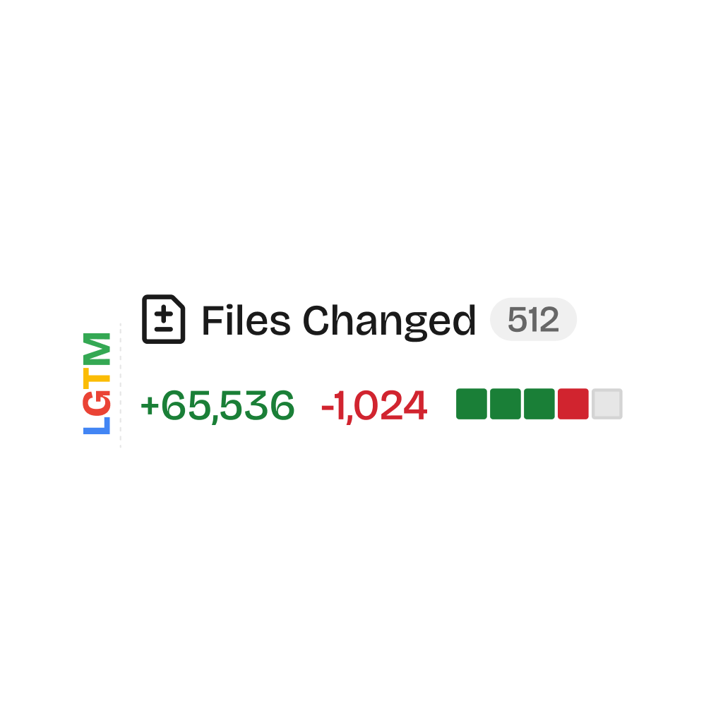
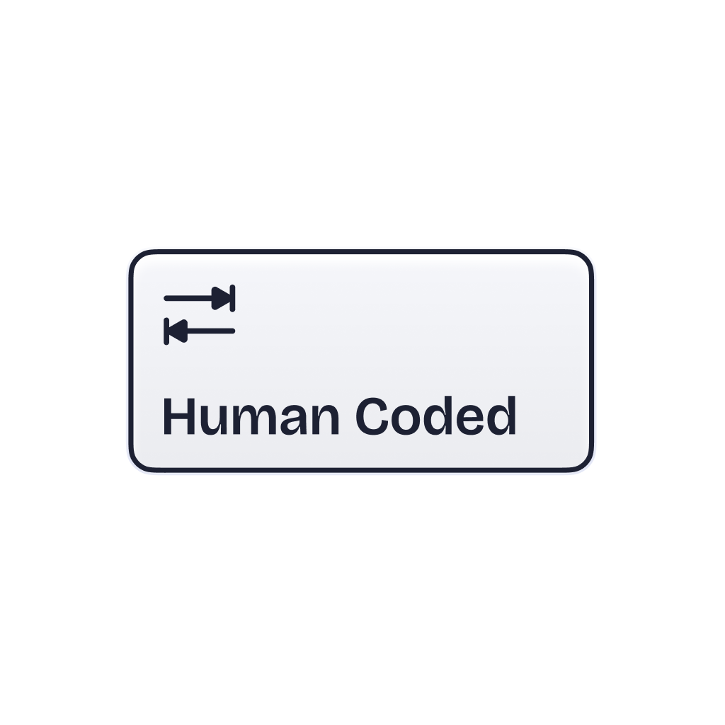
Task D · reflection
30
Task D AI Assistance
[1] OpenAI GPT and Codex, available at https://openai.com.
Used for general guidance and clarification during the development of the AWT/Swing graphical user interface, including interface design suggestions, explanation of Java GUI concepts, and improvement of implementation clarity. These tools were not used to directly generate the project’s final core algorithm code.
[2] Claude Code, available at https://www.anthropic.com.
Used together with the public GitHub repository beautiful-html-templates to assist in the design and preparation of the presentation template. This use was limited to presentation and visual material preparation rather than the implementation of the assessed project algorithms.
[3] beautiful-html-templates, GitHub public repository.
Used as a reference resource for presentation template design and visual layout.
[4] JIRA, available at https://www.atlassian.com/software/jira.
Used for project progress tracking, task allocation, and team coordination, in order to support clear division of work and efficient communication.
May 2026
Collaboration, EDI, and future work

Slide 31
Conclusion
31
One project, three core lessons.
Lesson 1
Lesson 2
Lesson 3
Sorting performance depends strongly on dataset characteristics, so algorithm choice should follow data rather than theory alone.
Dijkstra is effective for the current weighted graph and required route cases, but shortest local queries are not full inspection optimization.
Clear object-oriented design makes the program easier to understand, maintain, and extend for future improvements.
Thank you for listening.
May 2026
Thank you

