Slide 1
Recipe Site Traffic
A solution for Tasty Bytes

Slide 2
Project Overview
Tasty Bytes website displays a selected recipe on their homepage every day.
Some of the recipes generate high traffic on the website
The company needs a solution to select recipes that generate high traffic
Business goal:
Predict which recipes would generate high traffic with at least 80% precision

Slide 3
Data:
Received from the Product Manager of Tasty Bytes
DATA VALIDATION SUMMARY
52 records miss nutrients values
11 categories instead of 10
Servings had 2 descriptive inputs
Not-high traffic recipes left as NaN – potentially misleading
Name | Details
recipe | Unique identifier of recipe
calories | Number of calories
carbohydrate | Amount of carbohydrates in grams
sugar | Amount of sugar in grams
protein | Amount of protein in grams
category | Type of recipe, 10 classes
servings | Number of servings for the recipe
High_traffic | marked as “High” when the traffic to the site was high after this recipe was shown
Number of records:
947

Slide 4
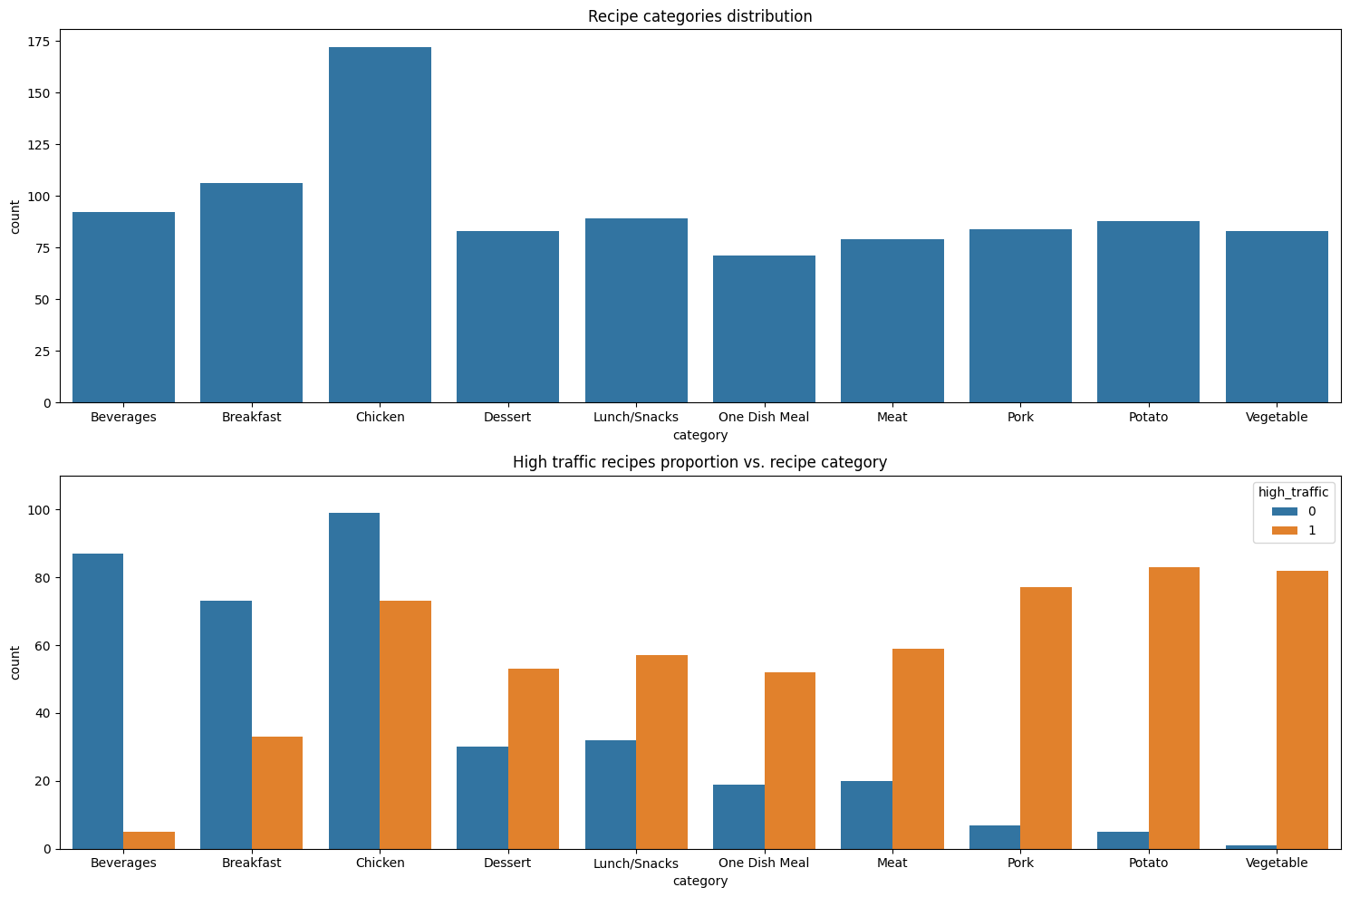
EDA: key findings
Category is the strongest predictor of high traffic
“Chicken” is the biggest category
The distribution of the categories is fairly homogenous, with the exception of “Chicken” class
very high proportion of high traffic recipes for “Vegetable”, “Potato” and “Pork”
very low proportion of high traffic recipes for “Beverages”, “Breakfast” and “Chicken”

Slide 5
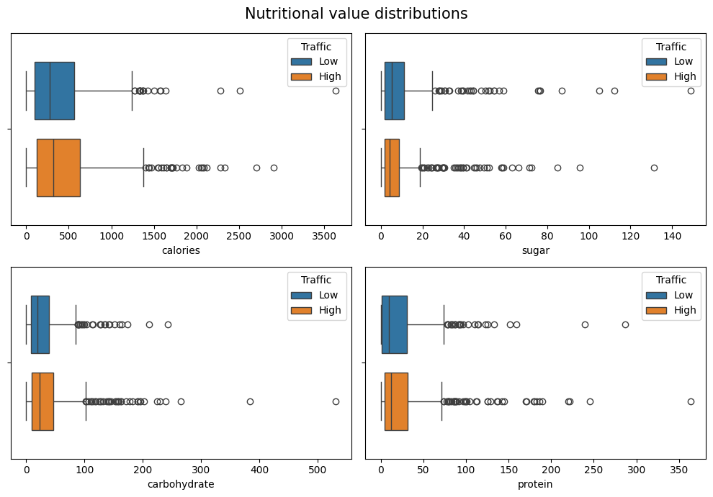
EDA: key findings
Nutrients alone don’t correlate with high traffic recipes
Distribution of each nutrient doesn’t differ between the high and low traffic recipes in a significant way
Every distribution has a substantial amount of outliers, which indicates strong skewness

Slide 6
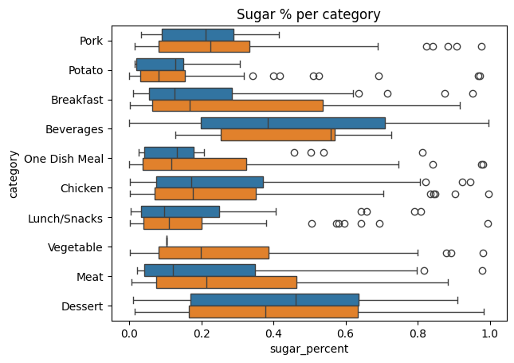
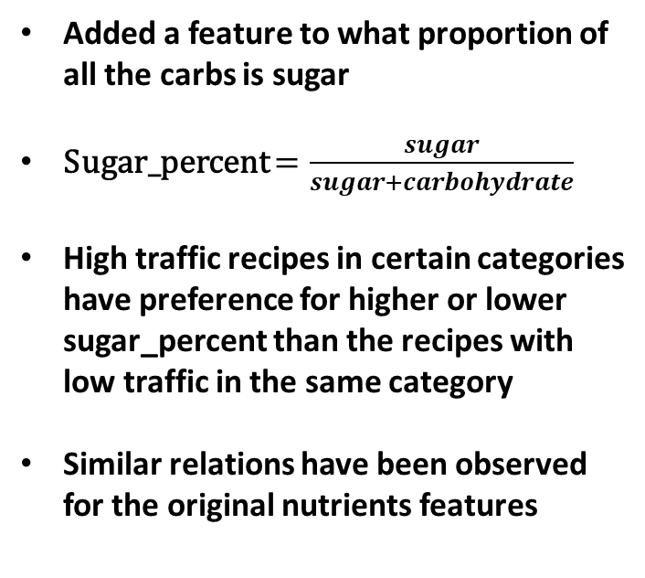
EDA: key findings
Feature engineering: sugar percentage
Added a feature to what proportion of all the carbs is sugar
Sugar_percent $=\frac{sugar}{sugar+carbohydrate}$
High traffic recipes in certain categories have preference for higher or lower sugar_percent than the recipes with low traffic in the same category
Similar relations have been observed for the original nutrients features

Slide 7
Modelling
Problem: binary classification
Features
recipe
calories
carbohydrate
sugar
protein
category
servings
sugar_percent
Traffic
high
low
Models
Logistic Regression
Decision Tree
Traffic
high
low

Slide 8
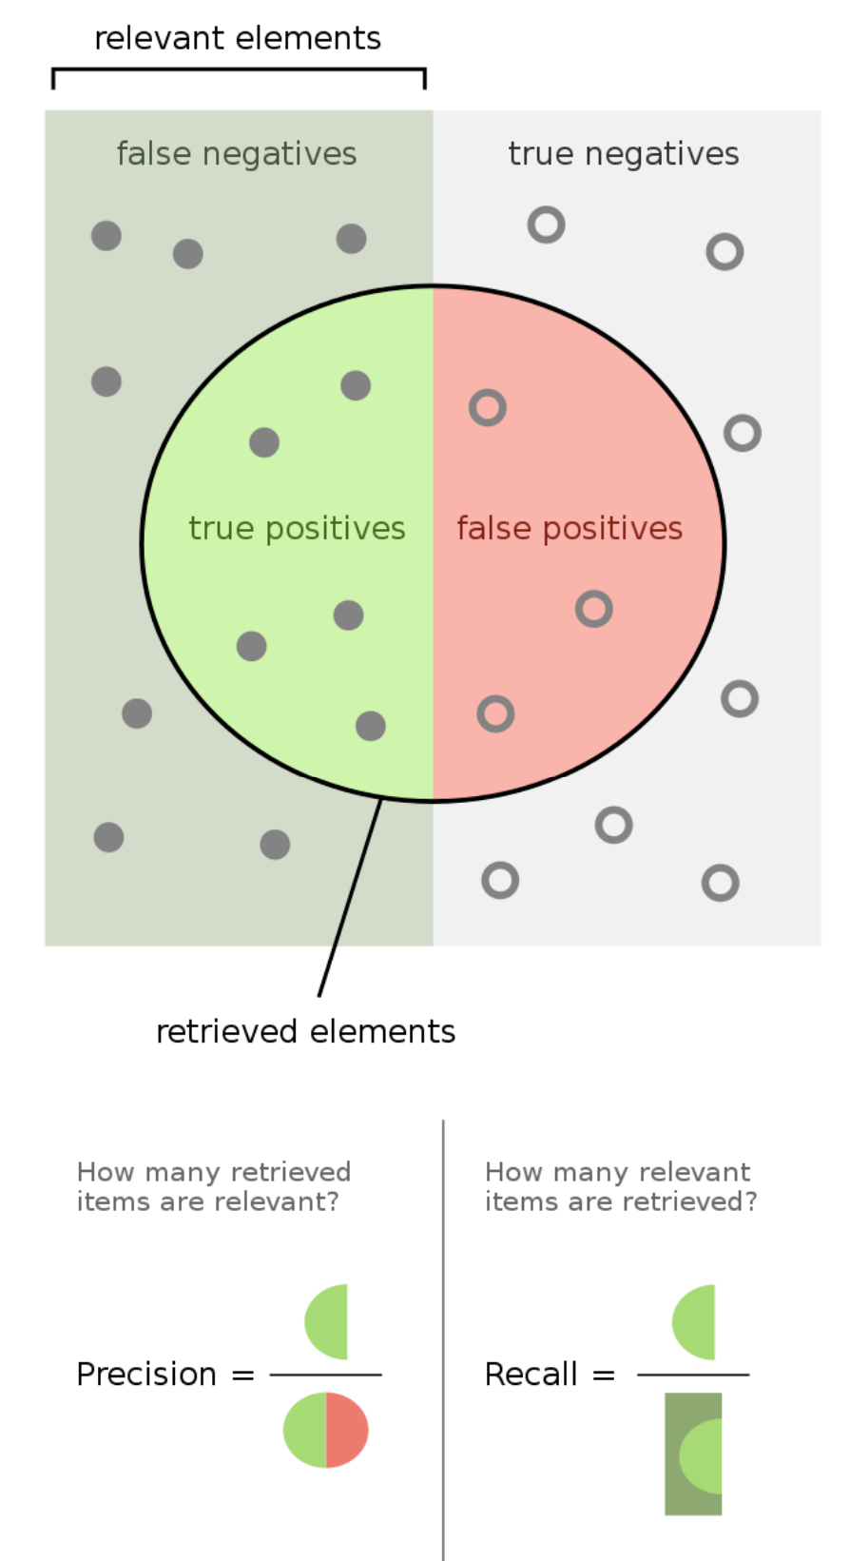
Modelling: KPI
Business requirement: precision at least 80%
Precision alone can be misleading.
What needs to be traced as well is recall.
Precision: wants to minimize false positives
Recall: wants to minimizes false negatives
How to find balance between these 2 important metrics?

Slide 9

Modelling: KPI
Business requirement: precision at least 80%
metrics | Purpose
precision | Business requirement
F1 score | Balance between precision and recall – our choice for a KPI
$$F_{1}=2 \frac{precision ∗recall}{precision+recall}$$
Maximizes both precision and recall
1 -> precision AND recall are 1
0 -> precision OR recall is 0
KPI metric:
F1 score (with at least 80% precision)

Slide 10
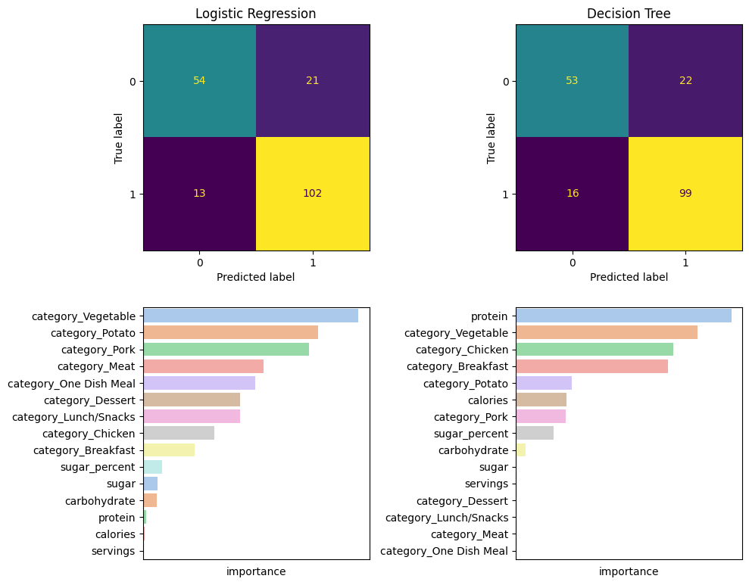
Modelling: results
Results
model | precision | recall | f1
Logistic Regression | 0.83 | 0.89 | 0.86
Decision Tree | 0.82 | 0.86 | 0.84
Logistic Regression performed better in all the measured metrics.
The confusion matrices show that the 2 models are comparable, however, Logistic Regression is consistently better

Slide 11
Modelling: results
Logistic Regression feature contributions
As expected, category dominated the feature importance distribution
The engineered feature is 2nd in importance, however, with way less impact than the category features.
Calories and servings impacted the outcome of the model the least
category
Engineered feature
nutrients

Slide 12
Conclusions and recommendations
Conclusions:
EDA:
“Categories” is the most indicative feature. Post the popular categories and limit the unpopular ones.
Modelling:
89% recall - 9/10 recipes that can generate high traffic are selected
83% precision - 8/10 high traffic recipe predictions are correct
Recommendations:
Deploy the provided model on the website
Use A/B testing to see its impact on the website traffic
Future steps:
Work on better data collection and more complete dataset
Add more features visible for the website’s customers that are not in the dataset
Work on clearer and less ambiguous categories. We recommend a tag system.

