Slide 1
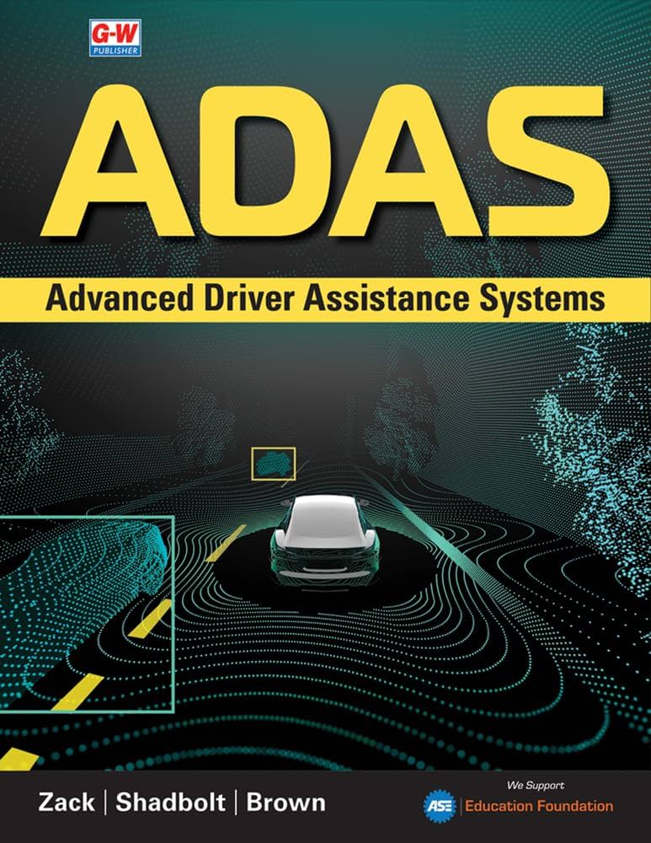
Advanced Driver Assistance Systems (ADAS)
A Presentation on ADAS - Principles, Working & Applications
Course: IoT & Applications
Instructor: Dr. Rakesh Chowdhury
(Department of Electrical and Electronics Engineering)
By: Jaisurya Vetrivel
2023-BEE-016
Page 1

Slide 2

Advanced Driver Assistance Systems (ADAS)
The ADAS are a collection of passive and active safety systems designed to remove the human error when operating vehicles. Hence, ADAS uses advanced technologies to assist the driver during driving and hence improve user performance.
The role of ADAS is to prevent deaths by reducing the number of car accidents and the serious impact of those which cannot be avoided. 90% of road accidents occur due to human error.
ADAS uses a wide variety of sensors to perceive the world around it and then either provides information to the driver or takes automatic action based on what it perceives.
The modernization of ADAS is the first steps towards realizing autonomous vehicles.
Page 2
Notes:
1

Slide 3
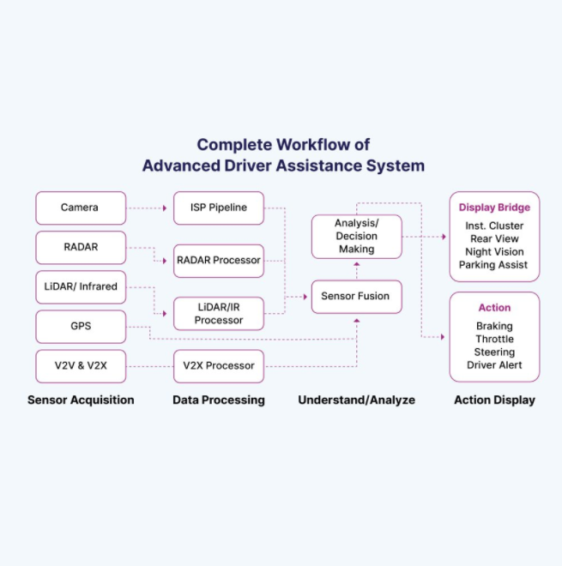
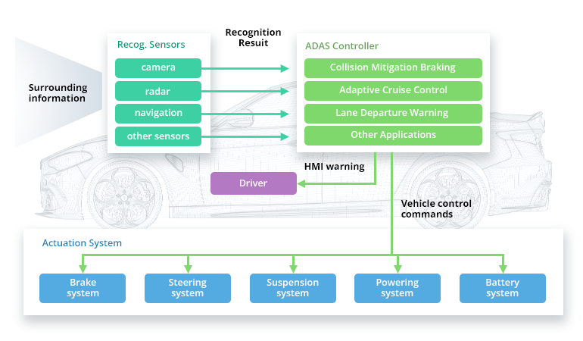
How does ADAS work?
Modern cars use a variety of technologies to gain 360-degree vision. The ADAS consists of sensors, SoCs (System on a Chip), interface and a processor that integrates all of the data and makes decisions in real-time.
ADAS uses sensor fusion - combines data from multiple sensors like camera, radar, LiDAR to produce more accurate and reliable than a single sensor can provide alone. This is then used to make decisions and alert the driver or take some action by itself.
The basic notion of ADAS is that it augments humans sensory and cognitive functions: eyes, ears and decision making. For example, humans cannot see in the dark but radar can, hence it can be used to see in the dark.
Page 3
Notes:
3

Slide 4
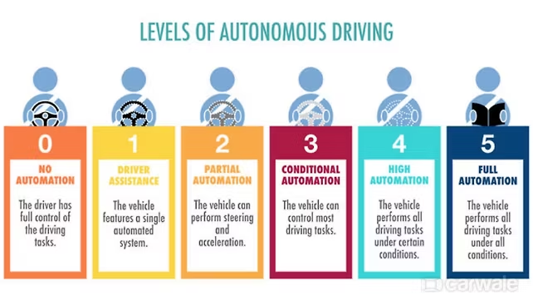
ADAS Levels
The ADAS levels are categorized based on the degree of automation, classified by the Society of Automotive Engineers (SAE), a professional association and standards organization for aerospace and automotive engineering.
Level 0: No automation, driver is entirely responsible for managing the vehicle.
Level 1: Vehicle has atleast one driver support system either steering or acceleration/braking but not both.
Level 2: Vehicle can perform steering and acceleration. The driver still monitors all tasks and take control at any time. Most modern cars lie in level 2.
Level 3: Drives itself in particular conditions, the driver may need to supervise if the vehicle asks.
Level 4: Restricted to point-to-point driving by geofencing technology
Level 5: Completely autonomous, no driver intervention needed at all.
Page 4
Notes:
4

Slide 5

Adaptive Cruise Control (ACC)
Adaptive Cruise Control automatically adjusts vehicle speed to maintain a safe following distance from the vehicle ahead, using advanced radar technology, cameras and LiDAR.
How It Works?
Radar sensors continuously scan road ahead
Detects presence and speed of vehicles
Automatically adjusts throttle and brakes
Maintains preset following distance
Key Benefits
Reduces driver fatigue on long drives
Improves highway driving comfort
Enhances safety through consistent spacing
ACC Technology is present in Tesla 3, Honda Accord, Toyota Camry
Page 5
Notes:
5

Slide 6



Stability & Traction Control Systems
Traction Control System (TCS)
Electronic Stability Control (ESC)
Crosswind Stabilization
Prevents wheel slip during acceleration by monitoring wheel rotation speeds and reducing engine power or applying brakes to slipping wheels. Improves grip on wet, icy, or loose surfaces.
Prevents vehicle skidding and loss of control by detecting oversteer or understeer conditions. Automatically applies brakes to individual wheels and adjusts engine power to maintain directional stability.
Detects strong side winds using sensors and compensates by applying selective braking to wheels on the windward side. Maintains vehicle trajectory and reduces driver correction effort.
Result: Significantly improves vehicle control in challenging driving conditions, reducing accident risk.
Some cars which include these ADAS mechanisms: BMW 3 Series, Mercedes Benz E-class, etc.
Page 6
Notes:
6

Slide 7

Parking Assistance Systems
By just a single press of a button, a car can get parked on its own without much human intervention.
Parking Assist
Uses ultrasonic sensors and cameras to detect parking spaces and guide the driver through steering inputs. Automatically calculates optimal steering angles and provides visual and audible guidance.
Rearview Camera
Provides real-time video view behind the vehicle on the dashboard display. Essential for preventing reversing accidents and detecting obstacles, children, or pets in the path.
Omniview Technology
Combines feeds from multiple cameras around the vehicle to create a seamless 360-degree bird's-eye view. Shows vehicle position relative to obstacles from above, eliminating blind spots.
Morris Garages, Ford Escape, Toyota Prius have Intelligent Parking Assistance systems present.
Page 7
Notes:
7

Slide 8
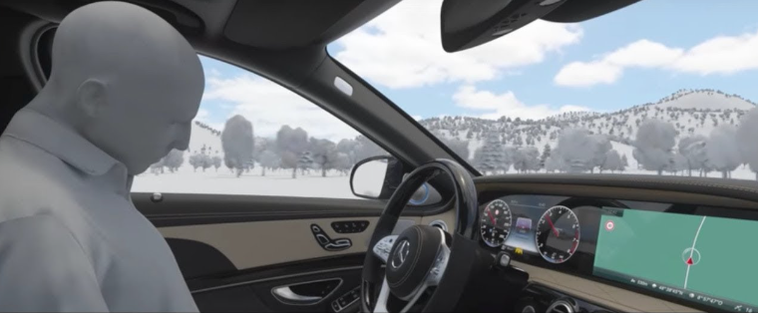
Driver Monitoring & Emergency Systems
Driver Emergency Stop Assist
Driver Emergency Stop Assist facilitates emergency counteract measures if the driver falls asleep or does not perform any driving actions like pressing the accelerator or brake or moving the steering wheel after a long time - sending audio & visual signals to alert the driver.
If the signals are not addressed, the system will make the car stop safely away from the oncoming traffic and turn on the emergency lights.
BMW 7 Series and Mercedes‑Benz S‑Class come with Active Emergency Stop Assist.
Page 8
Notes:
8

Slide 9
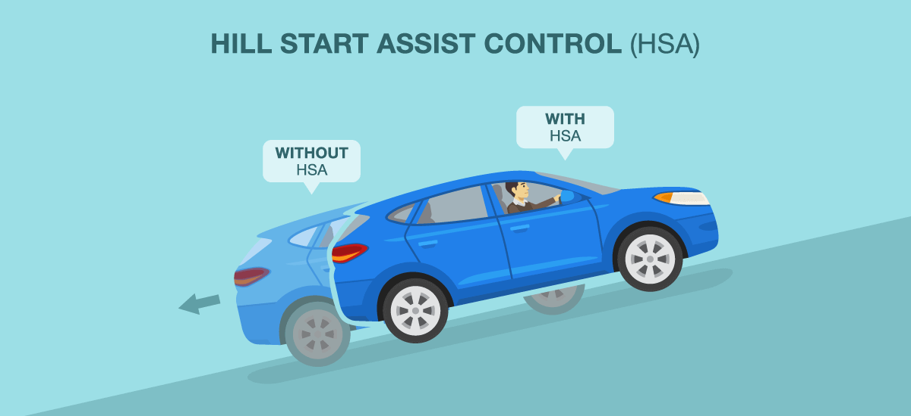
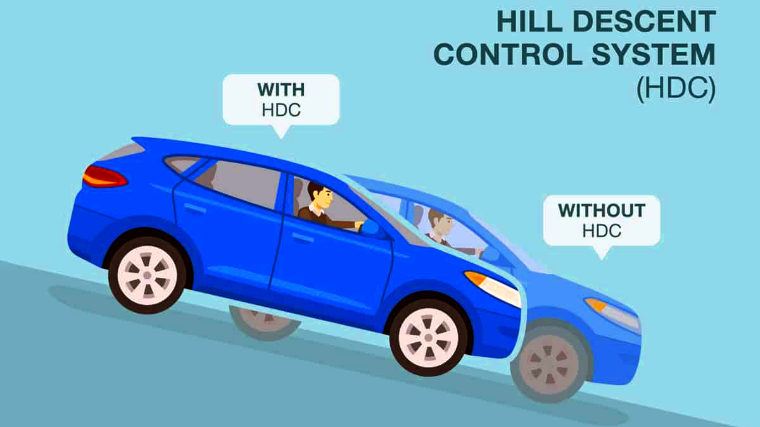
Hill Ascent and Descent Control
Hill Ascent Control
Hill Ascent Control helps a vehicle move smoothly uphill without rolling backward. When the driver releases the brake on a slope, the system briefly holds the brakes to prevent the car from rolling back. This gives the driver time to press the accelerator and move forward safely. It improves control and confidence when starting on steep inclines.
Hill Descent Control
Hill Descent Control helps maintain a controlled speed when driving down steep slopes. The system automatically applies the brakes to keep the vehicle from accelerating too quickly. This allows the driver to focus on steering instead of constantly braking. It is especially useful in off-road and mountainous driving conditions.
Page 9

Slide 10
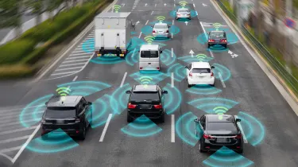



Lane & Collision Safety Systems
These critical safety systems work together to prevent lane departure and collision accidents through continuous monitoring and automated interventions.
Lane Assist
Collision Avoidance System
Detects lane markings using cameras and monitors vehicle position. Warns driver with visual, audible, or haptic alerts if vehicle drifts from lane without signal. Gently corrects steering to keep vehicle centered.
Continuously scans road ahead using radar and cameras. Detects potential collisions with vehicles, pedestrians, or obstacles. Provides escalating warnings and can pre-charge brakes for faster response.
Automatic Emergency Braking (AEB)
Applies brakes automatically when high collision risk is detected and driver has not responded. Reduces accident severity or prevents collisions entirely. AEBs are most effective at urban speeds.
This feature is present in Tesla Model Y as Autosteer and in Honda Civic cars. Modern Toyota Corolla have Pre-Collision systems built-in.
Page 10
Notes:
9

Slide 11
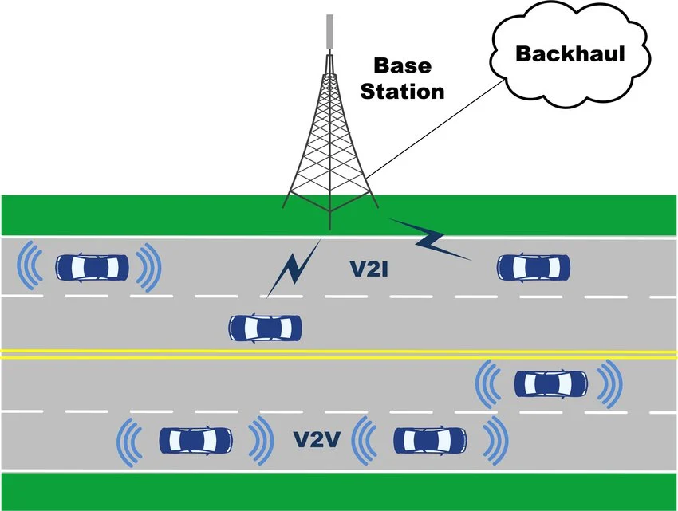
Vehicular Communication System
These systems are computer networks in which vehicles and roadside units are communicating nodes providing safety warning, traffic information and other essential information to each other. They come in 3 types:
V2V — Vehicle to Vehicle
V2I — Vehicle to Infrastructure
V2P — Vehicle to Pedestrian
Example:
A vehicle can warn another car ahead about sudden braking or road hazards (V2V).
Luxury cars like Cadillac CTS have built-in V2V communication systems.
Page 11

Slide 12
Vision, Display & Intelligent Driving Systems
Vision & Display Systems
Intelligent Driving Systems
Vision and Display Systems help the driver in perceving vision in extreme situations, mentioned below:
IDS represent the integration of advanced sensors, AI and control algorithms to enhance vehicle safety, comfort, and autonomy
Automotive Head-Up Display
Traffic Sign Recognition
Camera reads traffic signs including speed limits, stop signs, and warnings. Displays current speed limit and alerts when exceeded.
Projects critical driving information onto windshield, allowing driver to keep eyes on road instead of looking down. Displays speed, navigation, warnings without looking down.
Automotive Night Vision
Intelligent Speed Adaptation
Uses infrared cameras to detect pedestrians, animals, and obstacles in darkness. Extends visibility beyond headlight range with thermal imaging.
Automatically adjusts vehicle speed based on recognized speed limits. Can prevent speeding and adapt to changing zone limits.
Adaptive Light Control
Automotive Navigation
GPS-based route guidance with real-time traffic updates, congestion alerts, and optimal routing. Integrates with vehicle systems for enhanced driving experience.
Automatically adjusts headlight direction and intensity based on steering and conditions. Prevents blinding oncoming traffic while maximizing illumination.
Page 12
Notes:
10

Slide 13
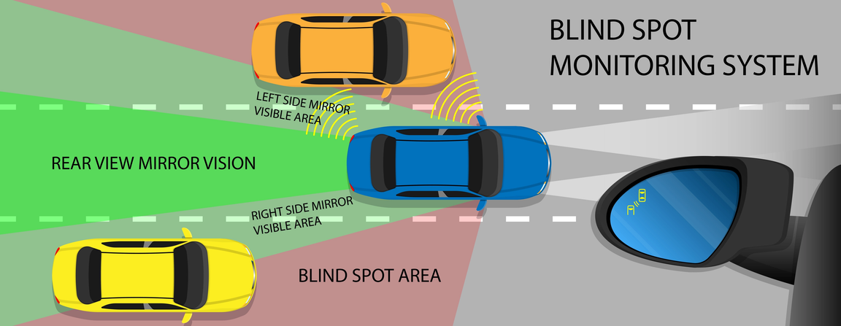
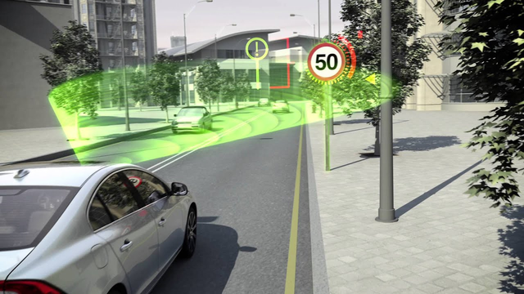
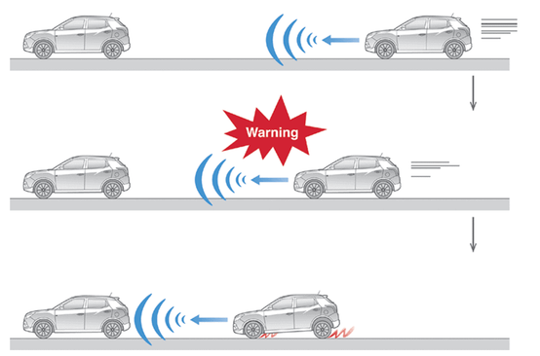
Other ADAS Features
Some other ADAS systems are mentioned here below:
Blind Spot Monitoring: Detects vehicles in the driver’s blind spots using sensors. It alerts the driver during lane changes to prevent collisions.
Omniview Technology (360° Camera System): Uses multiple cameras to provide a 360° bird’s-eye view around the vehicle. It helps drivers park and maneuver in tight spaces safely.
Traffic Sign Recognition (TSR): Uses cameras to detect and read road signs such as speed limits and warnings. The information is displayed on the vehicle’s dashboard.
Rearview Camera: Displays a live video of the area behind the vehicle while reversing. It helps the driver see obstacles and avoid accidents.
Automatic Emergency Braking (AEB): Detects potential collisions using sensors, radar, or cameras. The system first warns the driver if an obstacle or vehicle is detected ahead. If the driver does not react in time, it automatically applies the brakes to prevent the crash or reduce its impact. This feature significantly improves road safety and reduces accident severity.
Traffic Sign Recognition
AEB
Page 13

Slide 14
Conclusion & Future of ADAS
Conclusion:
The Advanced Driver Assistance Systems significantly reduce road accidents by minimizing or even completely eliminating human errors through real-time automated safety features. Hence, these have gained popularity among buyers and even governments to necessitate some basic ADAS features to be present in every modern vehicles.
ADAS lays the technological foundation for the autonomous vehicles of tomorrow. The technological advancement and modernization of Advanced Driver Assistance Systems paves the way for complete self-driving cars.
ADAS combines technologies and domains ranging from Electronics, IoT, Computer Science, Networking and Automative Engineering to create intelligent vehicles.
Future of ADAS
Greater use of AI and machine learning for better object detection and decision-making as AI increasingly finds its way in ADAS.
Expansion of connected vehicle technologies (V2V and V2I communication) for better networking.
More advanced sensor fusion using radar, cameras, and LiDAR.
Gradual transition toward higher levels of vehicle automation and self-driving cars and one day completely realize a self-driving cars without much restrictions.
Page 14

Slide 15
References
YouTube - ADAS | Every ADAS Level Explained: https://www.youtube.com/watch?v=EiWl5PAtfYA
What is ADAS? Ansys: https://www.ansys.com/simulation-topics/what-is-advanced-driver-assistance-system-adas
Wikipedia: https://en.wikipedia.org/wiki/Advanced_driver-assistance_system
Mercedes S-Class Features: https://www.mercedes-benz.co.in/passengercars/models/saloon-long/s-class/overview.html
BMW 7 Series Features: https://www.bmw.in/en/all-models/7-series/7-series-sedan/bmw-7-series-sedan.html
Page 15

Slide 16

Page 16

