Slide 1
Sinhgad Institute of Technology, Lonavala Department of Computer Engineering
LP -IV Mini Project
on
Form Data Encryption using
Cloud Computing
Presented by-
Shyam Bodke(BCC55)
Ajinkya Mistry(BCC51)

Slide 2
Index
Topics | Page No.
Introduction | 3
Objectives | 4
Methodology | 5
Architecture | 6
Data structure and Algorithm | 8
Implementation | 9
Results | 11
Applications | 15
Conclusion | 16

Slide 3
Introduction
Exponential growth in technology made computation easy and cheap which in return increase rate of data generation. Storage and managing this huge data requires a lot of resourses which are expensive and can not be brought by small sacale companies or indivisuals. This problem is solved by invention of cloud computing which allows companies or any indivisuals to buy service‘s they want by paying a fees according to usage.This makes whole process of setting up and manging resources.
But this this huge data should be secure and easily accessible too. Traditional ways exposes data stored in server to the persons who are in authorization to manage the database,which violets the data privacy policy.
To solve this problem we came up with the idea of encoding data before saving on database server and decode it to authorize user only.

Slide 4
Objectives
Develop an app to encode data before saving on database server and decode it to authorize user only.

Slide 5
Methodology
We will encryt form data using PHP code and then after we will store into Mysql table. When we want to show data to user at that time we will decrypt that encrypted string by using PHP script and display on web page.
So, it is called two way encrypt and decrpt string using PHP script. For encryption and decryption string in PHP we have used popular AES-256 alogorithm.

Slide 6
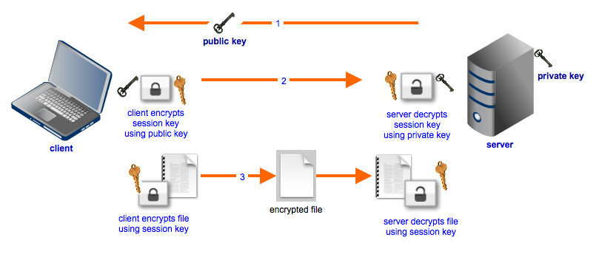
Architecture
Fig No. 1

Slide 7
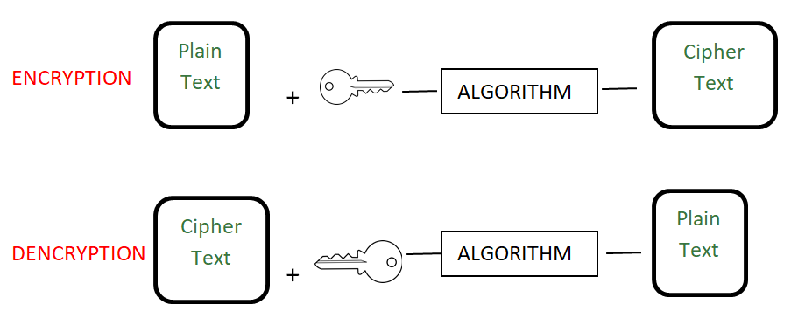
Fig No. 2

Slide 8
Data Structure And Algorithm Used
Data Structure :- Basic Data Types such as array, int,string etc.
Algorithm :- AES-256 . AES-256, which has a key length of 256 bits, supports the largest bit size and is practically unbreakable by brute force based on current computing power, making it the strongest encryption standard. Encryption is one of the most common ways to protect sensitive data. Encryption works by taking plain text and converting it into cipher text, which is made up of seemingly random characters. Only those who have the special key can decrypt it. AES uses symmetric key encryption, which involves the use of only one secret key to cipher and decipher information.

Slide 9
Implementation
We implemented two way encryption and decryption of Encrypted string. That means once we will store form data in encrypted form and then after whenever we want to display that encrypted string on their original format at that time we will decrypt that encrypted string by using PHP script and display on web page. For encryption and decryption string in PHP we have use different PHP encrypt method like AES-256-CBC. We have also use PHP hash() function for make encrypted string.
We have also use different PHP function like openssl_encrypt() function for convert string to encrypted form and after this we have use base64_encode(). By using this both function we can encrypt string. For decrypt string we have use base64_decode() function and openssl_decrypt() function for decrypt encryted string.

Slide 10
For Two way encryption and decryption in PHP depends on encryption key and initialization vector. If we have lost this two key then we cannot decrypt encrypted string. So string encryption is depends on this two keys. Main implementation consists of simple Insert, Update, Delete and Select data example by using PHP script with Ajax jQuery.
First we will fetch encrypted data from Mysql table and convert into normal string and display on web page in jQuery Data tables. After this we will Insert form data into Mysql table. So for this we will encrypt form data and insert into Mysql table. Then after we want to update, so update first we want to fetch single user encrypted data and decrypt and display in form field. For this all crud operation we have use PHP Script with Ajax Jquery.

Slide 11
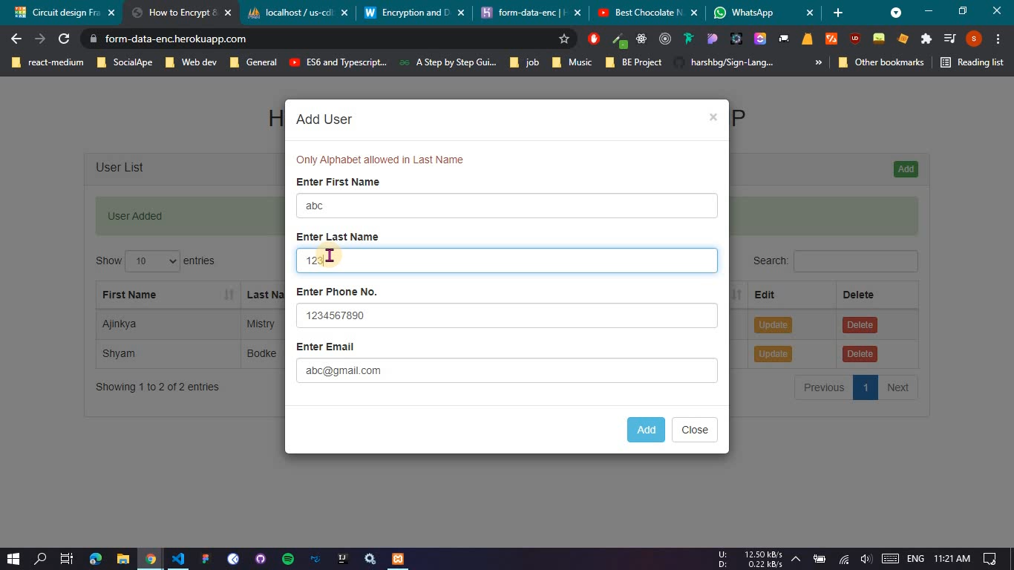
Results

Slide 12
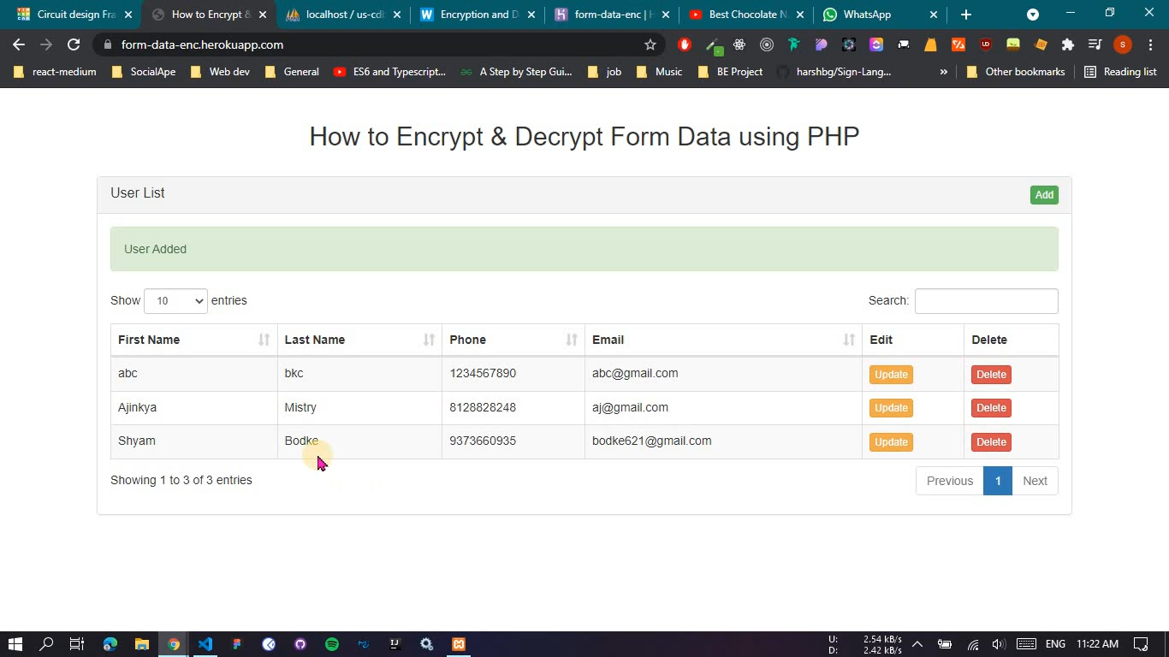

Slide 13
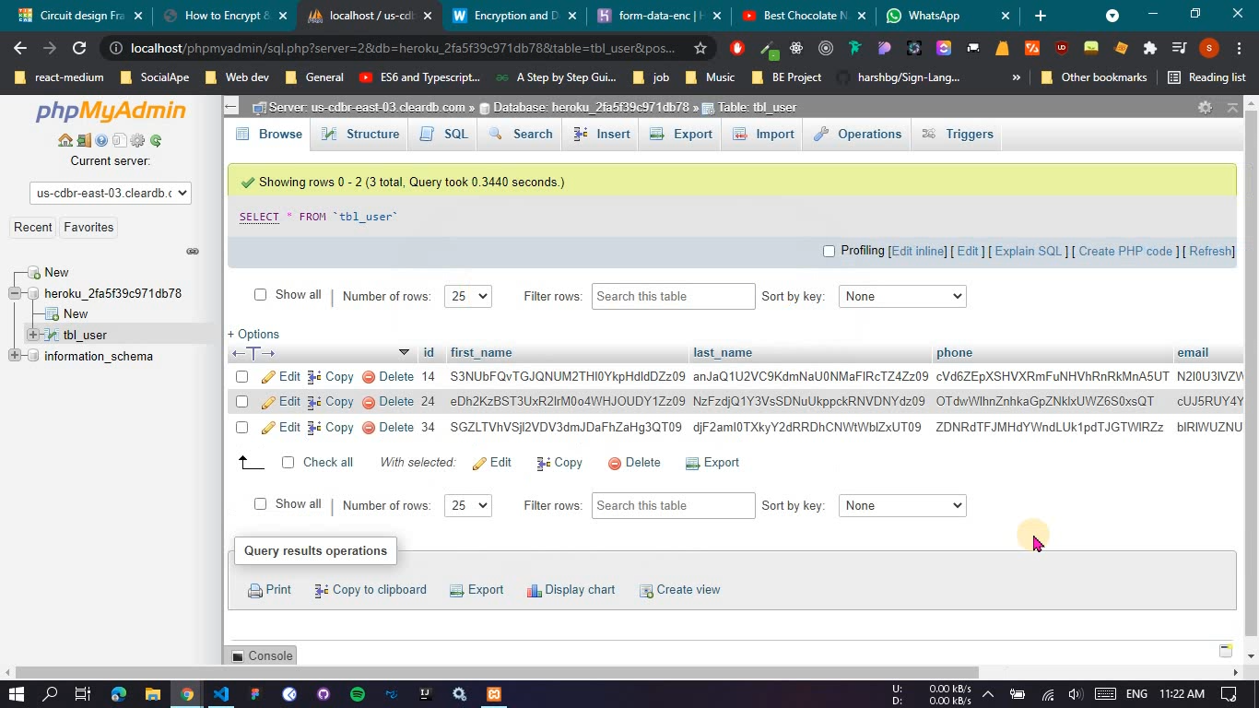

Slide 14
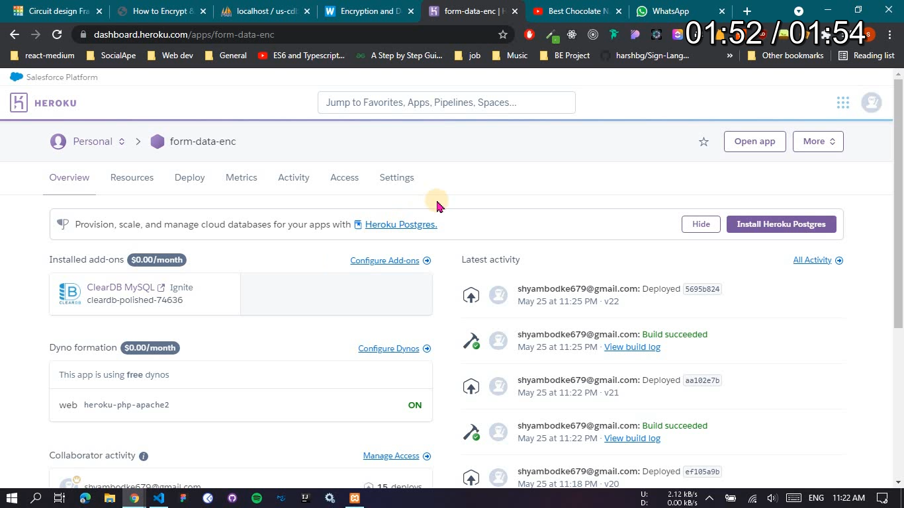

Slide 15
Applications
Cybercriminals are always on the prowl, looking for weak links to break and crack. How can users, especially in this increasingly connected world, have complete assurance that their data is safe, wherever it may be located?
Encryption is one of the most common ways to protect sensitive data. Encryption works by taking plain text and converting it into cipher text, which is made up of seemingly random characters. Only those who have the special key can decrypt it. AES uses symmetric key encryption, which involves the use of only one secret key to cipher and decipher information.
Lot of newbie programmers simply store their data in string format which is not advisable. So, We can expand this project to various applications which rely on data heavily to protect user privacy and prevent security lapses.

Slide 16
Conclusion
We implemented two way form data encryption and decryption using web technologies PHP,AJAX etc. by AES.
Also Deployed it to Heroku Cloud Architecture.

Slide 17
Thank You

