Slide 1


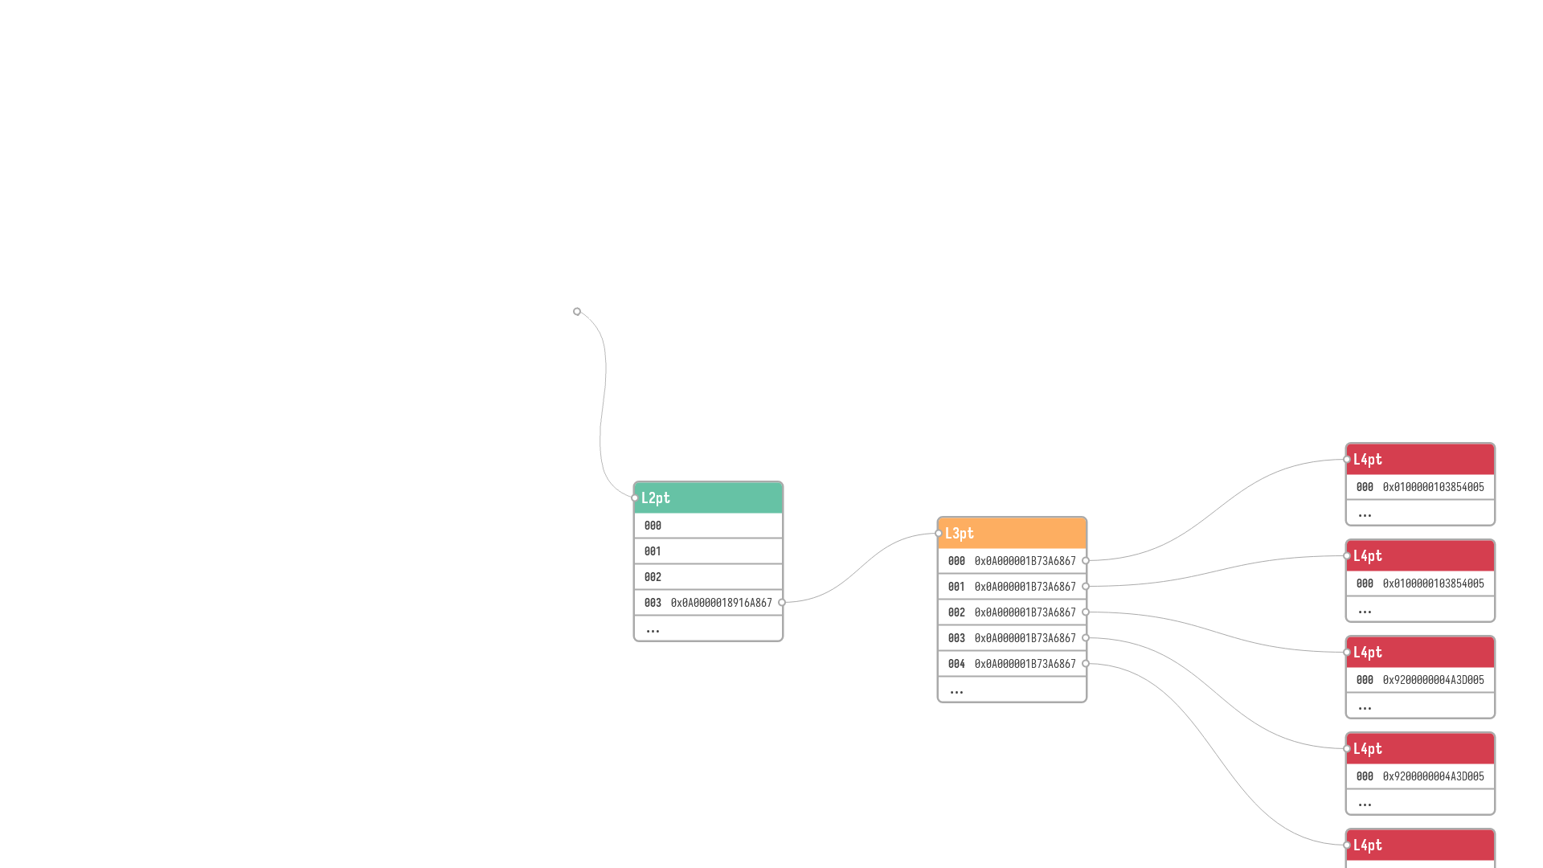
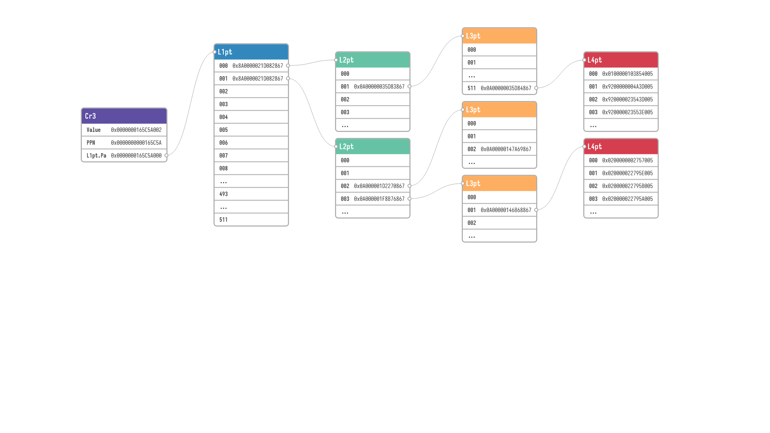
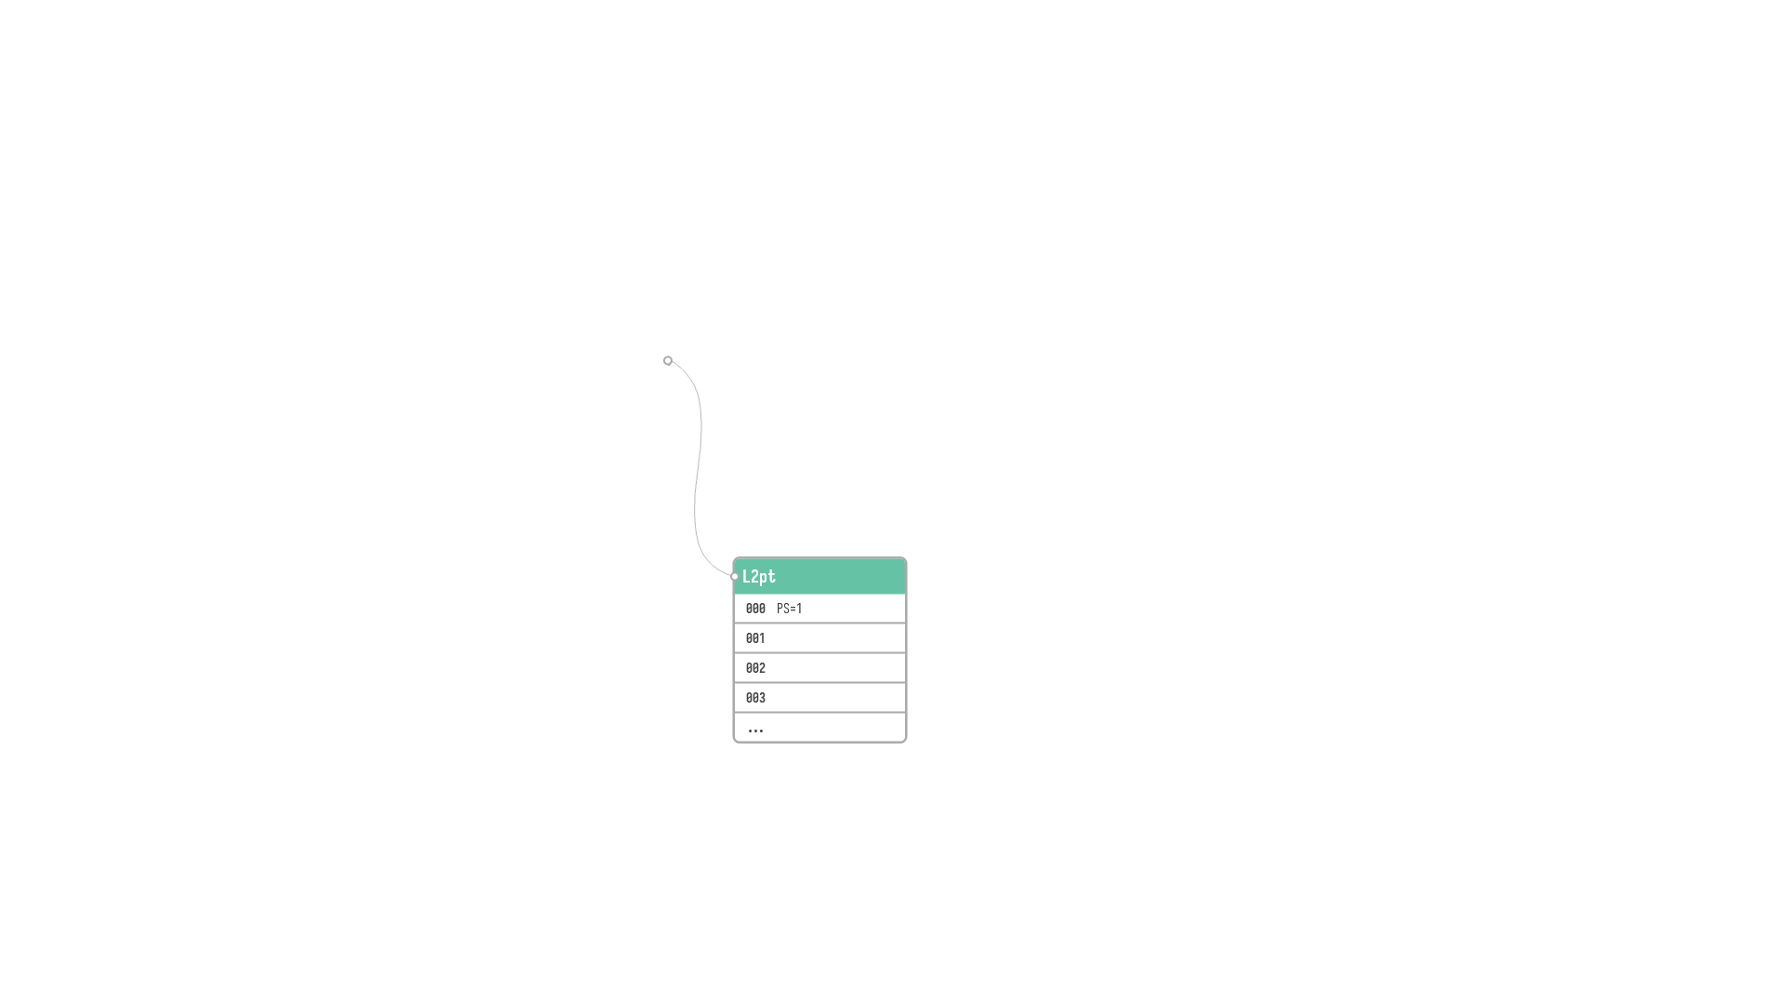

Slide 2
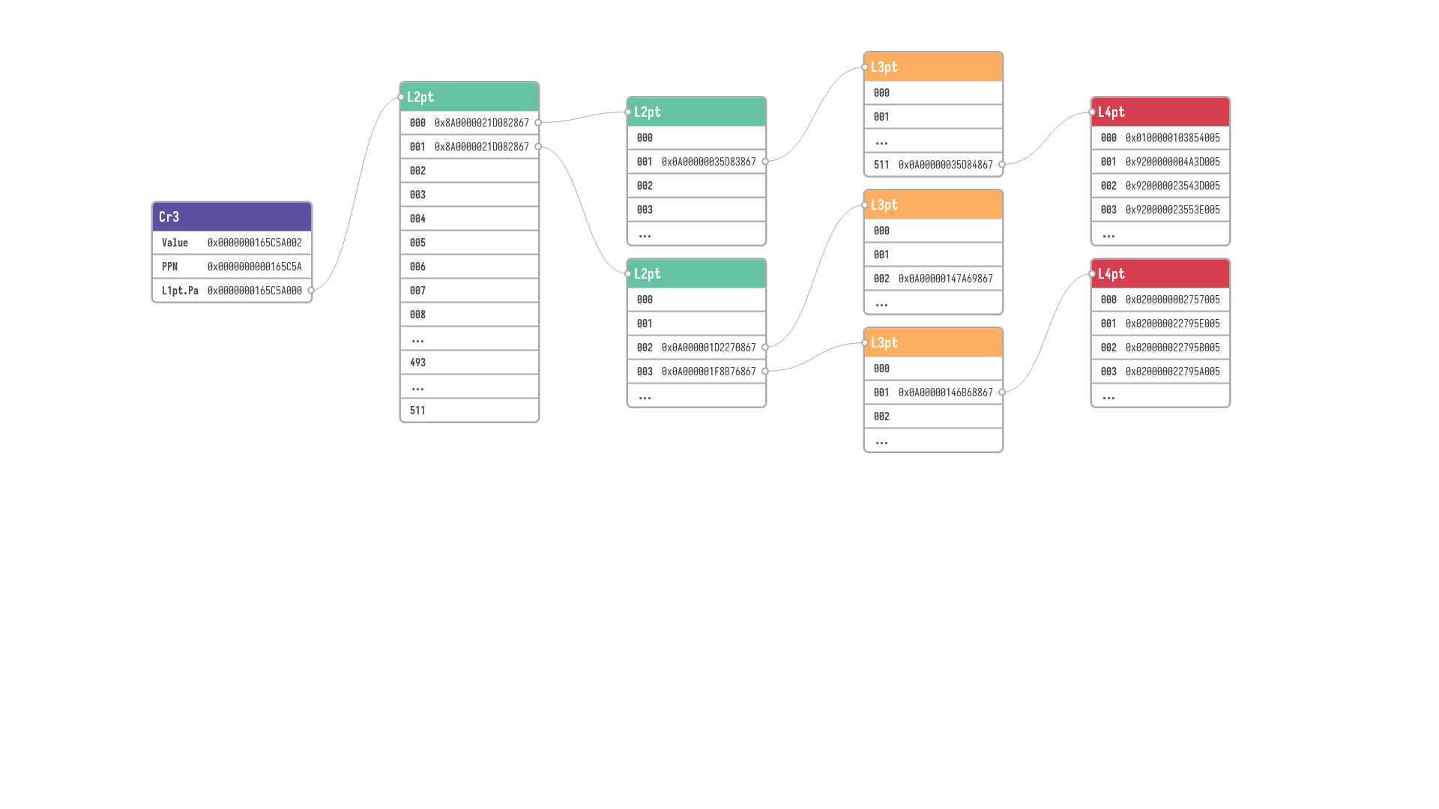

VPN1
 |  |  |  |  |  | VPO
L1pt.Va= | SEXT | VPN1 | VPN2 | VPN3 | VPN4 | 0
 |  | VPN1 | VPN2 | VPN3 | VPN4 | VPO
L1pt.Va= | SEXT | 493 | 493 | 493 | 493 | 0
L1pt.Va= | SEXT | VPN1 | VPN2 | VPN3 | VPN4 | VPO

Slide 3
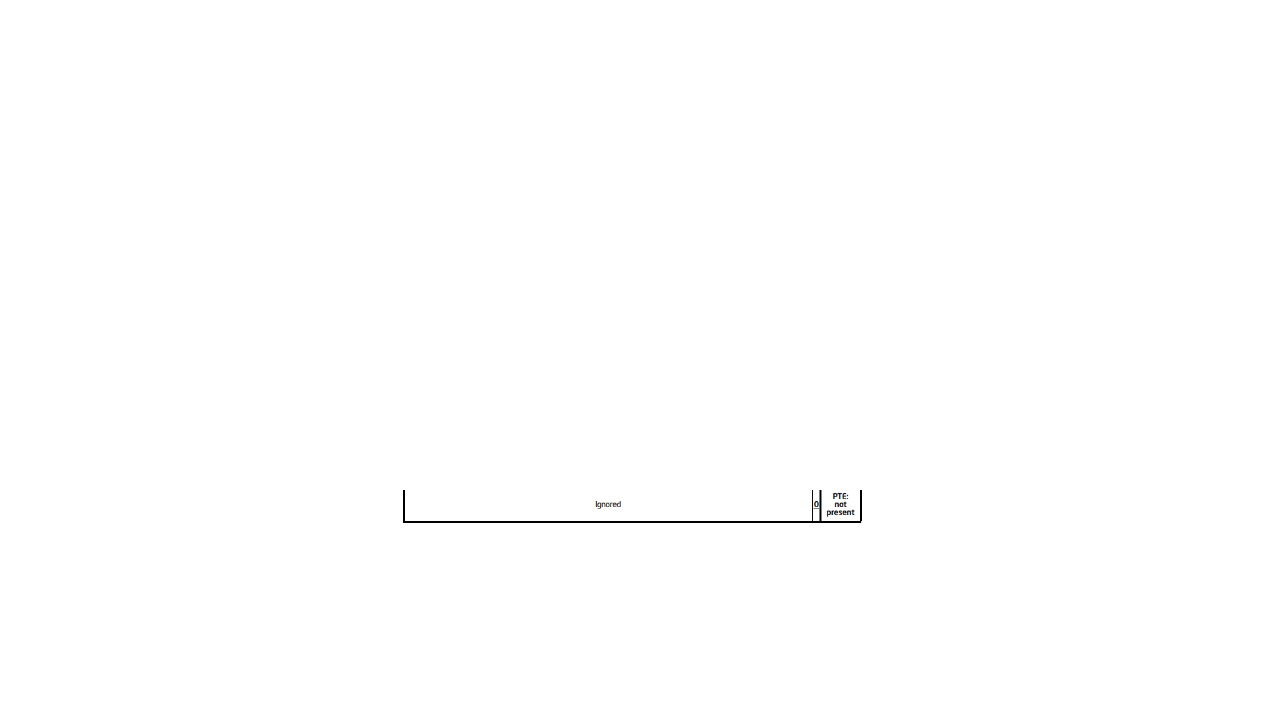
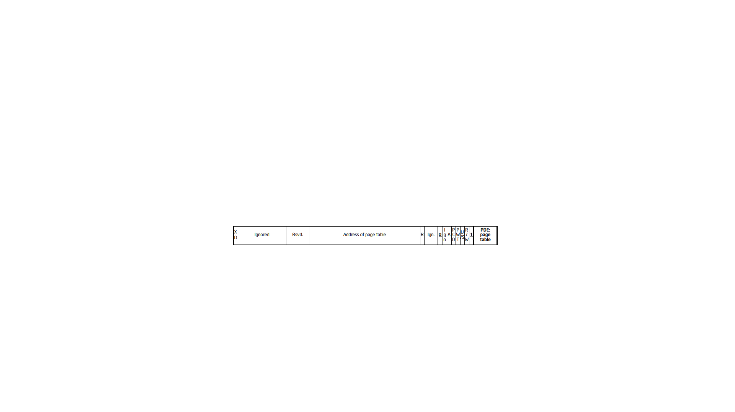


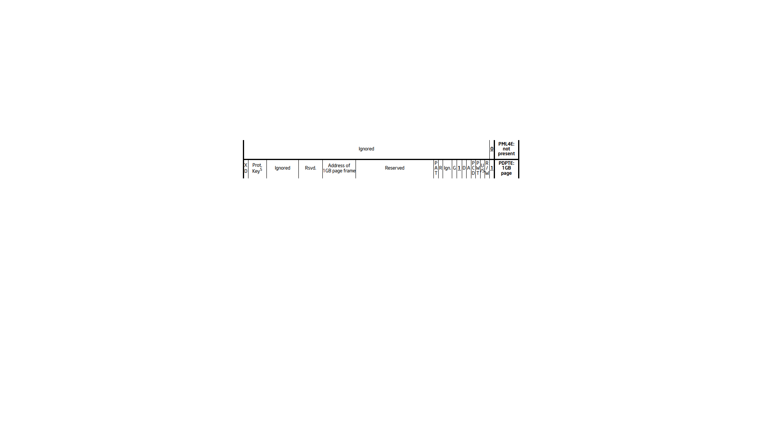
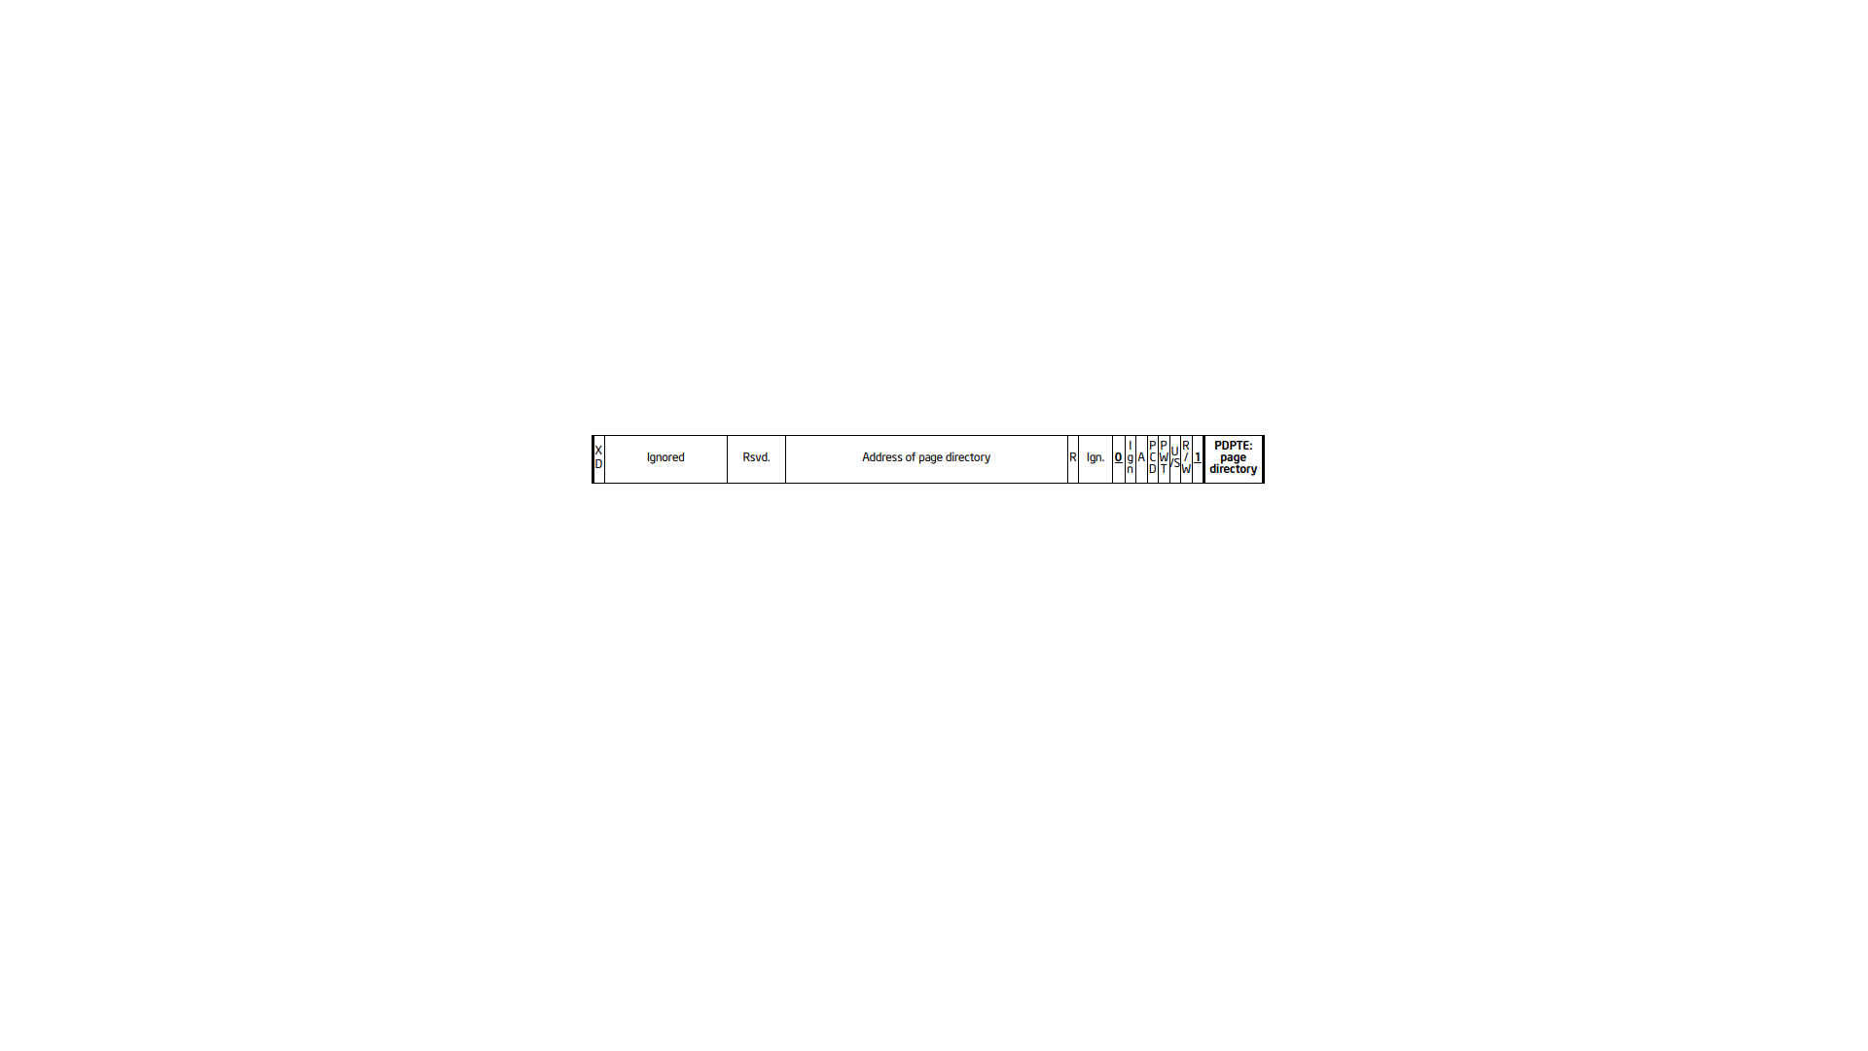
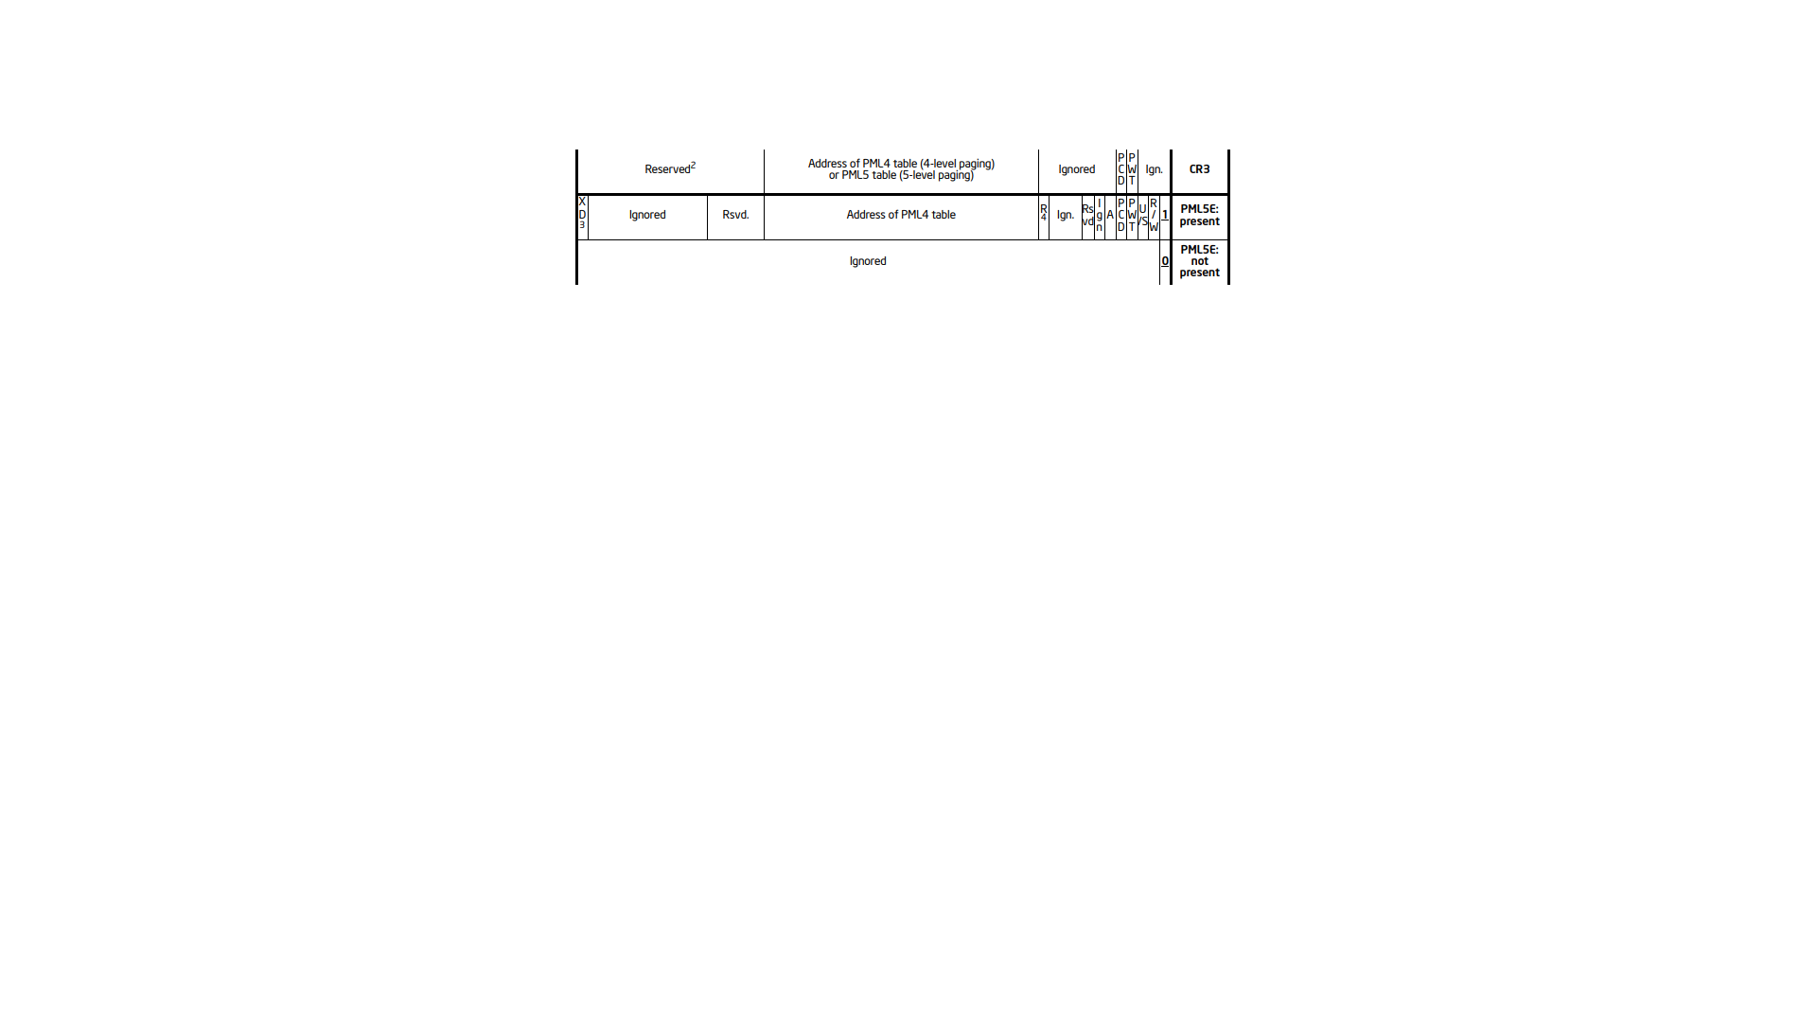
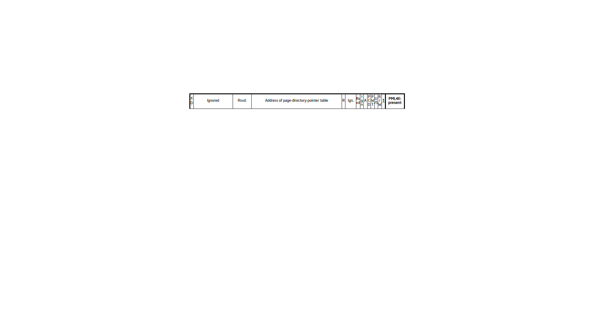
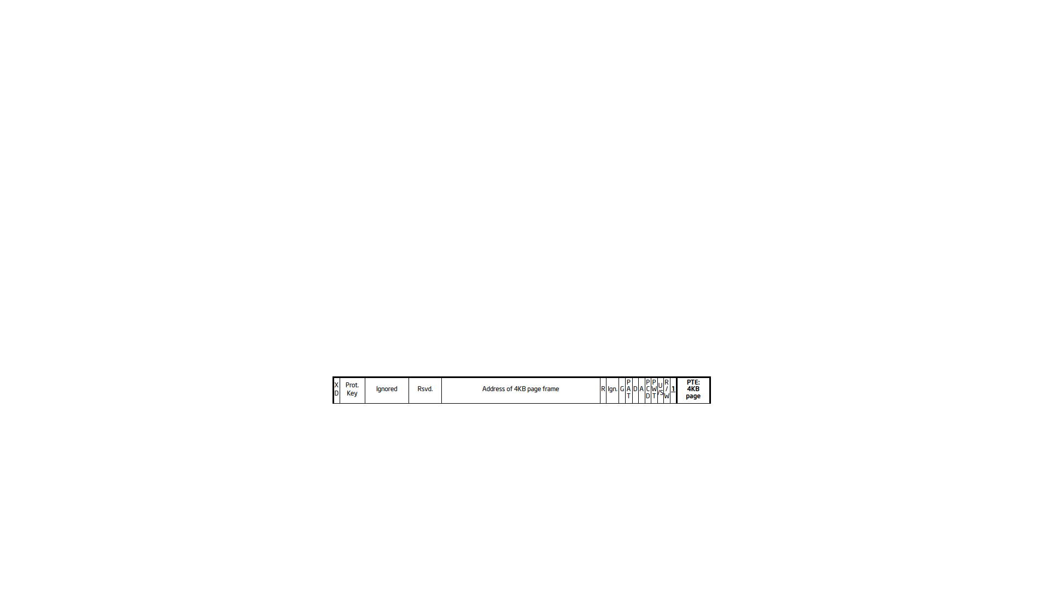

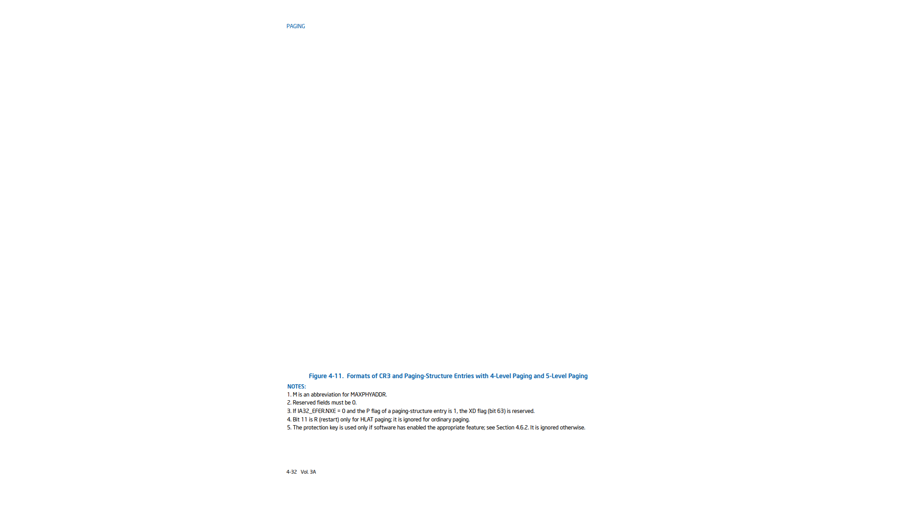
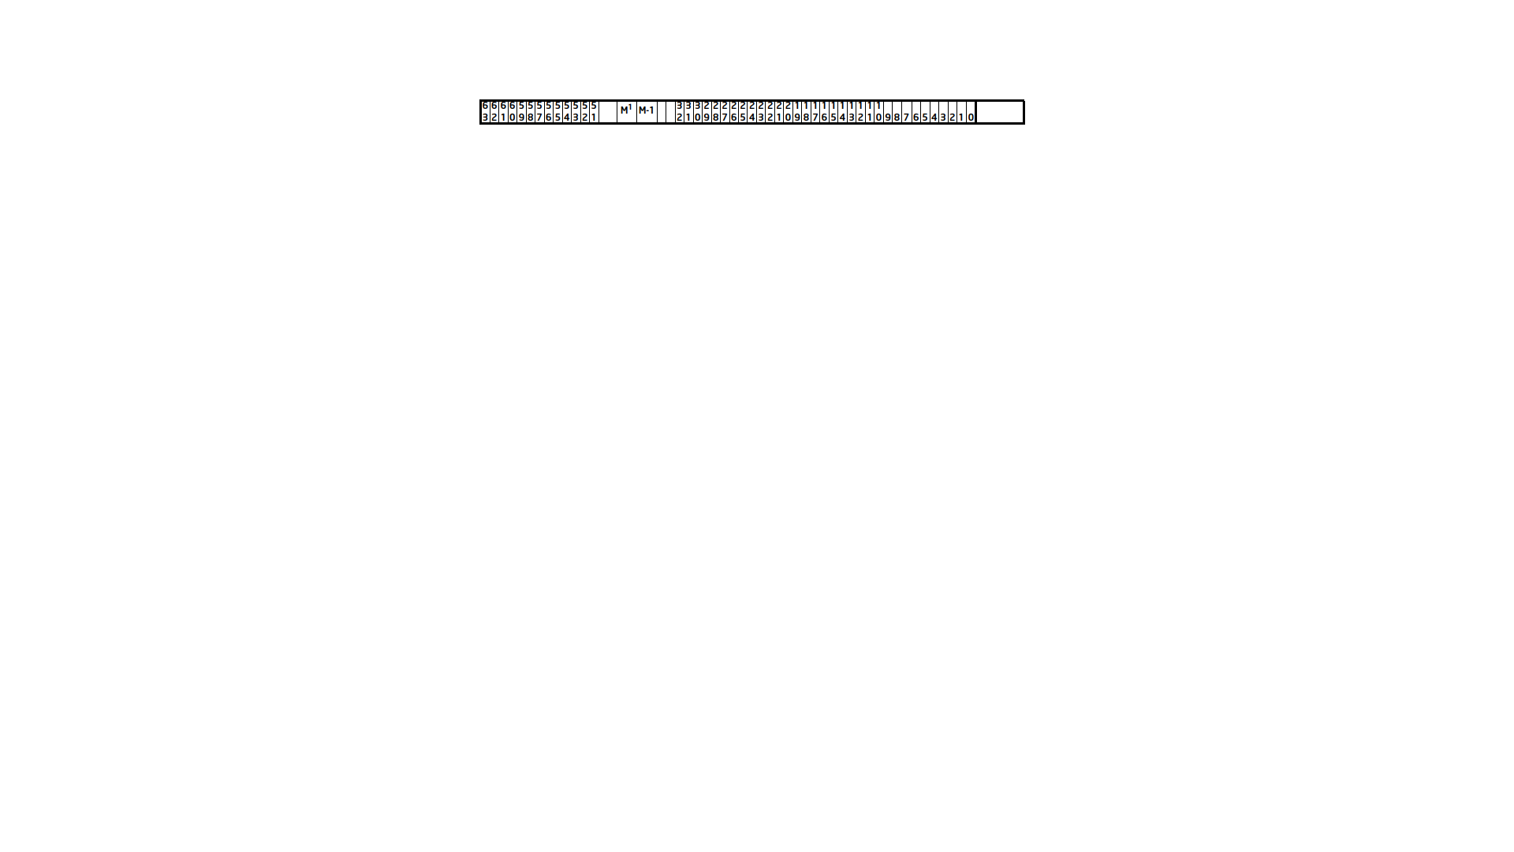
 |  | VPN1 | VPN2 | VPN3 | VPN4 | VPO
L1pt.Va= | SEXT | 493 | 493 | 493 | 493 | 0

Slide 4
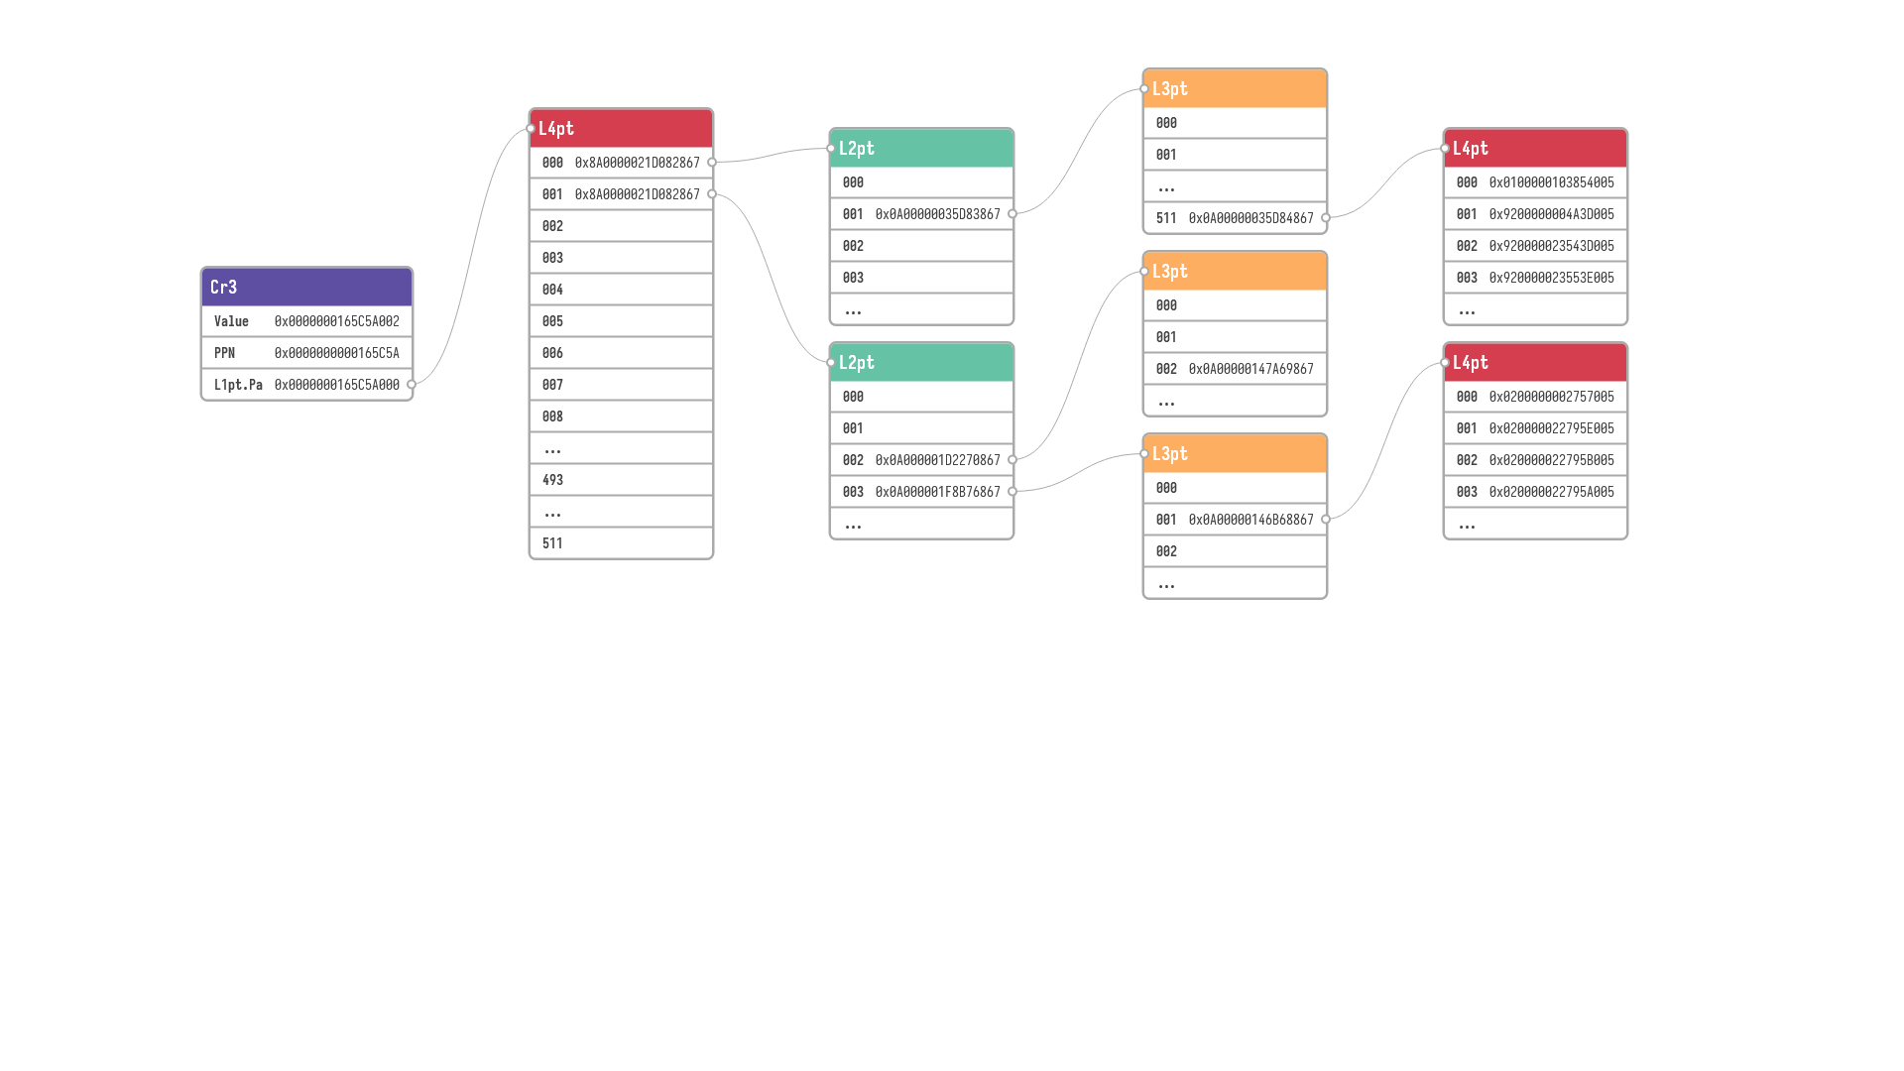
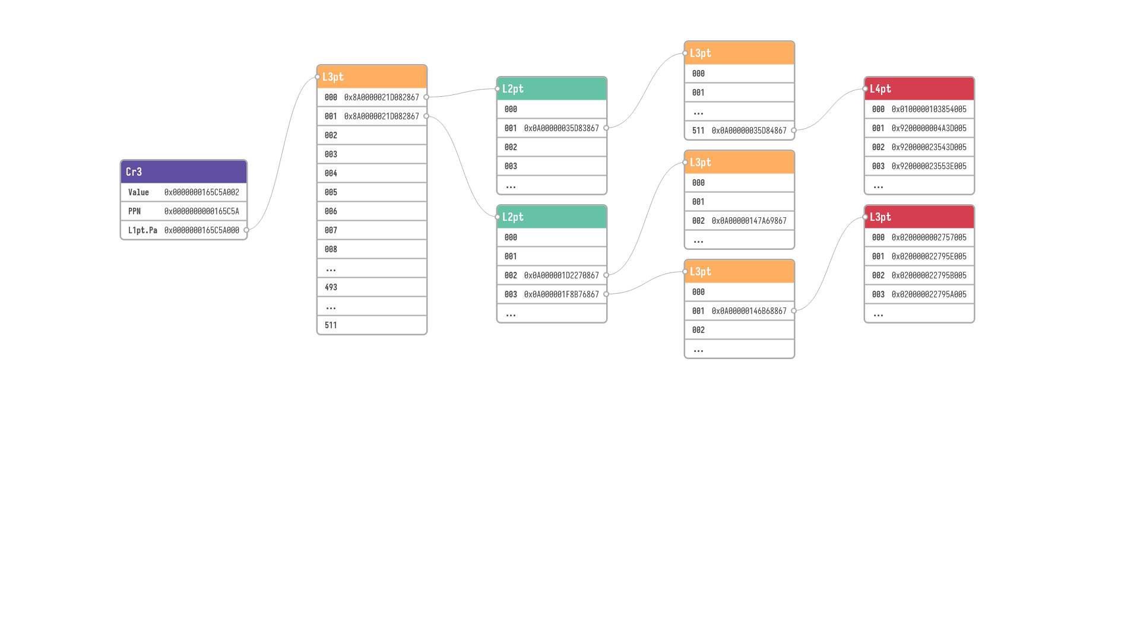
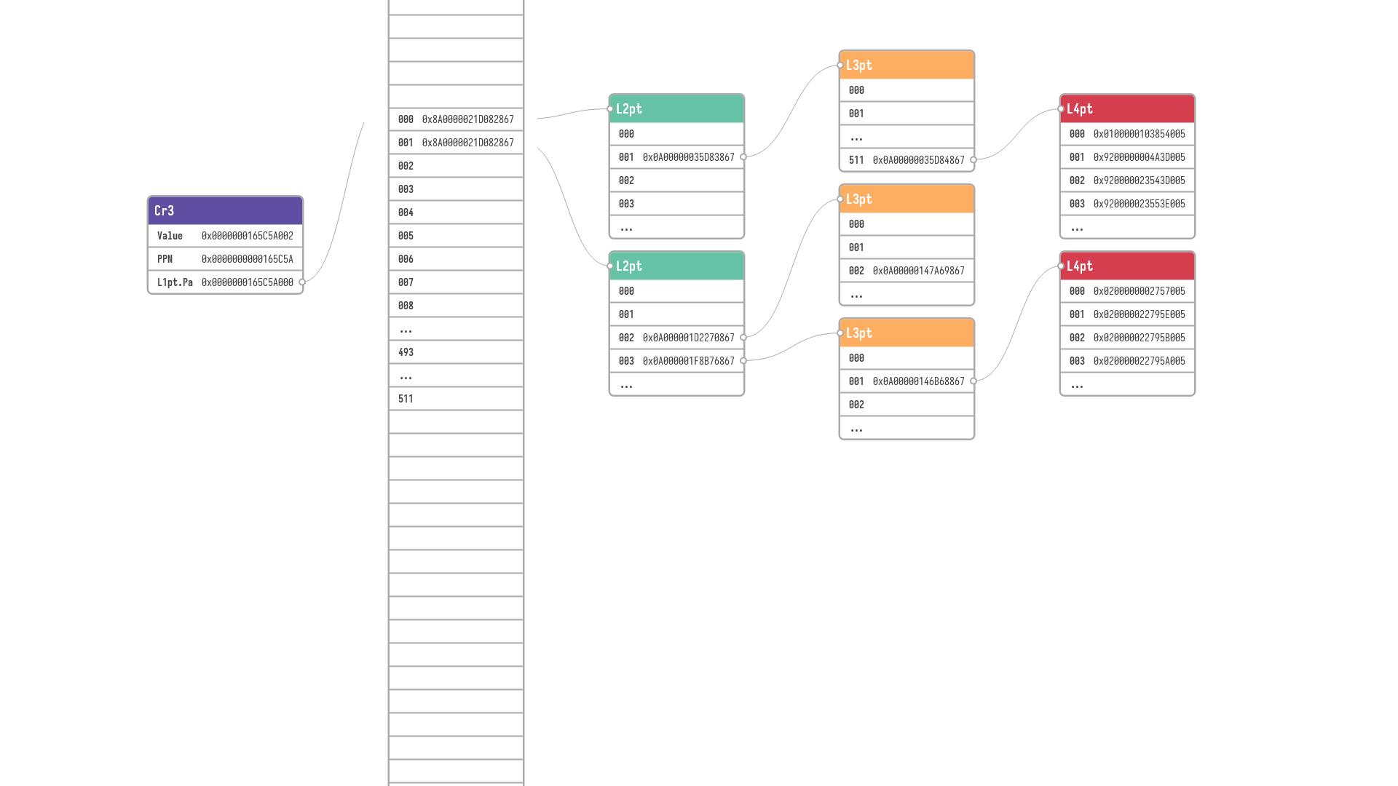
PPN+VPO
VPN4
VPN1
VPN2
VPN3
 |  | VPN1 | VPN2 | VPN3 | VPN4 | VPO
L1pt.Va= | SEXT | 493 | 493 | 493 | 493 | 0

Slide 5
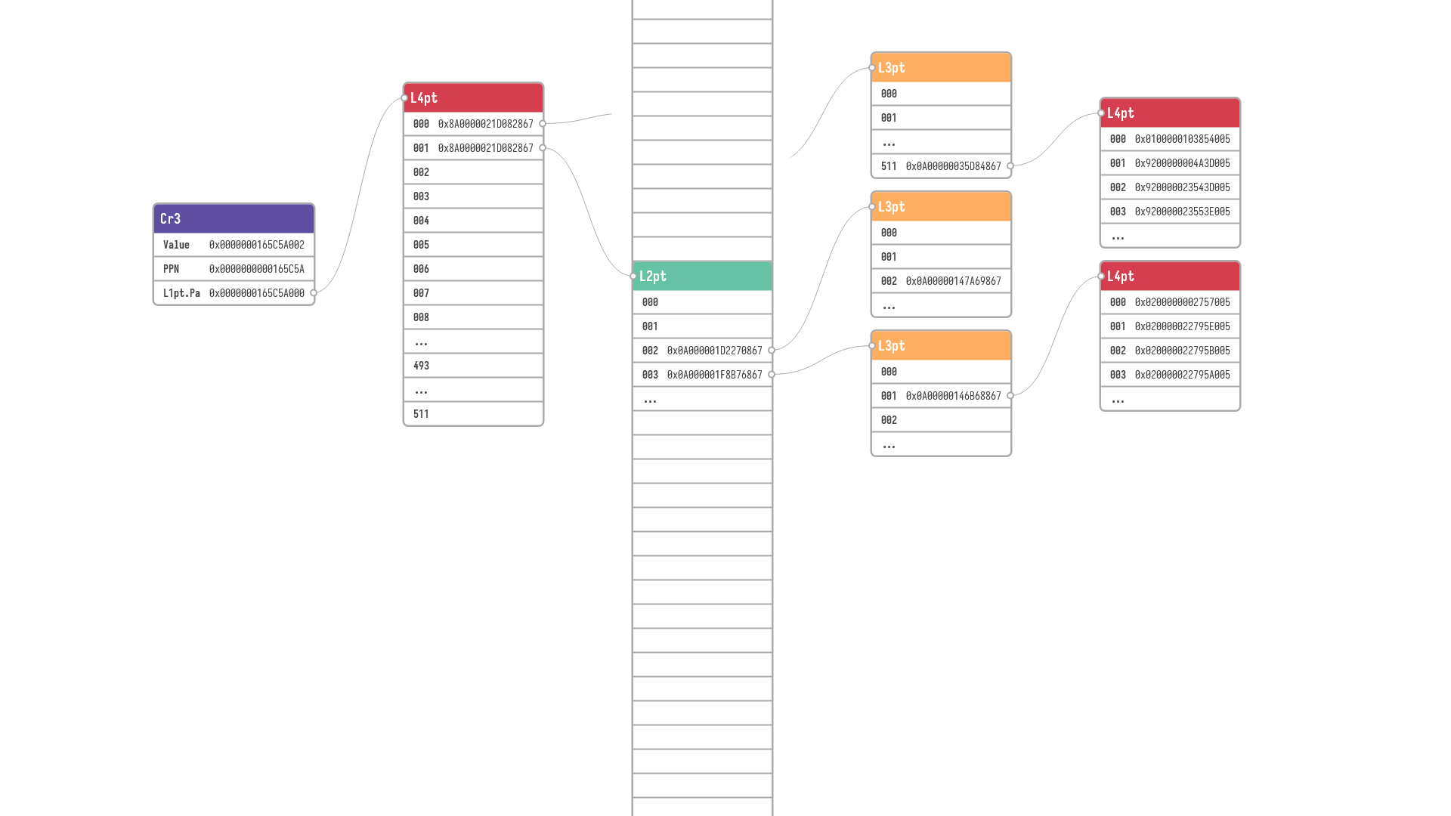
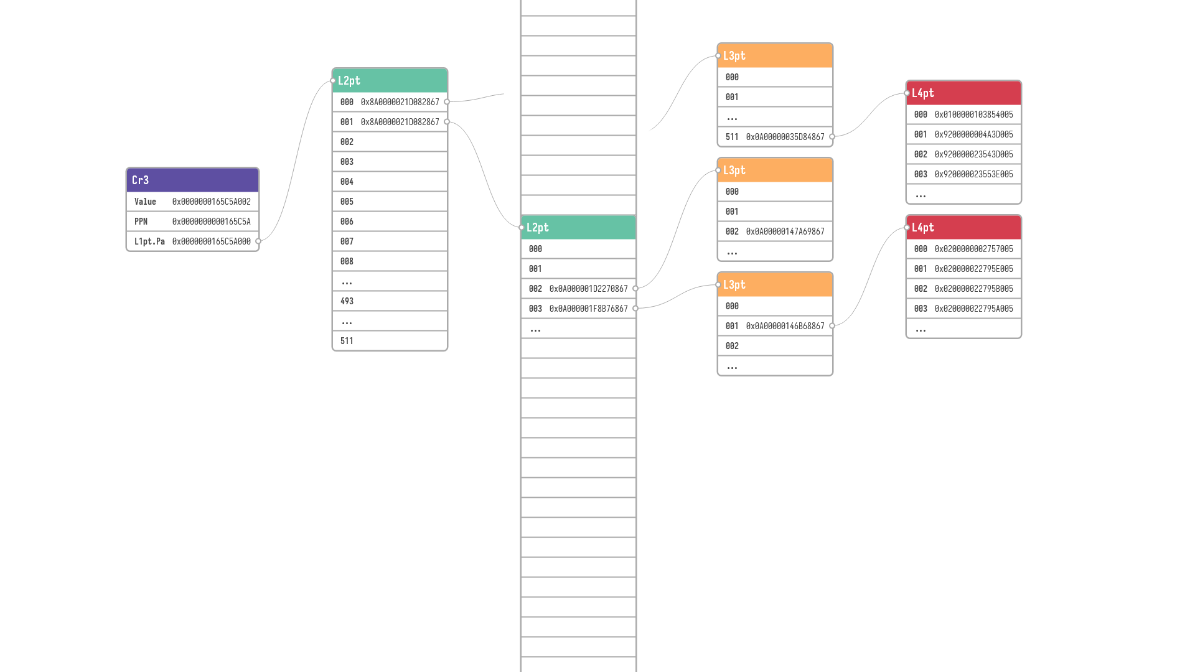

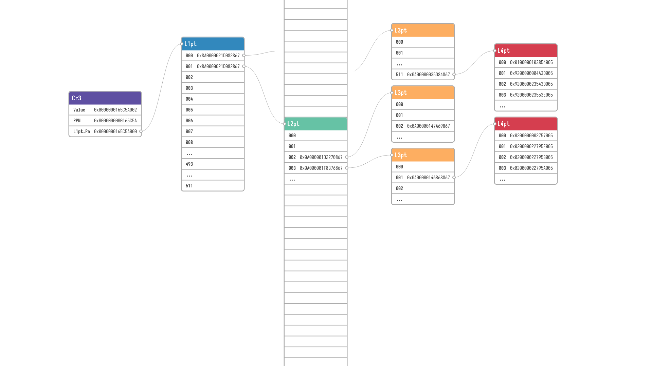
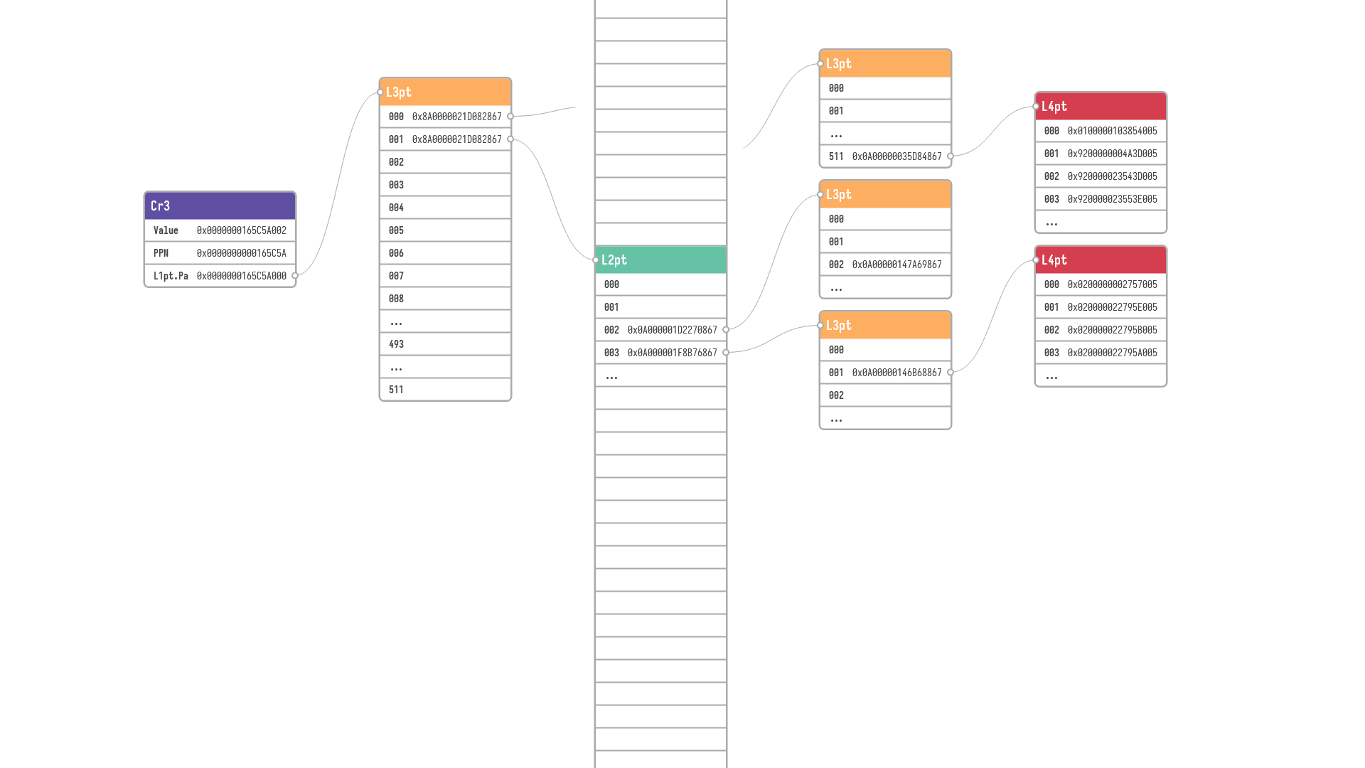

VPN4
PPN+VPO
VPN1
VPN2
VPN3
 |  | VPN1 | VPN2 | VPN3 | VPN4 | VPO
L1pt.Va= | SEXT | 493 | 493 | 493 | 493 | 0
 |  |  |  |  |  | VPO
L2pt.Va= | SEXT | VPN1 | VPN2 | VPN3 | VPN4 | 0
 |  | VPN1 | VPN2 | VPN3 |  | VPO
L2pt.Va= | SEXT | 493 | 493 | 493 | VPN4 | 0
 |  | VPN1 | VPN2 | VPN3 | VPN4 | VPO
L2pt.Va= | SEXT | 493 | 493 | 493 | 1 | 0
L2pt.Va= | SEXT | VPN1 | VPN2 | VPN3 | VPN4 | VPO

Slide 6
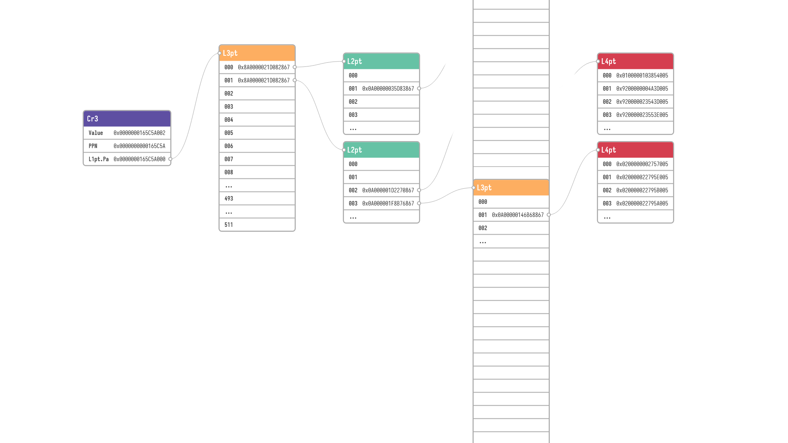

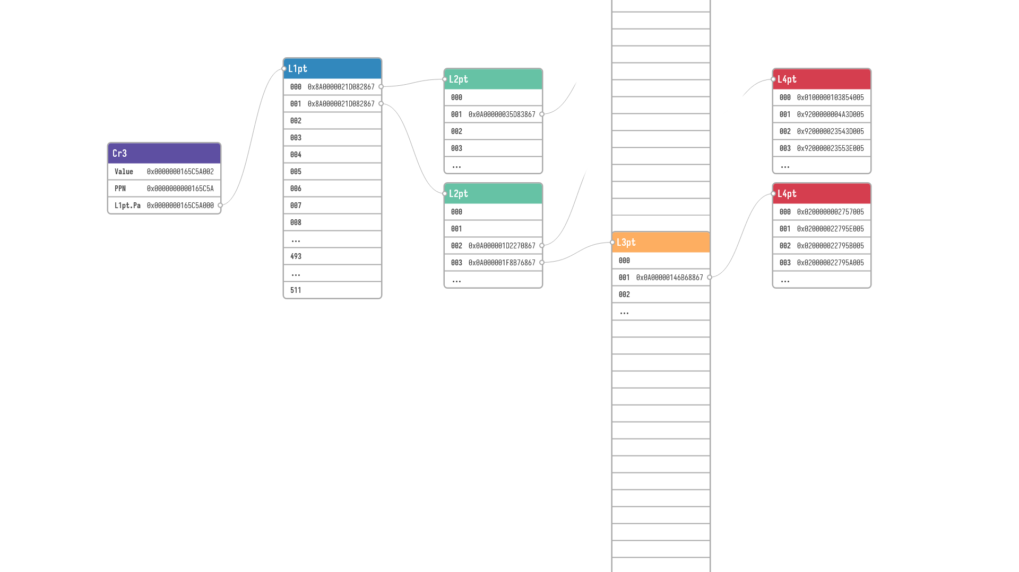
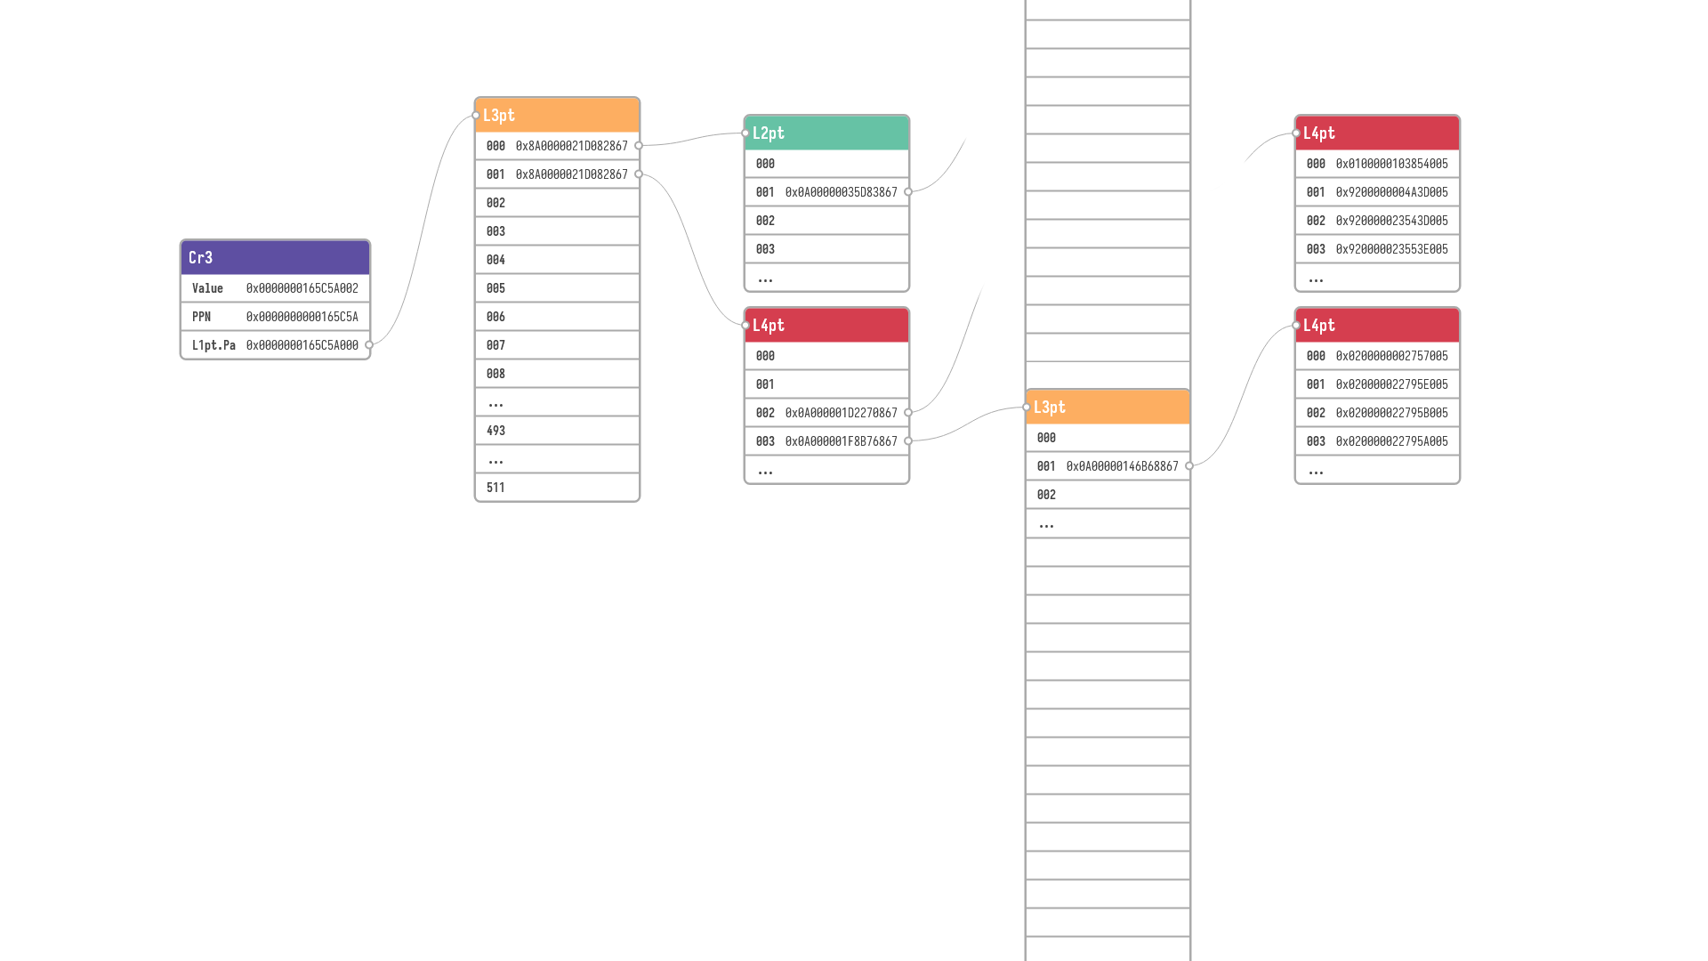

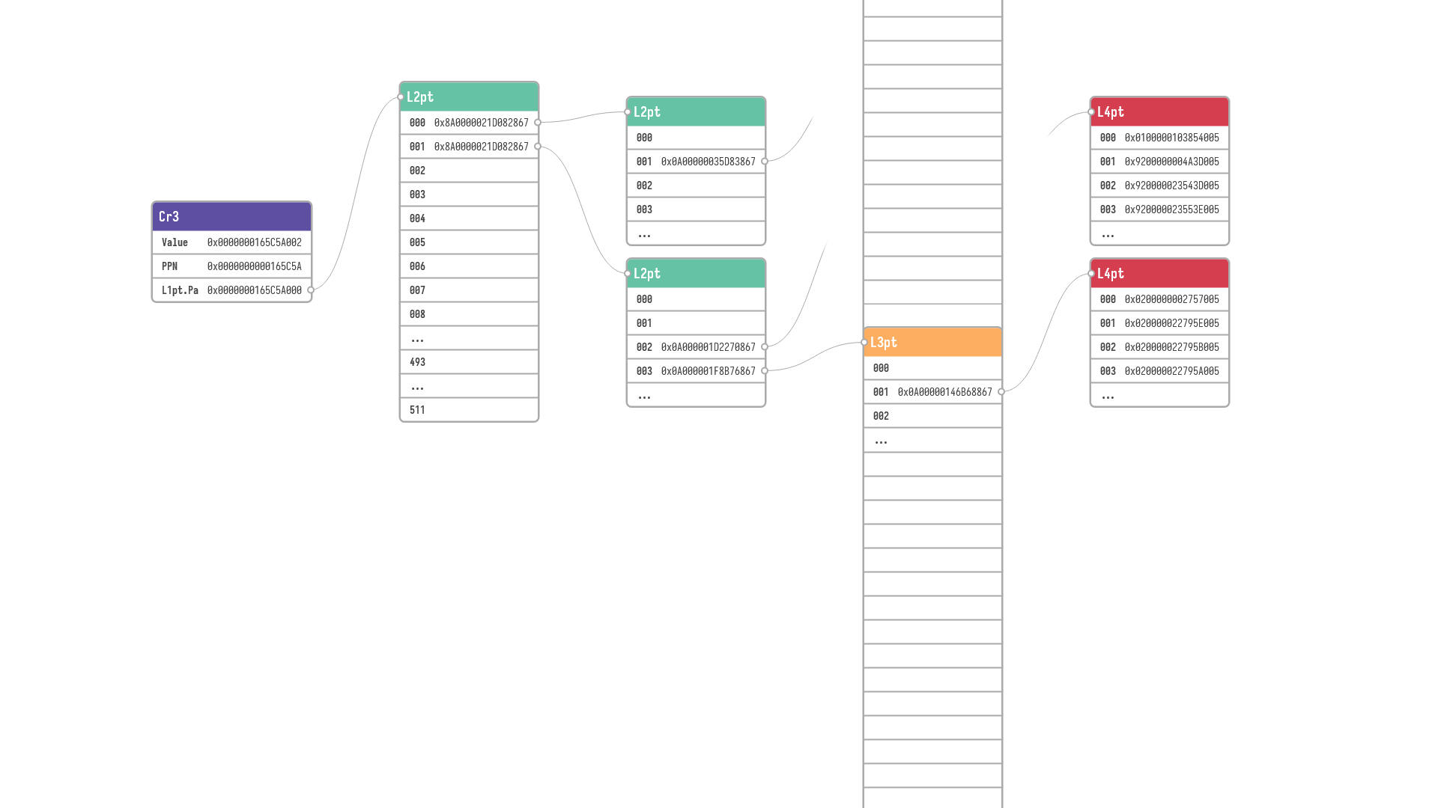
VPN3
PPN+VPO
VPN1
VPN2
VPN4
 |  | VPN1 | VPN2 | VPN3 | VPN4 | VPO
L1pt.Va= | SEXT | 493 | 493 | 493 | 493 | 0
 |  | VPN1 | VPN2 | VPN3 | VPN4 | VPO
L1pt.Va= | SEXT | 493 | 493 | 493 | 493 | 0
 |  | VPN1 | VPN2 | VPN3 | VPN4 | VPO
L2pt.Va= | SEXT | 493 | 493 | 493 | 1 | 0
 |  | VPN1 | VPN2 | VPN3 | VPN4 | VPO
L2pt.Va= | SEXT | 493 | 493 | 493 | 1 | 0
 |  |  |  |  |  | VPO
L3pt.Va= | SEXT | VPN1 | VPN2 | VPN3 | VPN4 | 0
 |  | VPN1 | VPN2 |  |  | VPO
L3pt.Va= | SEXT | 493 | 493 | VPN3 | VPN4 | 0
 |  | VPN1 | VPN2 | VPN3 |  | VPO
L3pt.Va= | SEXT | 493 | 493 | 1 | VPN4 | 0
 |  | VPN1 | VPN2 | VPN3 | VPN4 | VPO
L3pt.Va= | SEXT | 493 | 493 | 1 | 3 | 0
L3pt.Va= | SEXT | VPN1 | VPN2 | VPN3 | VPN4 | VPO

Slide 7

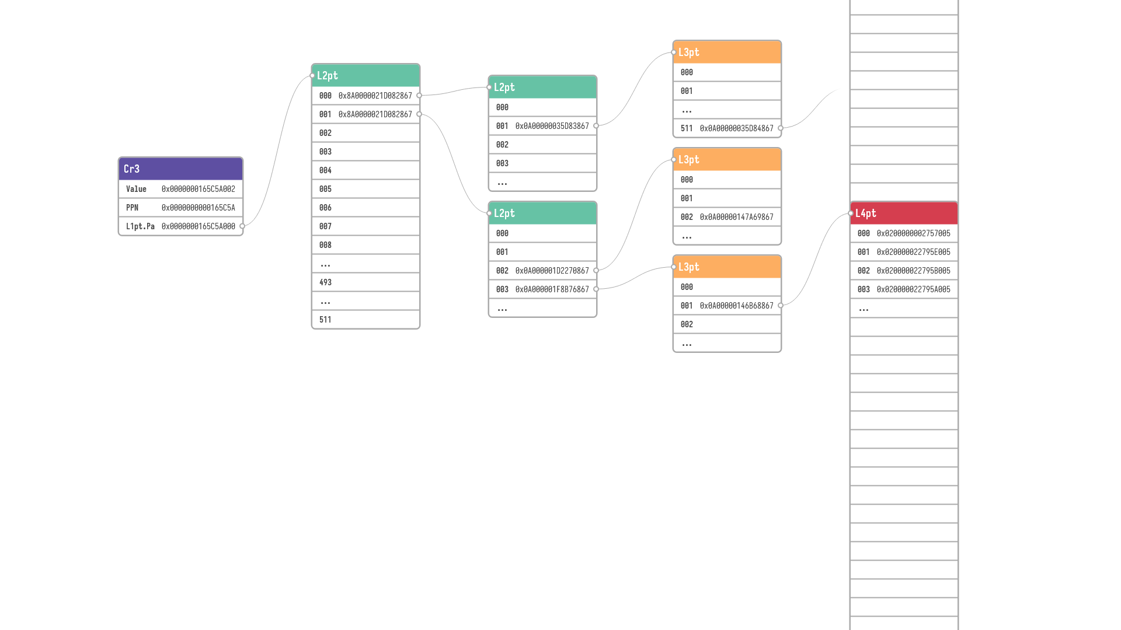
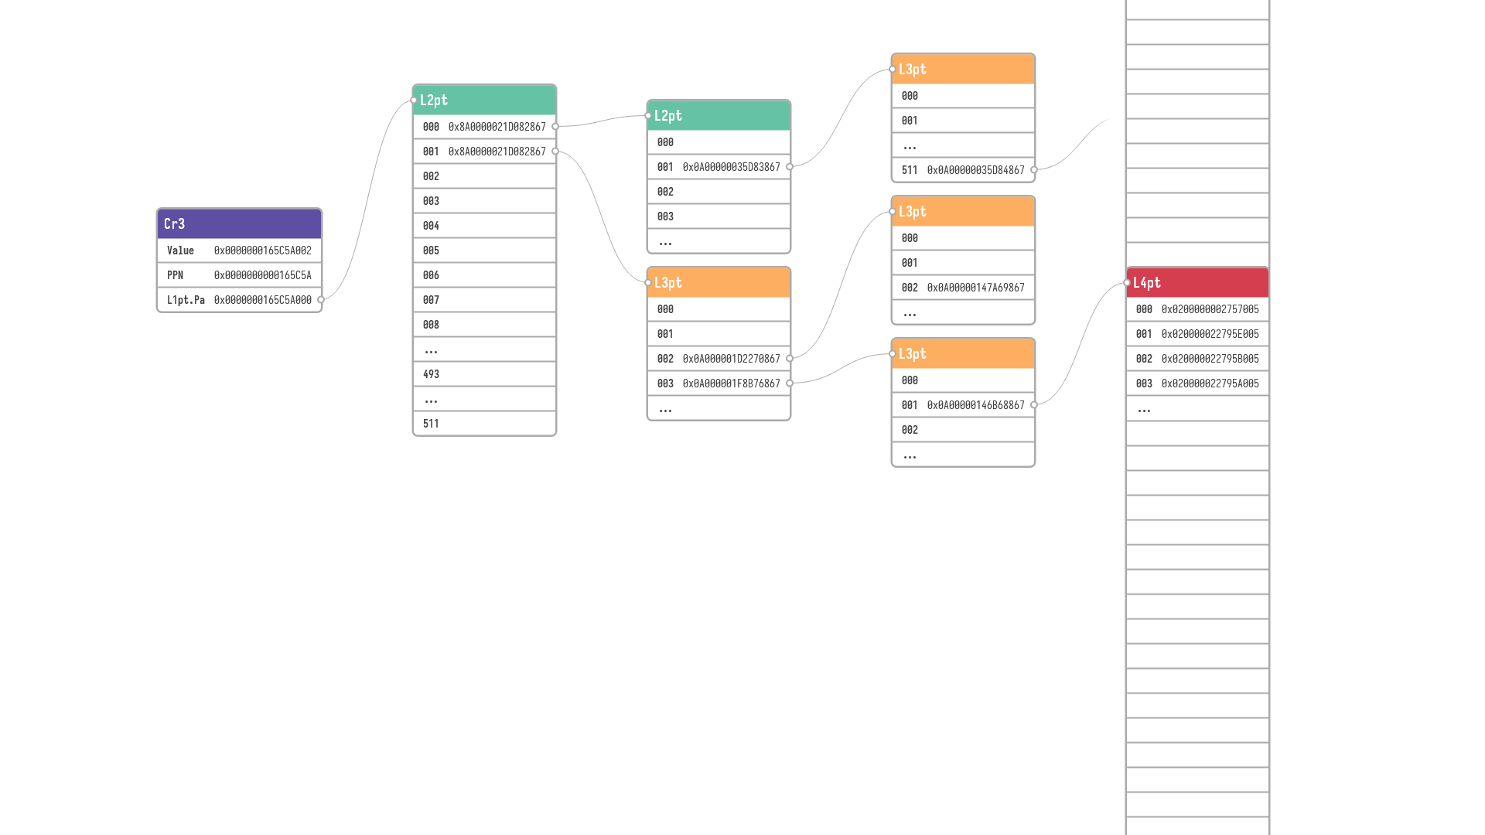
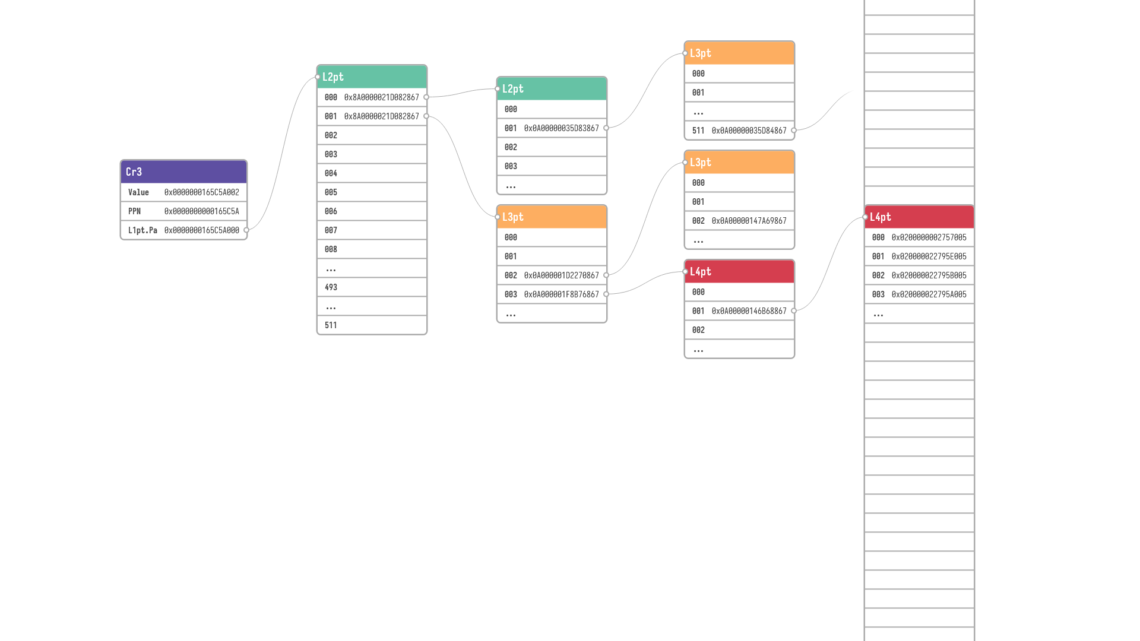
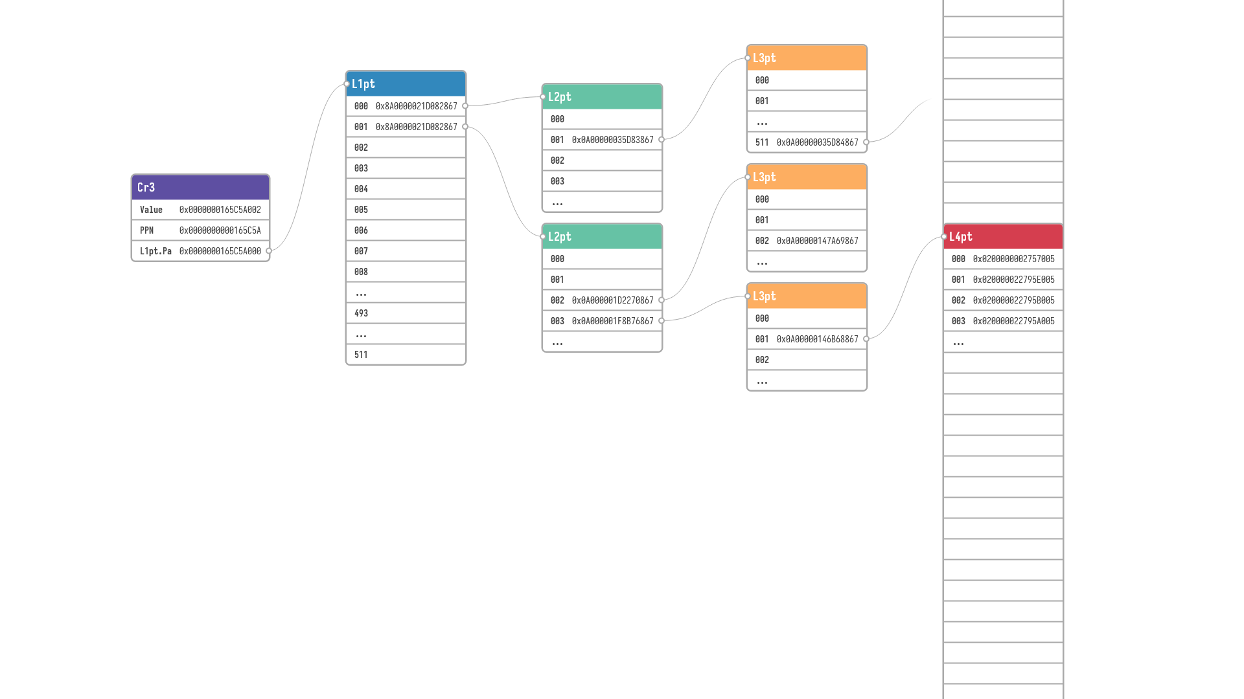
VPN2
PPN+VPO
VPN1
VPN3
VPN4
 |  | VPN1 | VPN2 | VPN3 | VPN4 | VPO
L1pt.Va= | SEXT | 493 | 493 | 493 | 493 | 0
 |  | VPN1 | VPN2 | VPN3 | VPN4 | VPO
L2pt.Va= | SEXT | 493 | 493 | 493 | 1 | 0
 |  | VPN1 | VPN2 | VPN3 | VPN4 | VPO
L3pt.Va= | SEXT | 493 | 493 | 1 | 3 | 0
 |  |  |  |  |  | VPO
L4pt.Va= | SEXT | VPN1 | VPN2 | VPN3 | VPN4 | 0
 |  | VPN1 |  |  |  | VPO
L4pt.Va= | SEXT | 493 | VPN2 | VPN3 | VPN4 | 0
 |  | VPN1 | VPN2 |  |  | VPO
L4pt.Va= | SEXT | 493 | 1 | VPN3 | VPN4 | 0
 |  | VPN1 | VPN2 | VPN3 |  | VPO
L4pt.Va= | SEXT | 493 | 1 | 3 | VPN4 | 0
 |  | VPN1 | VPN2 | VPN3 | VPN4 | VPO
L4pt.Va= | SEXT | 493 | 1 | 3 | 1 | 0
L4pt.Va= | SEXT | VPN1 | VPN2 | VPN3 | VPN4 | VPO

Slide 8
 |  | VPN1 | VPN2 | VPN3 | VPN4 | VPO
L4pt.Va= | SEXT | 493 | 1 | 3 | 1 | 0
 |  |  |  | VPN1 |  | VPN2 |  | VPN3 |  | VPN4 |  | VPO
L4pt.Va= |  | SEXT |  | 493 |  | 1 |  | 3 |  | 1 |  | 0
 |  | 63 | 48 | 47 | 39 | 38 | 30 | 29 | 21 | 20 | 12 | 11 | 0
 |  | VPN1 | VPN2 | VPN3 | VPN4 | VPO
L1pt.Va= | SEXT | 493 | 493 | 493 | 493 | 0
 |  | VPN1 | VPN2 | VPN3 | VPN4 | VPO
L2pt.Va= | SEXT | 493 | 493 | 493 | 1 | 0
 |  | VPN1 | VPN2 | VPN3 | VPN4 | VPO
L3pt.Va= | SEXT | 493 | 493 | 1 | 3 | 0
 |  | VPN1 | VPN2 | VPN3 | VPN4 | VPO
L4pt.Va= | SEXT | 493 | 1 | 3 | 1 | 0

Slide 9
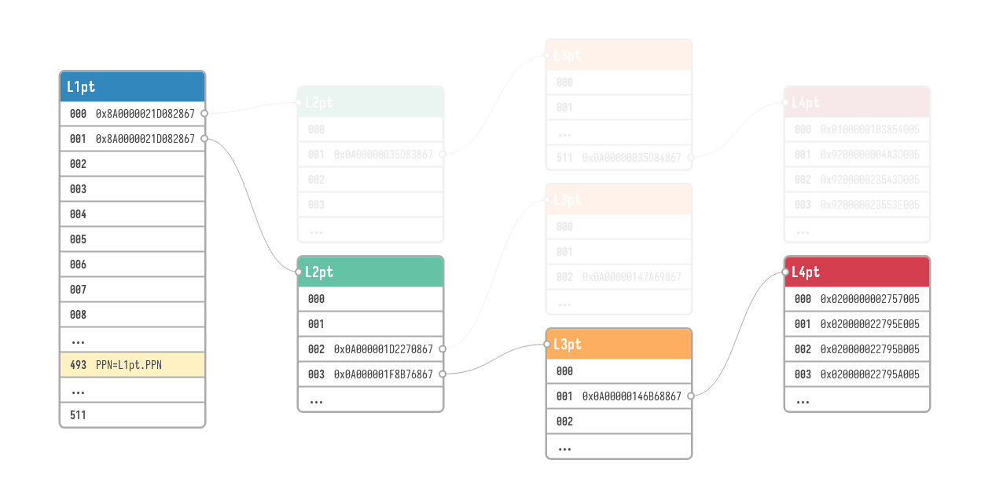












 |  |  |  | VPN1 |  | VPN2 |  | VPN3 |  | VPN4 |  | VPO
L4pt.Va= |  | SEXT |  | 493 |  | 1 |  | 3 |  | 1 |  | 0
 |  | 63 | 48 | 47 | 39 | 38 | 30 | 29 | 21 | 20 | 12 | 11 | 0
 |  |  |  | VPN1 |  | VPN2 |  | VPN3 |  | VPN4 |  | VPO
L4pt.Va= |  | $$s$$ |  | 493 |  | 1 |  | 3 |  | 1 |  | 0
 |  | 63 | 48 | 47 | 39 | 38 | 30 | 29 | 21 | 20 | 12 | 11 | 0
 |  |  |  | VPN1 |  | VPN2 |  | VPN3 |  | VPN4 |  | VPO
L4pt.Va= |  | $$s$$ |  | $$i$$ |  | 1 |  | 3 |  | 1 |  | 0
 |  | 63 | 48 | 47 | 39 | 38 | 30 | 29 | 21 | 20 | 12 | 11 | 0
 |  |  |  | VPN1 |  | VPN2 |  | VPN3 |  | VPN4 |  | VPO
L4pt.Va= |  | $$s$$ |  | $$i$$ |  | $$n_{1}$$ |  | $$n_{2}$$ |  | $$n_{3}$$ |  | 0
 |  | 63 | 48 | 47 | 39 | 38 | 30 | 29 | 21 | 20 | 12 | 11 | 0
 |  |  |  | VPN1 |  | VPN2 |  | VPN3 |  | VPN4 |  | VPO
L4pt.Va= |  | $$s$$ |  | $$i$$ |  | $$n_{1}$$ |  | $$n_{2}$$ |  | $$n_{3}$$ |  | $$o$$
 |  | 63 | 48 | 47 | 39 | 38 | 30 | 29 | 21 | 20 | 12 | 11 | 0
 |  |  |  | VPN1 |  | VPN2 |  | VPN3 |  | VPN4 |  | VPO
L4pt.Va= |  | $$s$$ |  | $$i$$ |  | $$00000000…00000000$$
 |  | 63 | 48 | 47 | 39 | 38 |  |  |  |  |  |  | 0
 |  |  |  | VPN1 |  | VPN2 |  | VPN3 |  | VPN4 |  | VPO
L4pt.Va= |  | $$s$$ |  | $$i$$ |  | $$11111111…11111111$$
 |  | 63 | 48 | 47 | 39 | 38 |  |  |  |  |  |  | 0
$$L4pt.Va.Max$$
$$2^{48}s+2^{39}i+0x7FFFFFFFFF$$
$$512GB$$
$$s∈\left\{ 0b0000000000000000, 0b1111111111111111 \right\}$$
$$0≤i≤511$$
$$0≤n_{1}≤511$$
$$0≤n_{2}≤511$$
$$0≤n_{3}≤511$$
$$0≤o≤4095$$
$$L4pt.Va=(s≪48)+(i≪39)+{(n}_{1}≪30)+{(n}_{2}≪21)+(n_{3}≪12)+o$$
$$L4pt.Va=2^{48}s+2^{39}i+2^{30}n_{1}+2^{21}n_{2}+2^{12}n_{3}+o$$
$$L4pt.Va.Min=2^{48}s+2^{39}i$$
$$L4pt.Va. Min=2^{48}s+2^{39}i+0b000000000000000000000000000000000000000$$
$$39$$
$$L4pt.Va.Max=2^{48}s+2^{39}i+2^{30}×511+2^{21}×511+2^{12}×511+4095$$
$$L4pt.Va.Max=2^{48}s+2^{39}i+0x7FFFFFFFFF$$
$$L4pt.Va.Max=2^{48}s+2^{39}i+0b111111111111111111111111111111111111111$$
$$39$$
$$L4pt.Va.Min$$
$$2^{48}s+2^{39}i$$

Slide 10







 |  |  |  | VPN1 |  | VPN2 |  | VPN3 |  | VPN4 |  | VPO
L4pt.Va= |  | $$s$$ |  | $$i$$ |  | $$n_{1}$$ |  | $$n_{2}$$ |  | $$n_{3}$$ |  | $$o$$
 |  | 63 | 48 | 47 | 39 | 38 | 30 | 29 | 21 | 20 | 12 | 11 | 0
$$L4pt.Va.Max$$
$$2^{48}s+2^{39}i+0x7FFFFFFFFF$$
$$512GB$$
 |  |  |  | VPN1 |  | VPN2 |  | VPN3 |  | VPN4 |  | VPO
L3pt.Va= |  | SEXT |  | 493 |  | 493 |  | 1 |  | 3 |  | 0
 |  | 63 | 48 | 47 | 39 | 38 | 30 | 29 | 21 | 20 | 12 | 11 | 0
 |  |  |  | VPN1 |  | VPN2 |  | VPN3 |  | VPN4 |  | VPO
L3pt.Va= |  | $$s$$ |  | $$i$$ |  | $$i$$ |  | $$n_{1}$$ |  | $$n_{2}$$ |  | $$o$$
 |  | 63 | 48 | 47 | 39 | 38 | 30 | 29 | 21 | 20 | 12 | 11 | 0
 |  |  |  | VPN1 |  | VPN2 |  | VPN3 |  | VPN4 |  | VPO
L3pt.Va= |  | $$s$$ |  | $$i$$ |  | $$i$$ |  | $$000000…000000$$
 |  | 63 | 48 | 47 | 39 | 38 | 30 | 29 |  |  |  |  | 0
 |  |  |  | VPN1 |  | VPN2 |  | VPN3 |  | VPN4 |  | VPO
L3pt.Va= |  | $$s$$ |  | $$i$$ |  | $$i$$ |  | $$111111…111111$$
 |  | 63 | 48 | 47 | 39 | 38 | 30 | 29 |  |  |  |  | 0
$$L3pt.Va.Min$$
$$2^{48}s+2^{39}i+2^{30}i+0x3FFFFFFF$$
$$1GB$$
$$L3pt.Va.Min=2^{48}s+2^{39}i+2^{30}i$$
$$L3pt.Va.Min>L4pt.Va.Min$$
$$L3pt.Va.Min−L4pt.Va.Max=\left(2^{48}s+2^{39}i+2^{30}i\right)−(2^{48}s+2^{39}i+0x7FFFFFFFFF)$$
$$L3pt.Va.Min−L4pt.Va.Max=2^{30}i−0x7FFFFFFFFF$$
$$L3pt.Va.Min−L4pt.Va.Max=2^{30}i−{(2}^{39}−1)=2^{30}i−2^{39}+1$$
$$L3pt.Va.Min−L4pt.Va.Max=2^{30}\left(i−512\right)+1$$
$$L3pt.Va.Min−L4pt.Va.Max<0$$
$$L4pt.Va.Min<L3pt.Va.Min<L4pt.Va.Max$$
$$L3pt.Va.Max=2^{48}s+2^{39}i+2^{30}i+0b111111111111111111111111111111$$
$$L3pt.Va.Min$$
$$2^{48}s+2^{39}i+2^{30}i$$
$$L3pt.Va.Max=2^{48}s+2^{39}i+2^{30}i+0x3FFFFFFF$$
$$L3pt.Va.Max−L4pt.Va.Max=\left(2^{48}s+2^{39}i+2^{30}i+0x3FFFFFFF\right)−(2^{48}s+2^{39}i+0x7FFFFFFFFF)$$
$$L3pt.Va.Man−L4pt.Va.Max=2^{30}i+0x3FFFFFFF−0x7FFFFFFFFF$$
$$L3pt.Va.Man−L4pt.Va.Max=2^{30} (i−511)$$
$$L3pt.Va.Man−L4pt.Va.Max≤0$$
$$L4pt.Va.Min$$
$$2^{48}s+2^{39}i$$
$$L3pt.Va.Min<L3pt.Va.Max≤L4pt.Va.Max$$

Slide 11





 |  |  |  | VPN1 |  | VPN2 |  | VPN3 |  | VPN4 |  | VPO
L4pt.Va= |  | $$s$$ |  | $$i$$ |  | $$n_{1}$$ |  | $$n_{2}$$ |  | $$n_{3}$$ |  | $$o$$
 |  | 63 | 48 | 47 | 39 | 38 | 30 | 29 | 21 | 20 | 12 | 11 | 0
$$L4pt.Va.Max$$
$$2^{48}s+2^{39}i+0x7FFFFFFFFF$$
$$512GB$$
 |  |  |  | VPN1 |  | VPN2 |  | VPN3 |  | VPN4 |  | VPO
L3pt.Va= |  | $$s$$ |  | $$i$$ |  | $$i$$ |  | $$n_{1}$$ |  | $$n_{2}$$ |  | $$o$$
 |  | 63 | 48 | 47 | 39 | 38 | 30 | 29 | 21 | 20 | 12 | 11 | 0
$$L3pt.Va.Min$$
$$2^{48}s+2^{39}i+2^{30}i+0x3FFFFFFF$$
$$1GB$$
 |  |  |  | VPN1 |  | VPN2 |  | VPN3 |  | VPN4 |  | VPO
L2pt.Va= |  | $$s$$ |  | $$i$$ |  | $$i$$ |  | $$i$$ |  | $$n_{1}$$ |  | $$o$$
 |  | 63 | 48 | 47 | 39 | 38 | 30 | 29 | 21 | 20 | 12 | 11 | 0
$$L2pt.Va.Min$$
$$2^{48}s+2^{39}i+2^{30}i+2^{21}i+0x1FFFFF$$
$$2MB$$
 |  |  |  | VPN1 |  | VPN2 |  | VPN3 |  | VPN4 |  | VPO
L1pt.Va= |  | $$s$$ |  | $$i$$ |  | $$i$$ |  | $$i$$ |  | $$i$$ |  | $$o$$
 |  | 63 | 48 | 47 | 39 | 38 | 30 | 29 | 21 | 20 | 12 | 11 | 0
$$L1pt.Va.Min$$
$2^{48}s+2^{39}i+2^{30}i+2^{21}i+2^{12}i+0xFF$F
$$4KB$$
$$L1pt.Va.Min$$
$$2^{48}s+2^{39}i+2^{30}i+2^{21}i+2^{12}i$$
$$L2pt.Va.Min$$
$$2^{48}s+2^{39}i+2^{30}i+2^{21}i$$
$$L3pt.Va.Min$$
$$2^{48}s+2^{39}i+2^{30}i$$
$$L4pt.Va.Min$$
$$2^{48}s+2^{39}i$$

