Slide 1

CVE-2017-5754
Meltdown was independently discovered and reported by three teams:
Jann Horn (Google Project Zero)
Werner Haas, Thomas Prescher (Cyberus Technology)
Daniel Gruss, Moritz Lipp, Stefan Mangard, Michael Schwarz (Graz University of Technology)
https://meltdownattack.com/

Slide 2

0xFFFFFFFF FFFFFFFF
char data = *(char*)0xFFFF8E891BDC4000;
printf("%c\n", data);
内核空间
0xFFFF8000 00000000
非规范地址
0x00007FFF FFFFFFFF
用户空间
0x00000000 00000000

Slide 3
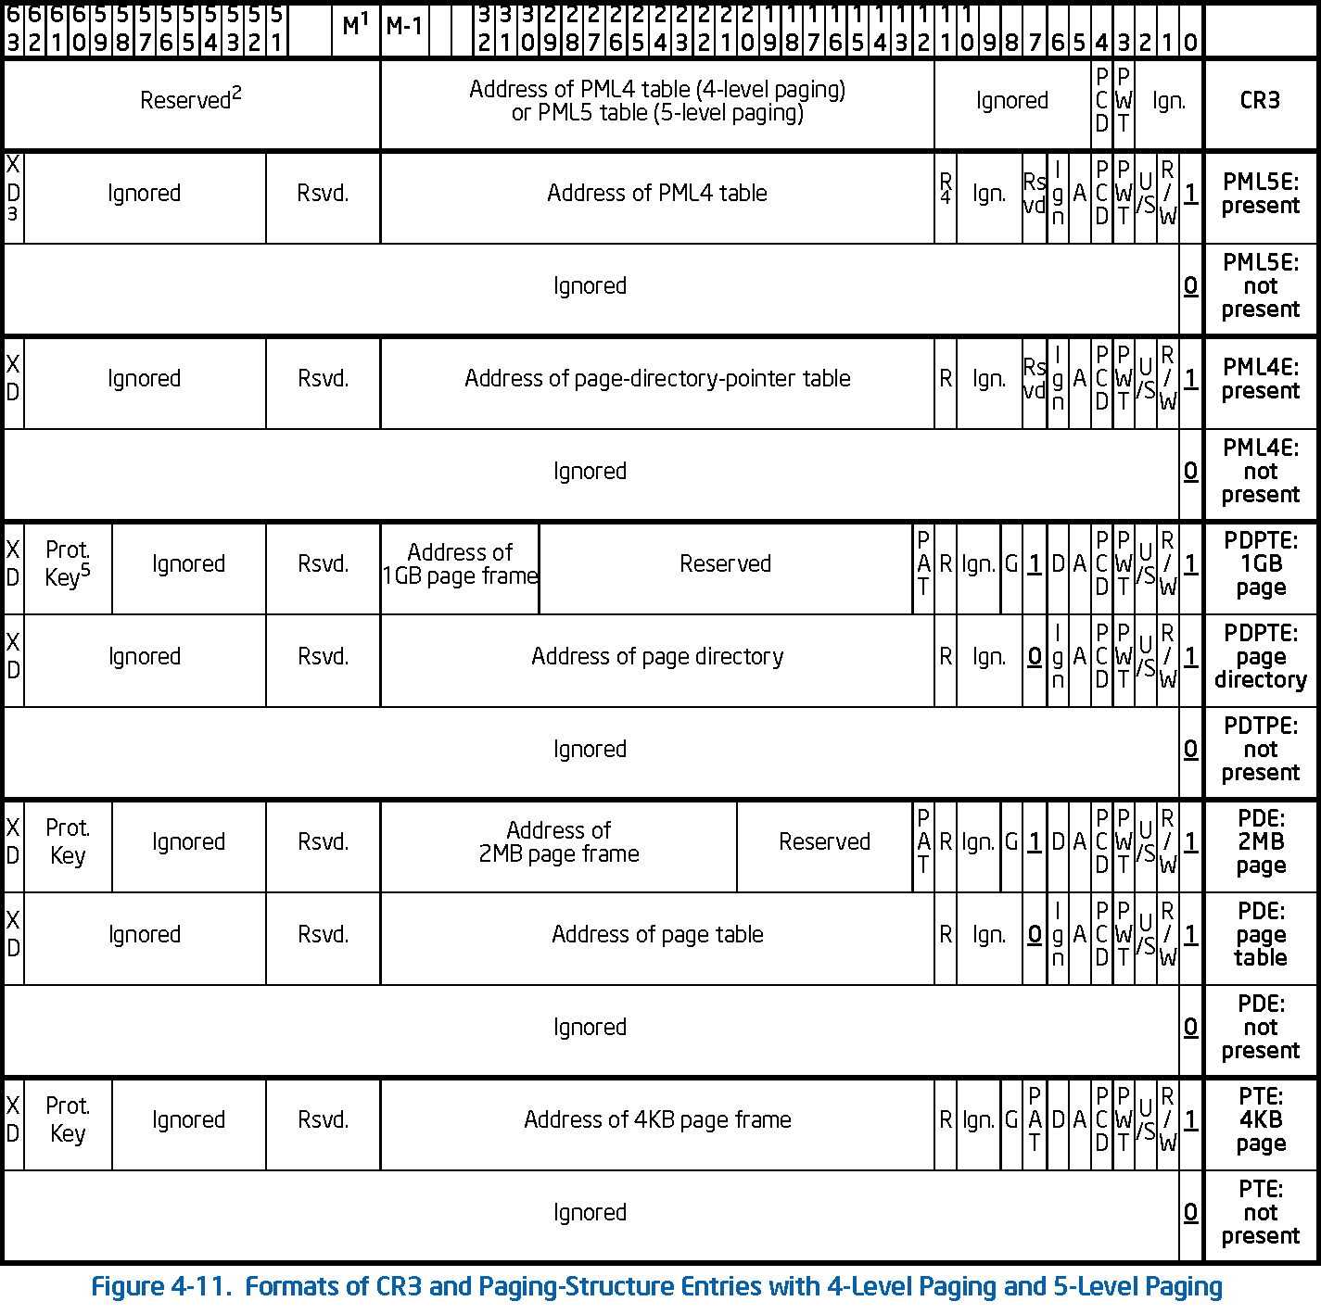

Slide 4
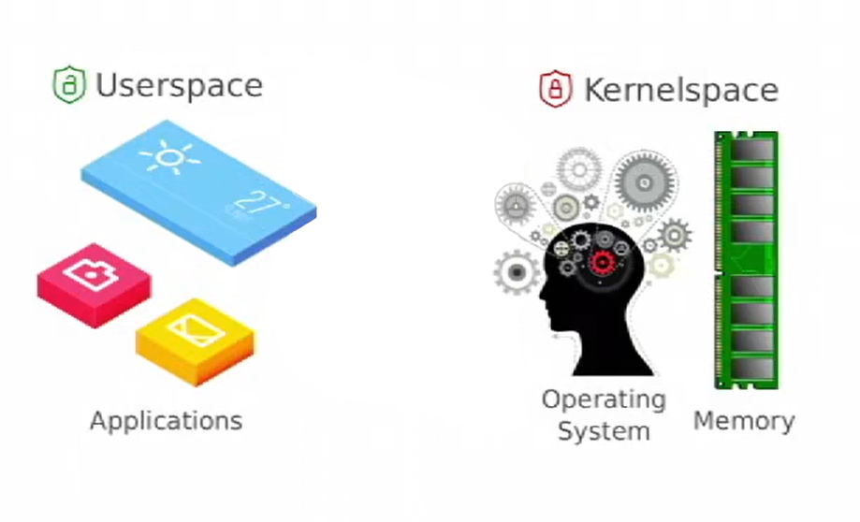
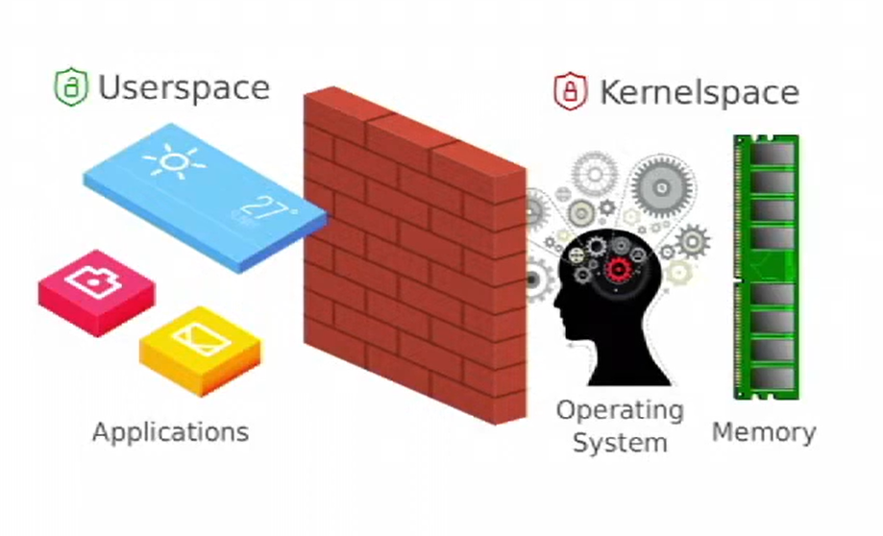
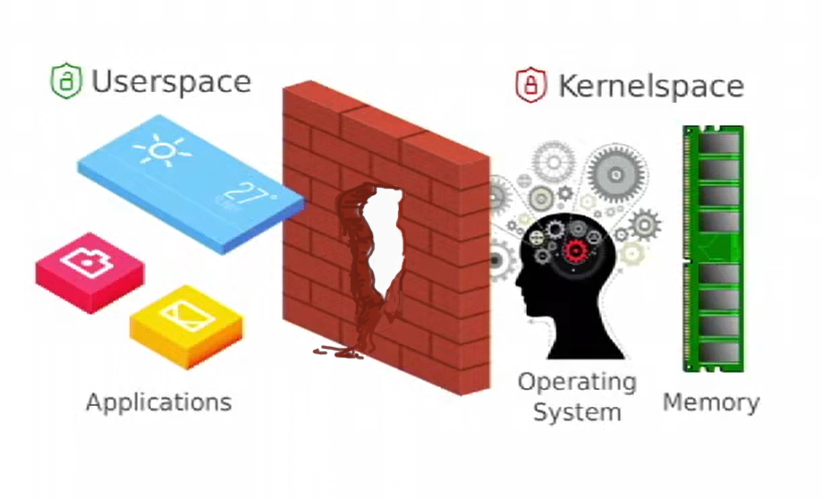
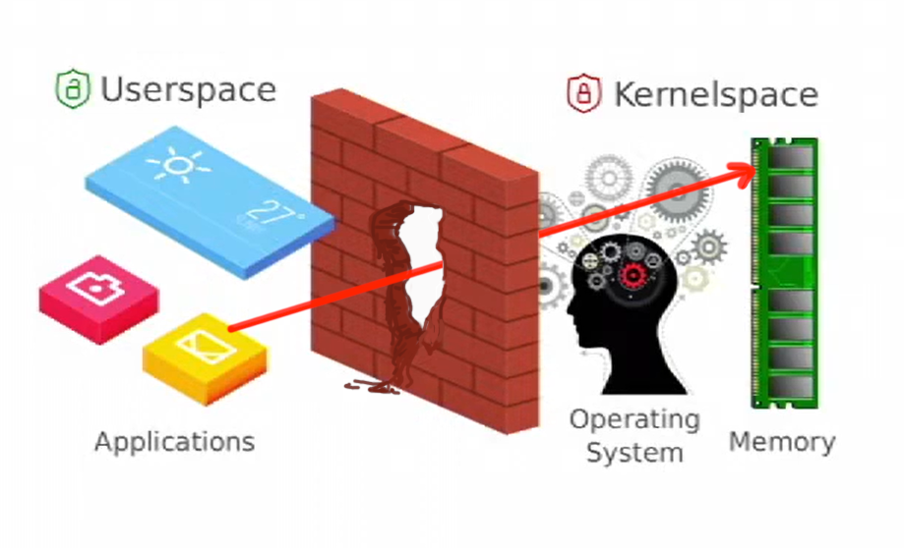

Slide 5
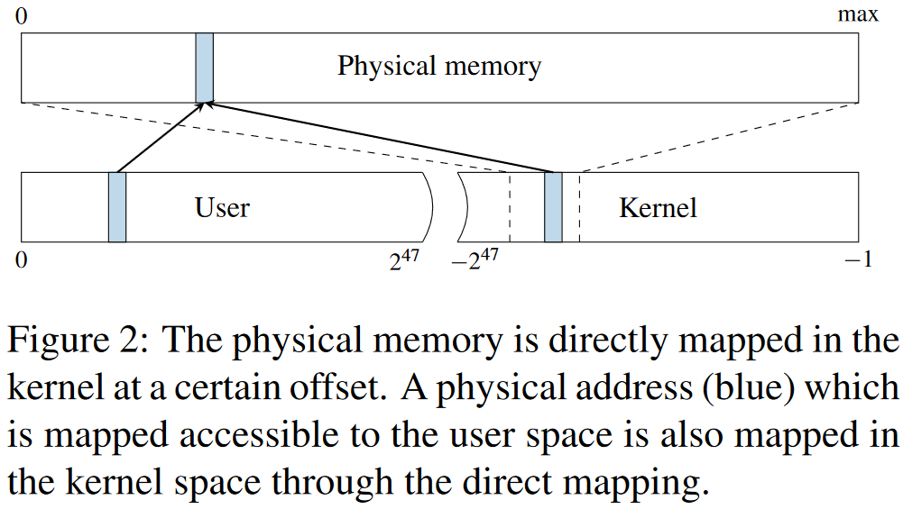

Slide 6
char data =*(char*)0xFFFF8E891BDC4000;
printf("%c\n", data);

