Slide 1
Handwritten Numeral Recognition Using Transfer Learning Technique
Kazi Ziaul Hassan, 1607061
Md. Golam Kaochhar, 1607100
Supervised by:
Mohammad Insanur Rahman Shuvo
Assistant Professor, Dept. of CSE, KUET

Slide 2
1
Presentation Outline
Introduction of Handwritten Numeral Recognition (HNR)
Basic Steps of HNR
Aim of this Study
Related Works
Proposed Methodology
Experimental Studies
Conclusions
Future Works

Slide 3
2
Introduction of Handwritten Numeral Recognition (HNR)

Slide 4

3
Handwritten Numeral Recognition (HNR) and its importance
Input Handwritten
Image
Class
Label
Recognition
System
৩
HNR is a process which considers images of handwritten numerals as input and classifies the images into different numeral classes.
Handwritten numerals are used in bank cheques, postal codes and in many other daily uses.
In this ICT age, automatic recognition of handwritten numerals becomes an important research topic.

Slide 5




4
Handwritten Numeral Recognition (HNR) and its challenges
Existence of similar shaped numerals make recognition task difficult.
Same handwritten numeral may look very different in size, shape, and orientation due to different writing patterns of people.
This numeral is “৫”
but it looks like “৬”
This numeral is “৬”
but it looks like “৫”
Numeral “১” looks different in handwritten format due to different writing patterns of people

Slide 6
5
Basic Steps of HNR

Slide 7
Basic Steps of Traditional HNR
6
Input Handwritten Image
Image Pre-process
Feature Extraction
৩
Class label
Class label Prediction
Classifier
Figure 01: Basic Steps of HNR using Traditional HNR

Slide 8
Basic Steps of HNR using Deep Learning
7
Input Handwritten Image
Image Pre-process
Deep Neural Model
(Feature Extraction + Classifier)
৩
Class label
Class label Prediction
Figure 02: Basic Steps of HNR using Deep Learning

Slide 9
Basic Steps of HNR using Transfer Learning
8
Pre trained Model
Input Handwritten Image
Image Pre-process
Freeze The Preceding Layers
Class label Prediction
New Model
Train The Subsequent Layers
৩
Class label
Figure 03: Basic Steps of HNR using Transfer Learning

Slide 10
Basic Steps of HNR with Fine Tuning
9
Pre Trained Model
Input Handwritten Image
Image Pre-process
Freeze The Preceding Layers
Train The Subsequent Layers
Including Some Preceding Convolve Layers
Class Label Prediction
New Model
৩
Class Label
Figure 04: Basic Steps of HNR with fine tuning

Slide 11
10
Aim of this Study
Study of existing classification techniques for HNR of different languages.
Propose a HNR system using transfer learning technique.
Performance comparison of the proposed system with other prominent works on HNR.

Slide 12
Related Works
11
Work Ref. [Author, Year] | Method
Basu et al., 2005 | MLP with Dempster-Shafter techniques
Pal et al., 2006 | Binary decision tree
Wen et al., 2007 | Support Vector Machine (SVM)
Akhand et al., 2016 | Convolutional neural network (CNN)
Shopon et al., 2016 | Auto-encoder (AE) with CNN
Guha et al., 2019 | Multilayer perceptron (MLP)
Mahtab et al., 2016 | Stacked Auto-encoder (SAE)
Akhand et al., 2018 | Convolutional neural network (CNN)
Mahtab et al., 2019 | Deep Long Short Term Memory (DLSTM)
Shuvo et al., 2019 | Convolutional Auto-Encoder(CAE) with CNN
In Dept. of
CSE, KUET

Slide 13
12
Contribution of the Study
Build a potential HNR system based on the transfer learning technique.
Investigate fine tuning (FT), without fine tuning, normal as well as rotational augmentation (±10⁰, ±20⁰) on the dataset and batch size (BS) to discover the most accurate HNR system.
Investigate the Bengali and Devanagari language to compare the models to see how well the pattern recognition and feature extraction work.

Slide 14
13
Proposed Methodology
Basic Structure of the Proposed HNR System
Development of Classifier
Development of Pre-Trained Model
Development of Transfer Learning Technique

Slide 15



14
Proposed Methodology: Basic Structure of the Proposed HNR System
5
English Handwritten numeral image
Source Model
Prediction
Output Class
Transfer source model weights
Bangla Handwritten numeral image
Target Model
Output Class
Prediction
Figure 05 : Structure of the Handwritten numeral recognition using transfer learning technique

Slide 16
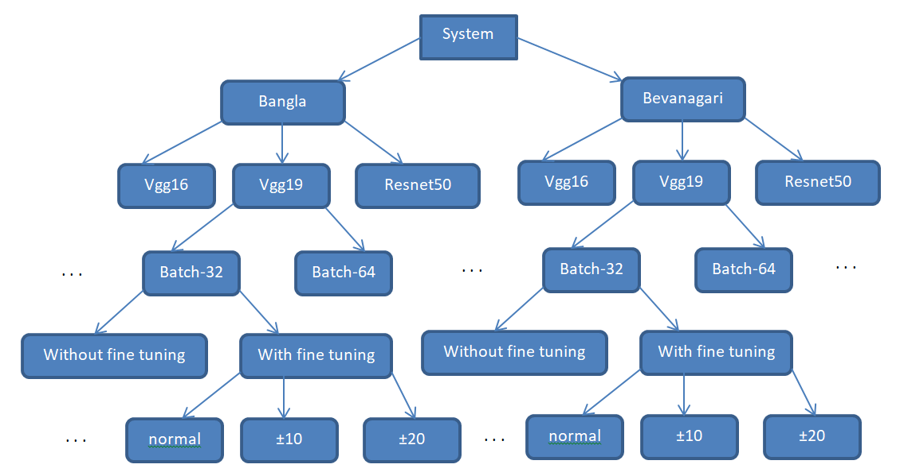
15
Basic Structure of the Overall Systems
Figure 06 : An illustration of how all the systems have been categorized

Slide 17
16
Proposed Methodology: Development of Classifier

Slide 18
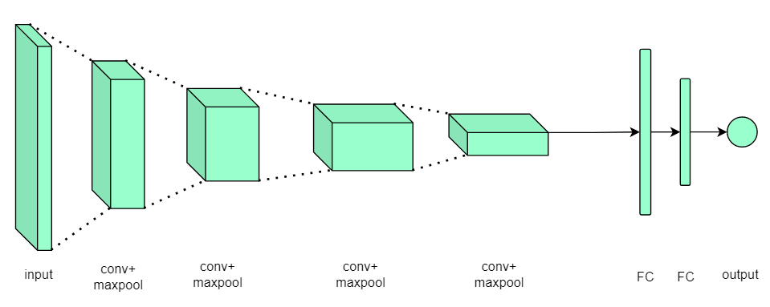
17
Convolutional Neural Network (CNN) as Classifier
The basic CNN structure contains an input layer, subsequent convolution-pooling layer(s), one or more dense layer(s) and an output layer.
Figure 07 : Basic structure of Convolutional Neural Network (CNN).

Slide 19
18
Proposed Methodology: Development of Pre Trained Model

Slide 20
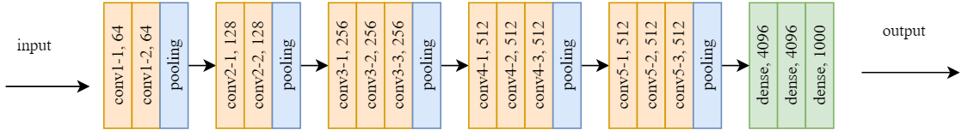
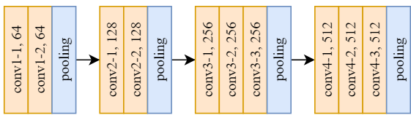
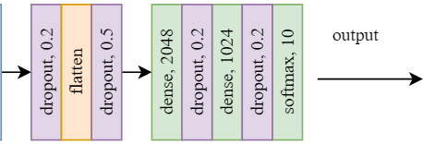
Development of Pre Trained Model
19
used this layer for making pre-trained model
add this layer on top of previous layer
Figure 08: Pre-trained model structure with vgg16

Slide 21
Development of Pre Trained Model
20
Table 01: Partial summary of pre-trained model vgg16
Layer(Type) | Output shape
input_1 (Input Layer) | (32, 32, 1)
zero_padding2d( Zero Padding 2D) | (38, 38, 1)
block1_conv1 (Conv2D) | (38, 38, 64)
block1_conv2 (Conv2D | (38, 38, 64)
block1_pool (MaxPooling2D) | (19, 19, 64)
block2_conv1 (Conv2D) | (19, 19, 128)
block2_conv2 (Conv2D) | (19, 19, 128)
block2_pool (MaxPooling2D) | (9, 9, 128)
... | …
block4_conv1 (Conv2D) | (4, 4, 512)
block4_conv2 (Conv2D) | (4, 4, 512)
block4_conv3 (Conv2D) | (4, 4, 512)
block4_pool (MaxPooling2D) | (2, 2, 512)
flatten (Flatten) | (2048)
fc1 (Dense) | (2048)
fc2 (Dense) | (1024)
predictions (Dense) | (10)

Slide 22
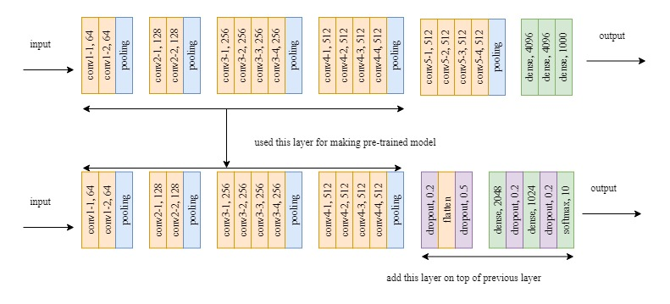
Development of Pre Trained Model
21
Figure 09: Pre-trained model structure with vgg19

Slide 23
Development of Pre Trained Model
22
Table 02: Partial summary of pre-trained model vgg19
Layer(Type) | Output shape
input_1 (Input Layer) | (32, 32, 1)
zero_padding2d (Zero Padding 2D) | (38, 38, 1)
block1_conv1 (Conv2D) | (38, 38, 64)
block1_conv2 (Conv2D) | (38, 38, 64)
block1_pool (MaxPooling2D) | (19, 19, 64)
… | …
block3_conv3 (Conv2D) | (9, 9, 256)
block3_pool (MaxPooling2D) | (4, 4, 256)
block4_conv1 (Conv2D) | (4, 4, 512)
block4_conv2 (Conv2D) | (4, 4, 512)
block4_conv3 (Conv2D) | (4, 4, 512)
block4_conv4 (Conv2D) | (4, 4, 512)
block4_pool (MaxPooling2D) | (2, 2, 512)
dropout (Dropout) | (2, 2, 512)
flatten (Flatten) | (2048)
dropout_1 (Dropout) | (2048)
fc1 (Dense) | (2048
fc2 (Dense) | (1024)
predictions (Dense) | (10)

Slide 24
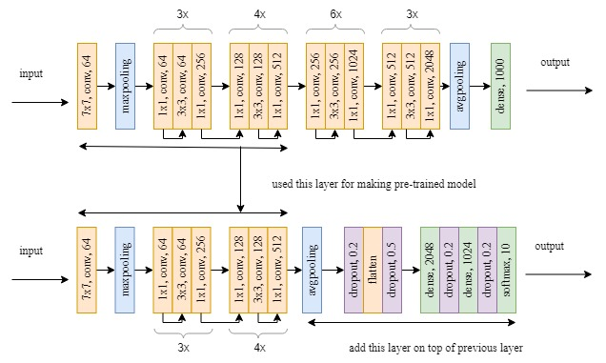
Development of Pre Trained Model
23
Figure 10: Pre-trained model structure with resnet50

Slide 25
Development of Pre Trained Model
24
Table 03: Standard structure of resnet50 model
layer name | output size | 50-layer | No. of layer
conv1 | 112x112 | 7x7, 64, stride 2 3x3 maxpool, stride 2 | 1
conv2_x | 56x56 | 1x1, 64 3x3, 64 1x1, 256 | 3x3 = 9
conv3_x | 28x28 | 1x1, 128 3x3, 128 1x1, 512 | 4x3 = 12
conv4_x | 14x14 | 1x1, 256 3x3, 256 1x1, 1024 | 6x3 = 18
conv5_x | 7x7 | 1x1, 512 3x3, 512 1x1, 2048 | 3x3 = 9
- | 1x1 | average pool, 1000-d, fc, softmax | 1

Slide 26
25
Proposed Methodology: Development of Transfer Learning Technique

Slide 27
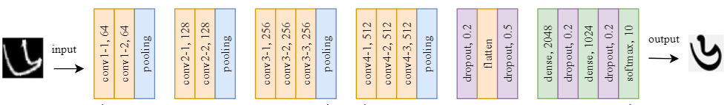
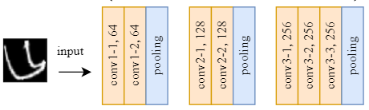
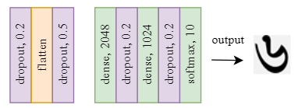
Development of Transfer Learning Technique
26
keep these layers
remove these layers
transfer weights
Do not train these layers
add and only train these layers
with fine tuning train these layers
Figure 11: Proposed method structure for vgg16, with and without fine tuning

Slide 28
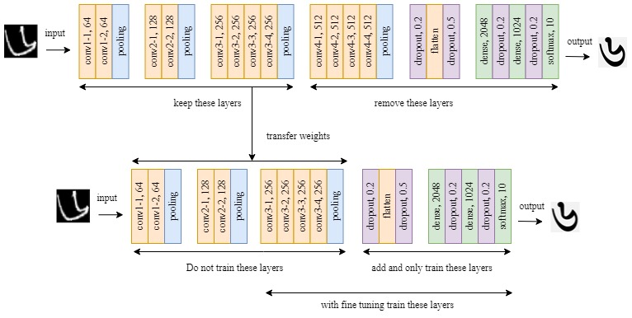
Development of Transfer Learning Technique
27
Figure 12: Proposed method structure vgg19, with and without fine tuning

Slide 29
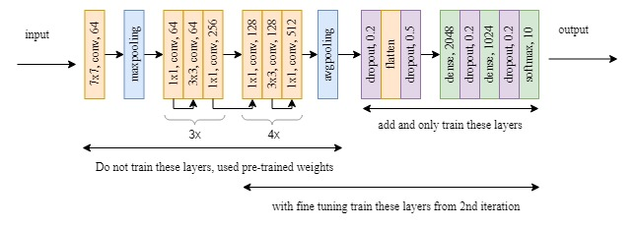
Development of Transfer Learning Technique
28
Figure 13: Proposed method structure resnet50, with and without fine tuning

Slide 30
Development of Transfer Learning Technique
29
Table 04: Training Parameter with Transfer Learning Approaches for vgg16
Type of Parameter | Without fine tuning | With fine tuning
Total | 13,949,642 | 13,949,642
Trainable | 6,304,778 | 13,832,586
Non-trainable | 7,644,864 | 117,056
Table 05: Training parameter with transfer learning approaches for vgg19
Type of Parameter | Without fine tuning | With fine tuning
Total | 12,829,130 | 16,902,602
Trainable | 10,499,082 | 16,635,914
Non-trainable | 2,330,048 | 266,688

Slide 31
30
Experimental Studies
Experimental Pre-trained Dataset
Benchmark Dataset
Experimental Setup
Experimental Results and Analysis

Slide 32
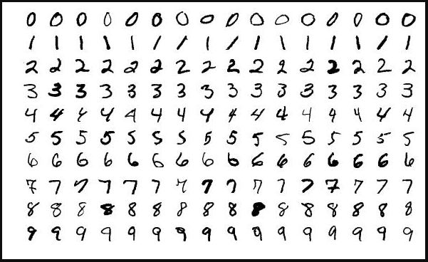
Experimental Pre-trained Dataset
31
English handwritten numeral images MNIST dataset a subset of a larger set available from NIST.
Figure 14: Samples of English handwritten numerals from MNIST dataset [8].

Slide 33
32
Experimental Pre-trained Dataset Info
English handwritten numeral images MNIST dataset a subset of a larger set available from NIST.
MNIST Stands for the Modified National Institute of Standards and Technology
Having set of 60,000 training examples and a test set of about 10,000 examples
The digits have been size-normalized and centered in a fixed-size image having square shape 28x28 pixel grayscale images of handwritten single digits between 0 and 9.

Slide 34
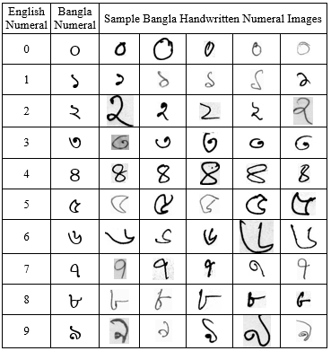
33
Experimental Studies: Benchmark Dataset
Bengali handwritten numeral images dataset preserved by Computer Vision and Pattern Recognition (CVPR) Unit of Indian Statistical Institute (ISI).
Figure 15: Samples of Bengali handwritten numerals from the CVRP, ISI dataset. [9]

Slide 35
34
Experimental Studies: Experimental Setup
The size of the input handwritten numeral images is fixed which is 32x32.
The considered rotation angles for training data augmentation are ±10° and ± 20°.
Batch Size (BS) is 32 and 64.
No of training images: 18000 (=1800×10) and testing images: 4000 (=400×10).

Slide 36
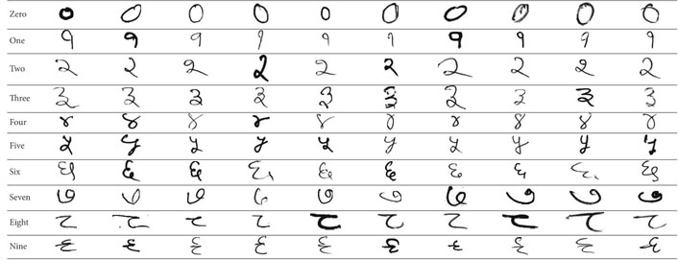
35
Experimental Studies: Benchmark Dataset
Devanagari handwritten numeral images dataset preserved by Computer Vision and Pattern Recognition (CVPR) Unit of Indian Statistical Institute (ISI).
Fig 16: Samples of Devanagari handwritten numerals from the CVRP, ISI dataset [9].

Slide 37
36
Experimental Studies: Experimental Setup
The size of the input handwritten numeral images is fixed which is 32x32.
The considered rotation angles for training data augmentation are ±10° and ± 20°.
Batch Size (BS) is 32 and 64.
No of training images: 18000 (=1800×10) and testing images: 3750(=375×10).

Slide 38
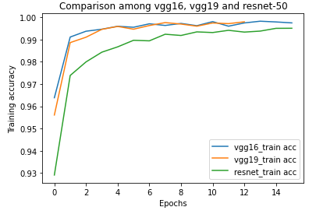
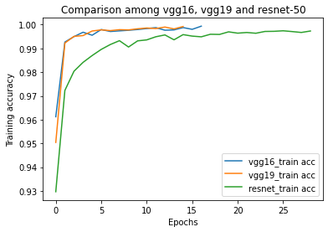
37
Experimental Studies: Experimental Results and Analysis
(a) BS=32
(b) BS=64
Fig 17: Performance of HNRUTL on Bengali CVPR, ISI dataset.
Pre Trained model weights helps reduce training time as well as achieve high accuracy.

Slide 39
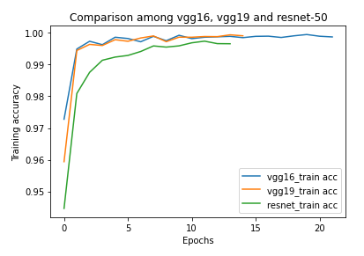
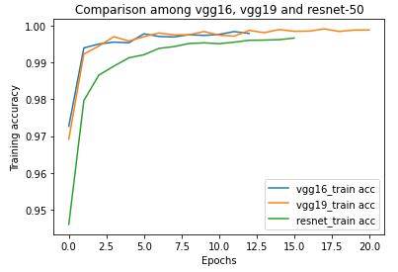
38
Experimental Results and Analysis (contd.)
(a) BS=32
(b) BS=64
Fig 18: Performance of HNRUTL on Devanagari CVPR, ISI dataset.
Performance with augmentation for rotation angle of ±10° or ±20° is better than without augmentation.

Slide 40
Experimental Results and Analysis (contd.)
39
Table 06: Testing accuracies for CVPR Bengali dataset with batch size 64
Model Used | Normal(%) | Normal FT(%) | ±10(%) | ± 10 FT(%) | ± 20(%) | ±20 FT(%)
VGG16 | 98.48 | 99.18 | 99.15 | 99.58 | 98.78 | 99.58
VGG19 | 98.88 | 99.28 | 98.90 | 99.68 | 98.75 | 99.58
RESNET50 | 97.50 | 98.05 | 98.08 | 98.93 | 98.23 | 98.55
±20 FT(%)
Table 07: Testing accuracies for CVPR Devanagari dataset with batch size 64
Model Used | Normal(%) | Normal FT(%) | ±10(%) | ±10 FT(%) | ±20(%) | ±20 FT(%)
VGG16 | 99.25 | 99.49 | 99.44 | 99.60 | 99.23 | 98.80
VGG19 | 98.75 | 99.28 | 99.09 | 99.63 | 99.04 | 99.52
RESNET50 | 98.72 | 98.91 | 99.07 | 99.31 | 98.85 | 99.31

Slide 41
Experimental Results and Analysis (contd.)
40
Table 08: Testing accuracies for CVPR Bengali dataset with batch size 32
Model Used | Normal(%) | Normal FT(%) | ±10(%) | ± 10 FT(%) | ± 20(%) | ±20 FT(%)
VGG16 | 98.38 | 99.18 | 98.98 | 99.73 | 98.88 | 99.43
VGG19 | 98.35 | 99.48 | 99.08 | 99.40 | 98.53 | 99.48
RESNET50 | 97.05 | 98.25 | 97.78 | 98.80 | 97.88 | 98.70
Table 09: Testing accuracies for CVPR Devanagari dataset with batch size 32
Model Used | Normal(%) | Normal FT(%) | ±10(%) | ±10 FT(%) | ±20(%) | ±20 FT(%)
VGG16 | 99.04 | 98.77 | 99.25 | 99.52 | 99.15 | 99.55
VGG19 | 99.07 | 99.31 | 99.33 | 99.55 | 99.25 | 99.60
RESNET50 | 98.64 | 99.01 | 99.01 | 99.49 | 98.43 | 99.31

Slide 42
41
Experimental Results and Analysis (contd.)
Table 10: Confusion matrix for test samples of handwritten Bengali numeral dataset.
Number of samples classified as
Bengali Numeral | 0 | ১ | ২ | ৩ | ৪ | ৫ | ৬ | ৭ | ৮ | ৯
0 | 399 | 0 | 0 | 1 | 0 | 0 | 0 | 0 | 0 | 0
১ | 0 | 399 | 0 | 0 | 0 | 0 | 0 | 0 | 0 | 1
২ | 0 | 0 | 400 | 0 | 0 | 0 | 0 | 0 | 0 | 0
৩ | 0 | 0 | 0 | 400 | 0 | 0 | 0 | 0 | 0 | 0
৪ | 0 | 0 | 0 | 0 | 400 | 0 | 0 | 0 | 0 | 0
৫ | 1 | 1 | 0 | 0 | 2 | 396 | 0 | 0 | 0 | 0
৬ | 0 | 0 | 0 | 0 | 0 | 0 | 400 | 0 | 0 | 0
৭ | 0 | 0 | 0 | 0 | 1 | 0 | 0 | 399 | 0 | 0
৮ | 0 | 0 | 0 | 0 | 0 | 0 | 0 | 0 | 400 | 0
৯ | 0 | 3 | 0 | 1 | 0 | 0 | 0 | 0 | 0 | 396
11 misclassified samples.

Slide 43
42
Experimental Results and Analysis (contd.)
Table 11: Confusion matrix for test samples of handwritten Devanagari numeral dataset.
Number of samples classified as
Devanagari Numeral | ० | १ | २ | ३ | ४ | ५ | ६ | ७ | ८ | ९
० | 375 | 0 | 0 | 0 | 0 | 0 | 0 | 0 | 0 | 0
१ | 0 | 370 | 1 | 0 | 0 | 0 | 0 | 2 | 2 | 0
२ | 0 | 0 | 375 | 0 | 0 | 0 | 0 | 0 | 0 | 0
३ | 0 | 0 | 1 | 373 | 0 | 0 | 0 | 1 | 0 | 0
४ | 1 | 0 | 0 | 0 | 374 | 0 | 0 | 0 | 0 | 0
५ | 0 | 0 | 0 | 0 | 0 | 375 | 0 | 0 | 0 | 0
६ | 0 | 1 | 0 | 0 | 0 | 0 | 372 | 0 | 0 | 2
७ | 0 | 0 | 0 | 0 | 0 | 0 | 0 | 375 | 0 | 0
८ | 0 | 0 | 1 | 0 | 0 | 0 | 0 | 0 | 374 | 0
९ | 0 | 0 | 0 | 0 | 0 | 0 | 1 | 0 | 1 | 373
14 misclassified samples.

Slide 44



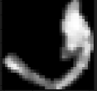


44
Experimental Results and Analysis (contd.)
Table 12: Misclassified handwritten Bengali numerals by HNRUTL.
Handwritten Bengali numeral image | Predicted value | Actual value
 | ৩ | ০
 | ৪ | ০
 | ৯ | ১
 | ৬ | ৩
 | ৫ | ৬
 | ৬ | ৫

Slide 45





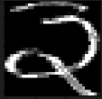
45
Experimental Results and Analysis (contd.)
Table 13: Misclassified handwritten Devanagari numerals by HNRUTL.
Handwritten Devanagari numeral image | Predicted value | Actual value
 | ७ | १
 | ० | ४
 | ७ | ३
 | ७ | १
 | ८ | १
 | २ | ३

Slide 46
Experimental Studies: Comparison of Results
46
Table 14: Comparison between traditional models and proposed model for the Bengali language
Work Reference and Year | Feature Selection | Method | Dataset; Training and Test Samples | Recognition Accuracy
Pal et al. [6], 2006 | Feature based on reservoir and water overflow | Binary decision tree | Self-prepared, 12000 | 92.80%
Wen et al. [5], 2007 | Principal component analysis (PCA) and Kernel PCA | SVM | Bangladesh postal system; 6000 and 10000 | 95.05%
Wen and He [4], 2012 | Eigenvalues and eigenvectors | Kernel and Bayesian discriminant | Bangladesh postal system; 30000 and 15000 | 96.91%
Nasir and Uddin [17], 2013 | Bayes’ theorem, K- means clustering and Maximum Posteriori | SVM | Self-prepared, 300 | 96.80%
Akhand et al. [7], 2016 | No | CNN | CVPR, ISI [9]; 18000 and 4000 | 98.45%
Mahtab et al. [18], 2016 | No | SAE | CVPR, ISI [9]; 18000 and 4000 | 96.30%
Akhand et al. [19], 2018 | No | CNN | CVPR, ISI [9]; 18000 and 4000 | 98.98%
Shuvo et al. [3], 2019 | No | CAE with CNN | CVPR, ISI [9]; 18000 and 4000 | 99.68%
Proposed Method | No | TL with VGG-16 using FT, BS 32 | 10 CVPR, ISI [9]; 54000 and 4000 | 99.73%

Slide 47
Experimental Studies: Comparison of Results
47
Table 15: Comparison between traditional models and proposed model for the Devanagari language
Work Reference and Year | Method | Dataset, Training and Test Samples | Recognition Accuracy
Arya et al. [16], 2015 | SVM and KNN | CVPR, ISI [9]; 19798 and 3763 | 98.06 %
Singh et al. [15], 2015 | Ensemble of NNs | CVPR, ISI [9]; 16794 and 3762 | 99.37 %
Singh et al. [14], 2016 | MLP | CMATERdb 3.2.1 [16]; 2000 and 1000 | 98.92 %
Singh et al. [10], 2017 | MLP | CMATERdb 3.2.1 [16]; 2000 and 1000 | 97.50 %
Akhand et al. [7], 2018 | CNN with data augmentation | CVPR, ISI [9]; 18000 and 3763 | 98.96 %
Trivedi et al. [13], 2018 | CNN with GA | CVPR, ISI [9]; 18784 and 3762 | 96.41%
Jiang et al. [12], 2020 | Edge-TripleNet | CMATERdb [16]; 2400 and 600 | 97.33%
Gupta et al. [11],2021 | Transfer Learning (MNIST Pre-trained) | CVPR, ISI [9]; 15789 and 2256 | 99.04%
Proposed Method | TL with VGG-19 using FT, BS 64 | 10 CVPR, ISI [9]; 54000 and 3750 | 99.63 %

Slide 48
Conclusions
48
Challenges tell us that normal dataset is not enough to handle such a convoluted task.
Rotational augmentation is introduced to enrich the dataset with some rotated images as if it had some distorted images.
The model that used fine tuning and ±10° rotational augmentation gives better result than others.
Since we have pre trained models, we do not need to train all the layers. That is why transfer learning is introduced to reduce the computation time, training time.

Slide 49
49
Future Works
Proposed HNR can be ameliorated to an extent for other languages also.
Other CNN architectures or adjusting the working CNN architectures may work fine.
Any image size other than 32x32 may improve the accuracy.
Necessary modifications out of all possible combinations may bring a satisfactory outcome.

Slide 50
50
Important References
A. K. Tushar, A. Ashiquzzaman, A. Afrin and M. R. Islam, “A novel transfer learning approach upon hindi, arabic and bangla numerals using convolutional neural networks,” in Computational Vision an Bio Inspired Computing. Springer, 2018, pp. 9972-981
Sakib Reza, Ohinda Binte Amin and M. M. A. Hashem “Basic to Compound: A Novel Transfer Learning Approach for Bengali Handwritten Character Recognition” in 2nd International Conference on Bangla Speech and Language Processing (ICBSLP), September 2019
M. I. R. Shuvo, M. A. H. Akhand, and N. Siddique, “Handwritten Numeral Superposition to Printed Form Using Convolutional Auto-encoder and Recognition Using Convolutional Neural Network”, International Joint Conference on Computational Intelligence (IJCCI), Dhaka, Bangladesh, 2019.
Y. Wen and L. He, “A classifier for Bangla handwritten numeral recognition,” Expert Syst. Appl., vol. 39, no. 1, pp. 948–953, Jan. 2012.
Y. Wen, Y. Lu, and P. Shi, “Handwritten Bangla numeral recognition system and its application to postal automation,” Pattern Recognit., vol. 40, no. 1, pp. 99–107, Jan. 2007.
U. Pal, B. B. Chaudhuri, and A. Belaid, “A Complete System for Bangla Handwritten Numeral Recognition,” IETE J. Res., vol. 52, no. 1, pp. 27–34, Jan. 2006.
M. M. H. Akhand, M. A. H.; Ahmed, Mahtab; Rahman, “Convolutional Neural Network based Handwritten Bengali and Bengali-English Mixed Numeral Recognition,” Int. J. Image, Graph. Signal Process., vol. 8, no. 9, pp. 40–50, 2016.
Y. C. C. C. J. C. B. LeCun, “THE MNIST DATABASE of handwritten digits”
B. . Bhattacharya, U.; Chaudhuri, “Offline Handwritten Bangla and Devanagari Numeral Databases. Kolkata: Computer Vision and Pattern Recognition Unit, Indian Statistical Institute.” 2009
M. A. H. Akhand, Deep Learning Fundamentals - A Practical Approach to Understanding Deep Learning Methods. Dhaka: University Grants Commission of Bangladesh, 2021.

Slide 51
50
Important References
D. Gupta and S. Bag, “CNN-based multilingual handwritten numeral recognition: A fusion-free approach,” Expert Syst. 26 Appl., vol. 165, p. 113784, Mar. 2021, doi: 10.1016/j.eswa.2020.113784.
W. JIANG and L. ZHANG, “Edge-SiamNet and Edge-TripleNet: New Deep Learning Models for Handwritten Numeral Recognition,” IEICE Trans. Inf. Syst., vol. E103.D, no. 3, pp. 720–723, Mar. 2020, doi: 10.1587/transinf.2019EDL8199
A. Trivedi, S. Srivastava, A. Mishra, A. Shukla, and R. Tiwari, “Hybrid evolutionary approach for Devanagari handwritten numeral recognition using Convolutional Neural Network,” Procedia Comput. Sci., vol. 125, pp. 525–532, 2018, doi: 10.1016/j.procs.2017.12.068.
P. K. Singh, R. Sarkar, and M. Nasipuri, “A Study of Moment Based Features on Handwritten Digit Recognition,” Appl. Comput. Intell. Soft Comput., vol. 2016, pp. 1–17, 2016, doi: 10.1155/2016/2796863.
P. SINGH, A. VERMA, and N. S. CHAUDHARI, “Feature selection based classifier combination approach for handwritten Devanagari numeral recognition,” Sadhana, vol. 40, no. 6, pp. 1701–1714, Sep. 2015, doi: 10.1007/s12046-015-0419-x.
S. Arya, I. Chhabra, and G. S. Lehal, “Recognition of Devnagari Numerals using Gabor Filter,” Indian J. Sci. Technol., vol. 8, no. 27, pp. 1–6, Oct. 2015, doi: 10.17485/ijst/2015/v8i27/81856.
M. K. Nasir, “Hand Written Bangla Numerals Recognition for Automated Postal System,” IOSR J. Comput. Eng., vol. 8, no. 6, pp. 43–48, 2013.
M. Ahmed, A. K. Paul, and M. A. H. Akhand, “Stacked auto encoder training incorporating printed text data for handwritten bangla numeral recognition,” in 2016 19th International Conference on Computer and Information Technology (ICCIT), 016, pp. 437–442
M. A. H. Akhand, M. Ahmed, M. M. H. Rahman, and M. M. Islam, “Convolutional Neural Network Training incorporating Rotation-Based Generated Patterns and Handwritten Numeral Recognition of Major Indian Scripts,” IETE J. Res., vol. 64, no. 2, pp. 176–194, Mar. 2018

Slide 52
Thank You

