Slide 1
CI/CD Pipeline
- Mykhailo Ryzhman -

Slide 2
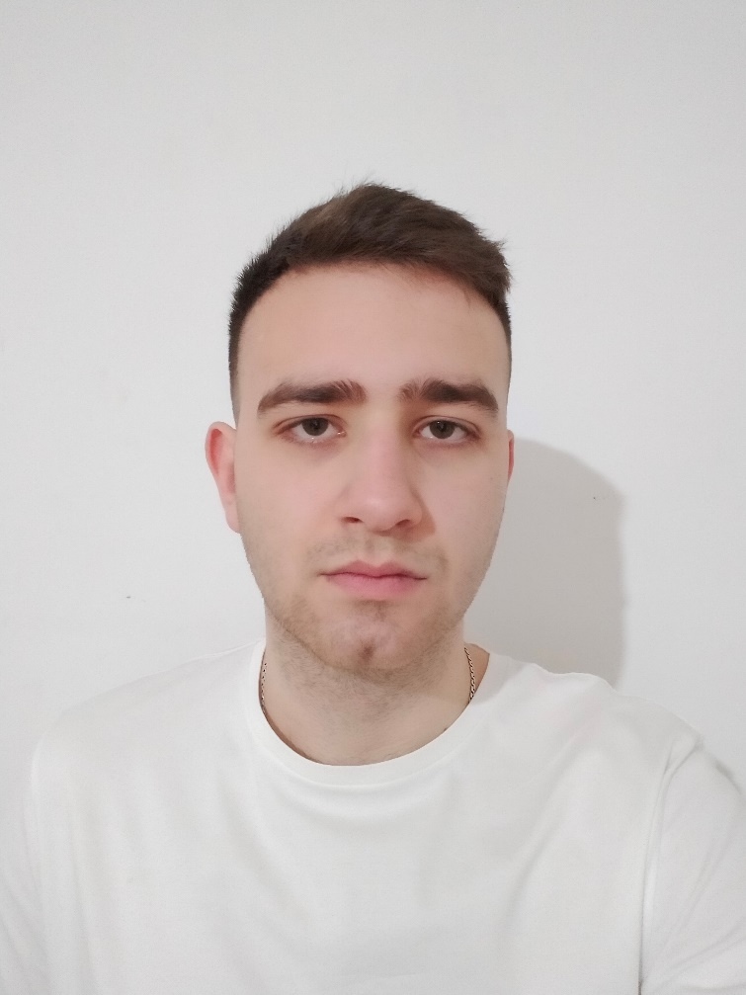
About me
A few facts about me:
I am currently a Cybersecurity student at the Lviv Polytechnic.
I am interested in DevOps and want to improve my professional skills.
I am a friendly and sociable person. I easily find a common language with people.
I love doing sports and keeping fit. It helps collect my thoughts.

Slide 3

Motivation
To create my first real CI/CD project and get an understanding of how DevOps tools work. It undoubtedly helped me to improve my professional skills.

Slide 4
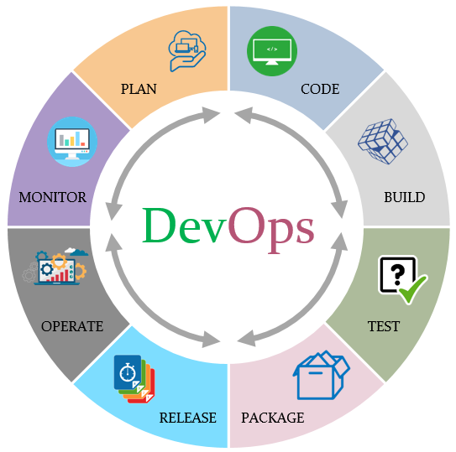
Relevance
Nowadays, there is a huge amount of projects for which agile methodology is the best strategy. CI/CD pipeline is one of the parts of this. In this project, I want to introduce you to my variant of realization.

Slide 5

Goals
My project has several goals:
Automation
Acceleration
Isolation
Easy shipping
Visualization

Slide 6

Tasks
Some of the tasks:
Dockerize infrastructure
Build
Test
Save artifacts
Initialize AWS infrastructure
Configure environments
Deploy

Slide 7
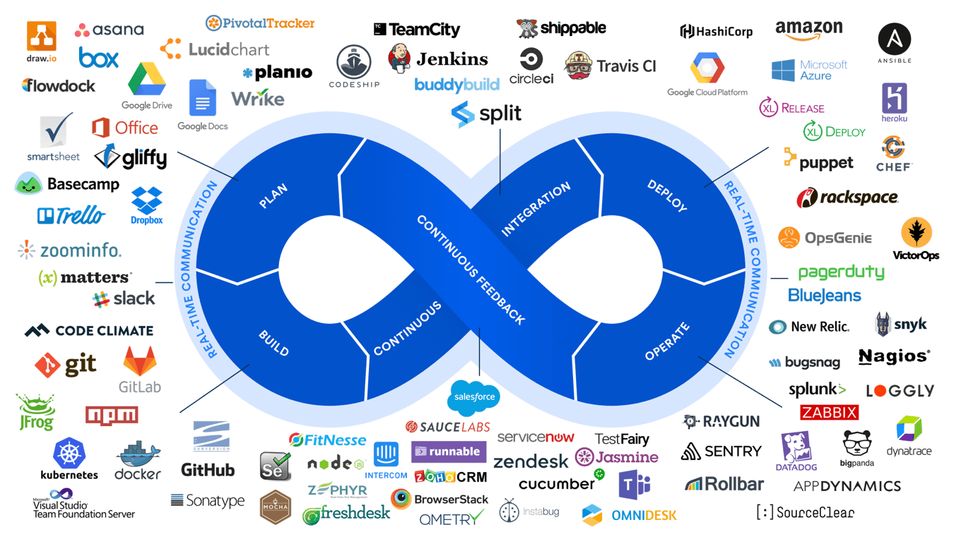
Technology stack
Selected technology stack:
GNU/Linux
Docker
Jenkins
GitHub
Smee
Amazon Web Services
Terraform
Ansible
Telegram

Slide 8
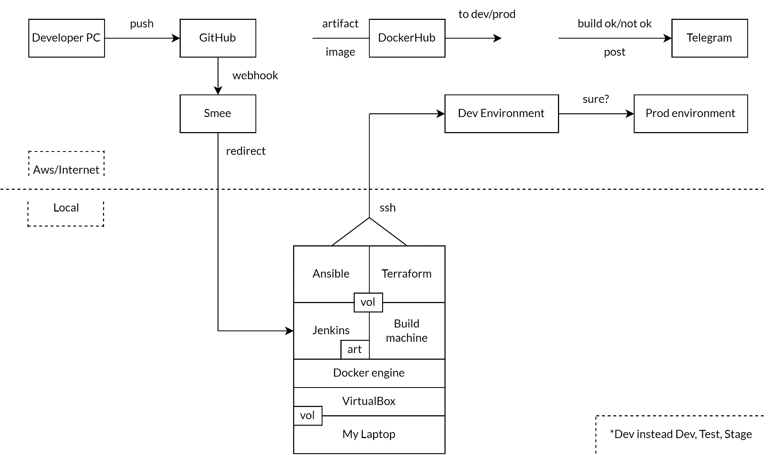
Inside project

Slide 9
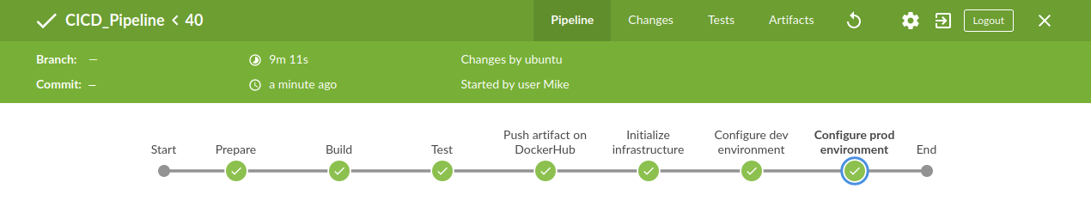
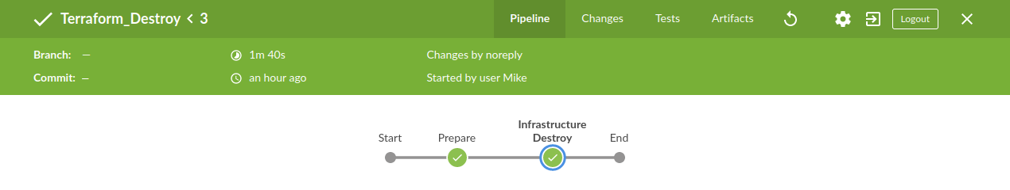

Pipeline

Slide 10
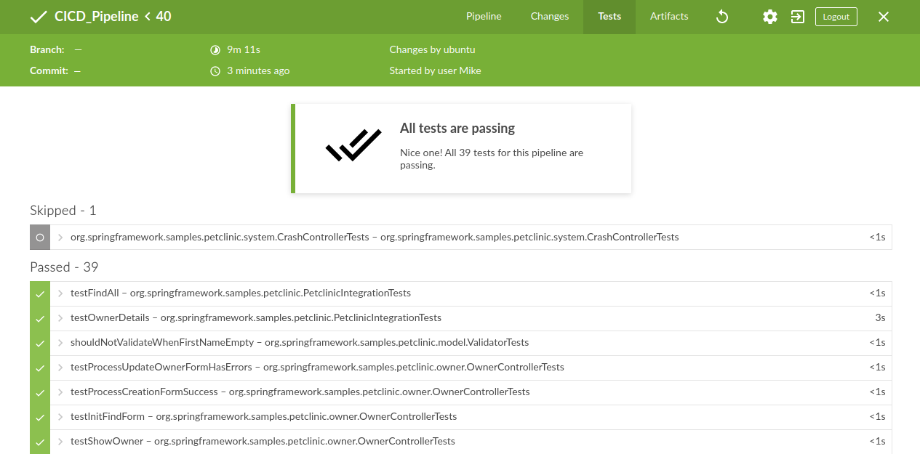
Tests

Slide 11
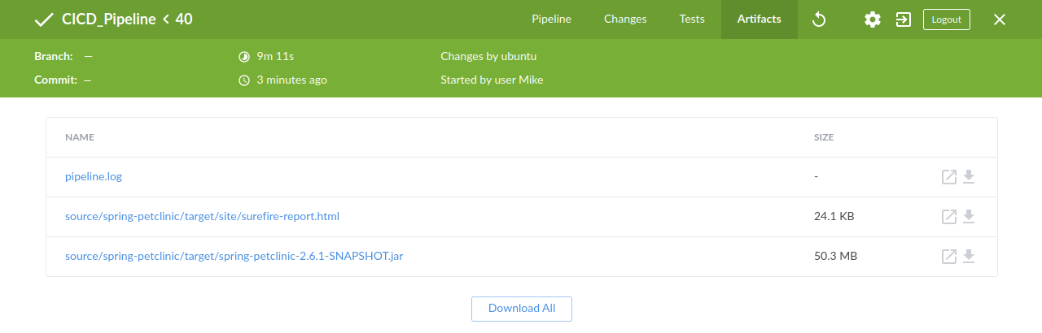
Artifacts

Slide 12
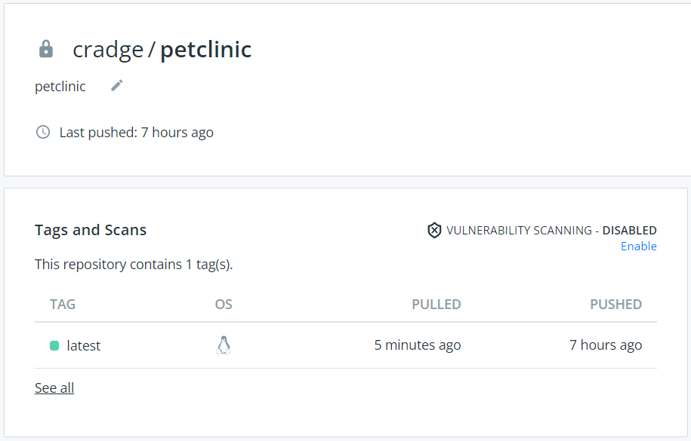
DockerHub

Slide 13
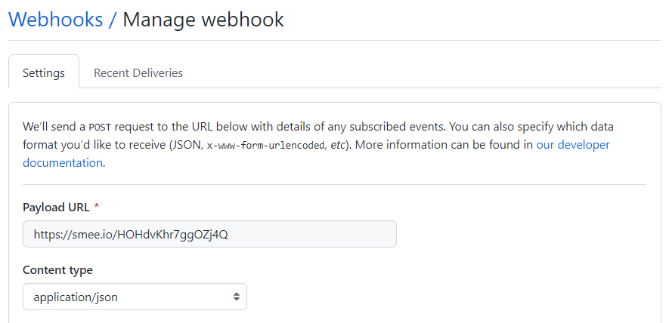
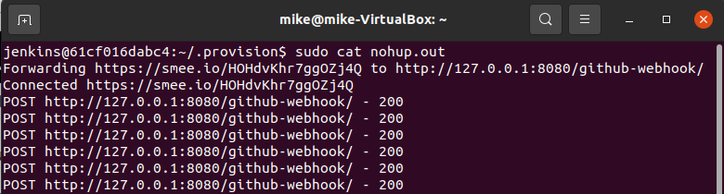
Webhooks

Slide 14
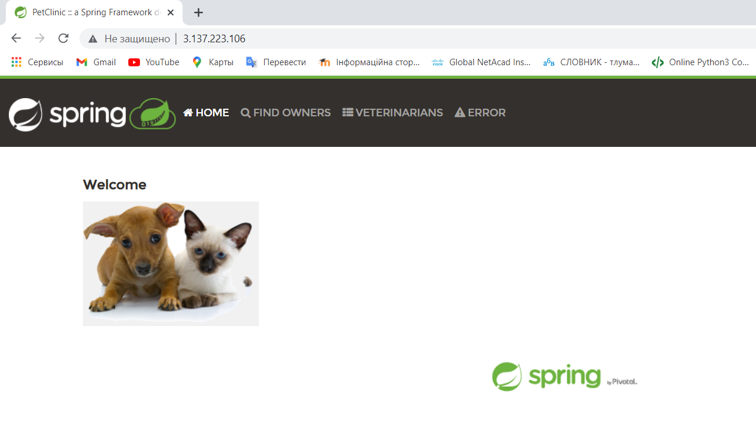
Results

Slide 15

Results

Slide 16
Thanks for your attention!

