Slide 1
ESE3 – Arcade game
Demo 2 – 14/11/2018

Slide 2
Original goals
Game design
Update Project description
Refactor chosen game to mainline code
Pick game name
Raspberry PI
Running game on PI
Interface with peripherals
Controlling game with peripherals
Neural Network Research
Recurrent NN
Convolutional NN
NN with the Raspberry Pi
Neural Network Implementation
Implement NN on raspberry Pi
Implement a related NN

Slide 3
Overview
Meeting – 1
-- Created wireframes
-- Intro to Recurrent NN
-- Research on peripherals
Meeting – 2
-- Created video demo
-- Recurrent NN with Keras
-- research into NN with the raspberry pi
Deliverables so Far
-- Wireframes
-- Video Demo
-- Updated NN Description
-- YOLOv2 NN
-- Refactored prototype 1
-- Name suggestions
-- interfacing with raspberry pi
-- small NN working on raspberry pi
Meeting 3
-- Updated NN description
-- YOLOv2 with Darknet
-- List of possible names created
-- small NN running on Raspberry pi
Meeting 4
-- Refactor game code
-- Running YOLOv2 NN on laptop
-- Interface with the raspberry pi

Slide 4
Progress – software
Prototype 1 Selected
Full refactor
Comments
Proper coding conventions
Updated Documentation and WIKI

Slide 5
Progress – Hardware
Purchases:
– Raspberry Pi 3
– Power supply
– Arcade controls
Basic set up
Software installed to run the game
Interfaces with peripherals
Has GitLab access
Ran various small NN
Works with arcade academy
Python3

Slide 6
Video – raspberry pi

Slide 7
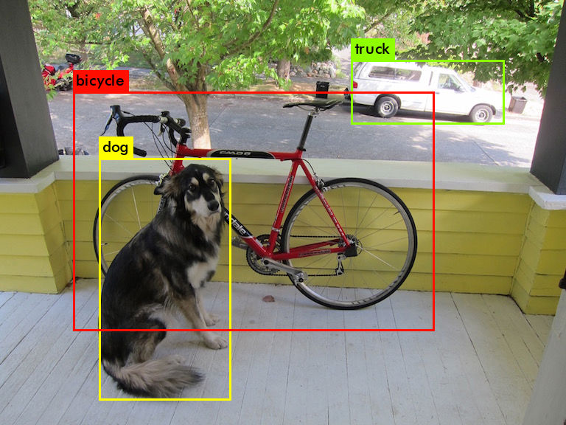
Neural Network
Mainly using Keras and tensorflow
Recurrent NN
Darknet
YOLO
Real Time NN
Object Detection
file:///home/andrew/Desktop/NN/darket/prdictions.jpg

