Slide 1
ESE3 – Arcade game
Demo 1 – 14/11/2018

Slide 2
Original goals
Requirements Gathering
Functional requirements
Non functional requirements
User stories
Software
Hardware
Hardware Proposal
Full description of hardware
Details regarding cabient
Game Proposal
Full proposal of possible games
Neural Network Research
Develop a basic understanding of NN

Slide 3
Overview
Meeting – 1
-- Communications
-- High level overview
-- Resources
Meeting – 2
-- Cabinet Details
-- Hardware
-- High level requirements of game
-- 6 Games
Deliverables so Far
-- Requierments
-- Game proposals
-- Hardware proposals
-- Cabient proposals
-- User Stories
-- Wireframes
-- Prototype 1 (Game 1)
-- Prototype 2 (Game 2)
-- NN Prototype/research
-- Interfacing with the Raspberry Pi
Meeting 3
-- 2 Games
-- Confirmed hardware
-- Confirmed purchase list
-- Emphasis on requirements

Slide 4
Progress – software
Original five proposals
Snake Satellite Proposal
Pac-Man Proposal
Cloud – Jump Proposal
Flappy-Bird Style Game
Satellite wars Proposal
Final two proposals
Flappy-Bird Style Game
Snake Satellite Proposal
Full proposals Include
Brief Description
Neural Network Involvement
Difficulty level
Controls
Scoring
End Game
Resources
Potential Issues
Education value
Wireframes

Slide 5
Progress – Hardware

Slide 6
Game 1 – Flappy bird style

Slide 7
Game 2 – snake style

Slide 8
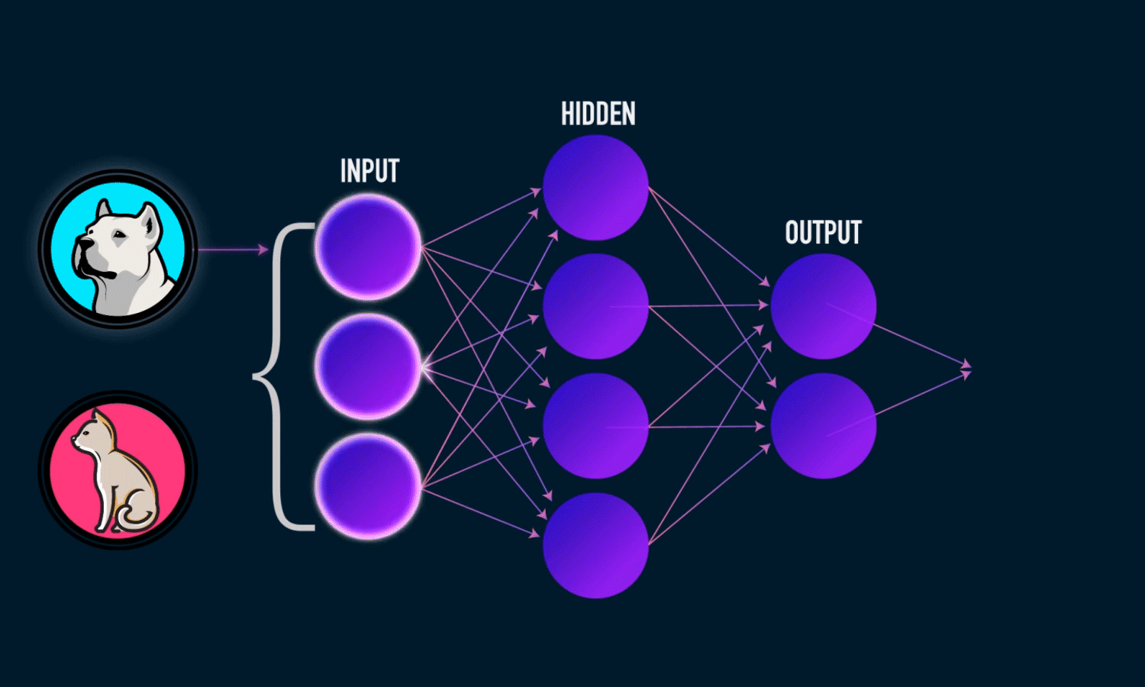
Neural Network
Convolutional Neural Networks
Python3
Keras
TensorFlow
Diabetes predictor
Accuracy 80.21%
Image recognition
Cats and Dogs
Colour recognition

