Slide 1
ESE3 – Arcade game
Demo 1 – 14/11/2018

Slide 2
Original goals
Requirements Gathering
Functional requirements
Non functional requirements
User stories
Software
Hardware
Hardware Proposal
Full description of hardware
Details regarding cabinet
Game Proposal
Full proposal of possible games
Neural Network Research
Develop a basic understanding of NN

Slide 3
Overview
Meeting – 1
-- Communications
-- High level overview
-- Resources
Meeting – 2
-- Cabinet Details
-- Hardware
-- High level requirements of game
-- 6 Games
Deliverables so Far
-- Requirements
-- Game proposals
-- Hardware proposals
-- Cabinet proposals
-- User Stories
-- Wireframes
-- Prototype 1 (Game 1)
-- Prototype 2 (Game 2)
-- NN Prototype/research
-- Interfacing with the Raspberry Pi
Meeting 3
-- 2 Games
-- Confirmed hardware
-- Confirmed purchase list
-- Emphasis on requirements

Slide 4

Overview-Alternate proposal
Meeting – 0
Discussed
-- Communications
-- High level overview
-- Resources
Deliverables
-- User stories
–- Requirements
–- Hardware research
–- Cabinet research
-- Game suggestions
–- NN research
Meeting – 1
Discussed
-- Cabinet Details
-- Hardware
-- High level requirements of game
Deliverables
-- Games proposals
–- Hardware proposal
with pricing
Meeting - 2
-- 2 Games
-- Initial hardware
-- Emphasis on requirements
Deliverables
-- 2 detailed game proposals
– Hardware purchase proposal

Slide 5
Progress – software
Design Requirements
Satellite based
Competitor CPU
NN powered CPU
Different difficulties
Side-scrolling
Score
Original five proposals
Snake Satellite Proposal
PAC-Man Proposal
Cloud – Jump Proposal
Flappy-Bird Style Game
Satellite wars Proposal
Full proposals Include
Brief Description
Neural Network Involvement
Difficulty level
Controls
Scoring
End Game
Resources
Potential Issues
Education value
Wireframes
Final two proposals
Flappy-Bird Style Game
Snake Satellite Proposal

Slide 6
Progress – Hardware
Requirements:
– Stand alone arcade game
– Small, fit on desk
– Economical
– Retro, like old arcades
Decisions made:
– £60 initial investment
– Will consider cabinet if the rest of the project is to a standard you are happy with
Purchases:
– Raspberry Pi 3
– Power supply
– Arcade controls

Slide 7
Game 1 – Flappy bird style

Slide 8
Game 2 – snake style

Slide 9
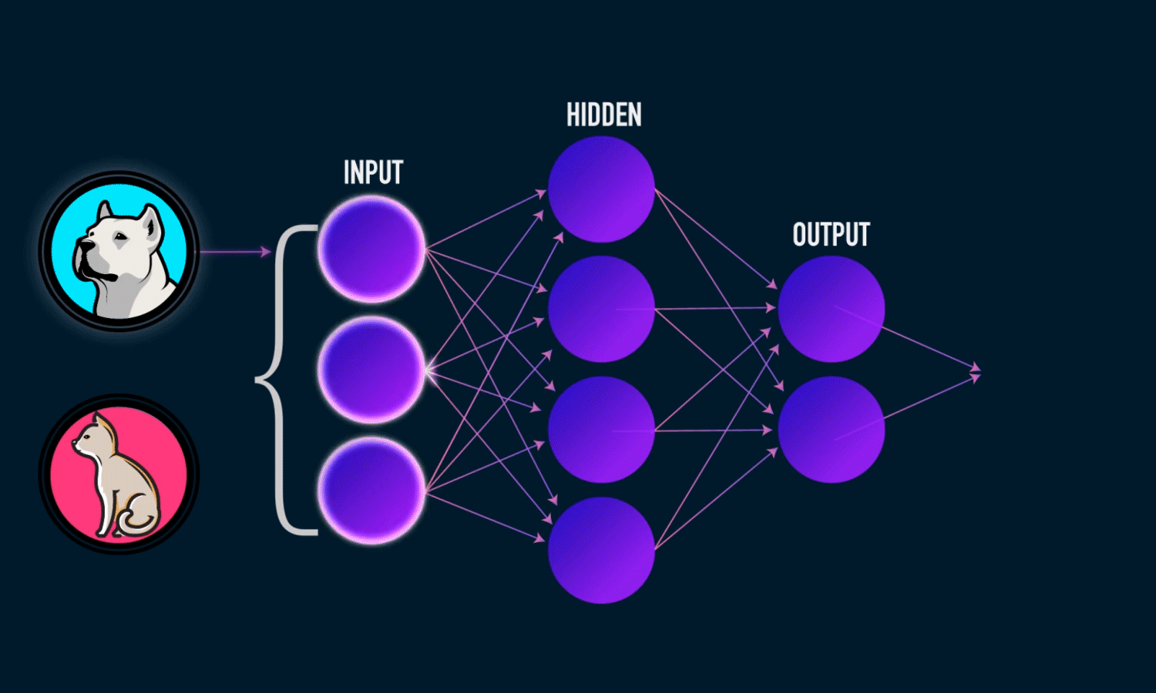
Neural Network
Convolutional Neural Networks
Python3
Keras
TensorFlow
Diabetes predictor
Accuracy 80.21%
Image recognition
Cats and Dogs
Colour recognition

