Slide 1
Automating your deployments
1
2
3
4
5
6
7
8
9
10
11
12
Scott Cowan
Long time developer

Slide 2

Scott Cowan
1
2
3
4
5
6
7
8
9
10
11
12
Who am I
About me
I’ve been consulting in london for a long time and currently work onsite at Schroders with Valtech. I enjoy devops and even get excited about it.
My experience
I’ve used octopus deploy on 4 projects in the past. Working with websites and signed clickonce deployments. I’ve been working with various CI environments including TeamCity and TFS.
Logo

Slide 3




The ways we deploy
1
2
3
4
5
6
7
8
9
10
11
12
Good and bad
Manual
File copying
Manual editing config
Release and pray
Build everywhere
deployment packages
Build agent tie up
Not OPS friendly
Build and Deploy
Hand off
Not compiling

Slide 4
Three in one
1
2
3
4
5
6
7
8
9
10
11
12
Change how you look at it
Build
CI
Promote

Slide 5
Build
1
2
3
4
5
6
7
8
9
10
11
12
Compiling at stuff
Compiling
Unit Testing
Packaging
Build

Slide 6
Deploy CI
1
2
3
4
5
6
7
8
9
10
11
12
Getting it out there
Copying
Acceptance Testing
Configuration
Code Signing
Deploy CI

Slide 7
Promoting
1
2
3
4
5
6
7
8
9
10
11
12
It’s getting serious
Copying
Smoke Testing
Configuration
Production issues
Promote

Slide 8
Our services
1
2
3
4
5
6
7
8
9
10
11
12
Branding
Building a brand
A respectable brand is something you have to build gradually in today’s market. Forget the quick fix, embrace customer delight.
The message
Your company conveys a message. Your brand should convey this same message, but without words.How? Ask our branding expert, who has over 10 years of experience with building brands.
Branding

Slide 9
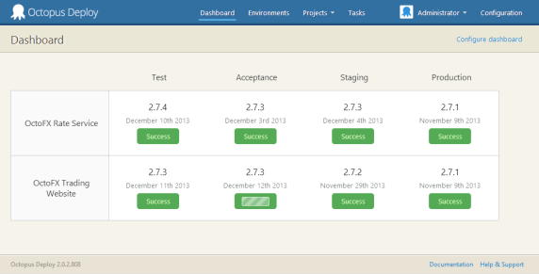
Octopus Deploy
See what’s happening

Slide 10
Send us a message
1
2
3
4
5
6
7
8
9
10
11
12
Our contact information
E-mail
You can contact us at info@lorem.com or me directly at lindsey@lorem.com
Our address
24 Brugstraat 3510 XV Utrecht The Netherlands
On the web
twitter.com/scottcowan
github.com/scottcowan

