Slide 1
Project-Based Assignment
Group Members
Instructor:
Abdullah Imran, Laiba Butt
Sir. Humayun Majeed
Department
Course
Computer Science
Data Structures
Date
1st January, 2026

Slide 2
01
Introduction

Slide 3
Introduction
This project implements fundamental data structures and algorithms in C++, covering:
Arrays, Linked Lists, Stacks, Queues, AVL Trees, and Graphs
28 distinct problems ranging from basic operations to advanced algorithms
Floyd's Cycle Detection, AVL Tree balancing, and Graph traversals
Purpose: Bridge theoretical knowledge with practical implementation, enhancing problem-solving capabilities and strengthening our foundation in data structures.

Slide 4
Assignment Overview
Part 1
Part 2
Part 3
Part 4
Part 5
Part 6
Array & Linked List Questions
Stack & Queue Questions
Cracking the Code Questions
AVL Trees Questions
Graphs Questions
Main Menu Question

Slide 5
Implementation Summary
Programming Language: C++
Key Data Structures Implemented:
Dynamic arrays with recursive operations
Singly and doubly linked lists
Stack and queue variations
Self-balancing AVL trees
Weighted directed and undirected graphs
Total Functions: 28 complete implementations with comprehensive testing

Slide 6
Array Implementation
Operations Implemented:
Recursive array reversal
Right rotation by k positions using three-reversal technique
Rearranging negative numbers before positives
Key Advantage: O(n) time complexity with O(1) space complexity for rotation
Limitation: Recursive approach may cause stack overflow for very large arrays

Slide 7
Linked List Implementation
Operations Implemented:
List reversal (iterative), palindrome detection
Merging sorted lists, cycle detection (Floyd's)
Removing consecutive absent nodes
Merge sort implementation
Finding Nth node from end
Advantages: Dynamic size, efficient insertion/deletion
Limitations: No random access, extra memory for pointers

Slide 8
Stack Implementation
Operations Implemented:
Recursive stack sorting without auxiliary structures
Balanced bracket checking (4 types: (), {}, [], <>)
Min-Stack with O(1) minimum retrieval
Applications:
Expression evaluation
Backtracking algorithms
Function call management

Slide 9
Queue Implementation
Operations Implemented:
Priority queue based on emergency levels
Queue sorting using stack and auxiliary queue
Stack implementation using two queues
Applications:
Hospital emergency management
Task scheduling
BFS graph traversal

Slide 10
Cracking the Code
Problem-Solving Strategies:
Two-pointer technique for Nth from end
Hash set for O(n) duplicate removal
In-place node deletion by data copying
Carry propagation for adding numbers
Key Logic: Efficient algorithms with optimal time/space complexity trade-offs

Slide 11
AVL Tree Construction
Steps for Construction:
Insert node as in BST
Update balance factors of ancestors
Check for imbalance (|BF| > 1)
Perform appropriate rotation (LL, RR, LR, RL)
Importance of Balance Factor: Maintains O(log n) search, insert, delete operations by keeping tree height balanced

Slide 12
Graph Traversals and Operations
Operations Implemented:
Adjacency list and matrix representations
BFS using queues (level-order traversal)
DFS using recursion (depth-first exploration)
MST using Kruskal's algorithm
Key Insights: Different traversal strategies suit different problems; MST minimizes total edge weight

Slide 13
Integrated Menu-Driven Program
Integration Features:
Dynamic menu displaying all 28 questions
User input validation
Sequential execution capability
Clean memory management across operations
Menu Options: Users can select any question (1-20), execute it, and optionally run another or exit

Slide 14
Dry Run Demonstrations
Test Cases Executed:
Example 1 - Floyd's Cycle Detection:
List: 1→2→3→4→5→(back to 3)
Cycle Start: Node 3
Example 2 - Palindrome Check:
List: [1, 2, 3, 2, 1]
Result: True (Is Palindrome)
Key Outputs: All implementations tested with edge cases including empty lists, single elements, and large inputs

Slide 15
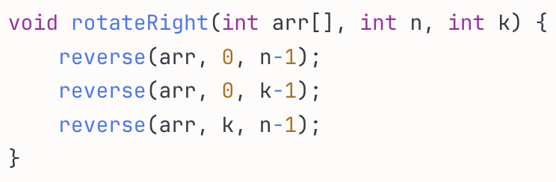
Code Snippets and Structure Explanation
Array Rotation (Three-Reversal):
Achieves O(n) time, O(1) space by reversing entire array, then first k elements, then remaining elements.
Floyd's Cycle Detection:
Slow pointer moves one step, fast moves two. When they meet, reset slow to head, move both one step until they meet at cycle start.

Slide 16
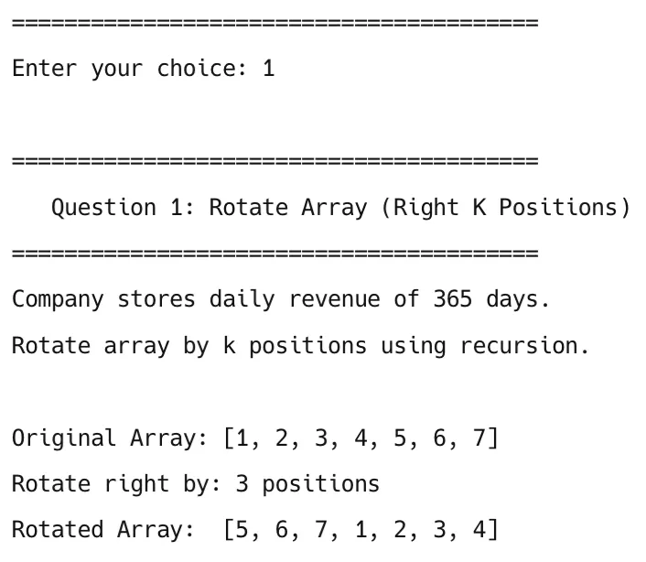
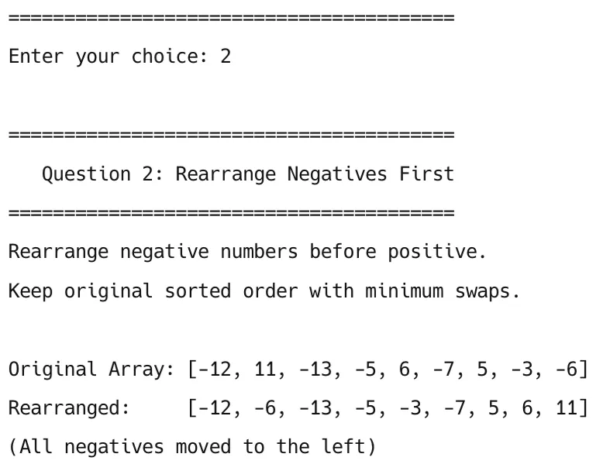
Output and Screenshots
Question 1 - Array Rotation:
Question 2 - Rearrange Negatives:

Slide 17
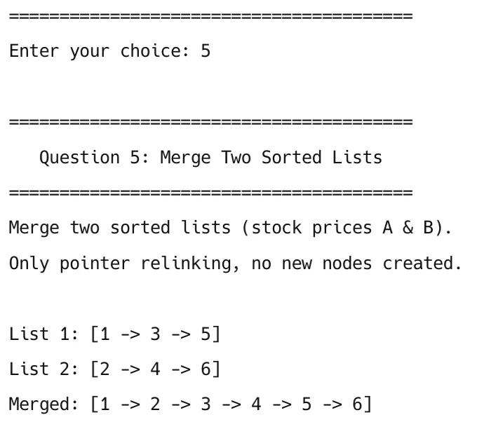
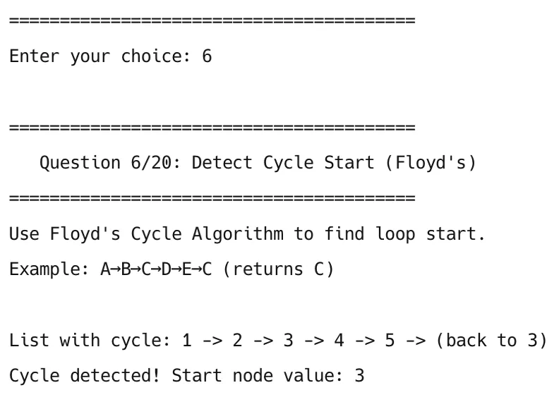
Output and Screenshots
Question 5 - Merge Sorted Lists
Question 6 - Detect Cycle Start

Slide 18
Discussion and Learning Reflection
Key Learnings:
Floyd's algorithm demonstrated clever pointer manipulation for cycle detection
Recursive stack sorting showed how call stack can replace auxiliary structures
AVL rotations taught importance of maintaining invariants
Graph algorithms revealed power of different traversal strategies
Skills Developed: Debugging, pointer manipulation, edge case handling, modular code design

Slide 19
Challenges Faced
Technical Challenges:
Memory management with dynamic allocation
Pointer manipulation in doubly-linked structures
Edge cases (empty lists, single nodes, tail operations)
Solutions Implemented:
Systematic testing with comprehensive test cases
Drawing diagrams for visualizing pointer changes
Creating decision flowcharts for AVL rotations
Recursion Depth: For large structures, iterative approaches preferred over recursive to avoid stack overflow

Slide 20
Conclusion
Achievements:
Successfully implemented 28 data structure problems
Mastered fundamental algorithms (Floyd's, Merge Sort, AVL balancing)
Integrated all implementations into cohesive menu-driven program
Results: Deep understanding of when and why to use specific data structures
Future Scope: Apply these concepts to advanced algorithms, system design, and optimize for parallel processing

Slide 21
References
Cormen, T. H., et al. (2009). Introduction to Algorithms (3rd ed.). MIT Press.
Weiss, M. A. (2013). Data Structures and Algorithm Analysis in C++ (4th ed.). Pearson.
Karumanchi, N. (2016). Data Structures and Algorithms Made Easy. CareerMonk Publications.
GeeksforGeeks. (2024). Data Structures. https://www.geeksforgeeks.org/data-structures/
LeetCode. (2024). Problems Archive. https://leetcode.com/problemset/
McDowell, G. L. Cracking the Coding Interview (6th Edition).
Class lecture notes - Mr. Humayun Majeed, Data Structures Lab, Fall 2025
Lab Tasks, Practicals 1 - 14

Slide 22
Thank You

