Slide 1
DevSecOps Proposal
Craig Dillon
Development Team Lead
Notes:
Hi, My name is Craig and I’m the Development Team Lead
Thanks for taking the time to attend this presentation.
I’d also like to extend a warm welcome to the new CEO who is making an instant positive impact

Slide 2
Current Challenges
Siloed workloads
Slow release schedule
Technical debt
Poor interpersonal relationships
Notes:
We’re facing current challenges
Siloed workloads, not a lot of knowledge sharing or communication on decisions made in the development process
Technical debt from poor product quality meaning engineers spend more time than they should fixing problems in production
Personality clashes are creating a challenging work environment and having a serious impact on collaboration and knowledge sharing
As a result, we have a year long release cycle where competitors are releasing at a much faster rate, the CEO has set a target of a release per quarter

Slide 3
Proposal Options
Focus on soft skills
Accountability and performance monitoring framework
Integrate security functions into the development process
Notes:
We could focus on developing soft skills like communication, conflict resolution and active listening. Utilise team-building events and a mentorship program to encourage teams to interact.
We could enforce Performance metrics where senior team members are accountable for ensuring there is clear communication between teams without incident. Consider mandatory team building events, leadership empowerment training and a strict conflict resolution process.
Integrate security into the development cycle, DevSecOps.

Slide 4
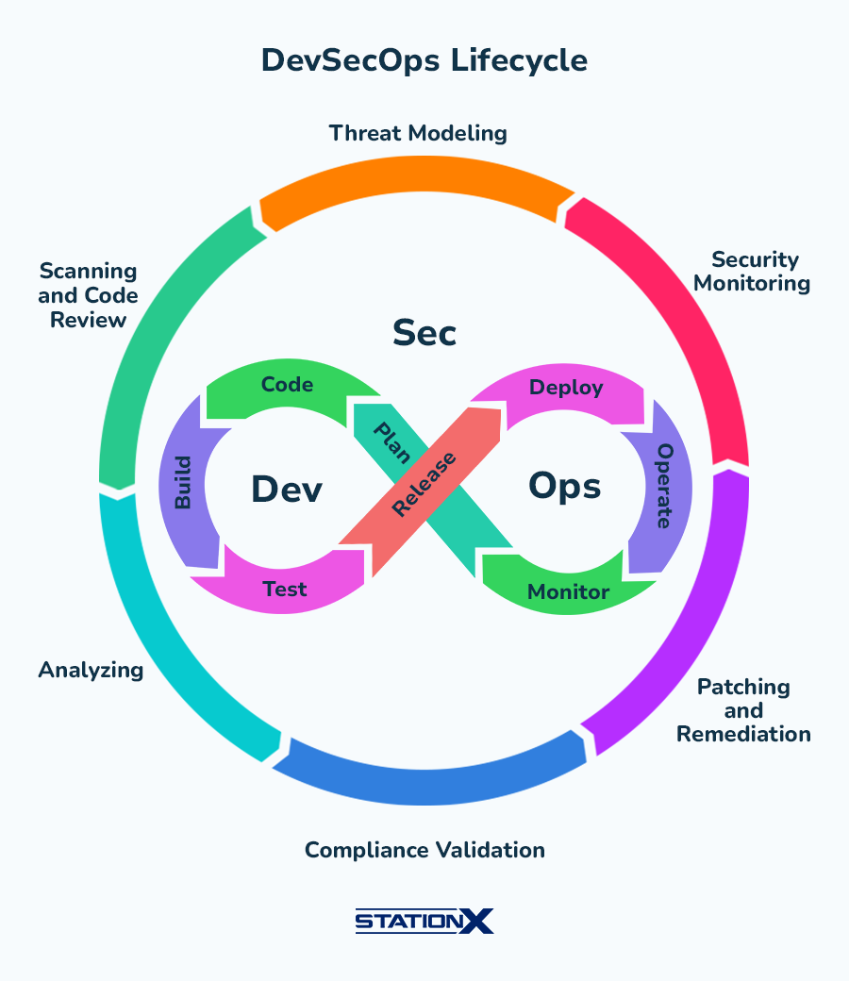
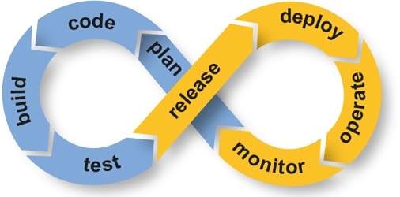
What is DevSecOps?
Source: ARCAD Software, Accessed March 2024
Source: StationX, Accessed March 2024
Notes:
We are familiar with the DevOps cycle of continuously moving and improving.
DevSecOps builds on that, and includes security functions as part of the cycle preventing it becoming an afterthought. In our case, the security team have no input to the development cycle and after analyising the product they then have to return issues to the development team. This has caused many disagreements and huge delays in releases, not to mention shortcuts being taken to attempt to remediate issues.

Slide 5
Implementation Plan
DevSecOps Culture
Cross-Functional Team
Automation
Notes:
How do we get to this Valhalla?
In one piece, hopefully. We embrace DevSecOps culture, that is open communication, staff empowerment, metrics, visibility and modern and efficient processes.
Create a cross functional team, bring the development and security teams together. Rely on the expertise and experience of both to build a fast, resilient and reliable development pipeline.
Automate as many of the functions as possible, security needs to be a 24/7 process and we can only achieve that through automation. Standardised checks with rapid alerting is the goal.

Slide 6
Financials
Training
Allocate €2,000 per person (25) for training
Recruitment
Allocate €120,000 for recruits with relevant skills and experience
Tools
Gitlab with SAST/DAST - €99 per month per user (25)
Snyk for SCA - €25 per month per product
Intruder for realtime scanning/reporting - €500 per month
Totals
First year - €206,300
After implementation - €86,300
Notes:
This all sounds great, but what is it going to cost us?
There will be a lot of training required, both for soft skills and technical skills.
We should allocate some funds for recruitment, bringing in one or two people with the experience of working in a DevSecOps environment would be beneficial.
We need modern tooling to enable the automation of features, SAST (static application security testing) scans software before it is compiled whereas DAST (dynamic application security testing) simulates malicious actors in a production environment, SCA checks dependencies for vulnerabilities and Intruder monitors the attack surface. Things like expired SSL certs, exposed cloud storage accounts and port scanning.
Ongoing annual financial cost includes training, keeping team members up to speed with the latest vulnerabilities and technology stacks.

Slide 7
KPIs and Expected Outcomes
Release Cycle
More frequent releases
Faster response to feedback
Security Vulnerabilities
Measure response times
Monitor for reduction in vulnerabilities detected in production
Collaboration
Improved relationships
Effective collaboration and communication

Slide 8
Timeline
Months 1-2
Months 3-6
Months 8-9
Kickoff
Evaluation and culture shift
Implementation
Months 9-10
Formalise Team
Months 10-12 and beyond
Continuous Improvement
Notes:
Kickoff meeting for the teams, introduce the vision and benefits. Ensure the topic comes up in company wide communications and meetings as well.
Start planning the formation of a cross-functional team, hold awareness sessions highlighting the requirements for change. Deep dive into the current processes of development and security teams, identify requirements and issues.
Begin training and Embed the culture shift by having regular company wide status updates, seek regular feedback and updates. Evaluate tools, what needs to change, shortlist and test new tooling. Begin planning and implementing and training for using these new tools and developing procedures around the DevSecOps pipeline.
Integrate new tooling into the existing workflow, replace what needs to be replaced. Deploy monitoring systems to check production environment in realtime.
Formalise the cross-functional team, no longer a development or security team, a single unit of self organising who take ownership of processes, issues and solutions.
Continue to monitor KPIs, regular feedback from staff and address issues as they arise, encourage mentorship programs and consider bringing QA into the same cycle and becoming a core part of the DevSecOps process.

Slide 9

Q&A
Notes:
Any questions?

Slide 10
References
administrator (2016). Relevance of a DevOps strategy. [online] ARCAD Software. Available at: https://www.arcadsoftware.com/arcad/news-events/blog/relevance-of-a-devops-strategy/ [Accessed 8 Mar. 2024].
Anon, (2023). DevOps vs DevSecOps: Key Differences (and Which Is Best?). [online] Available at: https://stationx.net/devops-vs-devsecops/ [Accessed 8 Mar. 2024].
Benjamin, J. (2023). GitLab Pricing – Actual Prices for All Plans, Including Enterprise. [online] RevPilots. Available at: https://revpilots.com/pricing/gitlab-pricing/ [Accessed 9 Mar. 2024].
snyk.io. (2019). Plans and Pricing | Free plan | Snyk. [online] Available at: https://snyk.io/plans/. [Accessed 9 Mar. 2024]

