Slide 1
Infrastructure as Code: Terraforming your Environment
Craig Dillon
MSC DevOps
Human and Organisational Skills
Notes:
Good afternoon everyone, thank you for joining me today. My name is Craig and I’m excited to discuss a new approach to managing our IT infrastructure that will bring many benefits to the organisation.

Slide 2
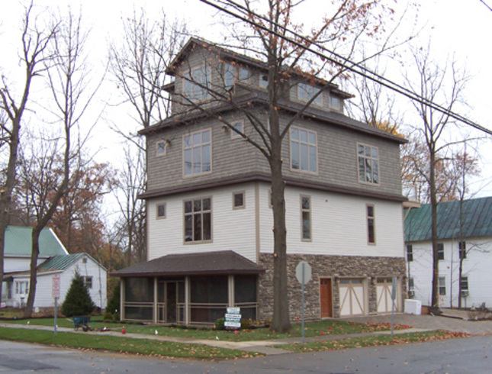


Infrastructure is currently deployed manually
Manual
Deployment
Time intensive
Inefficient
Inconsistent
Notes:
Company currently deploys IT infastructure manually
Takes engineers a lot of time to deploy small even the smallest services.
So what does that mean;
Use house analogy
It takes several builders to build a house
This expensive in terms of resources, time and finance
Initially the house meets your needs
What happens when your needs change?
You extend the home and keep extending until…

Slide 3


What is Infrastructure as Code?
Automated
Scalable
Modular
Notes:
Flatpack home
Instead of extending tear it down and rebuild for a fraction of the cost in the fraction of the time
Same can be said for our engineers, they can deploy and redeploy services in a fraction of time

Slide 4
The power of Infrastructure as code
Low cost
Efficient
Fast delivery times
Consistent
Scalable
Flexible
A standardized and transferable framework for all technical teams to use.
Notes:
Reduces cost
Increases efficiency and greatly improves delivery times
Standardised configuration language
Deployments can be tested and verified before going live
Transferable knowledge
Building infrastructure for services, deployment of applications
Standard for all technical teams to use
Reduces cost
Improves efficiency
Consistent
Innovative
Reduces impact of issues

Slide 5

Blueprints for a New Environment
Used Terraform execution processes
Leveraged Terraform modules
Implement standardized procedures
Improved security
Automate tasks
Improved productivity
Widespread adoption throughout organisation
Robust infrastructure management
“Now that our entire company uses Terraform Cloud, our
development process is more efficient.”
MR. RIKI MAKITA, INFRASTRUCTURE SECTION, SERVICE PLATFORM DIVISION, Money Forward
Notes:
Money Forward
Leading fintech company in Japan
Improved security by implementing standardised procedures for handling sensitive customer information
Improved productivity and accelerated development by automating tasks that were previously performed manually dozens of times a day
More robust infrastructure management and widespread adoption of Terraform throughout the organization
Use Terraform IaC execution processes to establish standardized procedures for managing sensitive customer information
Leverage Terraform IacC modules to streamline digital infrastructure

Slide 6
How Terraform Reshaped Corporate Landscapes
You are able to write the Terraform IaC to create cloud resources…that’s a paradigm shift.
“It’s by far my favorite tech in my 20-year career. It
just clicked for me…”
THOMAS CHALMERS, ASSISTANT VICE PRESIDENT CLOUD ENGINEERING, DEUTSCHE BANK
JOHN WEIGAND, SR DEVOPS ENGINEER, TRIMBLE
Notes:
Deutsche Bank
Broke down resource silos between teams
Application teams can autonomously create new offerings for internal teams
Reduced time to market of services to banking customers
Trimble
Reduced weekly tickets and improved productivity and production timeline estimates
Reduced infrastructure development from 3 days to 1 hour
Codified legacy infrastructure in Terraform and standardized environment-agnostic code, deployable anywhere

Slide 7
Embracing the future
Form a task force with a Project Manager
Training for all relevant staff
Begin deploying with Terraform ASAP
Champion and promote Terraform as the solution
Notes:
Champion the proposal, get staff on board with the new direction
Project manager and task force
Training for all technical staff
After training, begin all new deployments with terraform
Create a backlog to get old infrastructure in line

Slide 8
References
Hashicorp, ‘Deutsche bank | customer case study | A bank, the cloud, and a paradigm shift’, https://www.datocms-assets.com/2885/1689178113-hc_deutsche-bank_casestudy-2.pdf
Hashicorp, ‘Money forward | customer case study | Money for life’, https://www.datocms-assets.com/2885/1670367746-hc_moneyforward_casestudy_eng.pdf
Hashicorp, ‘Trimble | customer case study | Building at scale’, https://www.datocms-assets.com/2885/1635524145-hctrimblecasestudyweb.pdf

