Slide 1
GitOps for a global team
Craig Dillon
DevOps Lead
Notes:
Hi, welcome and thanks for taking the time to attend my presentation on GitOps. My name is Craig and I am a DevOps Lead.

Slide 2


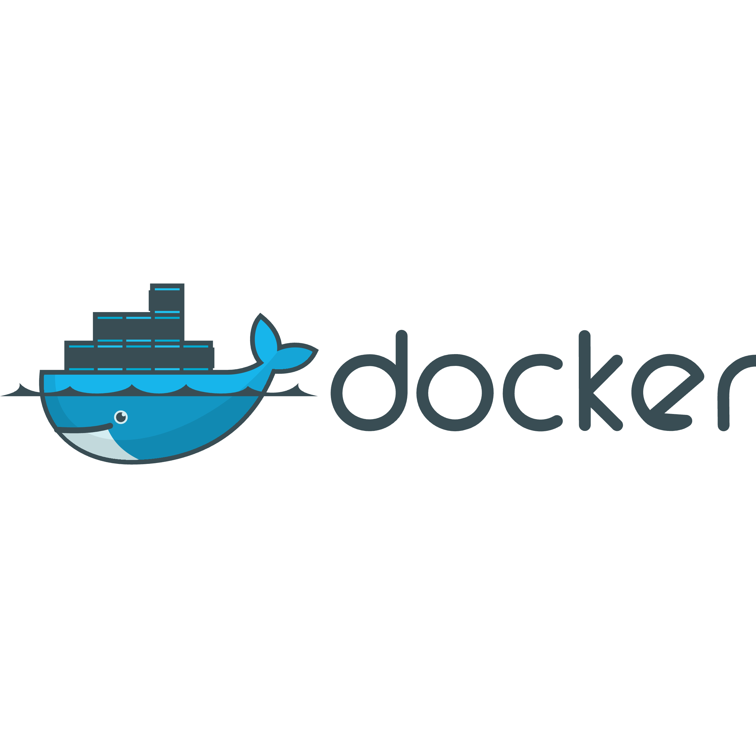
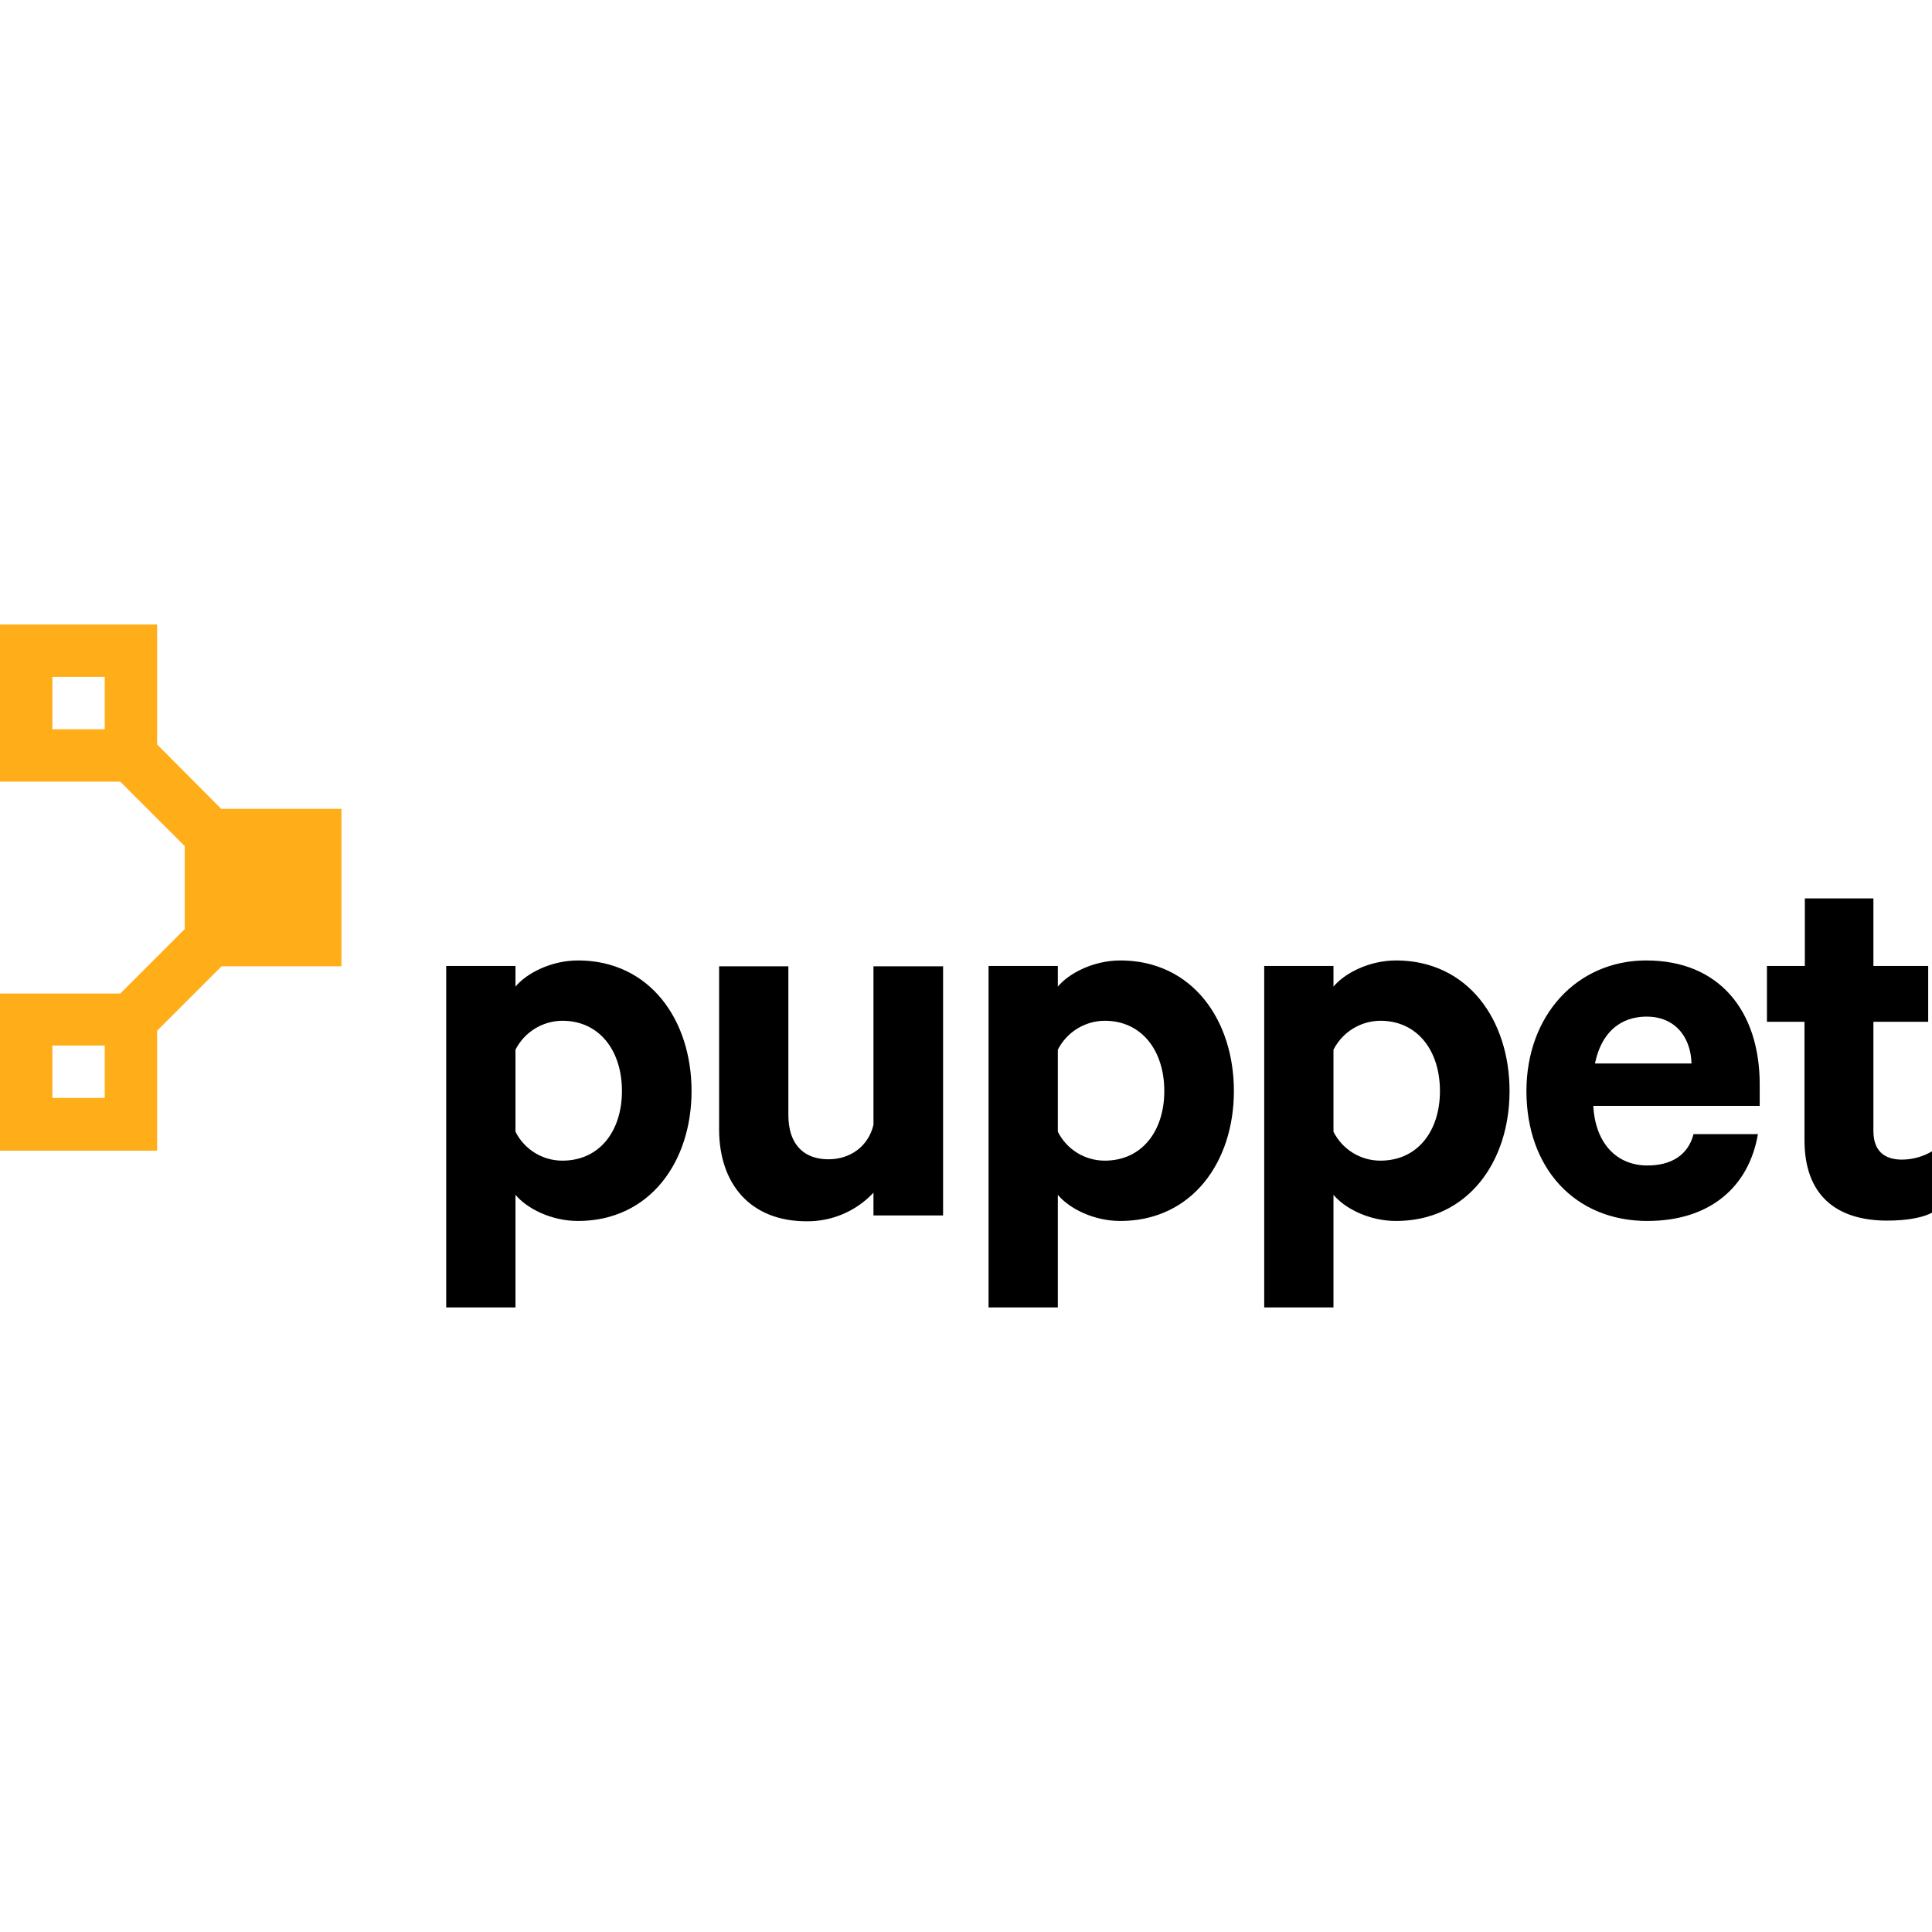


Where are we?
Notes:
Let’s take a quick look at the current state of affairs within the organisation. We have recently embarked on forming a global DevOps team from several pre-existing teams that spanned several regions of the world. Each of these teams has their own workflows and tooling systems leading to divergence in knowledge, development and delivery methods.

Slide 3



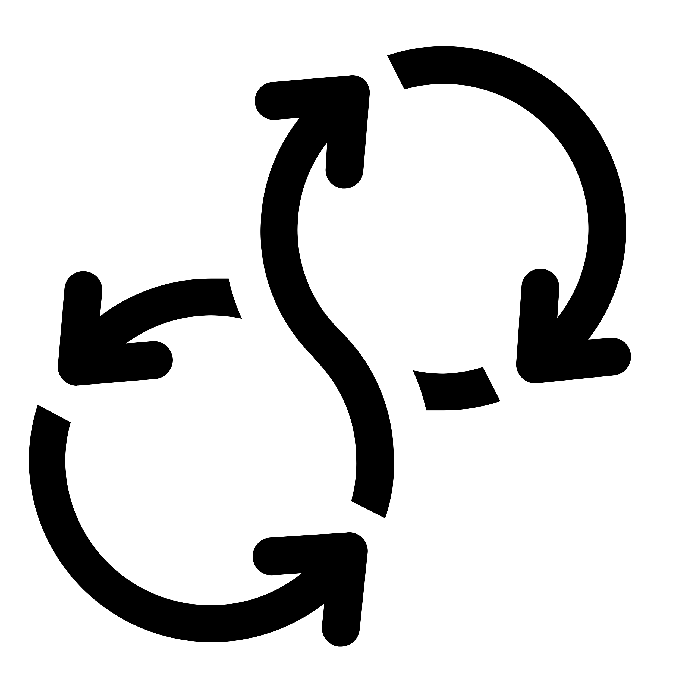



Where are we going?
Notes:
So, where are we going? What IS GitOps? GitOps is a framework that builds on DevOps best practices. There are three main pillars of GitOps;
Git is the single source of truth
Treat everything as code
Operations are performed through Git workflows
The diagram shows an example GitOps workflow, a user commits changes to the relevant Gitlab (or Github) repository, this is then processed in a CI/CD pipeline where tasks like security checks, dependency checks or performance checks can be automated and reported on. If the pipeline is successful then argoCD then deploys the code to whatever platform you want.
This could be terraform or crossplane for infrastructure creation and management, ansible for configuration management, directly to Kubernetes as a service or application or even to cloud services.
But what does that really mean?

Slide 4
Benefits
Faster time to market
Greater stability
Reduced costs
Efficiency gains
Enhanced security and compliance
Rapid incident response
Transparency and auditability
Notes:
Well, it translates to a more efficient development and deployment cycle. We will reduce costs, gain greater security and compliance over our services and will be able to provide customers with a vastly improved end user experience with greater stability, faster incident response and greater flexibility in adding features to applications.

Slide 5
Risk Analysis
Resistance to change
Training
Involvement
Security concerns
Access controls
Auditing
Compliance
Policy enforcement
Logging and monitoring
Data loss
Repository backups
Versioning recovery
Notes:
As with all great shifts, this proposal is not without risk.
Resistance to change;
Training will be provided
This is a project that will change how the company operates, get involved and have your say. The more discussion and more ideas at the beginning will allow us to shape this to suit the needs of everyone involved. I know it seems that some people may feel that their roles will no longer be required but that couldn’t be further from the truth. We need all the expertise, we may be virtualising and containerising a lot of the infrastructure but the underlying core technical principals remain. We still need people with networking knowledge, infrastructure knowledge or to provide frontline support.
Security and compliance concerns;
With this method we have full control over access to the source code along with full auditability
Security and compliance measures can be baked into the process and run as part of the pipeline
This platform provides extensive auditing and monitoring solutions, by bringing everything into one central framework we eliminate issues surrounding unknown unknowns where services exist outside of the regular frameworks
Data loss;
Repositories are easily backed up, if everything is treated as code then everything is recoverable
Data backends are also easily backed up and can be backed up in an endless multitude of ways
Version rollbacks are instantaneous, argoCD handles the deployment where engineers only need to focus on making changes for recovery

Slide 6
Cost Analysis
Training and onboarding
€80,000 training
€250,000 for recruitment
Implementation
€350,000
Annual running costs
GitLab €9,000
K8s clusters €15,000
Slack Pro €4,000
Total €28,000
Annual savings
First year cost €708,000
Total €330,000
Annual savings €42,000
Current running costs €70,000
Notes:
Of course, these changes come at a financial cost.
After an initial outlay of around €708k we expect to see savings of €42,000 compared to running on our current platforms. With the additional efficiency and flexibility we will be aiming to expand our repertoire and as each new service comes online these savings will continue to grow.

Slide 7
Project Roadmap
Phase 1: Weeks 1-4
Assessment
Identify key stakeholders and team members
Assess team proficiencies
Define goals and success metrics
Define objectives with stakeholders
Establish KPIs
Phase 2: Weeks 5-10
Phase 3: Weeks 11-16
Training
Provide training to cover knowledge gaps
Hands-on workshops in GitOps methods
Pilot kickoff
Select a suitable service for the pilot
Set up GitOps environment
Iterative implementation
Adjust processes and configurations
Perform regular retrospectives
Phase 4: Weeks 17-24
Scale up
Identify other suitable services
Migrate services to GitOps incrementally
Integration with existing processes
Update and adapt existing CI/CD processes
Collaborate with other teams to integrate their workflows
Phase 5: Ongoing
Review and refine workflows
Collect feedback from teams and stakeholders
Continually improve processes
Notes:
Implementation of GitOps is expected to take around 6 months, with a final phase of continual feedback and improvement.
Phase 1 is the assessment phase where the stakeholders will define the goals and KPIs of the project.
Phase 2 is training, all members of the newly formed global team will receive training in relevant competencies to bring everyone to the same knowledge level.
Phase 3 is the pilot kickoff, a suitable service will be selected for migration and the GitOps platform will be deployed. The pilot project will be used to refine processes and allow the team to get hands on experience.
Phase 4 is scaling up, this is where we will bring more services into the GitOps platform and begin engaging with other teams and integrating their workflows and continue to update CI/CD processes.

Slide 8
Demo
Notes:
Here’s one that I made earlier. This is a quick example to demonstrate the streamlined process of making a change and having a Git Operator handle the deployment process.

Slide 9
What next?
Notes:
What next? How do we venture into this brave new world?
We need funding to embark on this journey. This is a massive opportunity to get ahead of the competition with a framework that is considered an “Innovation Trigger” by Gartner.
This is also a massive opportunity to develop our skillsets, get experience with a cutting edge technology stack and to really improve ourselves as well as our products and organisation.
We need everyone to invest time and energy, input and feedback is key to the success of this project. If this is something you believe in, something you want to be part of then spread the word, sell it to your teams and colleagues.
Moving to GitOps is an amazing investment and will pay dividends both for the business and each individual.

Slide 10
Q&A
?
Notes:
Thanks for taking the time to attend, I greatly appreciate it and I open the floor to questions.

Slide 11
References
Powerpoint template from https://www.free-power-point-templates.com/free-abstract-blue-white-powerpoint-template/

