Slide 1
Quick note - Individual = Agent (because I couldn’t make up my mind) - Not a true agent based model in the sense there are still population level concepts e.g. carrying capacity (user sets B0), recruitment. This was done to easily align it with stock assessment models. A true agent based model would model agent interactions with environment and population signals would be a result or all agents. - Purpose of the ABM for my thesis is as an operating model to test stock assessment methodology (pretty generic)

Slide 2
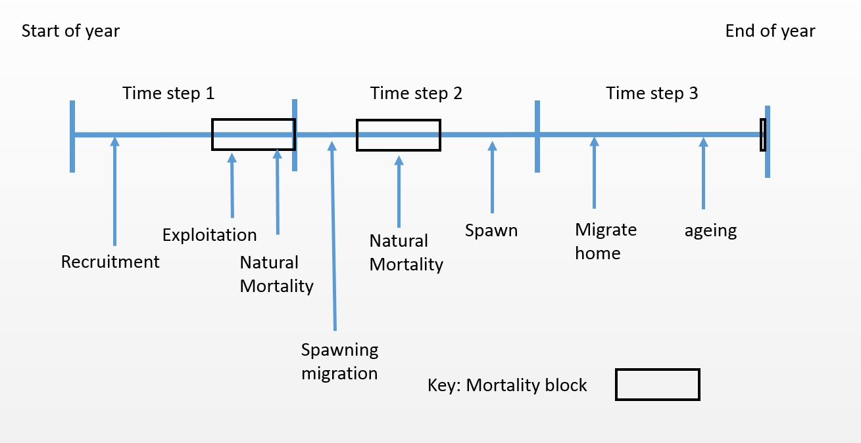
Model structure
The IBM implements a year based algorithm (annual cycle)
Annual cycles are completely user defined, they are split into two components
Time-steps
Processes
Subtle difference why you use a combination of them
Time steps can be months, seasons or any temporal construct.
For each time step users must specify processes that occur

Slide 3
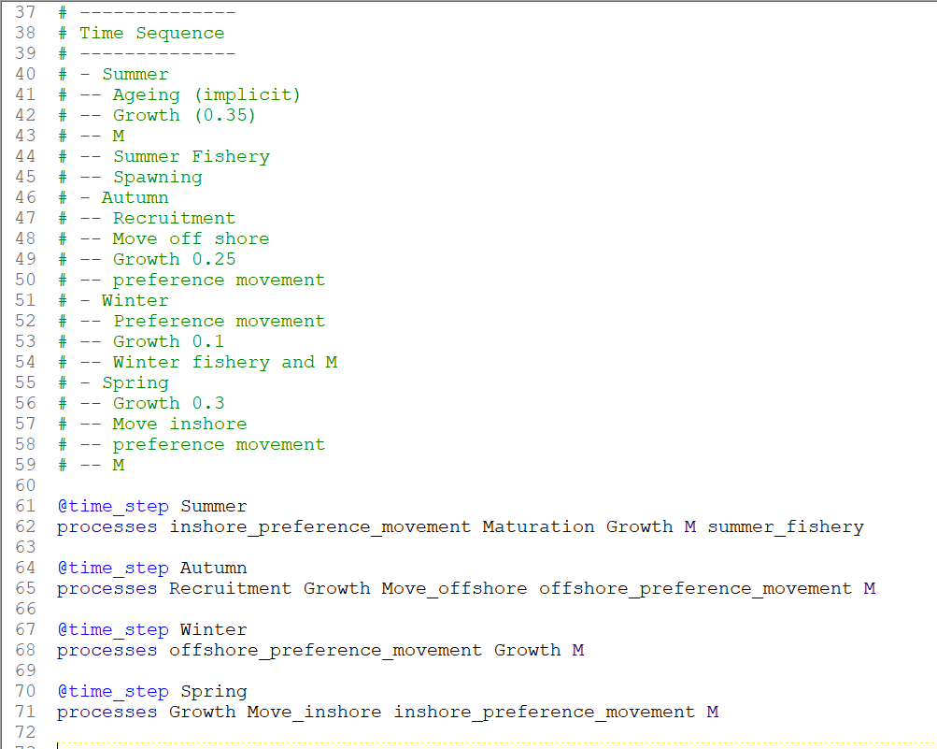

Slide 4
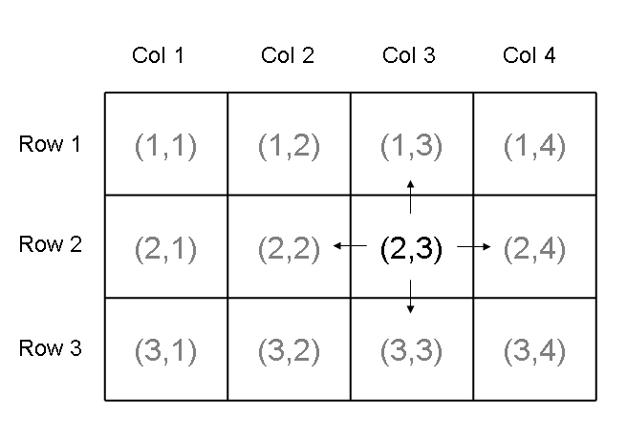
Spatial Domain
Users have to define a spatial domain, that is implemented as a grid, but users can turn off cells to stray away from the grid based structure. Only on number of cells is computational.
In each cell there are number of agents

Slide 5
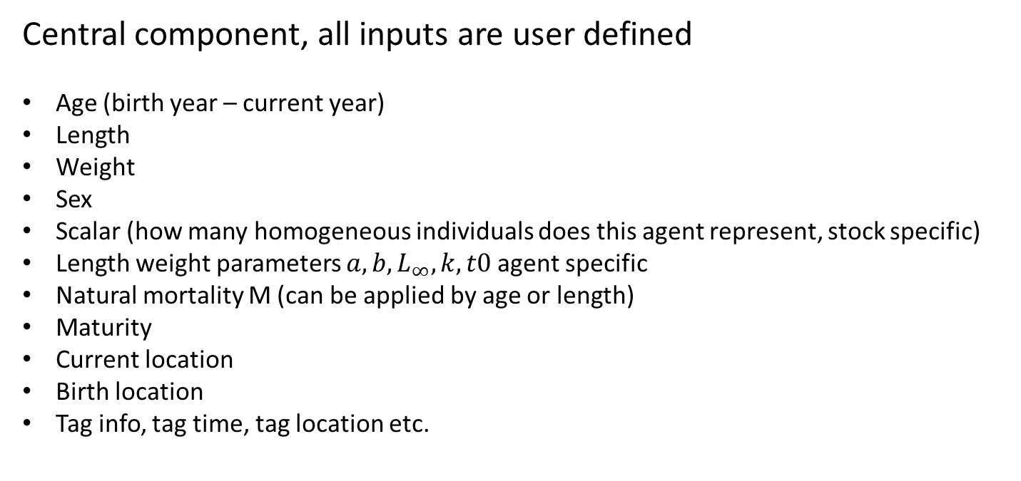
Agent characteristics
Central component, all inputs are user defined
Age (birth year – current year)
Length
Weight
Sex
Scalar (how many homogeneous individuals does this agent represent, stock specific)
Length weight parameters $a,b,L_{∞},k,t0$ agent specific
Natural mortality M (can be applied by age or length)
Maturity
Current location
Birth location
Tag info, tag time, tag location etc.
Note: No distinction of life history or stage, all interactions and dynamics are age or length based
This is on the dream list make distinct stages e.g. larval, juvenile and mature. Needs to be carefully thought of from a code design perspective

Slide 6
Agent interactions
Agent dynamics are applied by generic processes.
Fishing depends on method of removal
Biomass removals - user specifies catch for each cell and selectivity, randomly select agents if vulnerable remove entire agent. Can check for tagged fish in this process. Cons cannot apply M simultaneously, pros agents can have multiple interactions with gear.
Baranov style – user specifies an F for each cell applies both F and M.
Effort based – user specifies spatial effort and an annual catch and the IBM does a little minimisation to solve for F based on method in Truesdell et al (2017)
Movement
Multinomial proportion moving from source cell to sink cell
Diffusion movement undirected drift
Preference based movement, agents move based on gradient of habitat around them like a marble moving around a surface (needs more testing)

Slide 7
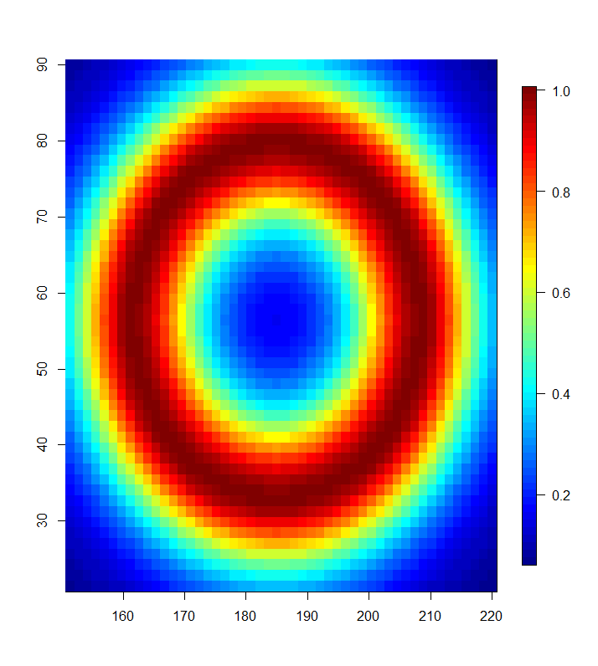
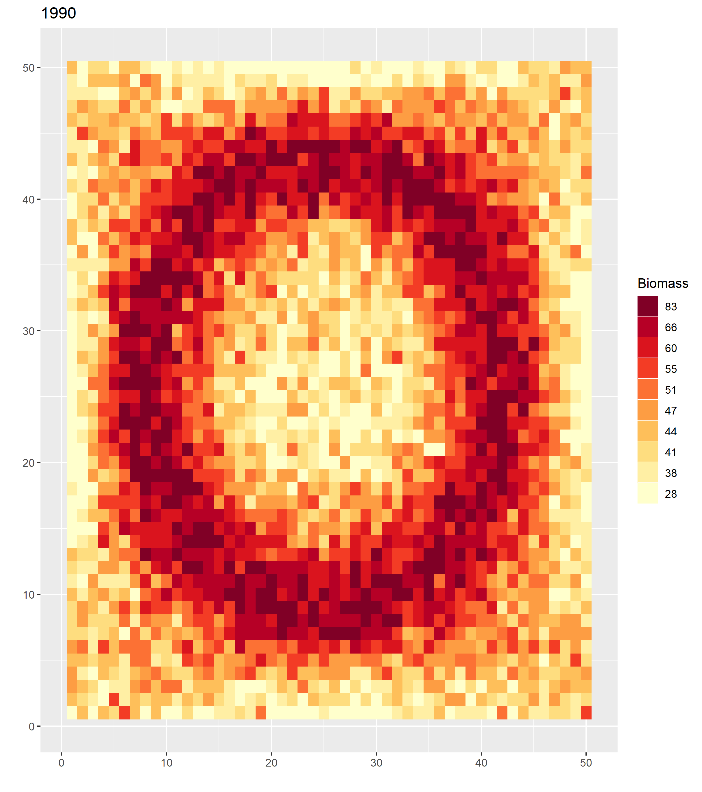
Movement examples
Depth preference
Population biomass
Preference based movement

Slide 8
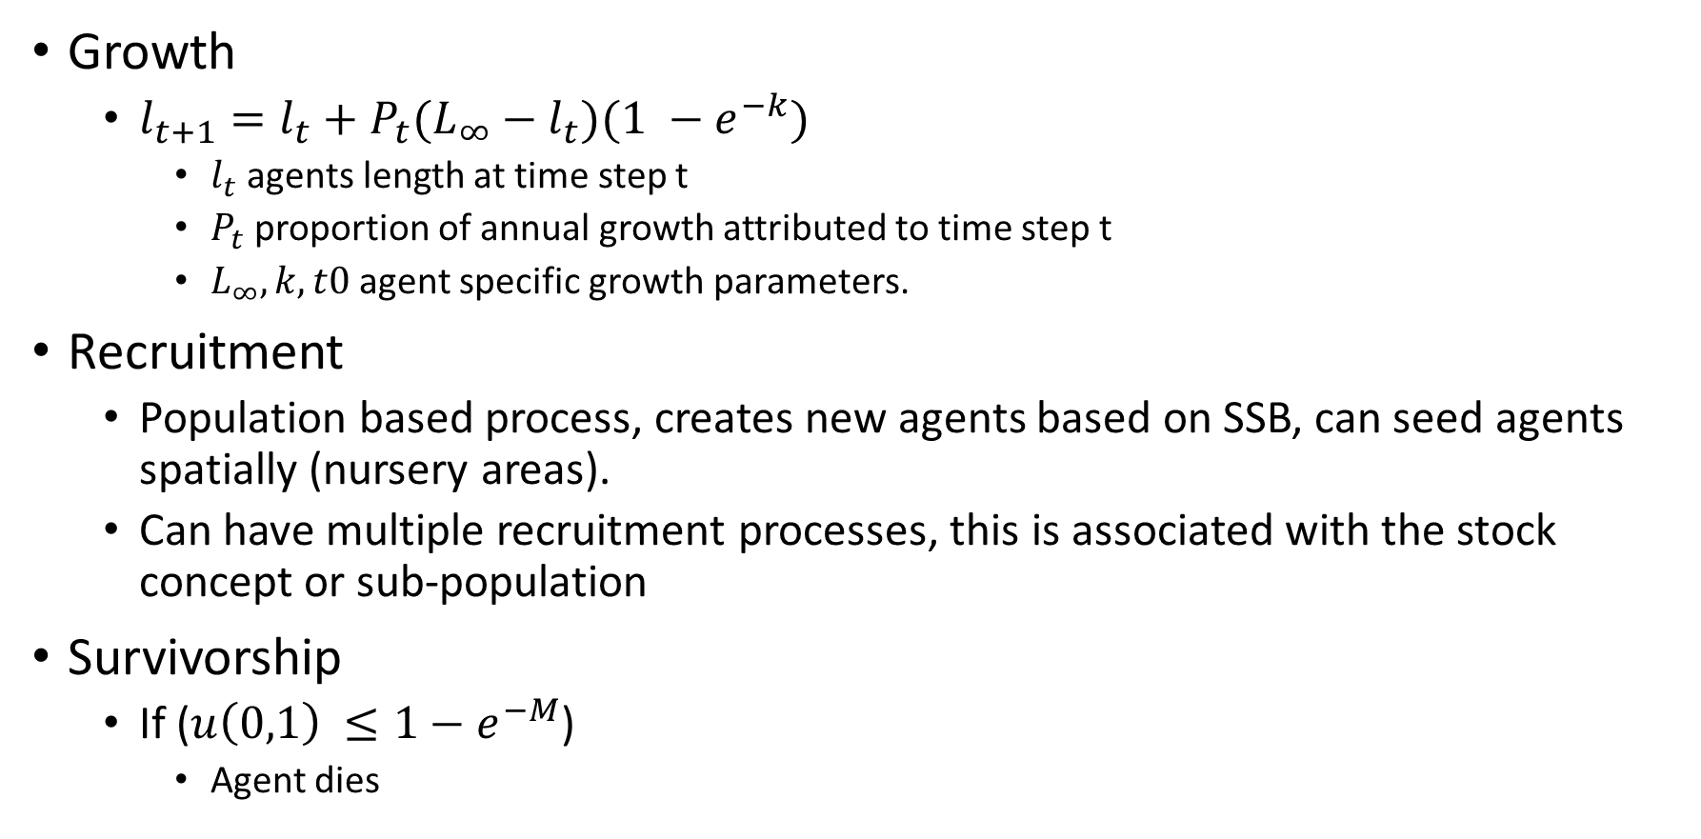
Agent interactions
Growth
$l_{t+1}=l_{t}+$ $P_{t}(L_{∞}−l_{t})(1 −e^{−k})$
$l_{t}$ agents length at time step t
$P_{t}$ proportion of annual growth attributed to time step t
$L_{∞},k,t0$ agent specific growth parameters.
Recruitment
Population based process, creates new agents based on SSB, can seed agents spatially (nursery areas).
Can have multiple recruitment processes, this is associated with the stock concept or sub-population
Survivorship
If ($u\left(0,1\right) ≤1−e^{−M}$)
Agent dies

Slide 9
Observations\Derived quantities
At the beginning or end of each time step you can ask for many characteristics of the agents over the spatial domain to be reported.
Age or length structure
Total biomass, spatial biomass
Age-length in a cell
Fishery based observation LF, AF, Tag-recapture info
There is an R library to read in output and some summary plots, which is a forever work in progress

Slide 10
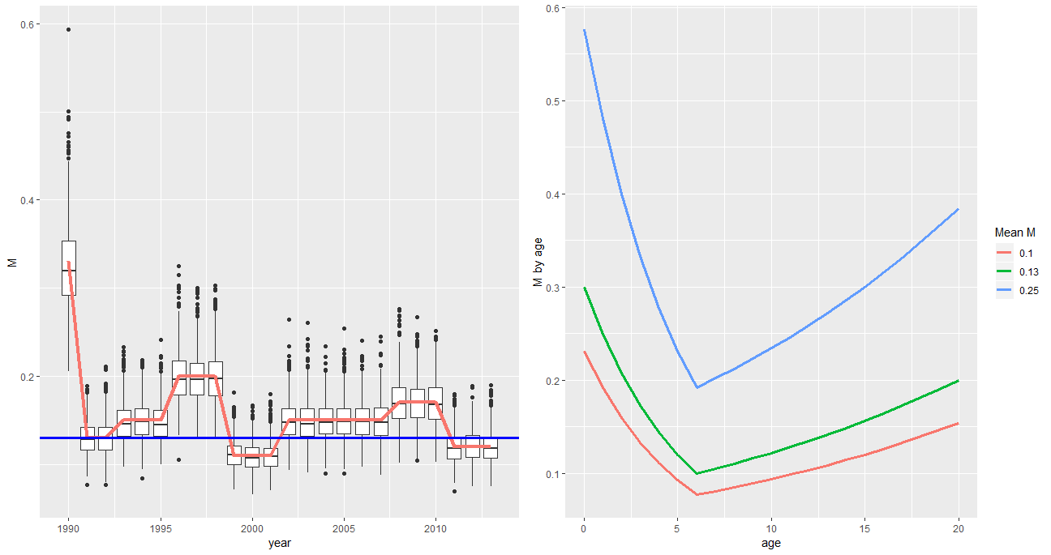
Nice components
Time varying and spatially varying parameters, M and growth
Notes:
Where you get information to justify these inputs is an important consideration

Slide 11
Test cases and speed run, Run on Windows 10 i7-4710 2.5 GHz
Single area
Years =
Time steps =
Fisheries =
N-agents =
Three area model = 58 seconds
Init phase = 50 years
Years 1990:2013
Time steps = 3
N-agents = 1 mil
10x10 area model =
Years = 30
Time steps = 4
N-agents = 1.5mil

Slide 12
To Add
Pass on traits at recruitment level so recruits represent SSB characteristics (evolutionary process). Currently where you are born is defined to have a certain M and growth (distribution) and that is what you get allocated
Threading proved to be very difficult due to too many shared resources random number generators etc.
Simultaneously apply multiple fisheries important otherwise age structures get weird if fisheries occur at same location and time.

Slide 13
Some notes
Not a true agent based model in the sense there are still population level concepts e.g. carrying capacity (user sets B0), recruitment. This was done to easily align it with stock assessment models. A true agent based model would model agent interactions with environment and population signals would be a result or all agents.

Slide 14
References
Samuel B Truesdell, Deborah R Hart, and Yong Chen. Effects of unequal capture probability on stock assessment abundance and mortality estimates: an example using the us atlantic sea scallop fishery. Canadian Journal of Fisheries and Aquatic Sciences, 74(11):1904–1917, 2017.

