Slide 1
OSI Model Breakdown
By: Andres Zamora, Xzavier Carter, Zachary Seixas, Cavan Lawes, Olivia Mccallum, Craig Auld
Client: USA Charities
Date: 8/20/2024
Notes:
Introduce yourself as Cyber Titans, Give your names and welcome the Client USA Charities

Slide 2
Introduction
We will teach you the seven layers of the OSI Model, their functions, and their respective real-world applications.
The OSI model has served as the most basic elements of computer networking since the late 1970s.
The Open Systems Interconnection model serves as the foundation upon which data is transmitted between two endpoints.
Notes:
Introduce the Project and begin with a simple definition of the OSI Model

Slide 3
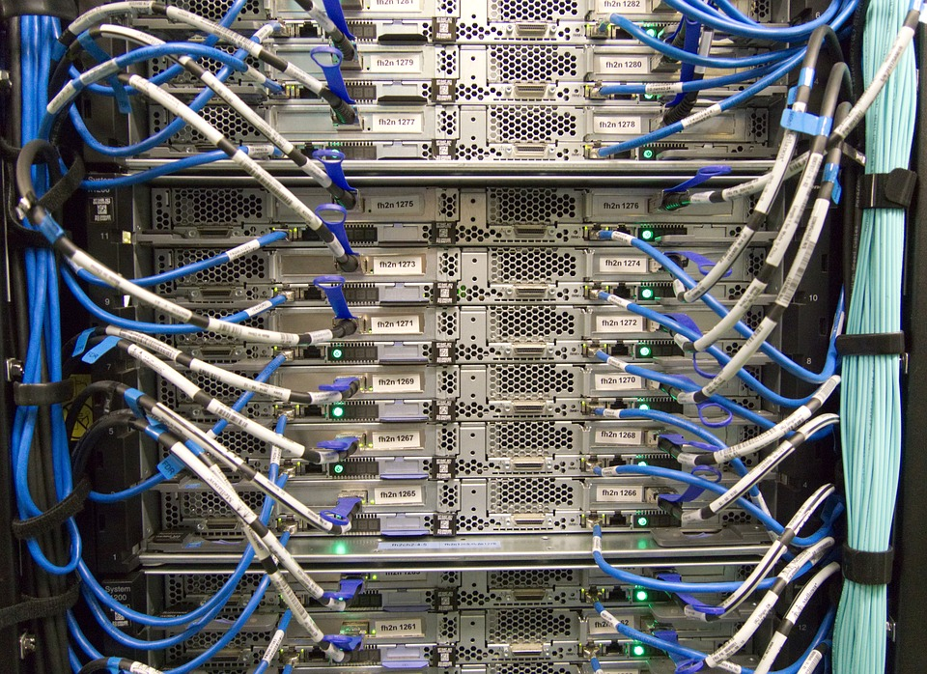
Physical Layer
Transmits raw data bits over physical and wireless mediums.
Physical mediums include copper wires, fiber-optic cables, and radio frequencies.
Key Appliances: Transceivers, media converters, repeaters.
Converts data into electrical, optical, or radio signals.
Notes:
Transceiver- The part of a network interface that sends and receives signals over a network.
Repeater- Device that amplifies electronic signals.
Media converter- A device that converts one signaling type to another. SPF (Segment packet frame)
Segments are created at the transport layer, packets at the network layer, and frames at the data link layer Physical Layer: Deals with the physical transmission of data, converting electrical signals into bits.
The raw bits is sent down to the data link layer organizes and manages these bits into frames for reliable communication between devices.

Slide 4
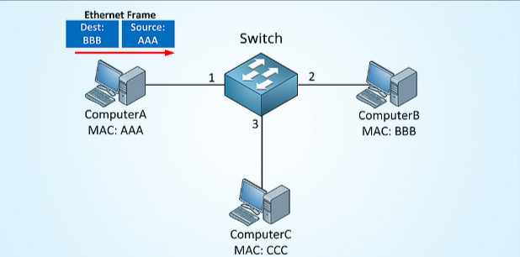
Data Link Layer
This layer is responsible for the transmission of data frames between two nodes.
The frame includes source and destination MAC addresses, the payload, and error-checking info in the Frame Check Sequence to ensure data integrity.
MAC addresses are hardware addresses found on NICs and assigned during device manufacturing.
Switches record all MAC addresses and their ports with a MAC address table.
Notes:
Each frame contains a header, a body, and a trailer.
The data link layer is responsible for ensuring reliable data transmission between two directly connected nodes on a network.
The data link layer receives the raw bits from the physical layer and divides them into smaller units called frames. These frames include additional information such as headers and trailers that contain addressing, error checking, and flow control data. It then adds a MAC address to the header of each frame The data link layer passes frames to the network layer
These frames are then passed

Slide 5
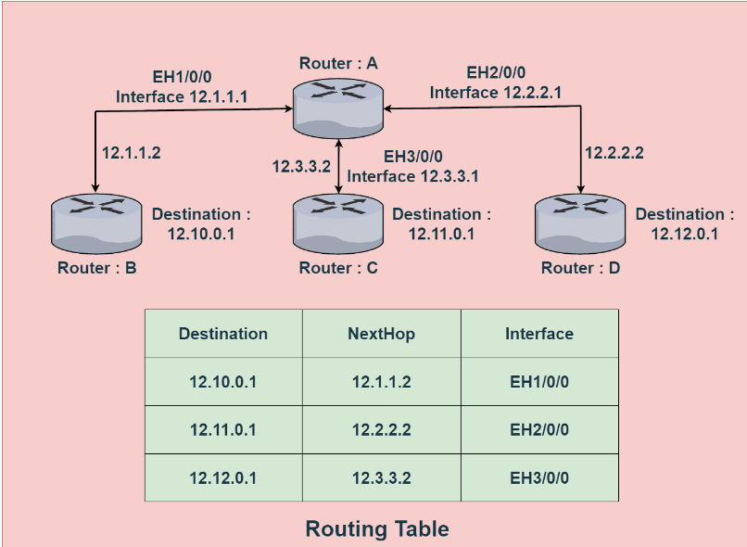
Network Layer
Its main function is to transfer data packets between networks using a router.
Routers use a routing table to determine the most optimal route for data transfer.
IP Addresses: Provides unique identifiers for nodes on a network.
Implements protocols like IP (Internet Protocol) for addressing and routing.
Notes:
The frame is then brought down into the network layer and is then goes through a process know as encapsulation turning the frame into a packet it is also given a IP address during this process
"Once the Network layer has encapsulated the frame, providing it with a source and destination IP address, it passes the packet to the Transport layer."

Slide 6
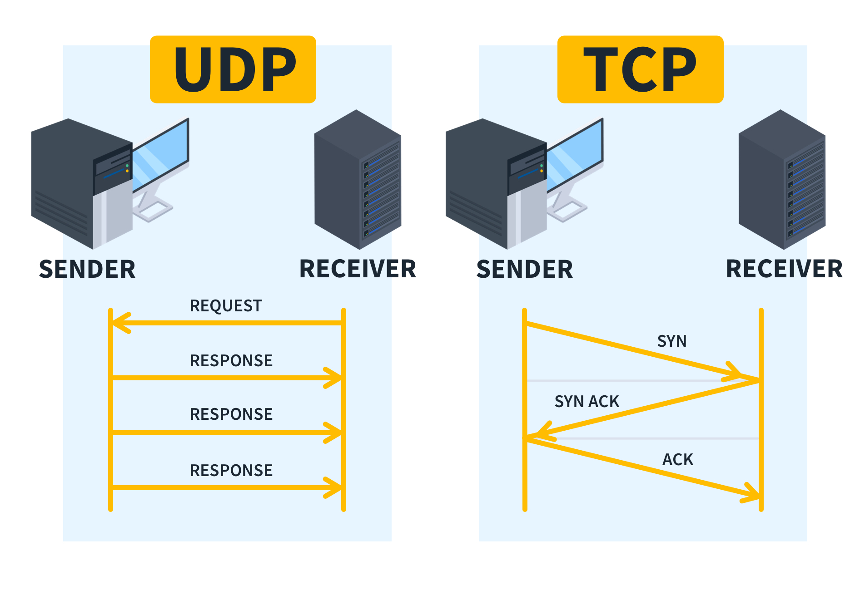
Transport Layer
Ensures reliable data transfer across the network.
Verifies and maintains a stable connection.
Assures accuracy of data packets and proper error-handling
TCP and UDP are key protocols within the Transport layer
Notes:
Once the packet is brought down to the Transport layer it then extracts the port number and destination, then it determines whether to process the packet using TCP or UDP.
To break down tcp and udp, TCP is ideal for applications where data integrity and reliability are crucial, while UDP is suitable for applications where speed and efficiency are more important rather than absolute reliability.

Slide 7
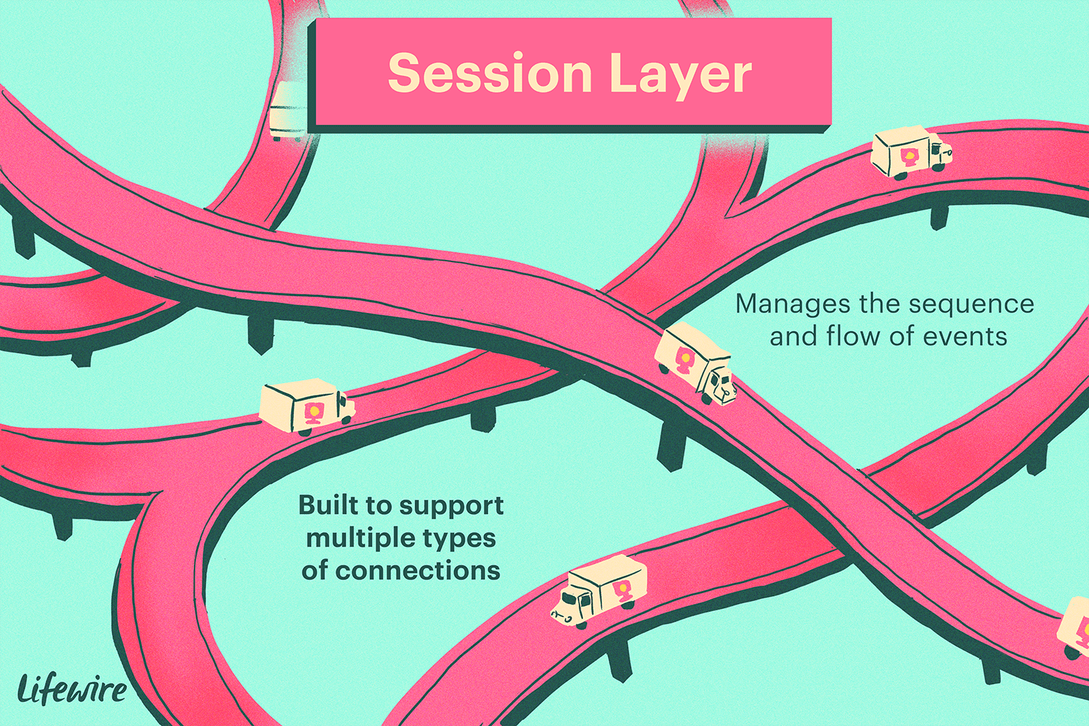
Session Layer
Facilitates organized and reliable conversations between end-user apps.
Manages sessions or dialogues between different applications.
Focused on establishing the session, controlling it, and terminating it.
Communicates with both presentation and application layers.
Notes:
The session which is created allows users to share data, remote access, and file management.
SMB for sharing files and printing resources

Slide 8
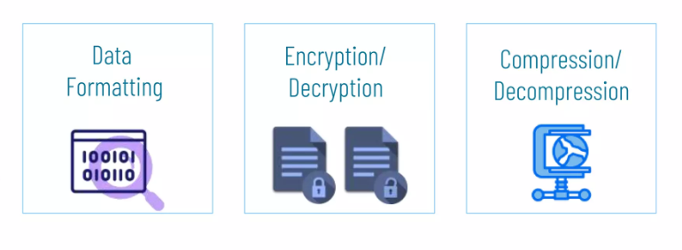
Presentation Layer
Formats and translates data to be used by the application layer.
Handles encryption and decryption to secure data.
Oversees data formatting and conversion for readability by the receiver.
Data compression is used for transmission efficiency.
Examples:
PNG, JPEG, TLS/SSL
Notes:
IMAGES
-PNG- portable network graphics
-JPEG- Joint photographic experts group
SECURITY
-TSL/SSL- transport layer security / secure socket
CODING
his presentation layer is responsible for adding encryption on the sender’s end as well as the decoding the encryption on the receiver’s end so that it can represent the application layer with unencrypted, readable data.
-HTML- hypertext markup language

Slide 9


Application Layer
Manages how applications interact with each other across devices
Formats data for user readability and understanding.
Supports remote hosting applications from various locations.
Provides vital services for web applications.
Identifies communication partners, and synchronizes exchanges
UDP, HTTPS
Notes:
The example shows how chrome on your device would interact with YouTube on the application layer. They use UDP (user datagram protocol) for video transfer and HTTPS(hyper text transfer protocol) for other requests like looking up a video or getting log in information. This example is extremely simplified because there aren’t any severs in between.
: The Application Layer helps determine which applications or devices are intended to communicate with each other. For example, when you use a messaging app, the Application Layer identifies the recipient of your message.

Slide 10
Conclusion + Q&A
In this presentation we have covered the intricacies of the OSI Model, from layer 1 to layer 7.
We have helped USA Charities achieve a better understanding of the OSI Model for increased productivity.

Slide 11
Sources
Imperva.com
Cloudflare.com
Geekforgeeks.org
IBM.com
StackOverflow.com
Lifewire.com

