Slide 1
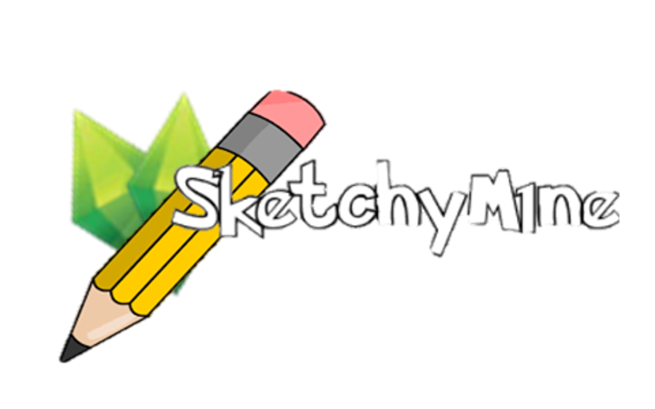
Sketchy Mine
Sprint 2 Review

Slide 2







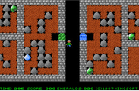
Recap game idea
Web browser based
Online
Multiplayer / Multirole
Chatting
Team based
Moderation
Ranking
Emerald mine inspired

Slide 3
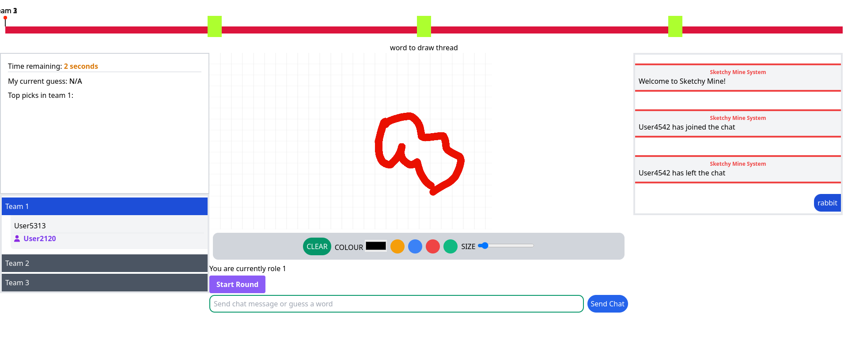
Recap game idea

Slide 4
Estimated price for the sprint – $13, 200
Actual cost for the sprint - $9'553

Slide 5
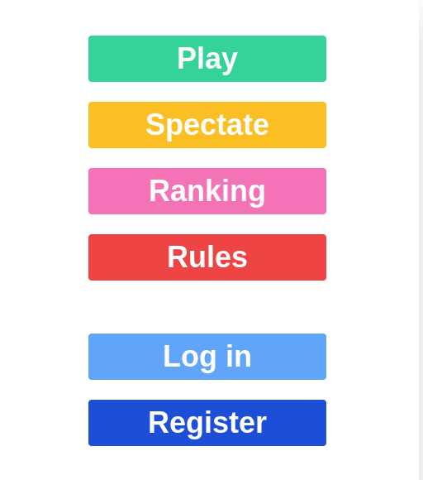
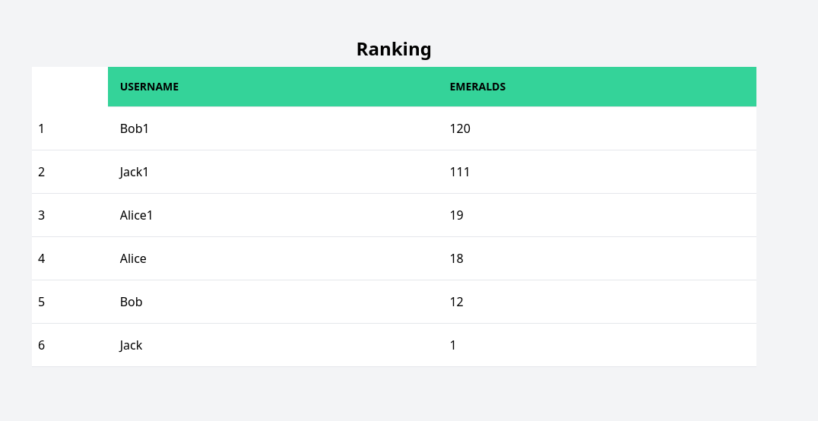
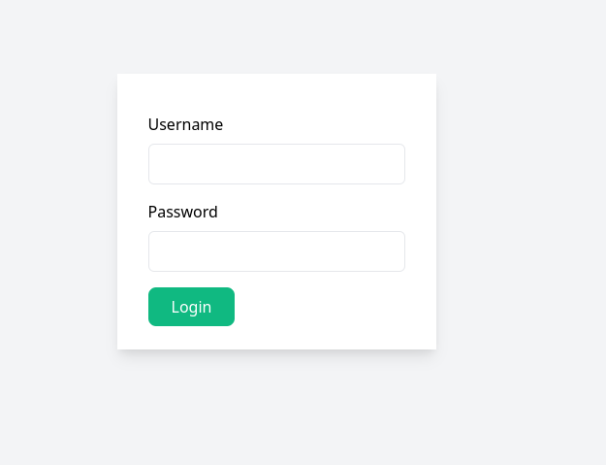
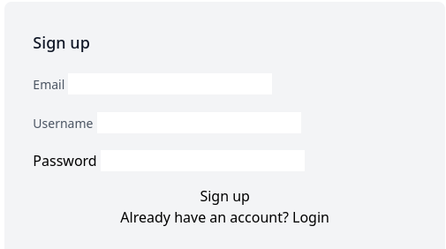
Progress

Slide 6
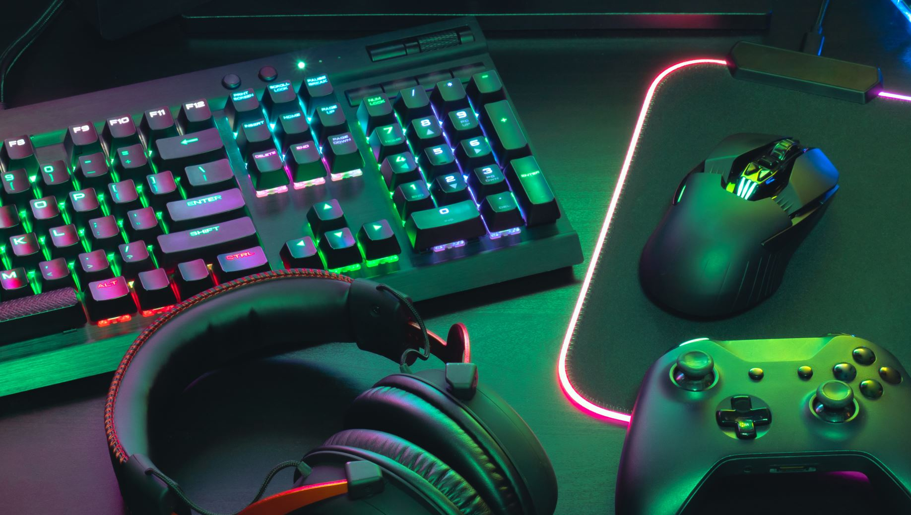
DEMO

Slide 7

NEXT SPRINT
What should we do?

Slide 8
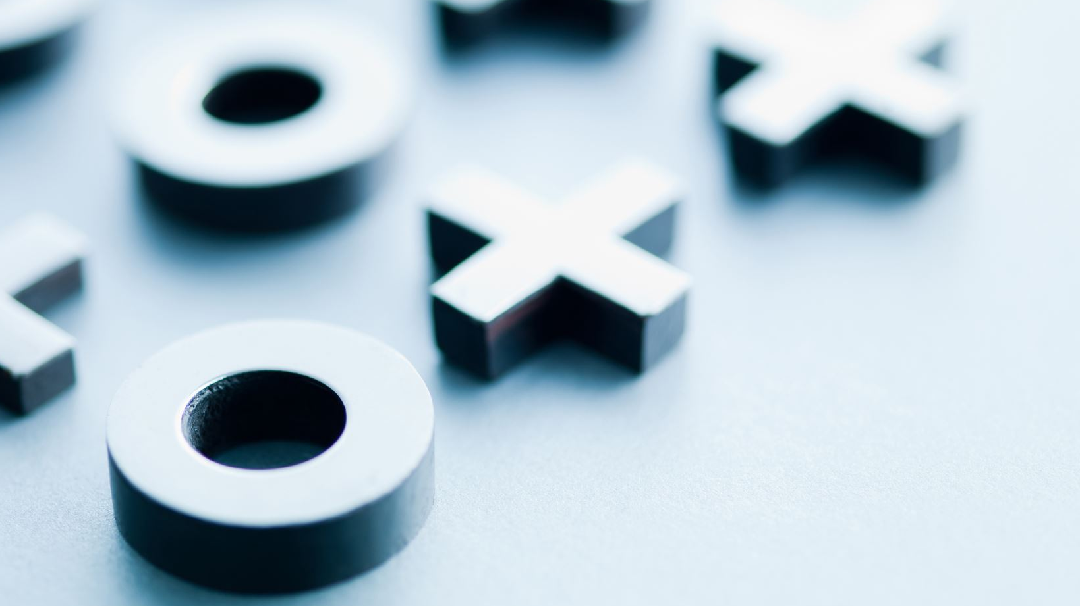
options
+ Polished look of the game
- Moderator abilities
+ All requirements completed
- Not as good looking GUI

Slide 9
THANK YOU FOR YOUR ATTENTION

