Slide 1
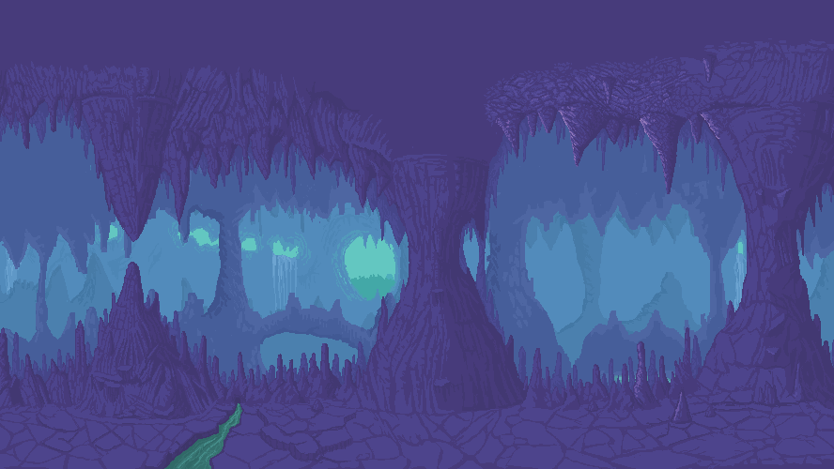

SketchyMine
WELCOME TO

Slide 2
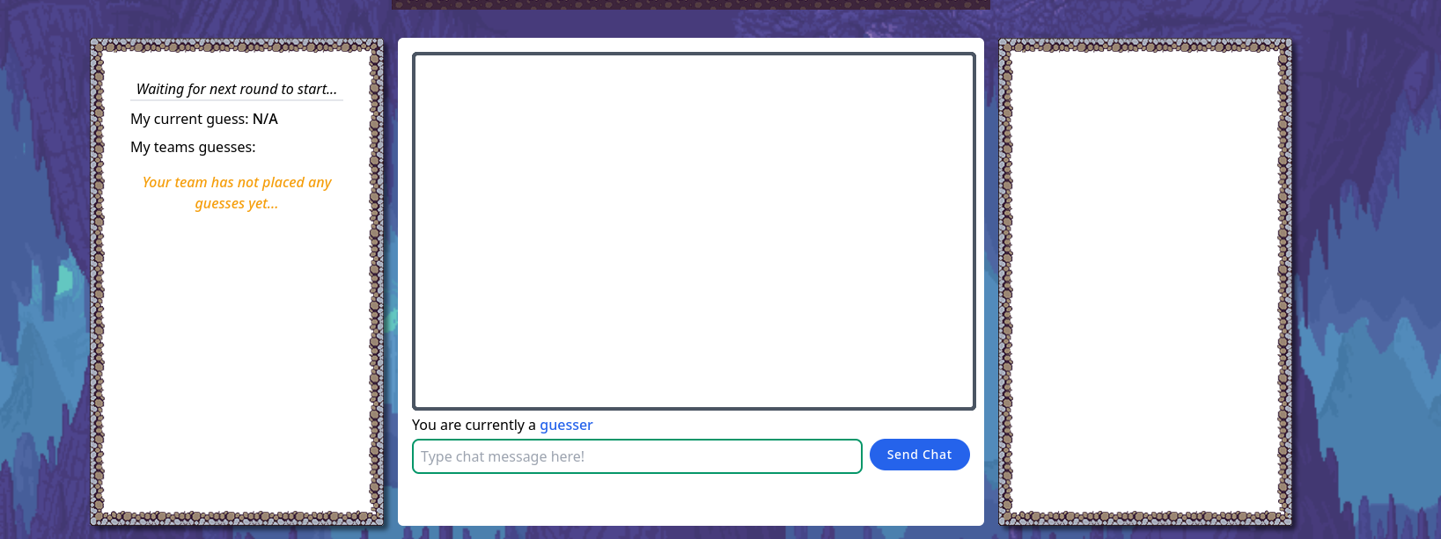
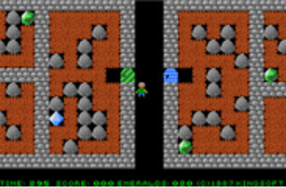
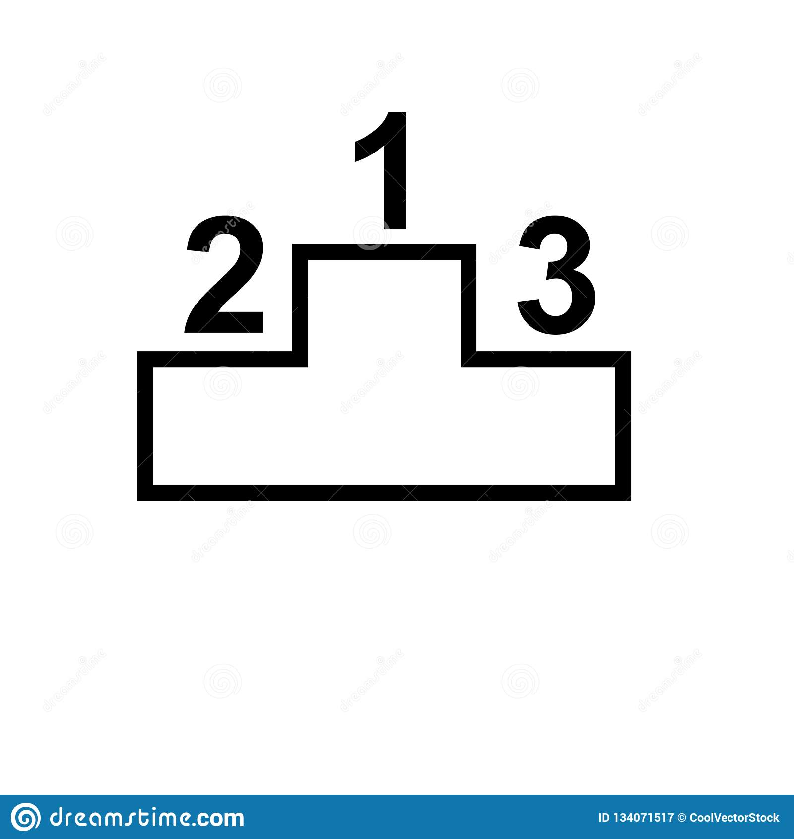





THE FINISHED PRODUCT

Slide 3
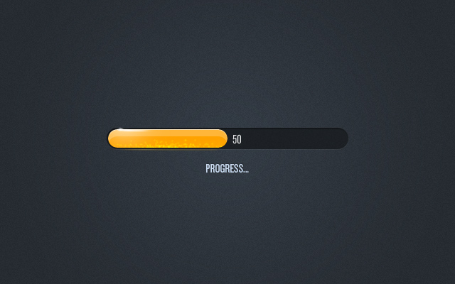
.
PROGRESS
Improved design
Improved GUI
Moderator abilities
Multiple bugs are fixed

Slide 4

Price per sprint
Sprint | Estimated price | Actual price
Sprint 0 | € 6,600 | € 6,285.5
Sprint 1 | € 13,200 | € 8,970.5
Sprint 2 | € 13,200 | € 9,553
Sprint 3 | € 19,800 | €
Total | € 52,800 | € 24, 809 + spr3

Slide 5
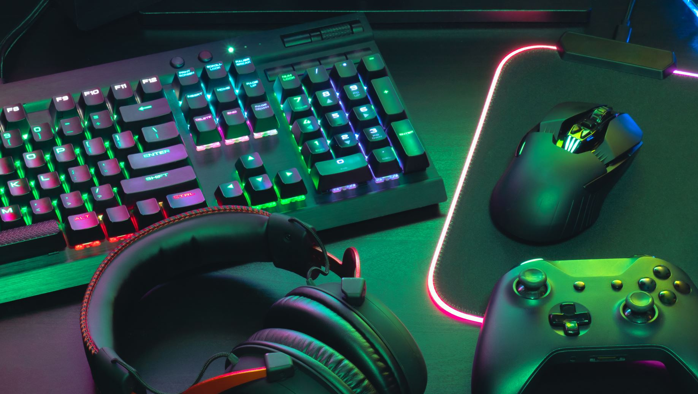
DEMO

Slide 6

What do you think?

