Slide 1
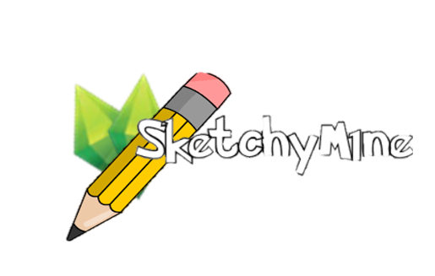
Sprint 1 Review
DHI2V.So2

Slide 2





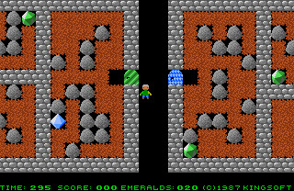


WHAT WAS REQUIRED
WHAT WAS ACHIEVED
Web browser based
Multiplayer/Multirole
Online
Moderation
Team-based
Emerald Mine inspired
In game chatting
Ranking

Slide 3







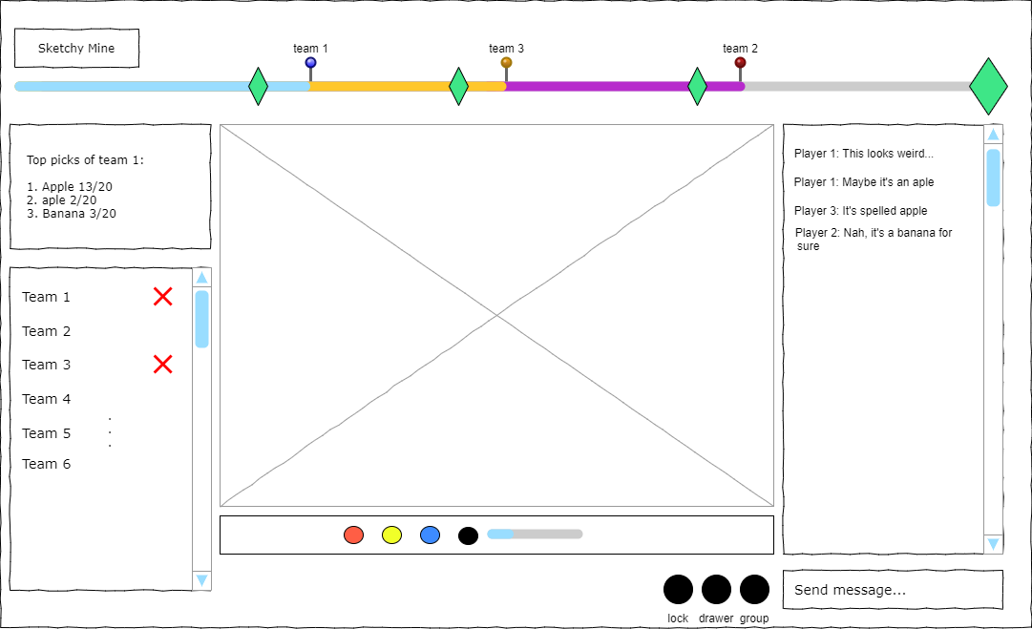
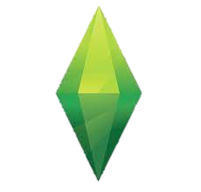

THE IDEA
Emeralds
Level

Slide 4
Sprint 1 Goals
Completely functional canvas
In-game chat functionality
GUI consisting of:
Word guess component
Team list component

Slide 5
Sprint 2 Goals
Implementation of database
Level progression system
User accounts
Teams
Moderation
Spectating

Slide 6

DEMO

Slide 7

QUESTIONS

