Slide 1
The Pomodoro Technique and Personal Kanban
Craig Dawson
11/25/2014

Slide 2
What Is the Pomodoro Technique?
A simple and effective productivity technique that:
Helps you focus on the task at hand
Helps you get started on tasks
Gives breaks so you can rejuvenate
Helps to deter distractions
Pomodoro Video

Slide 3
How the Pomodoro Technique Works
Choose a task
Set timer to 25 minutes
Work the task until the timer rings
Take a 5 minute break (15 minutes after 4 Pomodoros)
Repeat steps until task is completed
You can record how many Pomodoros a task takes and use that to estimate like tasks in the future

Slide 4
How to Get Started with the Pomodoro Technique
Simple kitchen timer
http://tomato.es/ (web)
http://www.marinaratimer.com/ (web)
http://www.tomighty.org (Win/Mac/Linux)
https://play.google.com/store/apps/details?id=com.dacer.simplepomodoro (Android)
https://itunes.apple.com/us/app/pomodoropro/id340156917?mt=8 (iOS)
Google “pomodoro timer”

Slide 5
Who the Pomodoro Technique Works Best For
People with a defined set of tasks
Also works for less defined tasks such as an “inbox” or queue
The system adapts to many kinds of work
Important to remember it is a productivity system not a ball and chain
Make sure you take the breaks
Pomodoros are for work not play

Slide 6
Integrating Pomodoro With Other Productivity Methods
Works well with other systems that organize tasks such as:
GTD aka Getting Things Done
Kaizen
Scrum
Personal Kanban
http://www.personalkanban.com

Slide 7
Additional Information
http://lifehacker.com/productivity-101-a-primer-to-the-pomodoro-technique-1598992730
http://pomodorotechnique.com/book/
http://pomodorotechnique.com/blog/
http://pomodorotechnique.com/get-started/
http://www.pomodoro-book.com/
https://www.youtube.com/watch?v=cH-z5kmVhzU
http://www.52weeksofhabits.com/2013/08/20/pomodoro-the-ultimate-work-habit/
http://lifehacker.com/tag/pomodoro
It took 3 Pomodoros to do these slides

Slide 8
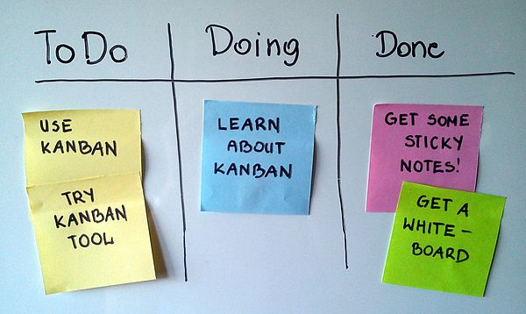
Personal Kanban Part 2

Slide 9
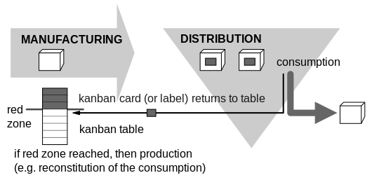
Kanban (かんばん) (literally signboard or billboard in Japanese) is a scheduling system for lean and just-in-time (JIT) production.

Slide 10
Personal Kanban
Two Rules
#1 Visualize Your Work
Make a personal Kanban board
#2 Limit your work-in-progress (WIP)
Don’t try to do too much at once

Slide 11
Personal Kanban #1 Visualize Your Work
Make a Kanban board.
Simple: ToDo, Doing, Done. Maybe: Today, Hold
This is the value stream
When adding to the ToDo:
Short term: well defined
Long term: less defined

Slide 12
Personal Kanban #2 Limit your work-in-progress (WIP)
Limit “Doing” column to 3 tasks
A limit of 1 may cause tasks to go back to “ToDo”
Tasks should always move forward in value stream
If your task is not getting done then redefine task or eliminate it

Slide 13
Personal Kanban Resources
http://www.personalkanban.com/
http://nomad8.com/kanbanfor1/
http://en.wikipedia.org/wiki/Kanban_board
http://en.wikipedia.org/wiki/Kanban
https://github.com/CraigDawson/Kanban-board

