Slide 1
Pando Pooling

Slide 2
Initial disclaimer
I knew nothing about baseball other than the basics before this project so if my feature engineering/ideas don’t make much sense, it’s because I’m not a domain expert nor had access to a domain expert

Slide 3
Pipeline
1. Data exploration
2. Feature selection
3. Feature cleaning
4. Feature engineering
5. Dataset preparations for modal
6. Model training/testing/tuning
7. Results

Slide 4
Data exploration
To see what features are positively or negatively correlated with org_top10_post, I plotted a correlation matrix(On next slide)
From what features I see are relevant, I performed feature selection/feature engineering with/on those features
There is a feature + ‘present’ feature/column that I added. It is a 1 if the feature associated with that column had an entry, else it is a 0 if it was NaN. I will explain in more detail on a later slide about my intuition behind this

Slide 5
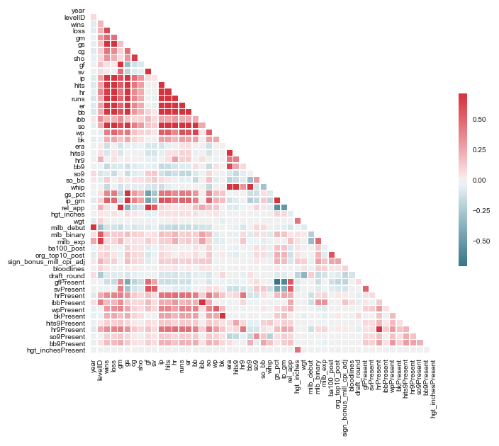
Data exploration

Slide 6
Feature selection
Dropped the following columns: bcubeID, level, teamName, firstName, lastName, fullName, sign_bonus_mill, cpi_factor, college, dob
BcubeID, firstName, lastName and fullName are all distinguishing features for each player. They say nothing of the player’s ability or potential. Even if a rookie has the name “Babe Ruth”, it doesn’t mean he’ll become a legend. In addition, people who are related(same last name) have a column for relatives so it’s fine to drop lastName
I wasn’t sure but I felt teamName was irrelevant as I’m trying to predict the top 10 within each organization. Also, it was my assumption that teams are owned by Organization like how it is for other sports. Because of that, I felt having both were redundant
Dropped sign_bonus_mill and cpi_factor and kept sign_bonus_mill_cpi as that column is a combination of the first two columns
Felt college was irrelevant enough to drop as a player’s stats are more relevant than the college they go to. In addition, in some sports, players who go to play at the college level fall apart while others can shine
Dropped date of birth because after making an age column and plotting a correlation matrix, I saw age had very little to do with the org_top10_post
After all of this, I apply a chi squared test to see if the label is independent or dependent of each feature. I found that taking the top 50 features with the highest value for dependency on org_top10_post performed best

Slide 7
Feature cleaning
Bloodline: If there was an entry, input a 1 if they had a bloodline connection, else a 0 if it was blank
All columns that had any number of NaNs, I filled those NaN entries with 0 and added another column which was the feature + ‘present’ to indicate if that row entry either had an entry for that feature or did not. I chose to do this because in previous data science projects, I had similar issues where I had missing values and was faced with what to do for NaN values. I could impute an average or fill them with a max or minimum. After researching for fixes and testing myself, the majority of my previous project model’s performed best if I set NaN’s to 0 and added a feature + ‘present’ column.
The following columns had at least a NaN that wasn’t dropped during feature selection: ['gf', 'sv', 'ibb', 'wp', 'bk', 'hits9', 'hr9', 'so9', 'bb9', 'hgt_inches', 'sign_bonus_mill_cpi_adj’]. Reason for this could be errors in data collecting

Slide 8
Feature engineering
After doing some baseball research, I felt that the following columns were important to keep: throws, bats, orgName, league. The reason for this is for many sports, being left handed can be a major advantage because many people aren’t used to left handed people, thus why I would keep throws and bats. orgName is important because I am trying to predict the top 10 prospects for each organization. League is also important as it’s the current level the player is competing at
All of these features contained strings so rather than categorically encoding them such as (bats: (R, 0), (L, 1), (B, 2)), I chose to one hot encode them as that would eliminate the machine learning model from potentially learning associations. For example, if I categorically encoded them, and say B got assigned 2 and L got assigned 1, someone batting B is considered twice the value of someone batting left handed which in reality, doesn’t make much sense to say your batting hand is quantitatively twice the value of another.

Slide 9
Dataset preparations for modal
Tried oversampling on the minoirty labels to create a better ratio between instances of 1’s and 0’s for org_top10_post. Oversampling was done with python library SMOTE
Tried using the class_weight hyperparameter for Scikit Random Forest Classification. By setting this hyper parameter to value “balanced”, it assigns weights to each class based on the formula n_samples / (n_classes * np.bincount(y)). Thus this will put more emphasis on 1’s as they appear much less frequently in the dataset.
Note: These two were not done at the same time as it makes no sense to assign class_weight when you have an even number of 0’s and 1’s label. I tried them separately and they both yielded very similar results

Slide 10
Dataset preparation for model(cont.)
Split the data into years before 2018 and 2018. Everything before 2018 is the training data, 2018 is the test data. I use cross validation on the training data with 7 folds.
Once I was satisfied with the overall cross validation mean scores, I applied the model to the test set

Slide 11
Models tested
Random forest
Reason: Easily understood unlike some other models. Historically, performs very well on many machine learning competitions/personal projects. Because of this, it has been one of my go to models for ML tasks
Logistic Regression
Reason: Basic linear classifier that can be used as a base line to see if the data is linear or more complex
MLPClassifier/Multi layer perceptron classifier/Neural Network
Reason: One of the best models today. A large reason for the rise in machine learning. Thought it’d be good to see if a basic NN could recognize a pattern in the data. I used the default hyper parameter of 100 neurons in the hidden layer as I didn’t have the time to find and test an optimal architecture

Slide 12
Model tuning
I chose to use random forest as that had the best performance on the dataset in terms of accuracy and F1 score. To prevent overfitting, I limited the depth of each decision tree in the forest to be max 20. The number of decision trees in the forest is 10, the default hyper parameter. This was done to prevent overfitting for the random forest. Performance did not vary much with changing the number of decision trees.

Slide 13
Results
Accuracy is not a good metric for this project because the majority of players aren’t ranked in the top 10 of their organization(a 1 in the dataset). Because of this, the model could predict a 0 for everybody and achieve a very high accuracy
F1 score is a much better metric for this project as it incorporates a balance between precision and recall. After evaluating the Random Forest, I received a mean F1 score of 55% on the validation set
Created a confusion matrix to see the number of false positives versus false negatives. Here is where I applied my thoughts of the Pando product. Of course getting a high F1 score is ideal but I couldn’t get it to perform super well so I turned my attention to false positives and false negatives. I believe reducing false positives is much more important. If your product is to pool players together and tell them that you think at least one of them will make it big and make $20 million dollars, when in reality none of them do, that’s due to having false positives. It’s much better for customers to expect not much money from the pooling and then be surprised with a large sum of money. In order to do this, you must minimize the number of false positives.

Slide 14
Things to try in the future
Better Neural Network architecture: If I had more time, I think finding an optimal Neural Network architecture would improve F1 score
Synthetic data generation for the Neural Network: Because Neural Networks rely on extremely large amounts of data, generating more data could help the model learn. Examples of this could include having the NN make predictions on the data and then adding those predicted rows to the training set. Other ways involve using statistical tests to find traits of your data(mean, standard deviation etc), and then creating random data that follows that distribution
With the increase in data and Neural Network architecture, it could mean the model may take a while so putting it on parallel computing machines becomes an option
Feature hash instead of one hot encoding: one hot encoding could have made the data to sparse for the ML model to learn well. Feature hashing involves applying a hash function to your categories which will output a value. This helps with feature encoding categorical values while also remaining low dimensional

