Slide 1
Synthetic Patient Data
Categorizing Patient-Provider Interactions

Slide 2
Why Synthetic Data ?
To work around HIPAA Restrictions

Slide 3
About SyntheticMass
Background
SyntheticMass contains realistic but fictional residents of the state of Massachusetts. The synthetic population aims to statistically mirrors the real population in terms of demographics, disease burden, vaccinations, medical visits, and social determinants. SyntheticMass establishes a risk-free environment for experimenting with:
Data visualization
Risk stratification
Care management
Clinical decision support
Patient reported data integration
Evaluation of new treatment models
Privacy and consent models
Security and authorization models
Third-party app development
SyntheticMass will provide a sandbox for Health IT developers, researchers, and clinicians interested in exploring new healthcare solutions. It enables this through:
Realistic data for fictional patients
Data that is free of protected health information (PHI) and personally identifiable information (PII) constraints
Datasets updated over time based on clinical healthcare models and epidemiological models of population health.
Source: https://syntheticmass.mitre.org/about.html

Slide 4

SyntheaTM Patient Generator
SyntheaTM is a Synthetic Patient Population Simulator. The goal is to output synthetic, realistic (but not real), patient data and associated health records in a variety of formats.

Slide 5
Column Name | Data Type | Required | Description
 | ID | UUID | true | Primary Key. Unique Identifier of the patient.
 | BirthDate | Date (YYYY-MM-DD) | true | The date the patient was born.
 | DeathDate | Date (YYYY-MM-DD) | false | The date the patient died.
 | Marital | String | false | Marital Status. M is married, S is single. Currently no support for divorce (D) or widowing (W)
 | Gender | String | true | Gender. M is male, F is female.
Source: https://github.com/synthetichealth/synthea/wiki/CSV-File-Data-Dictionary#patients

Slide 6
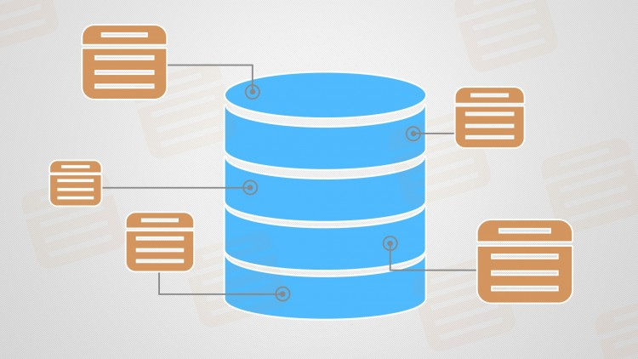
The csv’s can be made into database tables via Databricks.

Slide 7
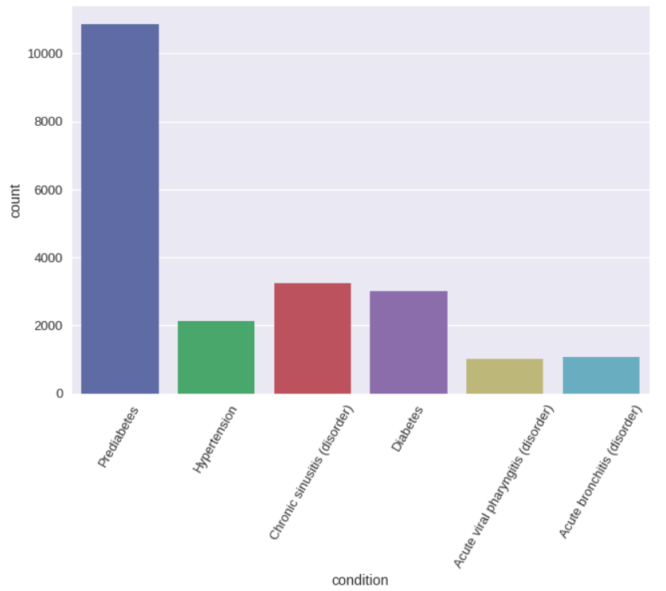
A total of
10,933 patients.
4120 patients suffering
from only one condition.
6813 patients suffering from
Multiple conditions.
A cross section of diabetic and prediabetic patients.

Slide 8
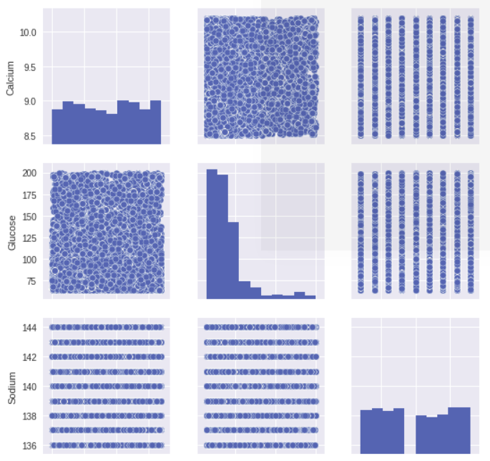
...but, there is a
Problem with
Synthetic data.

Slide 9
Where to Start
A prototype model that will predict whether a patient suffers from a single condition or multiple related conditions.
The patients in the prototype case are be those with at least one diabetes related diagnosis.
This is a starting point towards a more robust model that can analyze patients grouped by medical condition.
The data available to the model consists of vital signs and demographic info.

Slide 10
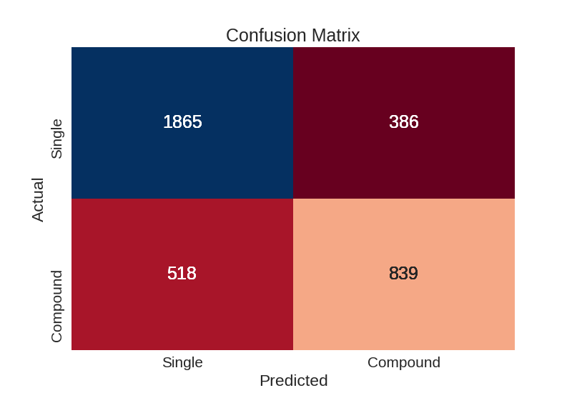
Single Condition vs Compound Condition

Slide 11
Baseline Accuracy: 0.62
 | Precision | Recall | F1 Score | Support
Compound | 0.78 | 0.83 | 0.80 | 2251
Single | 0.68 | 0.62 | 0.65 | 1357
AVG / Total | 0.75 | 0.75 | 0.75 | 3608
Logistic Regression Classification Report

Slide 12
Closing Remarks
Phase I is complete. A prototype has been established.
Phase II automate data querying and cleaning.
Phase III develop more sophisticated features and models.
eg bayesian model for prior medical conditions
Phase IV reconfigure with spark in order to scale up.

