Slide 1
PFI simulator notes
Peter Mao
2018 Mar 21

Slide 2
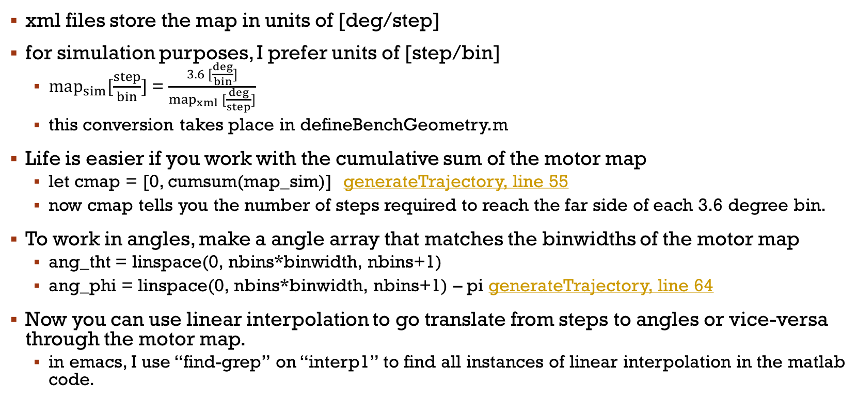
Motor maps
xml files store the map in units of [deg/step]
for simulation purposes, I prefer units of [step/bin]
$map_{sim}[\frac{step}{bin}]$ = $\frac{3.6 [\frac{deg}{bin}]}{map_{xml} [\frac{deg}{step}]}$
this conversion takes place in defineBenchGeometry.m
Life is easier if you work with the cumulative sum of the motor map
let cmap = [0, cumsum(map_sim)] generateTrajectory, line 55
now cmap tells you the number of steps required to reach the far side of each 3.6 degree bin.
To work in angles, make a angle array that matches the binwidths of the motor map
ang_tht = linspace(0, nbins*binwidth, nbins+1)
ang_phi = linspace(0, nbins*binwidth, nbins+1) – pi generateTrajectory, line 64
Now you can use linear interpolation to go translate from steps to angles or vice-versa through the motor map.
in emacs, I use “find-grep” on “interp1” to find all instances of linear interpolation in the matlab code.

Slide 3
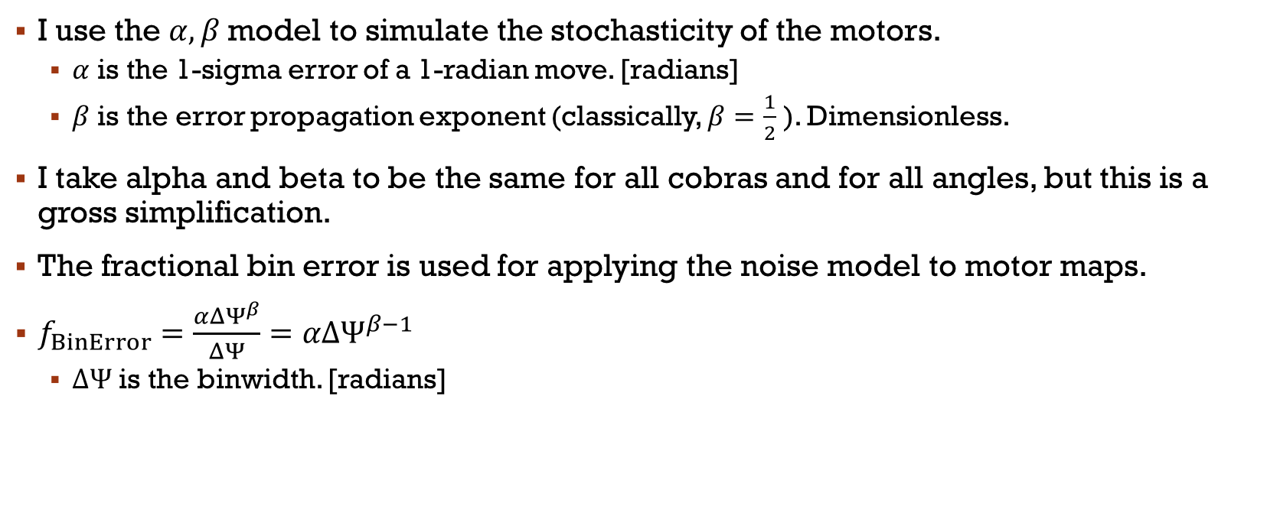
Noise
I use the $α, β$ model to simulate the stochasticity of the motors.
$α$ is the 1-sigma error of a 1-radian move. [radians]
$β$ is the error propagation exponent (classically, $β=\frac{1}{2}$ ). Dimensionless.
I take alpha and beta to be the same for all cobras and for all angles, but this is a gross simplification.
The fractional bin error is used for applying the noise model to motor maps.
$f_{BinError}=\frac{αΔΨ^{β}}{ΔΨ}=αΔΨ^{β−1}$
$ΔΨ$ is the binwidth. [radians]

Slide 4
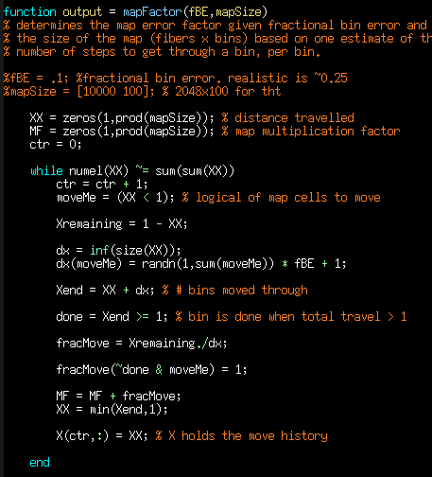
applying noise to maps
subroutine in addNoise.m:
The motor map tells us how many steps we need to get through a given angular bin.
Stochasticity in the motors means that the actual displacement per step differs from the motor map prediction.
Noise is added to the maps by determining how far we go with a given # of steps, but then using that to determine how many steps we need to traverse the bin.
WARNING: Directly calculating the # noisy steps needed to traverse the bin gives a result that is biased towards a large # of steps!
If the RNG moves the motor through the bin without using all of the allocated steps, then the number required to traverse the bin is recorded as the noisy map value
If the RNG only moves the motor part way through, then another move is simulated (with the number of steps to move through the remainder of the bin).
The second ”if” above is repeated until the condition of the first “if” is achieved.

Slide 5
Notes on revised functions
generateTrajectory2:
calculates the same sense and opposite sense theta trajectories
makes no assumptions about relative timing of moves
trajectories are all different lengths
realizeTrajectory2:
picks or is told which trajectory to use
picks or is told whether to start a motor early or late
produces a trajectory matrix with axes (cobraID, time) and values of angle.
generateTrajectory:
not currently used in simFun.m
calculates a trajectory given start and end positions.
timing strategy
radially outward: theta early, phi late
radially inward: theta late, phi early

