Slide 1

Introduction to Sequence Informatics
Institute of Infection and Global Health

Slide 2
Course overview
Session | Topic
1 | UNIX and command line environment
2 | Genomics: sequencing, assembly and annotation
3 | Programming in R
4 | Genomics: mapping and population analysis
5 | Transcriptomics and differential expression
6 | Extended exercise

Slide 3
Introduction to R

Slide 4
Overview
The basics: Assigning variables
Data structures
Manipulating data
Basic statistics
Plotting Learning more
Advanced Statistics for Epidemiology module - Led by Dr Rob Christley
Numerous online training modules available for example: Introduction to R - https://www.datacamp.com/courses/free-introduction-to-r R for Data Science - http://r4ds.had.co.nz/index.html

Slide 5
R or python or perl?
R was designed specifically for statistical analyses Thousands of additional modules to extend functionality Excellent for exploring data in an ad-hoc or one off manner Steep learning curve
Python and perl are programming languages Data analysis tools added through growing number of optional modules Excellent for scripting repetitious tasks requiring data in a standardised format Python is currently more popular than perl Easier for beginners
Each have their own strengths, weaknesses and quirks
No single language is best, need to consider the task and context before deciding which to use

Slide 6
The basics
R is a programming language for statistical computing
It can be used as an efficient and powerful calculator What is ((123.45 + 987.65)*3)/12 ?
It’s more than that because we can store data in variables, manipulate it and plot the results
As always expect to make mistakes and to have to search the web

Slide 7
The basics
We can store data for analysis within a Variable or Object
To store text it must be surrounded by quote marks x = “this is a string”
Anything within the quote marks is referred to as a string
R treats everything within a string as a single piece of data
y <- mx+c
Variables

Slide 8
The basics
To assign data to a variable we use <- or =
To store the value 3 in variable x we would type x <- 3 x = 3
While storing the sentence “I am learning R” we would type x <- “I am learning R” x = “I am learning R”
R is case sensitive. X and x refer to 2 different variables

Slide 9
Data structures - Vectors
Variable name
x
x
x
Note that we start from index 1 Most full programming languages start at index 0
Contents of the variable
1
A
fish
Data index
1
1
1
Variable name
my_data
Contents of the variable
1 | A | S | fish
Data index
1
2
3
4

Slide 10
Data structures - Matrices
Variable name
my_matrix
1
2
3
4
1
1 | 11 | 0 | NA
2 | 23 | 1 | 3
3 | 4 | 34 | 44
4 | 2 | 5 | 6
5 | 56 | 6 | 5
2
3
4
5

Slide 11




Data structures - Dataframes
Variable name
my_dataframe
Animal
Letters
Weight
Age
Cat | 1 | A | 3
Fish | 2 | A | 4
Dog | 1 | B | 2
Cat | 3 | Y | 5
Dog | 2 | V | 6
Dataframes are a collection of vectors or factors of equal length

Slide 12
History and TAB complete
When using R we can use many of the same shortcuts that we learned during the introduction to unix session
Use the up and down arrows to scroll through recent code
Use history() to view (and copy and paste) the code you have used in this session
Use TAB to complete both the names of functions and of variables that already exist

Slide 13
Accessing data
To access all of the data in a variable we simply need to enter its name and press Return
Most of the time we want to only access a subset of data
We do this by putting square brackets around the index we wish to retrieve
So to retrieve ‘fish’ from my_data we would write: my_data[4]
We can specify a range using : to separate the first and last indices my_data[2:4] returns “A”, “S”, “fish”
my_data
1 | A | S | fish
1
2
3
4

Slide 14
Accessing data
my_matrix
1
2
3
4
If the data contains more than 1 dimension then we need to specify each position. For example a matrix has 2 dimensions just like a spreadsheet.
To retrieve the value 44 from my_matrix we must specify the row and column positions separated by a comma: my_matrix[row number, column number] my_matrix[3,4]
Dataframes can use the row/column notation but have a special way of accessing entire columns my_dataframe$Animal would return the entire column with the name ‘Animal’
1
1 | 11 | 0 | NA
2 | 23 | 1 | 3
3 | 4 | 34 | 44
4 | 2 | 5 | 6
5 | 56 | 6 | 5
2
3
4
5
my_dataframe
Animal
Letters
Weight
Age
Cat | 1 | A | 3
Fish | 2 | A | 4
Dog | 1 | B | 2
Cat | 3 | Y | 5
Dog | 2 | V | 6

Slide 15
Manipulating data
We can also use square brackets to change individual pieces of data
Our matrix currently contains a point of missing data, indicated by the presence of the NA
To replace if with a 7 we would write: my_matrix[1,4] <- 7
my_matrix
my_matrix
1
2
3
4
1
2
3
4
1
1 | 11 | 0 | NA
2 | 23 | 1 | 3
3 | 4 | 34 | 44
4 | 2 | 5 | 6
5 | 56 | 6 | 5
1
1 | 11 | 0 | 7
2 | 23 | 1 | 3
3 | 4 | 34 | 44
4 | 2 | 5 | 6
5 | 56 | 6 | 5
2
2
3
3
4
4
5
5

Slide 16
Copying variables
To copy data from one variable to another we simply assign it in the same way as if we were creating it my_backup_matrix <- my_matrix
The copy is independent of the original. If we change one the other is not affected
If we wish to only copy part of the data then we must subset it my_backup_matrix <- my_matrix[1:2,] would copy only rows 1 and 2 into the new variable

Slide 17
Tests of equality
x <- 3
==
!=
>
>=
<
<=
x == 2
x != 2
x > 2
x >= 2
x < 2
x <= 2
Returns TRUE or FALSE

Slide 18
What is the age of every cat in our data frame?
myData
myData[c(1,4),2]
myData[c(1,4),“Age”]
Animal
Letters
Weight
Animal
Letters
Weight
Age
Age
Cat | 1 | A | 3
Fish | 2 | A | 4
Dog | 1 | B | 2
Cat | 3 | Y | 5
Dog | 2 | V | 6
Cat | 1 | A | 3
Fish | 2 | A | 4
Dog | 1 | B | 2
Cat | 3 | Y | 5
Dog | 2 | V | 6
myData[which(myData$Animal == “Cat”),“Age”]

Slide 19
myData[which(myData$Animal == “Cat”),“Age”]
myData$Animal
myData$Animal == “Cat”
which(myData$Animal == “Cat”)
Animal
Letters
Weight
Age
1
4
Cat | 1 | A | 3
Fish | 2 | A | 4
Dog | 1 | B | 2
Cat | 3 | Y | 5
Dog | 2 | V | 6
Cat
Fish
Dog
Cat
Dog
==
Cat
Cat
Cat
Cat
Cat
->
TRUE
FALSE
FALSE
TRUE
FALSE
==
->
==
->
==
->
==
->
Our data
Our test

Slide 20
myData[rows we want , columns we want]
myData
myData[which(myData$Animal == “Cat”),]
Animal
Letters
Weight
Animal
Letters
Weight
Age
Age
Cat | 1 | A | 3
Cat | 3 | Y | 5
Cat | 1 | A | 3
Fish | 2 | A | 4
Dog | 1 | B | 2
Cat | 3 | Y | 5
Dog | 2 | V | 6
Cat | 1 | A | 3
Fish | 2 | A | 4
Dog | 1 | B | 2
Cat | 3 | Y | 5
Dog | 2 | V | 6

Slide 21
myData[rows we want , columns we want]
myData
myData[which(myData$Animal == “Cat”),“Age”]
Animal
Letters
Weight
Animal
Letters
Weight
Age
Age
Cat | 1 | A | 3
Fish | 2 | A | 4
Dog | 1 | B | 2
Cat | 3 | Y | 5
Dog | 2 | V | 6
 | 1
 | 3

Slide 22
Manipulating data with functions
R comes with hundreds of built in functions and we can add more through the use of modules or by writing our own.
The basic form of a function is: function(arguments) mean(my_vector) apply(my_matrix, 1, mean) plot(x, y, pch=16, cex=0.5, col=“green”)

Slide 23
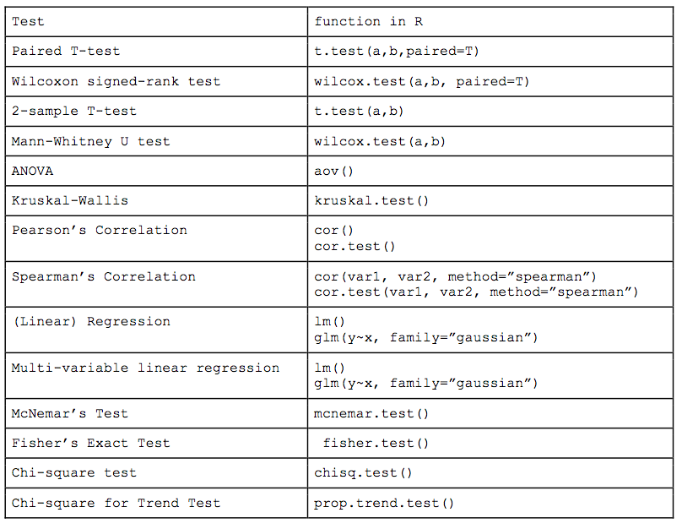
Basic statistics

Slide 24
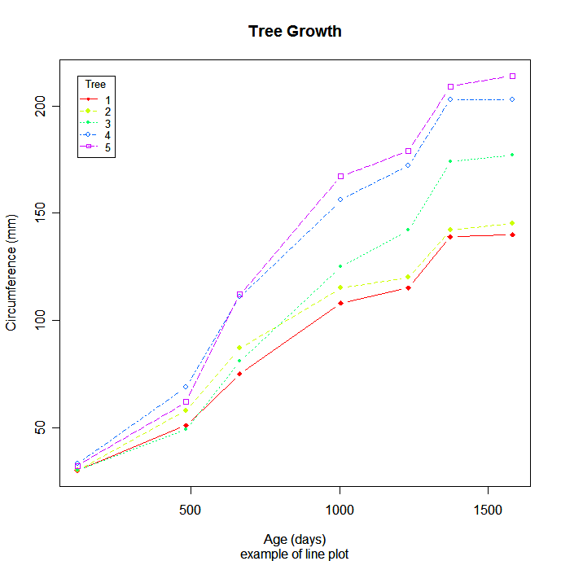
Plotting
One of the most powerful features of R is its ability to generate plots

Slide 25
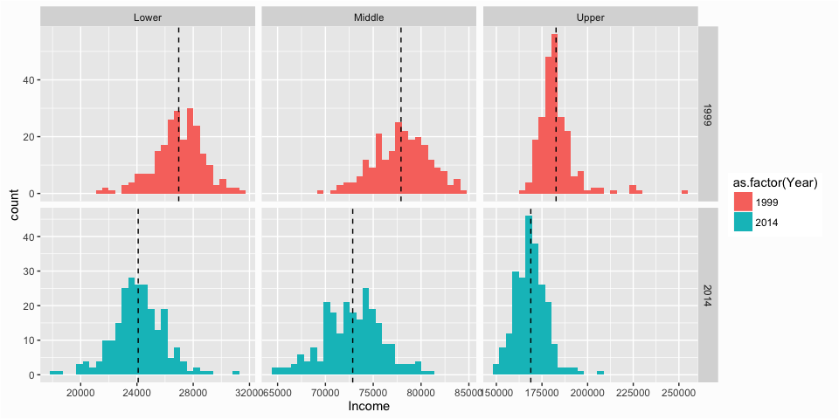
Plotting

Slide 26
Plotting

Slide 27
Summary
By the end of this session you will have learned to:
Create variables and use them to store data
Access and copy subsets of data from one variable to another
Perform conditional tests and use them to search for matching data
Access the built in help functions of R
Utilise in-built and custom functions to conduct statistical analysis
Visualise data using a few of the basic plotting functions

Slide 28
Data structures - Lists and dataframes
Variable name
my_list
[[1]] Num
1
[[2]] Animals
Variable name
my_dataframe
Cat | Fish | Dog | Cat
Animal
Letters
Weight
[[3]] Pets
Age
Cat | 1 | A | 3
Fish | 2 | A | 4
Dog | 1 | B | 2
Cat | 3 | Y | 5
Dog | 2 | V | 6
Cat | 1 | A | 3
Fish | 2 | A | 4
Dog | 1 | B | 2
Cat | 3 | Y | 5
Dog | 2 | V | 6
Standard lists can combine vectors, matrices and factors
Dataframes are a collection of vectors or factors of equal length

