Slide 1

Introduction to Sequence Informatics
Institute of Infection and Global Health

Slide 2
Course overview
Session | Topic
1 | UNIX and command line environment
2 | Genomics: sequencing, assembly and annotation
3 | Programming in R
4 | Genomics: mapping and population analysis
5 | Transcriptomics and differential expression
6 | Extended exercise

Slide 3
Introduction to Mapping and Population Genetics

Slide 4
Reconstructing the genome
Two approaches - De novo assembly

Slide 5
Reconstructing the genome
ACGTGTGTCGTCAACTGA
TCAACTGAACGGCGTGA
ACGTGTGTCGTCAACTGA
TCAACTGAACGGCGTGA

Slide 6
Reconstructing the genome
Two approaches - Mapping

Slide 7
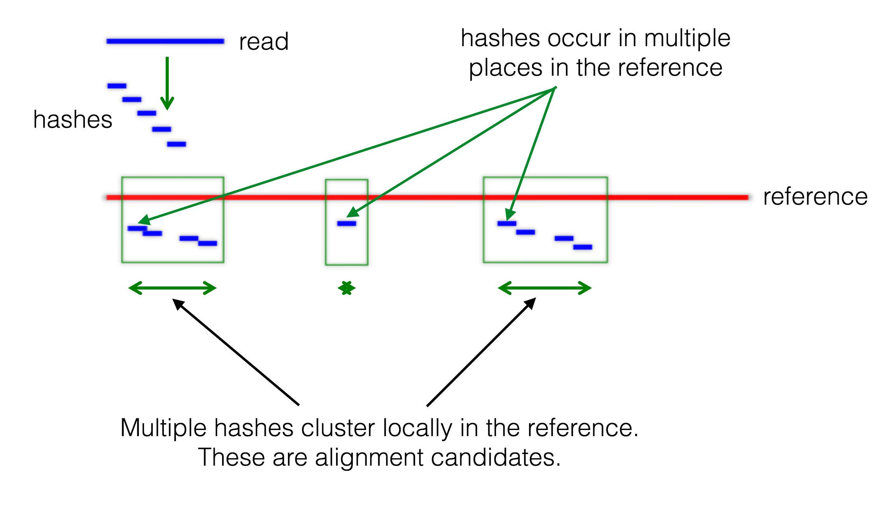

Slide 8
Reconstructing the genome
Reference

Slide 9
Reconstructing the genome
Reference
Depth = 13
Depth = 2

Slide 10
Mapping vs de novo assembly
Advantages
Provides a fixed point of reference when comparing samples
Contigs are often entire chromosomes
Computationally easier, allowing for higher throughput
Easy to identify SNPs
Can use existing reference annotation
Disadvantages
Requires an existing reference sequence
Assumes the reference is accurate
Difficult to identify and analyse insertions and deletions
Large scale variation often missed

Slide 11
A fixed point of reference
Reference
A A C G T A G C G C G T A C A A A A C G T T A C G A A C
Sample 1
A A C G T A G C G C G T A C A A A A C G T T A C G A A C
Sample 2
A A C G T A G C T G C G C G T A C A A A A C G T T A C G A A C
Sample 3
A A C G T A G C G C G T A C A C G T T A C G A A C

Slide 12
A fixed point of reference
Reference
A A C G T A G C G C G T A C A A A A C G T T A C G A A C
Sample 1
A A C G T A G C G C G T A C A A A A C G T T A C G A A C
Sample 2
A A C G T A G C G C G T A C A A A A C G T T A C G A A C
Sample 3
A A C G T A G C G C G T A C A - - - C G T T A C G A A C

Slide 13
Calling SNPs
SNP - Single Nucleotide Polymorphism
Present throughout the genome
A SNP can have a positive effect, negative effect or no effect on the organism.
Only a very small proportion of all SNPs are beneficial and subsequently selected for.
We can identify SNPs by looking for single base-pair differences between two sequences, in this case between our reference and our reads.
True SNP
Mismatch
Reference

Slide 14
You have already analysed SNP data
Chr | Pos | Ref | Sample 1 | Sample 2 | Sample 3 | Sample 4 | Sample 5
1 | 134 | A | A | A | A | C | A
1 | 1453 | C | C | G | G | C | G
1 | 19210 | A | T | A | T | A | C
1 | 302102 | T | A | A | A | A | T

Slide 15
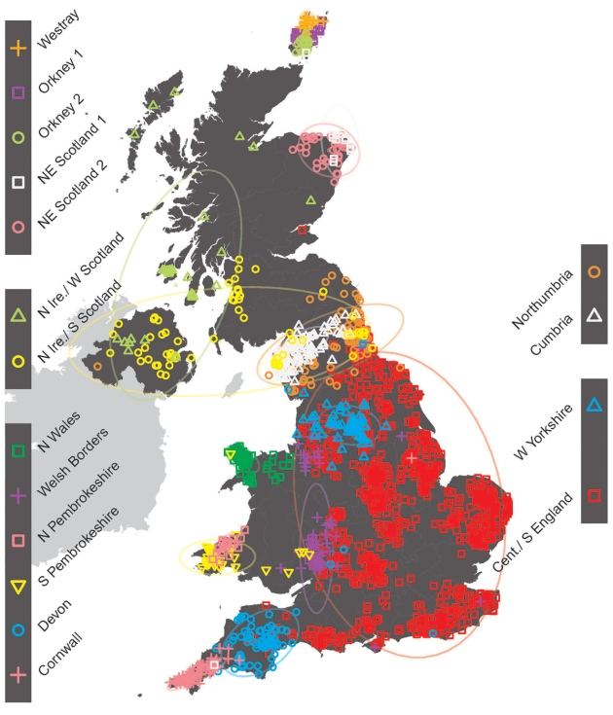
Population genetics
The study of genetic variation within and between natural populations
By studying the patterns of genetic diversity we can identify patterns of selection, determine the structure of populations and reconstruct evolutionary histories

Slide 16
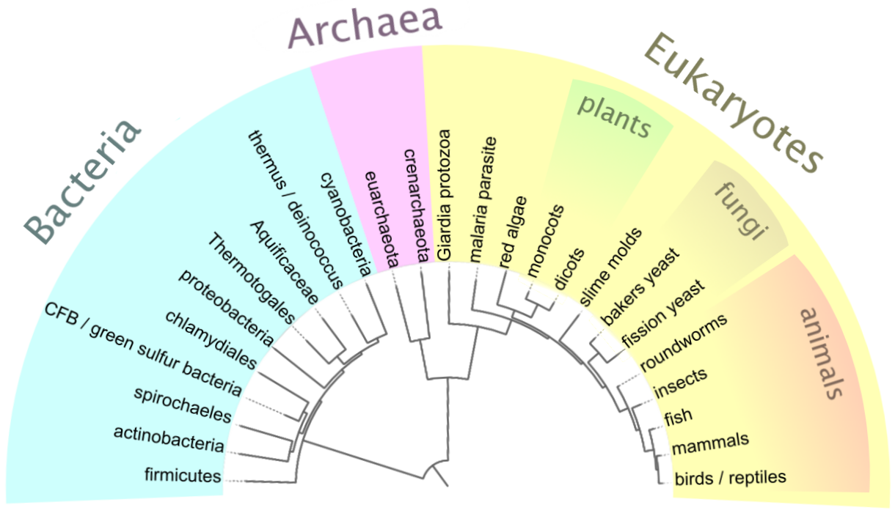
Phylogenetic Trees
Plot the evolutionary relationships between samples
Can be within species or between species
First we must align sequences against one another to calculate the number of differences between each of them

Slide 17
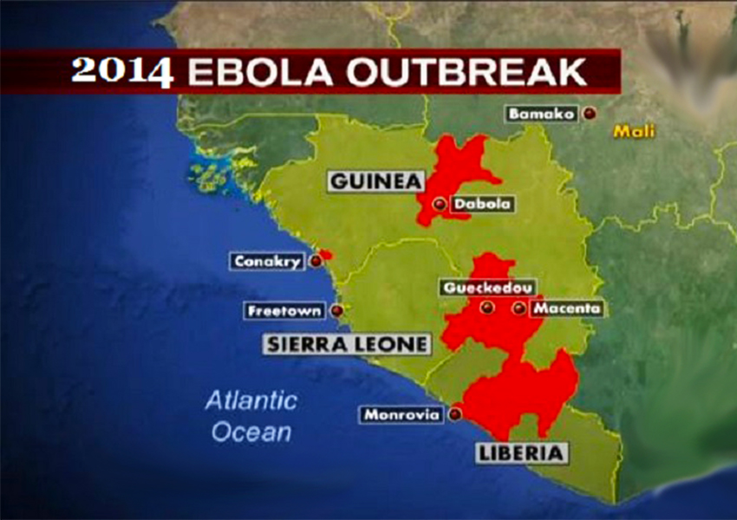
Ebola-virus comparative genomics
During this session you will learn to:
Map reads from the 2014 Ebola outbreak to 2 different reference sequence
Examine the mapped sequences and call SNPs
Generate consensus sequences by merging SNP calls onto a reference
Perform multiple sequence alignment
Calculate the relationships between a group of samples and use the results to plot a phylogenetic tree

