Slide 1

PHINSHING ATTACK INCIDENT ANALYSIS ON TWILIO PHISHING ATTACK

Slide 2
INTRODUCTION OF PHISHING
Phishing is an online cyber attack carried out through deceptive emails sent by the attacker.
Such emails are designed in such a way that they appear to originate from some trustworthy individual or organization.
The intention of the attack is to steal sensitive information including passwords, banking details, or any other financial information.
These phishing emails always carry some form of urgent message that forces users to take immediate action.
It remains among the most common forms of cyber attack and hence calls for extra caution.

Slide 3
PHISHING ATTACK
Phishing is a common type of cyber-attack that targets individuals through email, text messages, phone calls, and other forms of communication.
How can we prevent attacks?
Malicious emails
Fake websites
Fraudulent links
A phishing attack aims to trick the recipient into taking the action the attacker wants, such as revealing financial information, system login details, or other sensitive information.

Slide 4

TYPES OF PHISHING
Email Phishing:
Example:
Fake account notifications
False security alerts
Counterfeit invoice emails.
This is the most common form of phishing. Attackers send fake emails that contain malicious links or attachments.
These messages often appear to be from trusted sources. Their goal is to steal sensitive information or install malware.

Slide 5
Spear Phishing
Example:
Emails that seem to be from a college or a business partner
Requesting sensitive information
Asking the recipient to click on a specific link. .
This is a more targeted type of phishing. Attackers tailor emails to specific individuals or organizations based on research about the target. They use details like names and positions to steal sensitive information.

Slide 6
Whaling:
Example:
Emails that pose as urgent requests from a CEO or CFO
Often involving financial transactions
Sensitive company data.
This is a highly targeted phishing attack aimed at senior executives and
high-profile individuals, like CEOs. Attackers use detailed information about the executive’s role and responsibilities to create convincing emails.

Slide 7
Smishing (SMS Phishing):
Example:
Fake messages from banks asking to verify account information or details
Fraudulent delivery notifications prompting the user to click on a link.
This type of phishing occurs through text messages rather than emails. Attackers send messages containing malicious links or phone numbers, urging recipients to respond or click.

Slide 8
Vishing (Voice Phishing):
This phishing attack takes place via phone calls, where attackers impersonate legitimate entities. They use social engineering to persuade victims to reveal personal information or transfer money.
Example:
Calls pretending to be from a bank’s fraud department, tax authorities, or tech support.

Slide 9
COMPANY OVERVIEW
Twilio is a cloud communications company. Founded: 2008.
Headquartered: San Francisco, USA.
Offers APIs for SMS, voice, video, and authentication services.
Used by companies around the world for their communication needs.

Slide 10
OVERVIEW OF THE ATTACK
In August 2022, Twilio, a cloud communication company, suffered a phishing attack.
The employees of the company received fake SMS messages. The messages asked the employees to log in to a fake company portal.
The attackers stole the login credentials of the employees.

Slide 11
TECHNIQUES USED IN THE ATTACK
Hackers gained access to internal systems. Customer data was compromised.
Approximately 125 Twilio customers were impacted.
Cloudflare and Okta are some of the companies that were targeted.

Slide 12
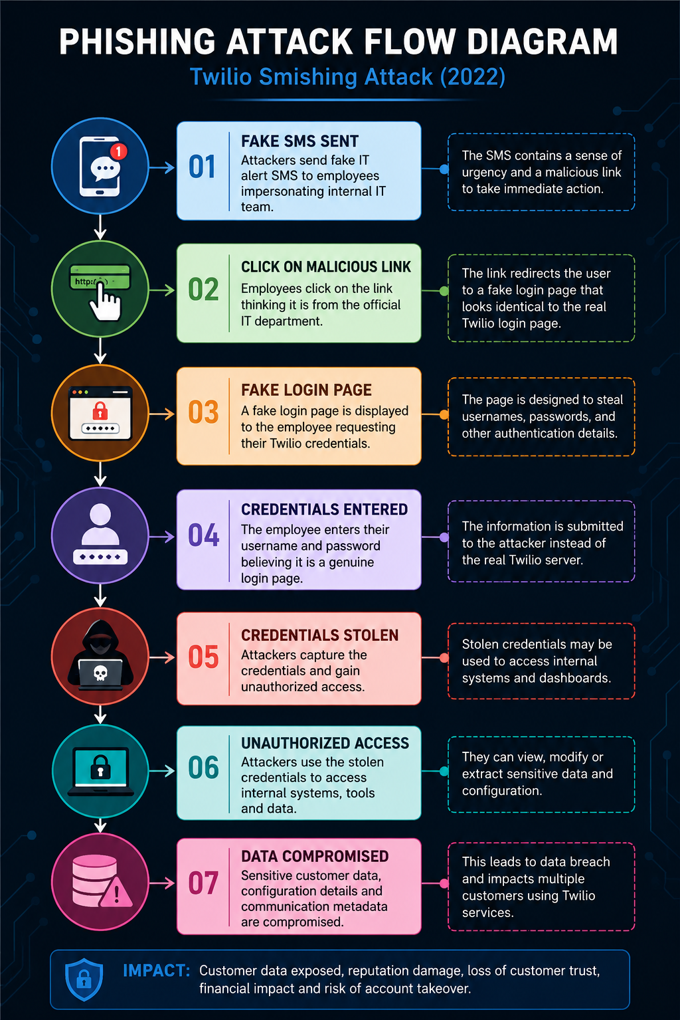

Slide 13
Tools for practical
Go Phish – Creation and tracking of phishing campaigns Mail trap – Email testing environment Kali Linux – Security testing platform Browser/local – Phishing pages and campaigns testing

Slide 14
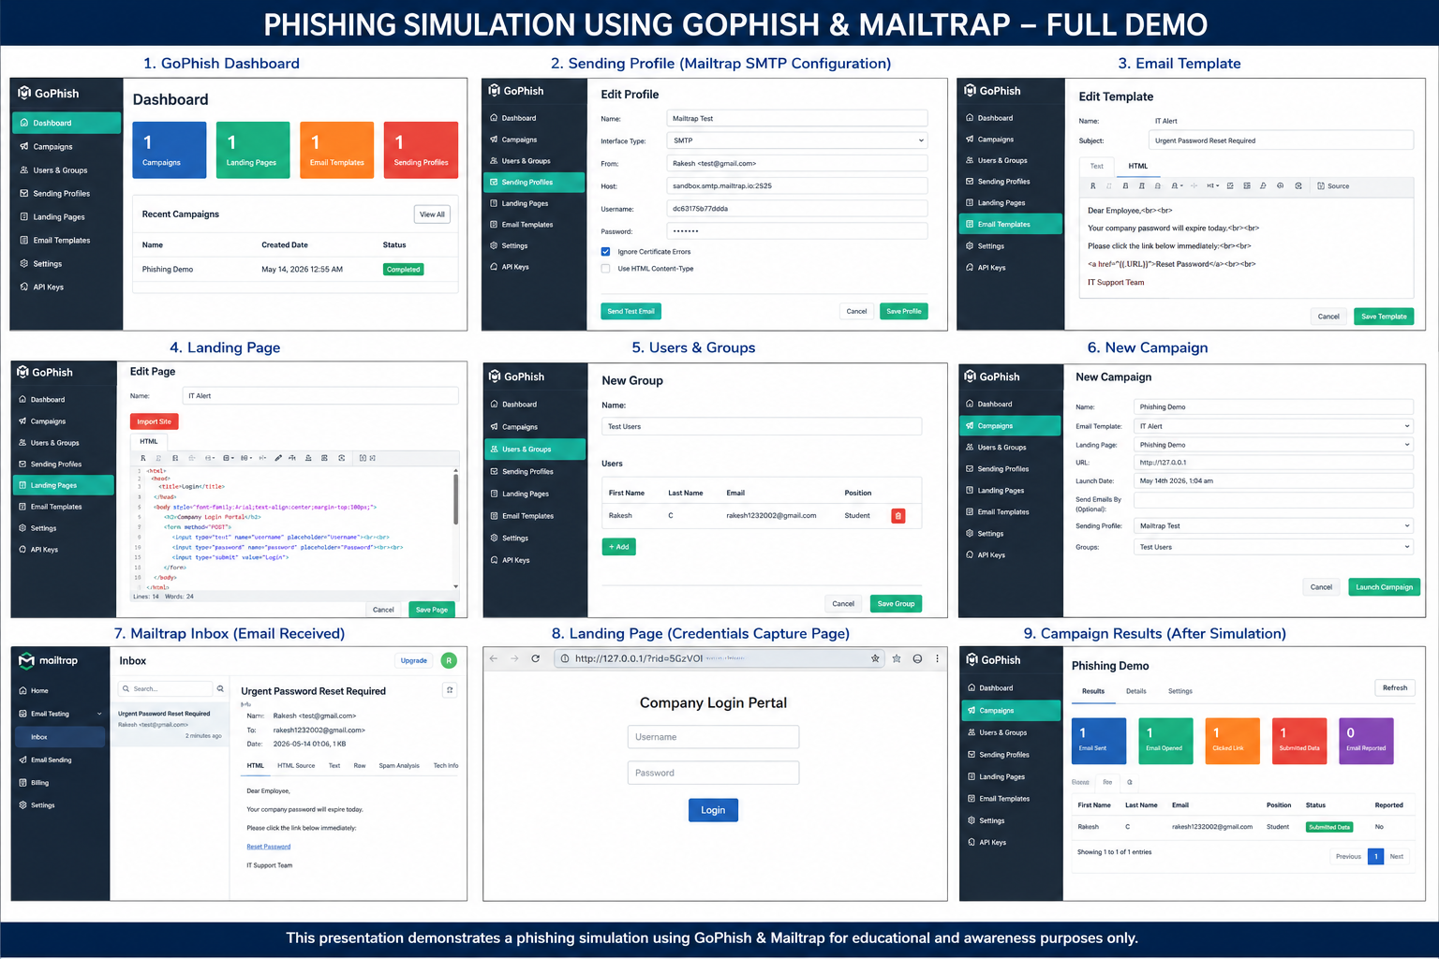

Slide 15
IMPACT OF PHISHING ATTACKS ON COMPANIES
Financial Losses Phishing attacks can lead to financial loss through fraudulent transactions or unauthorized access to financial data.
Data Breaches Attackers may access sensitive information, including customer data, company information, and confidential business details.
Damaging Company Reputation Public phishing attacks can harm a company’s reputation and relationships.
Legal Consequences Companies may face lawsuits and incur substantial fines if they fail to protect sensitive information adequately.
Loss of Intellectual Property Phishing attacks can result in the loss of trade secrets, product ideas, and business strategies, affecting competitiveness.
Impact on Employee Morale Employees may feel threatened and insecure after phishing attacks, which can lower their productivity and confidence.
Disruption of Business Operations Phishing attacks can disrupt business operations, negatively affecting the company.

Slide 16
RESPONSE FROM TWILIO
Twilio took swift action to investigate the attack.
Unauthorized access was blocked. Impacted customers were alerted. Improved security measures were implemented.

Slide 17
TO PREVENT PHISHING ATTACKS
Cybersecurity training for employees Multi-Factor Authentication (MFA) Security filters for email and SMS Security monitoring

Slide 18
RECOMMENDATIONS
Regular phishing attacks training Implementation of robust authentication systems Monitoring of suspicious login activity Improving incident response preparedness

Slide 19

THANK YOU!!!

