Slide 1
IMPLEMENTING SECURITY MEASURES FOR WEB APPLICATION FIREWALL (WAF)
Design, Implementation, Security Testing & Performance Evaluation

Slide 2


Objective
Implement and evaluate a Web Application Firewall to protect a web application against common application-layer attacks while providing monitoring, logging, access control and configurable security rules.

Slide 3


KEY SECURITY REQUIREMENTS
Open-source WAF implementation
OWASP CRS integration
SQL Injection protection
Cross-Site Scripting (XSS) protection
CSRF protection
Modular and configurable rules
OWASP Top 10 security coverage
Security monitoring and anomaly detection
Management authentication and authorization
Performance evaluation
PCI DSS control alignment

Slide 4
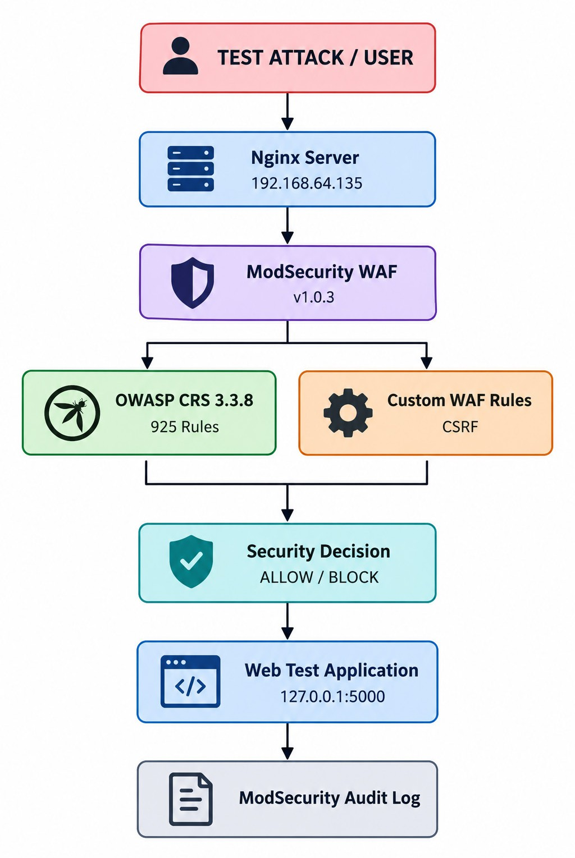
PROJECT ARCHITECTURE

Slide 5
Technology & Environment
Component
Host OS Virtualization WAF Server Hostname WAF IP
Web Server WAF Engine Rule Set CRS Rules Backend Log�ing Testing
Conﬁguration
Windows 11 VMware Workstation
Ubuntu Linux waf-server 192.168.64.135
Nginx ModSecurity-nginx v1.0.3
OWASP CRS 3.3.8
925
127.0.0.1:5000
ModSecurity Audit Log cURL + ApacheBench

Slide 6
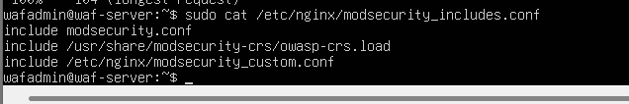
WAF Conﬁguration
/etc/nginx/modsecurity_includes.conf
modsecurity.conf
OWASP CRS
owasp-crs.load
modsecurity_custom.conf
The WAF uses a modular conﬁguration structure separating the base ModSecurity conﬁguration, OWASP CRS rules and custom security rules. This allows security controls to be maintained and customized independently.

Slide 7

WAF Rule Loading Veriﬁcation ModSecurity-nginx v1.0.3
rules loaded inline/local/remote: 0/925/0
syntax is ok
test is successful
Final Conﬁguration Validation — 925 OWASP CRS rules successfully loaded

Slide 8
SQL Injection Protection
Attack Tested
' OR 1=1 --
Test
GET /search?username=' OR 1=1 --
Detection
SQL Injection detected using libinjection
OWASP CRS SQL Injection rules triggered
Rule 949110 triggered anomaly threshold
Request blocked
Result
HTTP/1.1 403 Forbidden
Evidence
Add:
•
cURL test screenshot
Audit-log screenshot showing SQLi detection

Slide 9
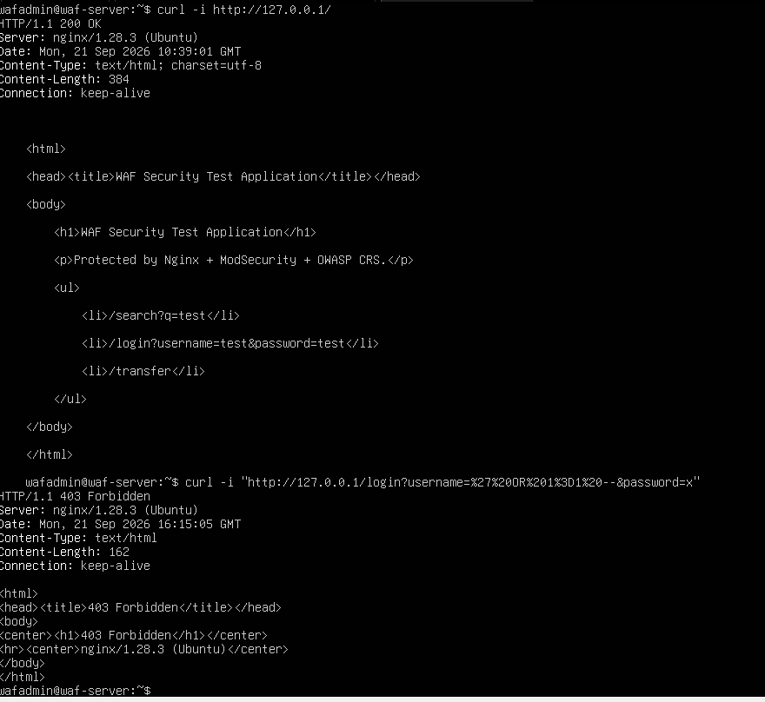

Slide 10
CSRF Protection — Custom WAF Rule
Request Without Token Request With Token
Put: Put:
POST /transfer
X-CSRF-Token: test-token
Result:
Result:
HTTP/1.1 403 Forbidden
HTTP/1.1 200 OK
WAF Message:
Detection Rule:
WAF CSRF protection: missing CSRF token
Rule ID: 1000001

Slide 11
Cross-Site Scripting (XSS) Protection
Attack Tested
<script>alert(1)</script> Test Request
GET /search?username=<script>alert(1)</script> WAF Detection
Add these points:
OWASP CRS detected the XSS payload.
Libinjection identified the request as XSS.
CRS rule 941110 detected the <script> pattern.
HTML injection was detected.
Rule 949110 triggered the inbound anomaly-score threshold.
ModSecurity blocked the request.
Result
HTTP/1.1 403 Forbidden

Slide 12
LFI / PATH TRAVERSAL PROTECTION
Attack Tested
../../../../etc/passwd
Test Request
GET /search?file=../../../../etc/passwd
WAF Detection
930110 — Path Traversal Attack 930120 — OS File Access Attack
932160 — RCE-related pattern detection 949110 — Inbound Anomaly Score Exceeded ModSecurity denied the request
Result
HTTP/1.1 403 Forbidden
Conclusion
OWASP CRS detected the path traversal and sensitive file-access patterns and blocked the malicious request before it reached the backend application.

Slide 13
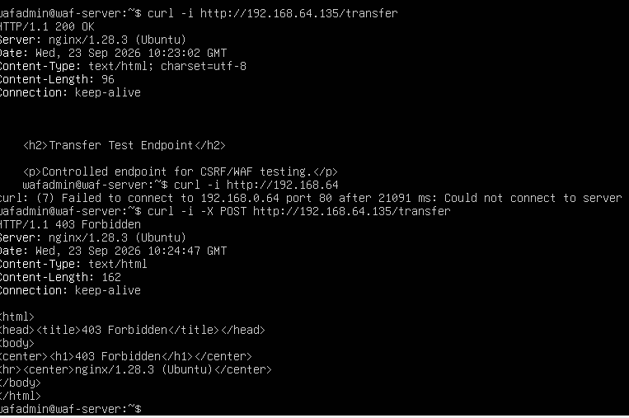
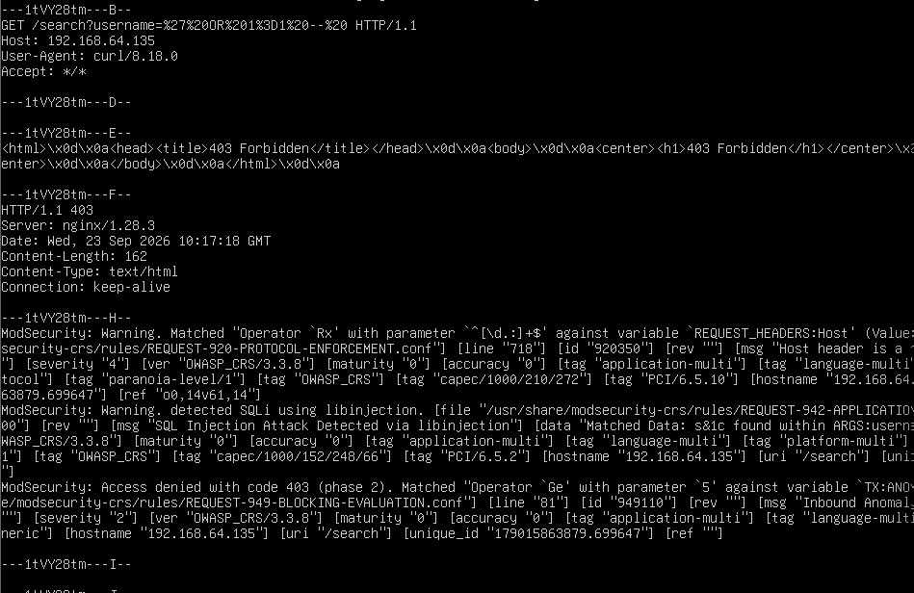
LFI / PATH TRAVERSAL PROTECTION
Detection: Path Traversal + OS File Access
Result: Malicious request blocked
Status: IMPLEMENTED & TESTED

Slide 14
Remote Code Execution (RCE) Protection
Attack Pattern Tested cat /etc/passwd
Test Request
GET /search?cmd=cat /etc/passwd
WAF Detection
932160 — Remote Command Execution detection attack-rce classification
930120 — OS File Access Attack
949110 — Inbound Anomaly Score Exceeded ModSecurity denied the request
Result
HTTP/1.1 403 Forbidden

Slide 15

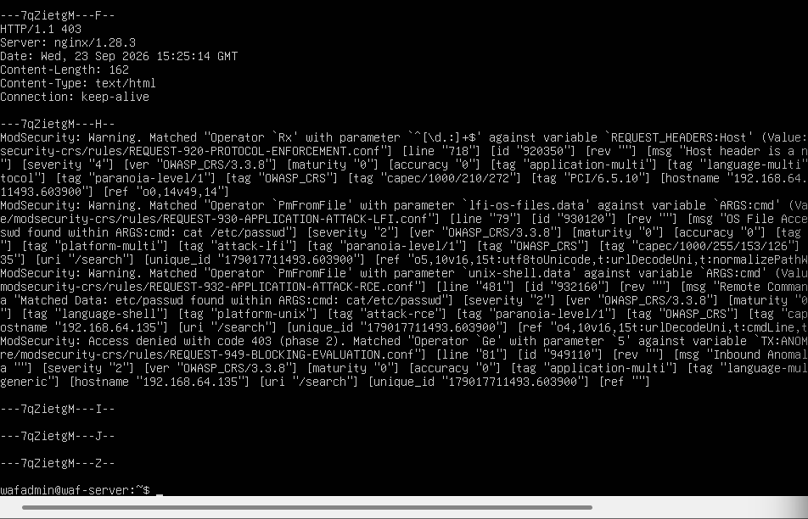
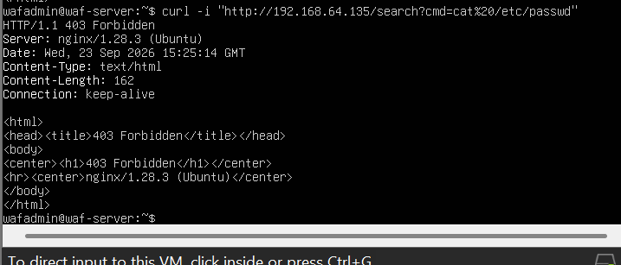

REMOTE CODE EXECUTION PROTECTION
Result: RCE-related request blocked Status: IMPLEMENTED & TESTED

Slide 16
ANOMALY DETECTION & SECURITY MONITORING
OWASP CRS Anomaly Scoring
The WAF evaluates incoming requests and assigns anomaly scores based on detected security violations. When the configured threshold is exceeded, the request is blocked.
Evidence Use:
Rule: 949110
Inbound Anomaly Score Exceeded
This rule appeared during your SQLi, XSS, LFI and RCE tests. Monitoring
ModSecurity records security events in:
/var/log/nginx/modsec_audit.log Monitoring Capabilities
Attack detection Anomaly scoring Rule identification
HTTP response tracking Security event logging
Near-real-time audit monitoring Result
The WAF successfully demonstrated anomaly-based detection and security event monitoring using OWASP CRS and ModSecurity audit logs.

Slide 17
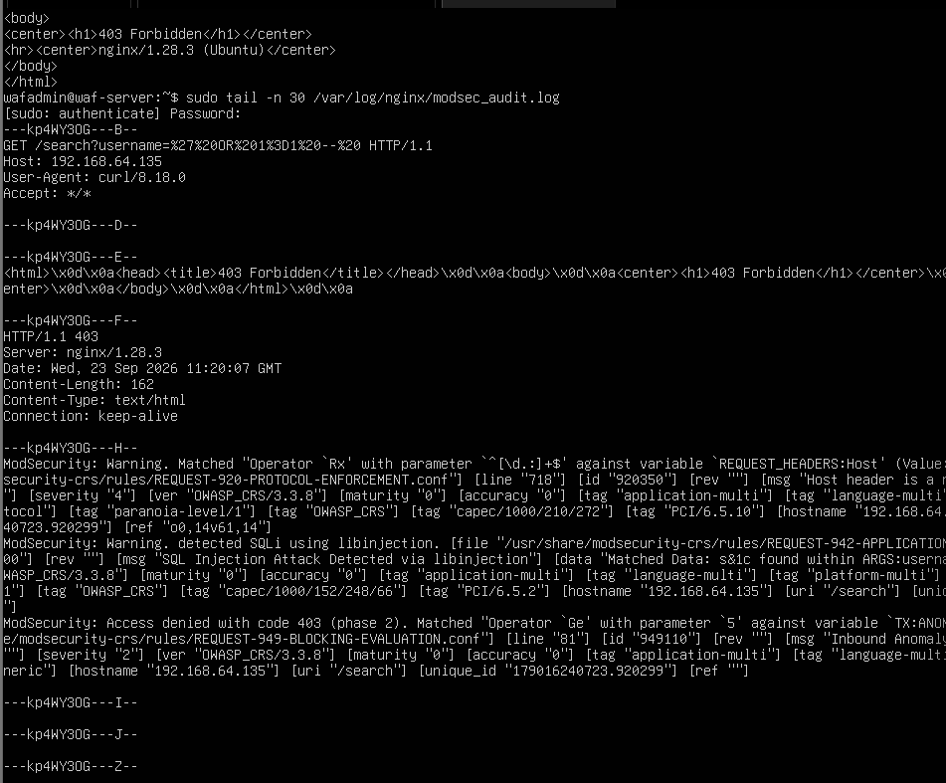
ANOMALY DETECTION & SECURITY MONITORING
Detection s Anomaly Score s Decision s Logging Status: IMPLEMENTED & DEMONSTRATED

Slide 18
ModSecurity Audit Logging & Security Events
Audit Log Location
/var/log/nginx/modsec_audit.log
Security Information Recorded
Client/request information
HTTP request details
Matched ModSecurity rule
Attack category
CRS rule ID
Anomaly score
Security message
HTTP response status
Block/allow decision
Example Detection Events Attack
CRS Detection
Result
SQL Injection | REQUEST-942 | 403
XSS | REQUEST-941 | 403
LFI / Path Traversal | REQUEST-930 | 403
RCE | REQUEST-932 | 403
Anomaly 949110 |  | 403

Slide 19
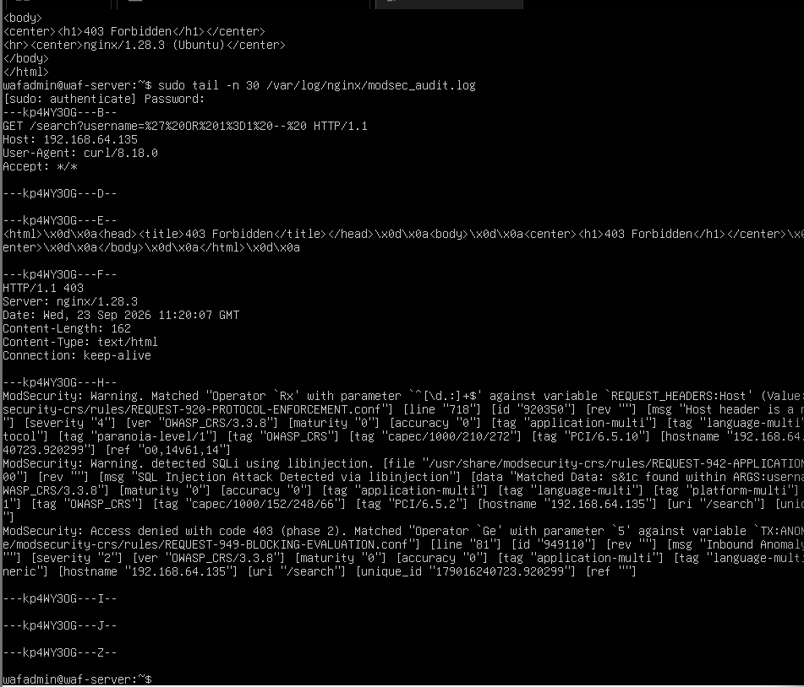
ModSecurity Audit Log

Slide 20
WAF Management Authentication & Authorization
Protected Management Endpoint
/waf-admin
The WAF management endpoint is protected using HTTP Basic Authentication. Authentication Test
Without credentials:
HTTP/1.1 401 Unauthorized With valid credentials:
  HTTP/1.1 200 OK
  WAF Management Access - Authenticated
Network Authorization
The management endpoint is restricted to the internal network: allow 192.168.64.0/24;
deny all;
Authentication File
/etc/nginx/.htpasswd

Slide 21

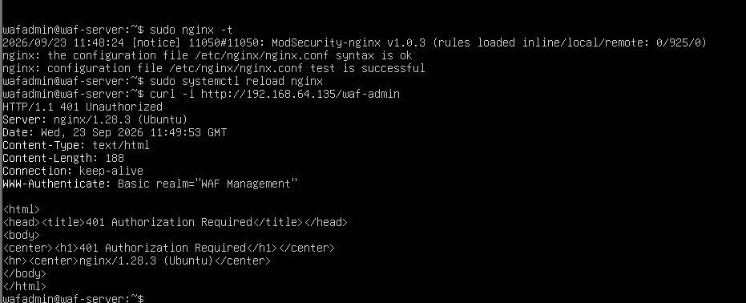
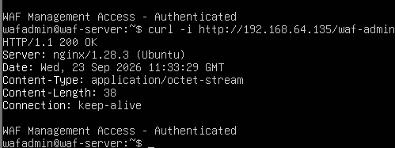

WAF MANAGEMENT AUTHENTICATION & AUTHORIZATION
Unauthorized Access Authenticated Access
Network: 192.168.64.0/24 Authentication: HTTP Basic Auth Authorization: allow/deny ACL Status: IMPLEMENTED & TESTED

Slide 22
WAF Performance Testing & Evaluation
Testing Tool
ApacheBench (AB) 2.3
Test Configuration Total Requests: 1,000
Concurrent Requests: 10
Failed Requests: 0
Performace Results
Metric | Result
Requests per second | 357.51 req/s
Mean time/request | 27.97 ms
Median response time | 25 ms
90th percentile | 34 ms
95th percentile | 36 ms
99th percentile | 92 ms
Maximum | 104 ms
Failed requests | 0

Slide 23
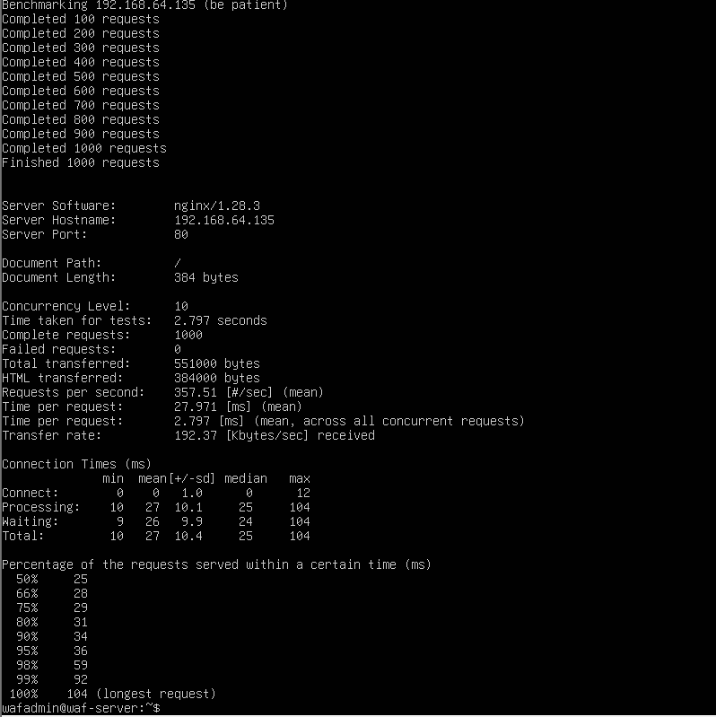
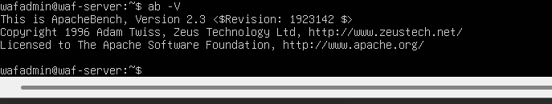
WAF PERFORMANCE TESTING & EVALUATION
Controlled VMware laboratory benchmark Status: TESTED

Slide 24


OWASP Top 10 Security Coverage
OWASP CRS Integration
OWASP Core Rule Set (CRS) 3.3.8 integrated with ModSecurity. 925 CRS rules loaded and active.
Provides broad protection against common web application attacks.
Practical Security Tests
SQL Injection s Detected and blocked with HTTP 403
Cross-Site Scripting (XSS) s Detected and blocked with HTTP 403 CSRF s Custom token-header protection implemented and tested LFI / Path Traversal s Detected and blocked with HTTP 403
Remote Code Execution patterns s Detected and blocked with HTTP 403
Coverage Approach
OWASP CRS provides broad application-attack coverage.
Selected OWASP-relevant attack scenarios were practically tested. Audit logs provide evidence of detected security events.

Slide 25
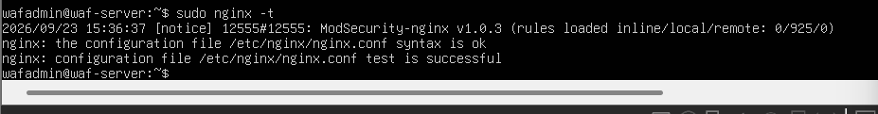
CRS rules loaded

Slide 26
PCI DSS Control Alignment
PCI DSS Security Alignment
ModSecurity with OWASP CRS provides security controls for web application traffic.
CRS audit events include PCI DSS references such as:
PCI/6.5.2
PCI/6.5.10
These references provide traceability between WAF detection rules and applicable application-security controls.
Implemented Security Controls
SQL Injection detection and blocking
XSS detection and blocking
CSRF protection
Path traversal / LFI detection
RCE pattern detection
Security event logging and monitoring
Management endpoint authentication and authorization
Compliance Statement
The project demonstrates technical alignment with applicable PCI DSS application-security controls. It does not constitute PCI DSS certification or compliance certification.

Slide 27
PCI DSS screenshot
PCI DSS References Identified in ModSecurity Audit Events

Slide 28

Security Test Results Summary
Security Test | Detection | Response | Status
SQL Injection | CRS SQLi rules | HTTP 403 | Blocked
XSS | CRS XSS rules | HTTP 403 | Blocked
CSRF | Custom Rule 1000001 | HTTP 403 / 200 with token | Tested
LFI / Path Traversal | CRS 930110 / 930120 | HTTP 403 | Blocked
RCE Pattern | CRS 932160 | HTTP 403 | Blocked
Anomaly Detection | CRS 949110 | HTTP 403 | Demonstrated
Audit Logging | ModSecurity Audit Log | Security event recorded | Demonstrated
Management Access | Nginx Basic Auth | 401 / 200 | Tested
Performance | ApacheBench | 357.51 req/s | Tested

Slide 29
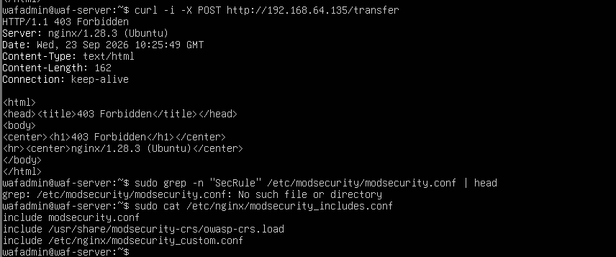
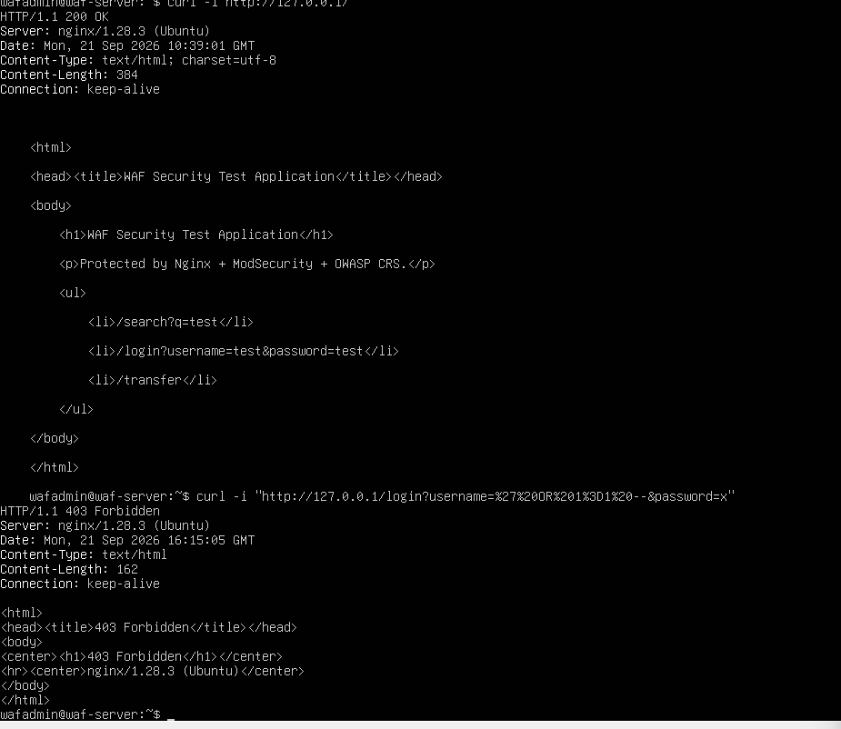
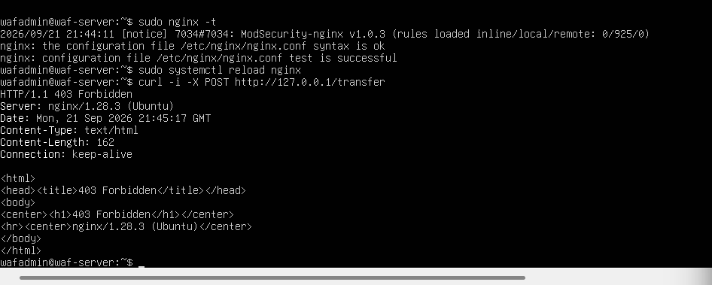
TESTING COMPLETED
SQL Injection — 403
CSRF — 403/200
XSS — 403

Slide 30
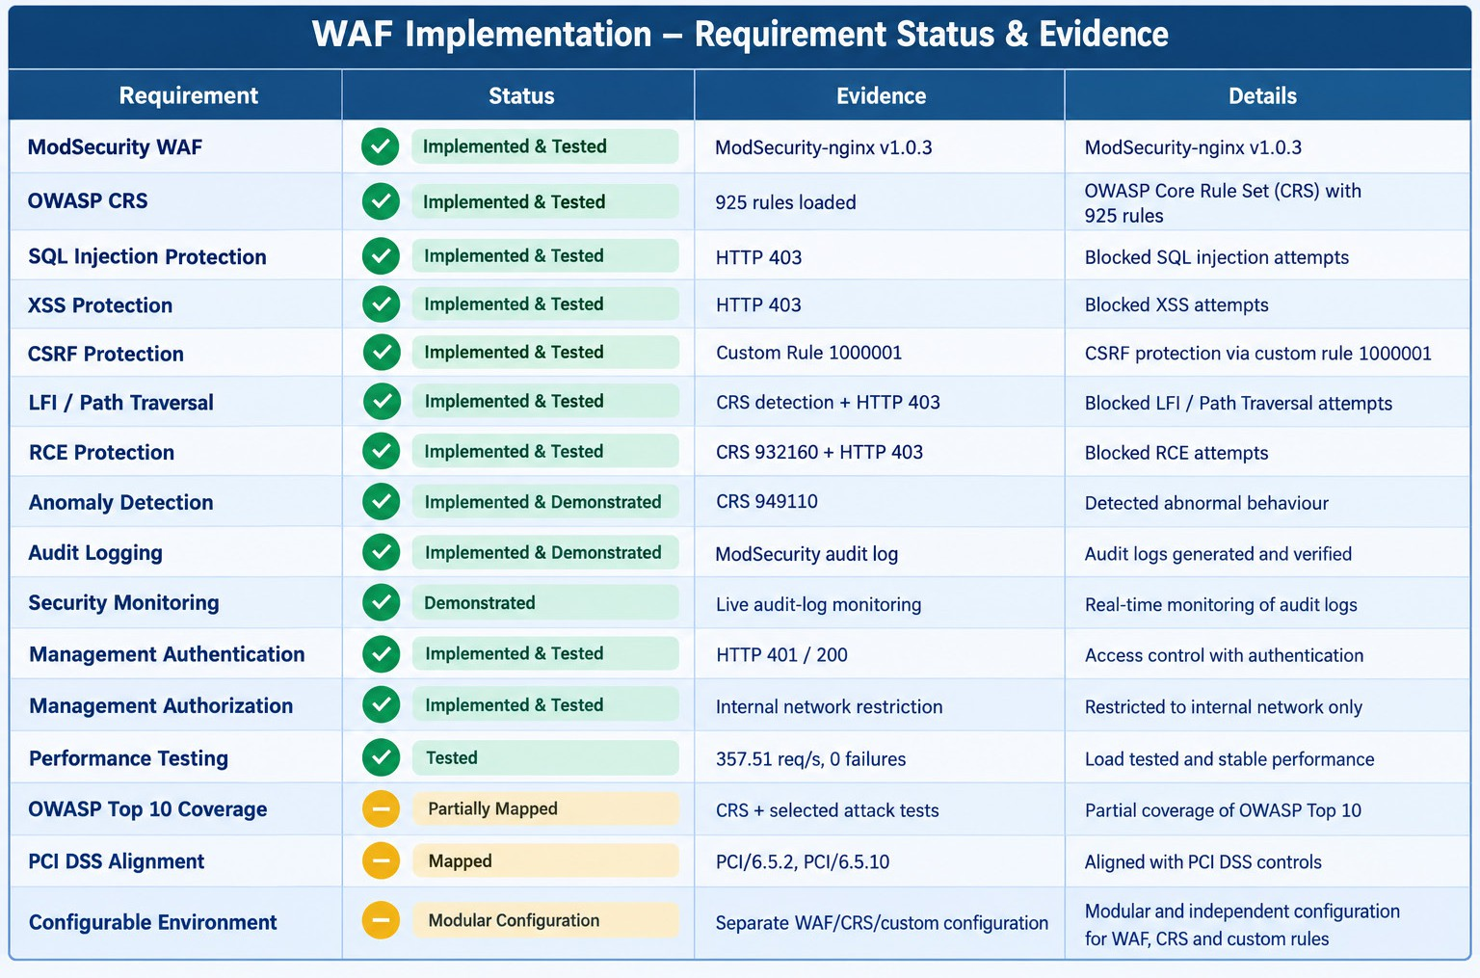
WAF Implementation Status Matrix

Slide 31
Future Enhancements
Deploy centralized security monitoring/SIEM integration.
Add automated alerting for critical WAF events.
Implement more advanced rate limiting and DDoS protection.
Establish separate development, testing, and production configurations.
Conduct larger-scale performance and load testing.
Integrate additional authentication methods and role-based administration.

Slide 32
Conclusion
Successfully implemented an open-source ModSecurity WAF with Nginx.
Integrated OWASP CRS 3.3.8 with 925 active rules.
Tested protection against SQL Injection, XSS, CSRF, LFI/Path Traversal, and RCE patterns.
Implemented security event logging and anomaly detection.
Implemented management authentication and network-based authorization.
Performance testing achieved 357.51 requests/second with 0 failed requests under the controlled lab workload.
Demonstrated technical alignment with OWASP security practices and applicable PCI DSS controls

