Slide 1

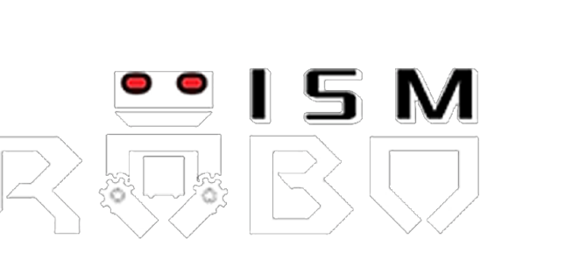
ROBOISM
NAME:- SHUVAM DAS
ADMN NO:- 21JE0914
PROBLEM
STATEMENT DIV:- IOT

Slide 2
DIVISION OF MY PROJECT
THE AREA ON WHICH I AM GOING TO DO THE PROJECT IS LOGISTICS MAINLY ON FLEET AND VEHICLE TRACKING.

Slide 3
MY PROBLEM STATEMENT
Vehicle tracking has been an essential purpose for improving our lifestyle and to detect emergency vehicles or accidental places for crime forensics. Thus it is important to provide a very cost effective way to create a system to track a vehicle through smartphone.

Slide 4
USE OF INTERNET OF THINGS FOR THIS PROJECT
Iot in fleet management allows the fleet operators to automate various processes and trip planning. For example: if a vehicle breaks down then the system can send automatic ticket notification to tow trucks and nearest service stations. In the case of weather warnings, automatic notifications can be sent to drivers to help them in rerouting etc. Through various sensors, fleet companies have access to vast amount of data which they can analyze to gain actionable insights into the adherence to laws by drivers, vehicle speeding and idling, and driving patterns and so on. This information can help the companies make real-time quick decisions for instant improvements

Slide 5
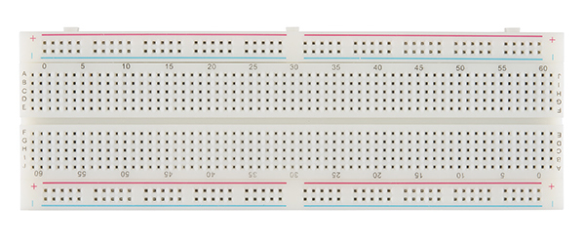
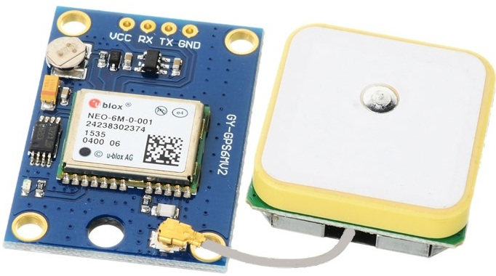
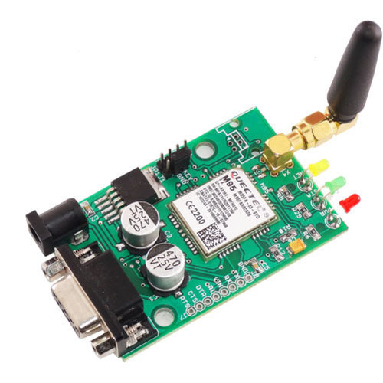
COMPONENTS REQUIRED
1.] BREADBOARD
2.] GPS MODULE
3.] GSM MODULE

Slide 6
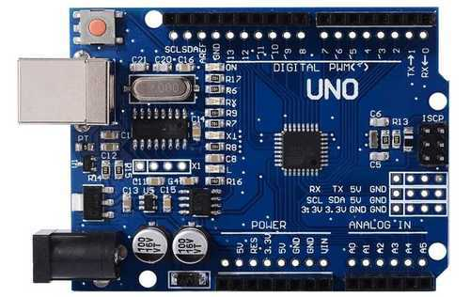
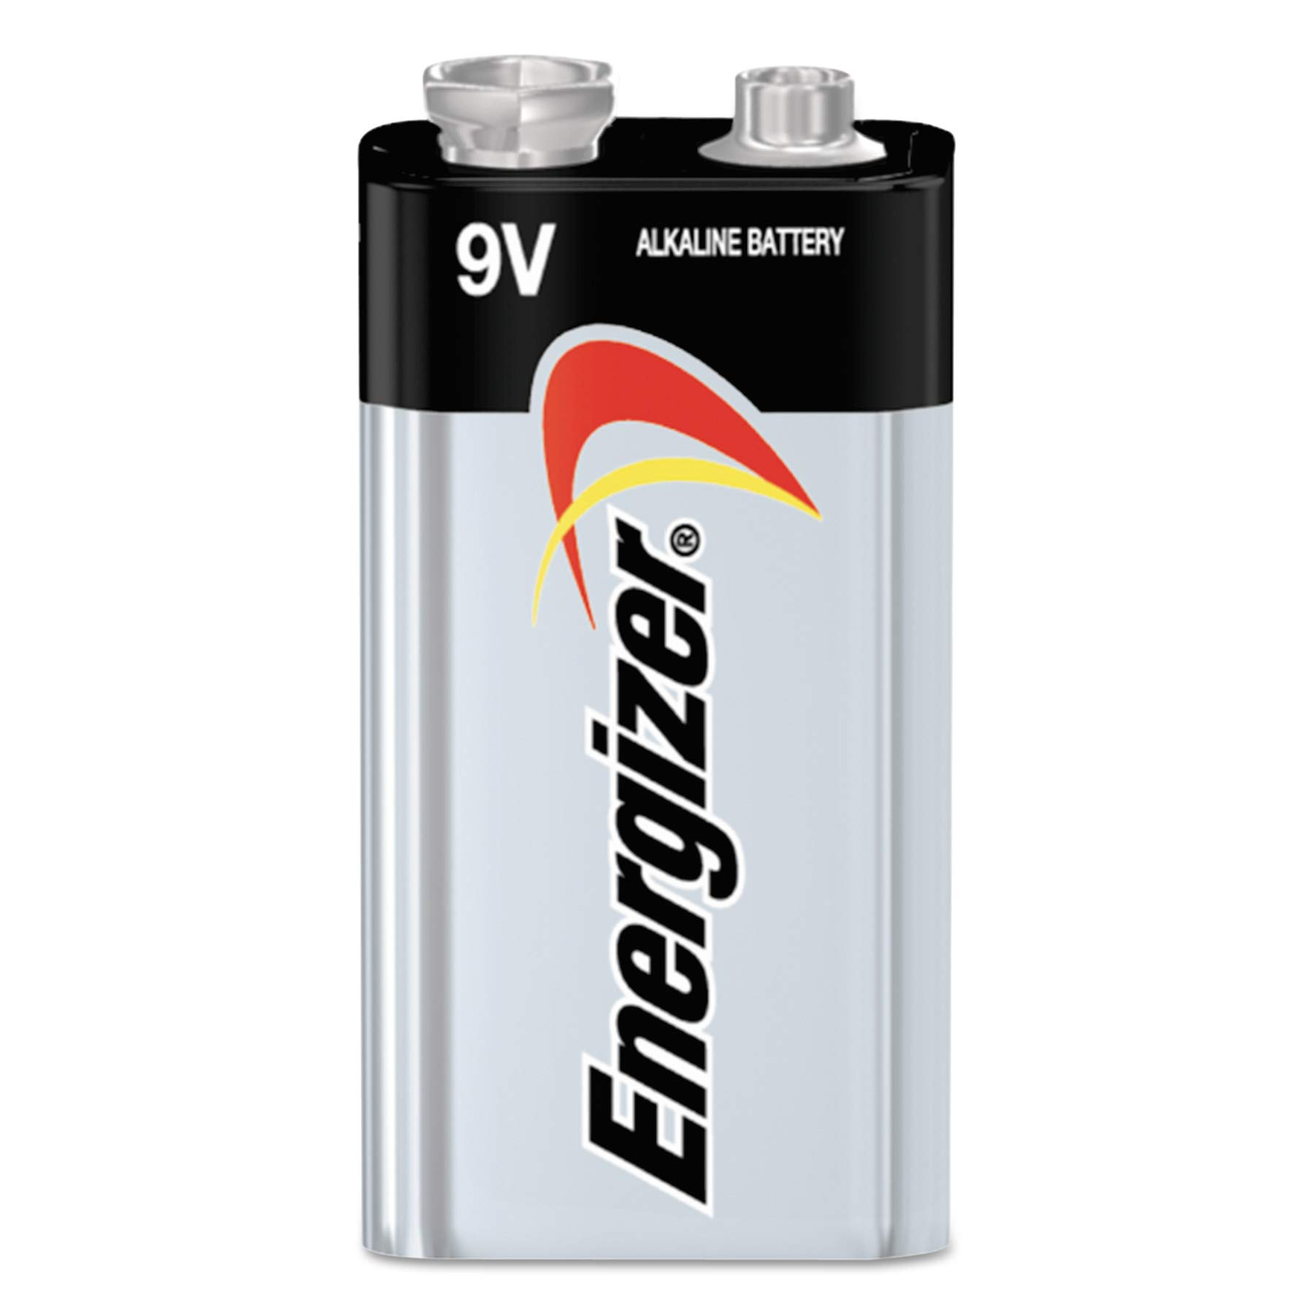
COMPONENTS REQUIRED
4.] ARDUINO UNO
5.] POWER SUPPLY

Slide 7
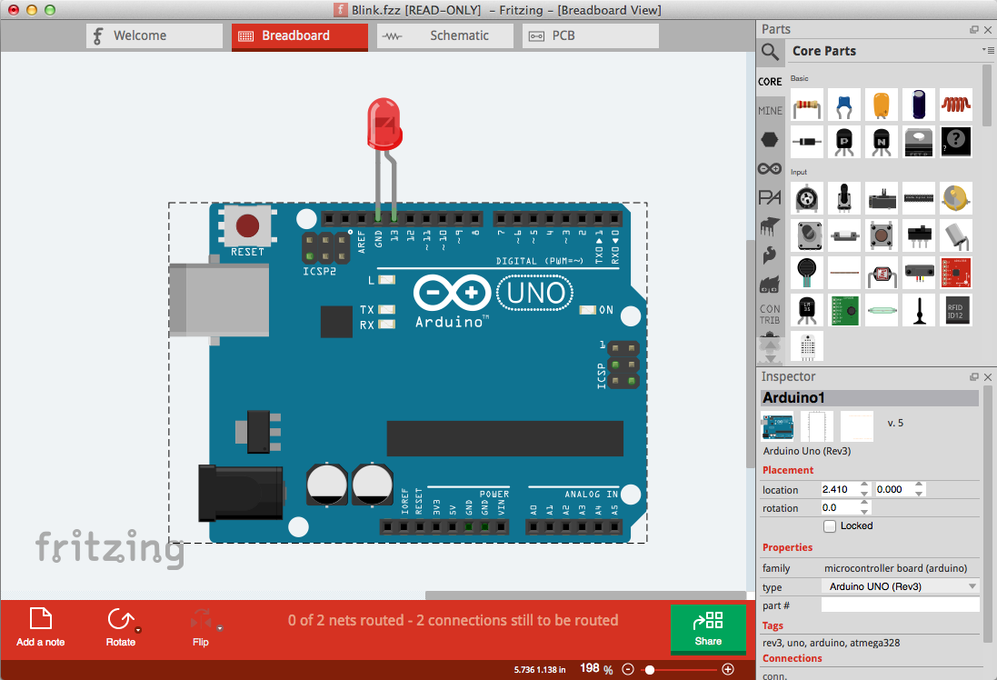
SOFTWARE REQUIRED
1] FRITZING (64 BIT VERSION)

Slide 8
APPROACH TOWARDS THE PROBLEM
Vehicle fleet tracking system uses GPS technology to track the locations of vehicles in real time. Tracking of vehicle is a process in which we track the vehicle location in form of latitude and longitude (gps coordinates).
GPS coordinates are the value of a location. This kind of Vehicle Tracking System Project is widely in tracking Taxis, stolen vehicles, school buses ,crime scene vehicles etc.

Slide 9
APPROACH TOWARDS THE PROBLEM
GPS stands for Global Positioning System and used to detect the Latitude and Longitude of any location on the Earth, with exact real time. This device receives the coordinates from the satellite for each and every second, with time and date.
A GSM modem or GSM module is a device that uses GSM mobile telephone technology to provide a wireless data link to a network. GSM modems are used in mobile telephones and other equipment that communicates with mobile telephone networks. They use SIMs to identify their device to the network.

Slide 10
EXPLANATION OF THE WORKFLOW
In this project, Arduino will use for controlling whole the process with a GPS Receiver and GSM module. GPS Receiver is used for detecting coordinates of the embedded system which is the phone of the user, and GSM module is used for sending the coordinates to user by SMS. We have to download the TinyGPS++ library and import it in our code to use the feature of live location.
When we turn on embedded system first GPS module will collect the Latitude and Longitude of the embedded system and it will send the data to the Arduino.
The Arduino will send the data to the GSM module and GSM module will send the SMS to the user.

Slide 11
EXPLANATION OF THE WORKFLOW
After we make the necessary connections we write the code on the Arduino compiler and then upload the code to the Arduino and on the embedded system.
Now after that we have to switch ON the hardware. Download the code. check the Network range on the GSM module with the blinking of the network led.
We have to type "TRACK VEHICLE" as SMS and send to the sim module in the GSM Modem.
Now you can receive the GPS co-ordinates as SMS. The SMS consist of web link which will redirect to the GOOGLE MAP

Slide 12
BLOCK DIAGRAM
GPS
Arduino uno
GSM
USER
DG

Slide 13
BLOCK DIAGRAM
START OF THE PROCESS
GPS ACTIVE TO GATHER DATA
GPS SENDING DATA TO ARDUINO
ARDUINO SENDS DATA TO GSM
ARDUINO FEEDS THE DATA AS LATITUDE AND LONGITUDE
GSM SENDS SMS O TO USER EMBEDDED SYSTEM
END OF PROCESS
DG

Slide 14
CONNECTIONS
GPS AND ARDUINO UNO:-
1. 5V ARDUINO TO VIN ON THE GPS BREAKOUT
2. GND TO GND
3. RX PIN GPS MODULE TO DIGITAL PIN 2 ARDUINO
4. TX PIN GPS MODULE TO DIGITAL PIN 3 ARDUINO

Slide 15
CONNECTIONS
GSM AND ARDUINO UNO:-
1. TX PIN OF GSM MODULE TO ARDUINO RX PIN
2. RX PIN OF GSM MODULE TO ARDUINO TX PIN.
3. GND PIN OF GSM MODULE TO ARDUINO GND PIN

Slide 16
SOURCE CODE
https://github.com/Cralsic123/ROBOISM_IOT_PROJECT

Slide 17
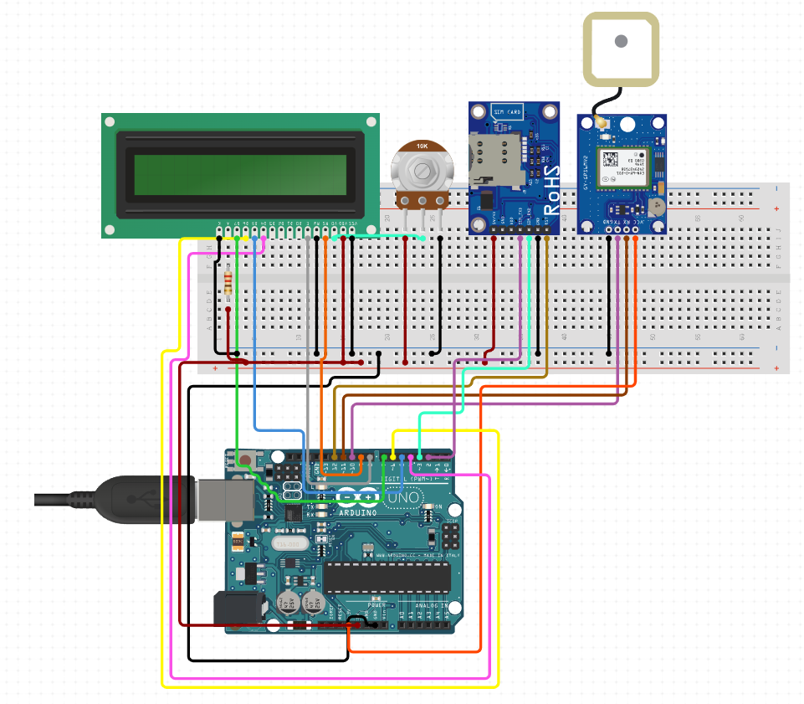
CIRCUIT DIAGRAM

Slide 18
PROSPECT
WHILE DOING THIS PROJECT I LEARNT A LOT ABOUT THE PROSPECTS OF ROBOTICS AND ALSO A LOT ABOUT ARDUINO UNO AND HOW IT IS THE BACKBONE OF ROBOTICS. I WAS HAVING SOME PROBLEM FIGURING OUT THE USE OF GPS AND GSM TOGETHER. I COULD HAVE USED A MORE ADVANCED GPS SYSTEM TO CONSTANTLY PROVIDE THE LIVE LOCATION AND ALSO TO FIGHT THE TIME LATENCY PROBLEM TO PROVIDE MORE ACCURACY.

Slide 19
ADVANCED USES
CLOUD BASED FLEET TRACKING SYSTEMS CAN BE SCALED UP ON DEMAND TO HANDLE LARGE NUMBER OF VEHICLES. ALERTS CAN BE GENERATED IN CASE OF DEVIATIONS IN PLANNED ROUTES. THE SYSTEM CAN BE MODIFIED TO ANALYZE MESSAGES SENT FROM THE VEHICLES TO IDENTIFY UNEXPECTED INCIDENTS AND DISCREPANCIES BETWEEN ACTUAL AND PLANNED DATA, SO THAT REMEDIAL ACTIONS CAN BE TAKEN.

Slide 20
RESOURCES
FOR KNOWING ABOUT CONNECTIONS:-
1. YOUTUBE:- 1. https://www.youtube.com/watch?v=1sq1OenmNIo
2. https://www.youtube.com/watch?v=58jFAammYcw&t=289s
2. WEBSITES:- 1.https://github.com/e-radionicacom/e-radionica.com- Fritzing-Library-parts-
2. https://www.filehorse.com/download-fritzing-64/
3. BOOKS:- Internet of Things by Arshdeep Bahga

Slide 21
ACKNOWLEDGEMENT
THANK YOU ROBOISM AND MEMBERS FOR PROVIDING ME THIS OPPORTUNITY TO DO THIS PROJECT AND FOR HELPING ME IN DOING THIS PROJECT. I LEARNT A LOT WHILE DOING THIS PROJECT AND THIS WILL HELP ME IN THE LONG RUN OF MY LIFE.
THANK YOU

