Slide 1
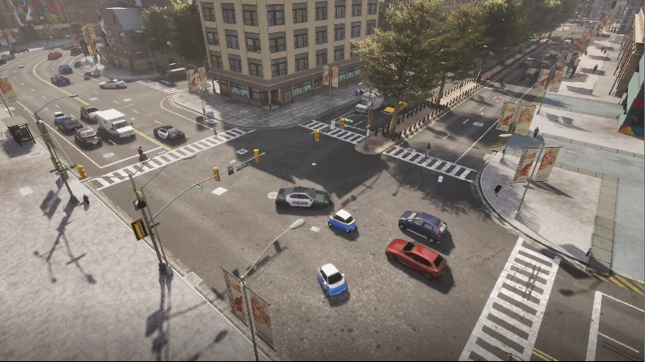
Inter-dependencias
between Vehicles

