Slide 1
MUDAC 2019
Team 20
Tejo, Rohan, Cran, Sophia, Jason

Slide 2
Problem 1:

Slide 3
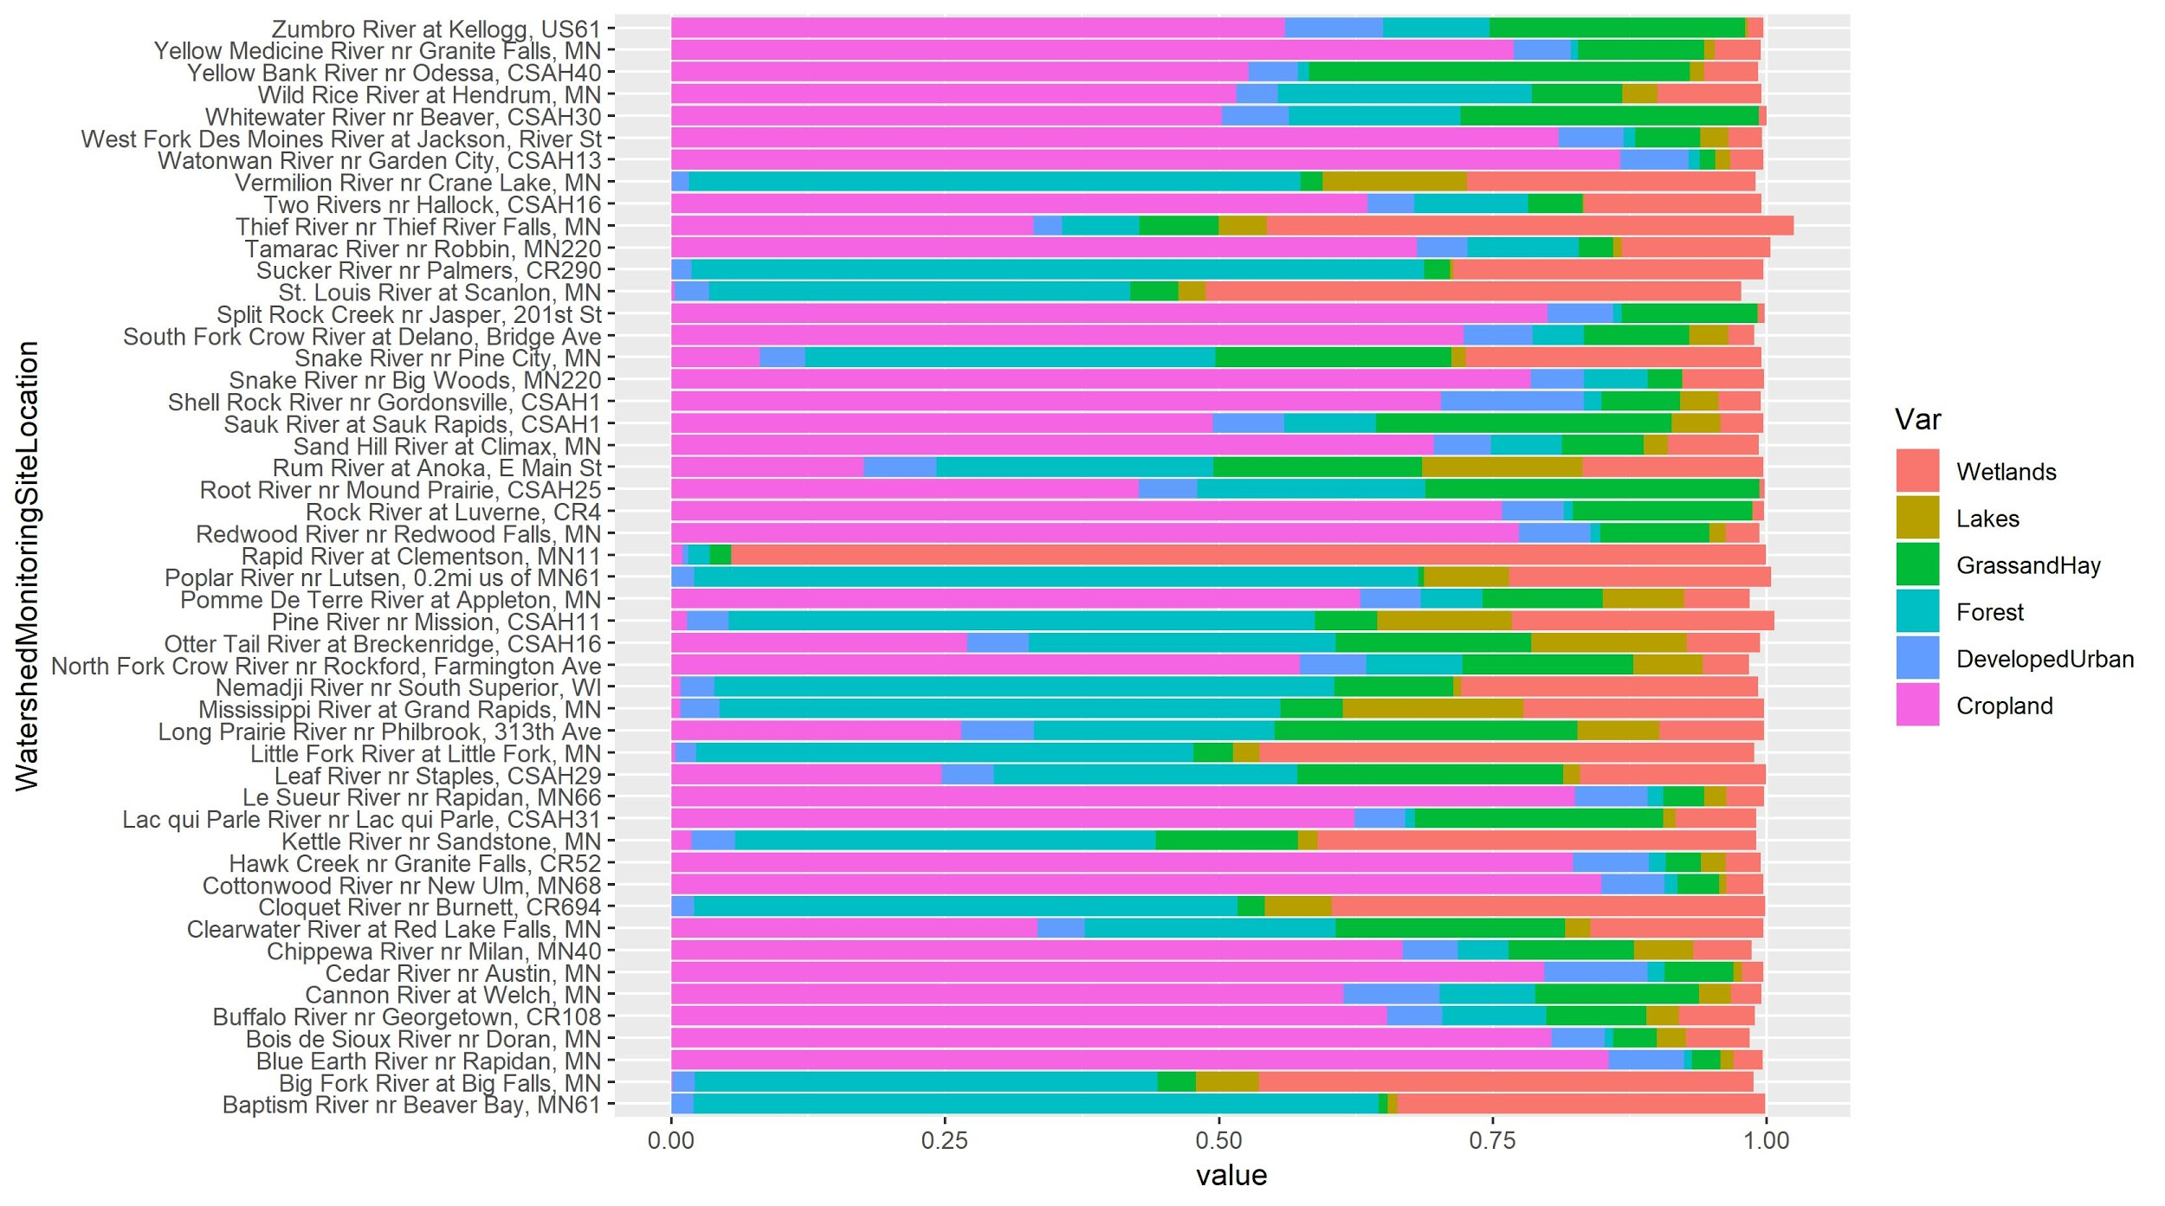
Distribution of Variables
Distribution of cover
Highly dynamic
Max: Cropland
Min: Lakes

Slide 4
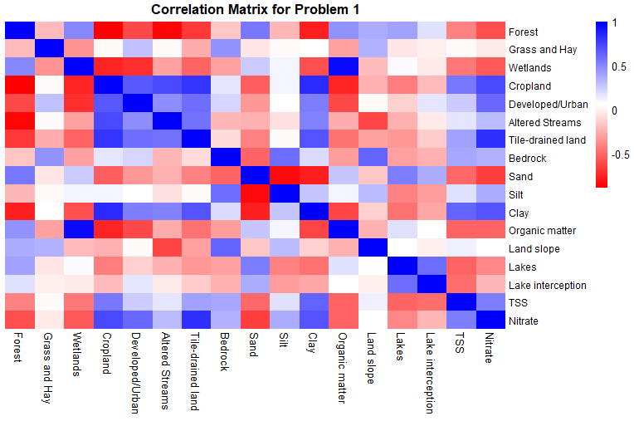
Correlations
We looked at the correlation matrix to gain an idea of what relationships to investigate

Slide 5
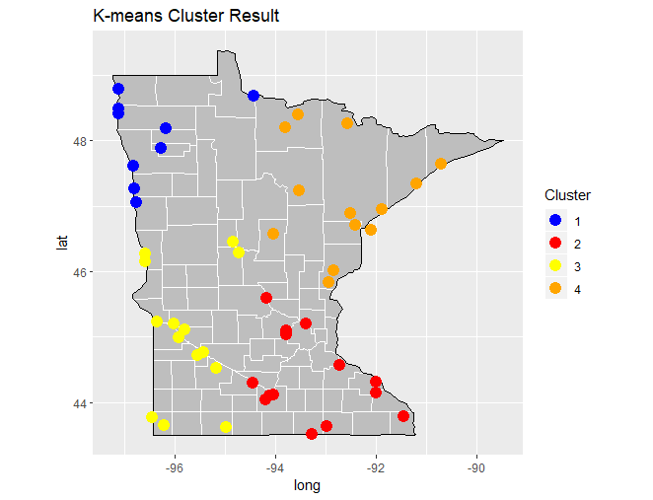
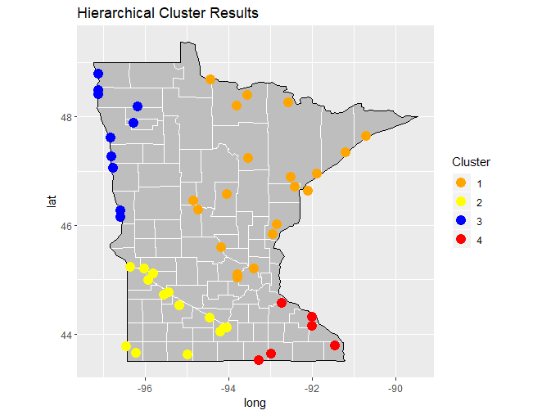
Clustering Results
K-Means
Hierarchical
What we would expect given Minnesota land use

Slide 6
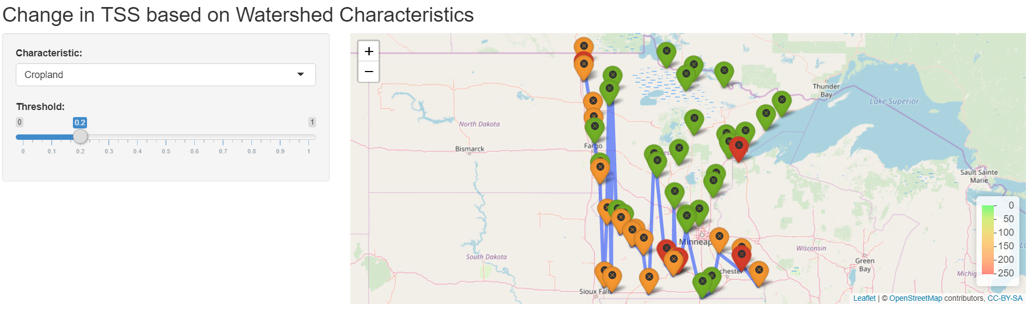
Rshiny Visualization

Slide 7
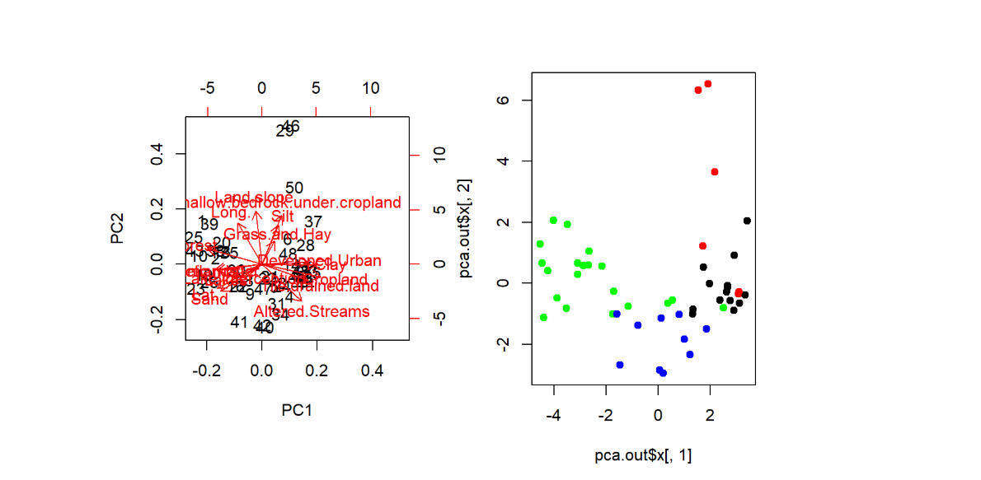
Outlier Detection
PCA: 25,46, are obviously far away from the center.
The 50 is suspicious for the outliers
Hierarchical cluster: The red group has the smallest elements which corresponds to the 29, 46, 50 too
29: Root River nr Mound Prairie, CSAH25
46: Whitewater River nr Beaver, CSAH30
50: Zumbro River at Kellogg, US61

Slide 8
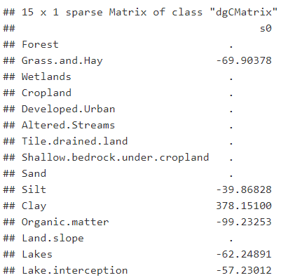
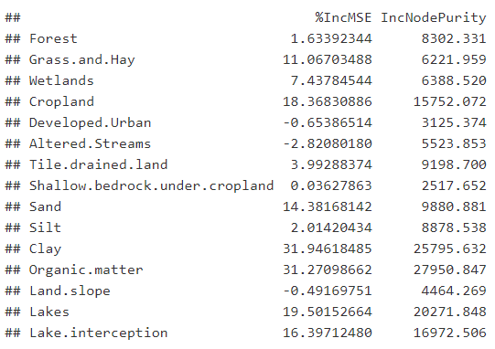
Model Interpretation
Response Variable: TSS
LASSO
RANDOM FOREST

Slide 9
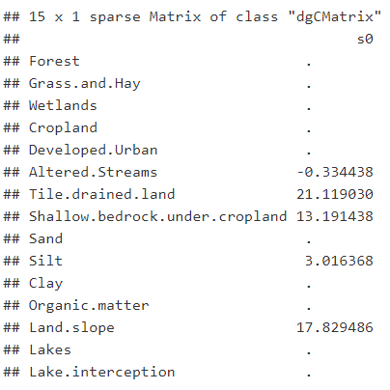
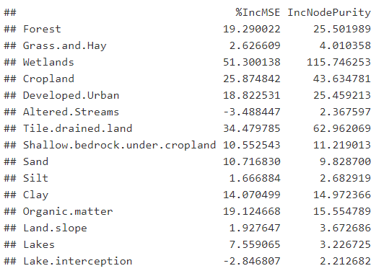
Model Interpretation
Response Variable: Nitrate
LASSO
RANDOM FOREST

Slide 10
Model Prediction
Response Variable: TSS
Metric Used: MSE
 |  | 2515.709 | 1139.858 | 1486.757
 | 1608.085 | 1444.759 | 837.6856 | 1017.677
Models
Ridge
LASSO
Random Forest
XGBoost
Stages
Before removing Outliers
1669.913
After
removing Outliers

Slide 11
Model Prediction
Response Variable: Nitrate
Metric Used: MSE
 |  | 2.583584 | 2.087315 | 1.361923
 |  | 2.119835 | 0.517035 | 1.586211
Models Used
Ridge
LASSO
Random Forest
XGBoost
Stages
Before removing Outliers
3.167908
1.643914
After
removing Outliers

Slide 12
Problem 1 Conclusion
For TSS, the most influential predictors are % clay, % organic matter in watershed soil, % watershed covered by Grass and Hay, % watershed covered by Lakes, % watershed land lake interception
For Nitrate: tile-drained land, silt, shallow bedrock under cropland, and land slope are most important
Fertilizer in the soil, heavy in nitrates, be carried by water flow throughout tile drained land
Lack of absorption by bedrock allows material such as silt to pass and land slope allows transfer of silt
Nitrates are highest in fine texture soils (i.e. silt)
TSS and nitrate have little to no relationship according to the linear relationship
Ensembled Method such as RandomForest and XGBoost are good for the prediction of Water Quality
CSAH25, CSAH30, US61 are outliers compared with others which are not representative

Slide 13
Problem 2:

Slide 14
Methodology
APII
Total number of days March - November where at least half of the precipitation zones in a watershed had more than 0.5 inch of precipitation.
Set a high threshold will make it unreachable for all of precipitations of the watersheds, therefore the results will be similar to each other
Groupby() + apply() + aggregate()
Index of April to July
Special Period which has greatest impact
Sum of the precipitation from April to July per year per watershed

Slide 15
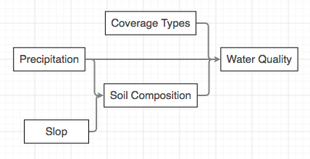
Research Results
Association & causation
Coverage Types: Variables that are static and won’t be affected by the precipitation, such as the Forests, Wetlands, Croplands.
Soil Compositions: Variables that are dynamics and will be affected by the precipitation, such as sands, silts, clays.
Slope: “Higher rainfall intensities yield raindrops with more kinetic energy, which has two consequences that increase the amount of runoff and disfavor infiltration” (Huang, 2012).
https://www.researchgate.net/publication/257169394_Effects_of_rainfall_intensity_underlying_surface_and_slope_gradient_on_soil_infiltration_under_simulated_rainfall_experiments

Slide 16
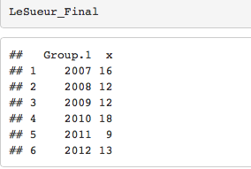
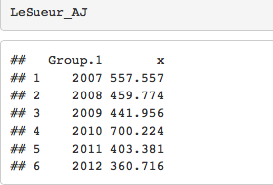
Results
APII (Days)
Total Precipitation during April to June (inces)

Slide 17
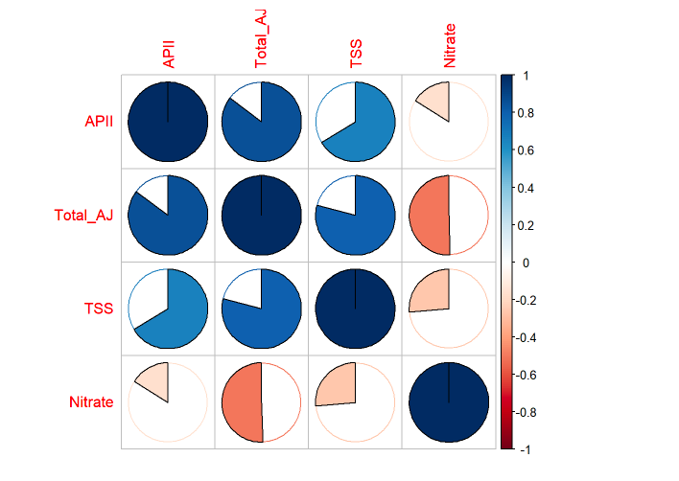
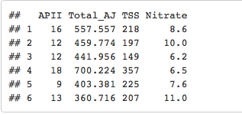
Final Dataset

Slide 18
Problem 2
Conclusion & Recommendation
APII (Precipitation Intensity)) could change the composition percentage of the soil
APII has high correlation with Total precipitation, indicating most of the days of APII during April to June
Company should pay more attention to the water quality problem during April to June

