Slide 1
HW2 & HW3
TA Zhang, Hanwen
College of Computer Science, Sichuan University
2022.12.12

Slide 2
Outline
The Foundations: Logic and Proofs
Relations
Induction and Recursion
Counting
Advanced Counting Techniques
Graphs

Slide 3
Relations
Chapter 9

Slide 4
Relations
7. Let R be the relation on the set {0, 1, 2, 3} containing the ordered pairs(0, 1), (1, 1), (1, 2), (2, 0), (2, 2), and (3, 0). Find the
a) reflexive closure of R. b) symmetric closure of R.
Definition of the properties + Adding as few relations as possible
Answer:
a) {(0, 0), (0, 1), (1, 1), (1, 2), (2, 0), (2, 2), (3, 0), (3, 3)}
b) {(0, 1), (0, 2), (0, 3), (1, 0), (1, 1), (1, 2), (2, 0), (2, 1), (2, 2), (3,0)}

Slide 5
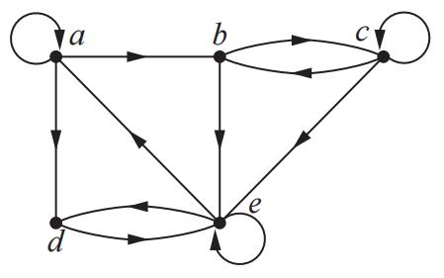
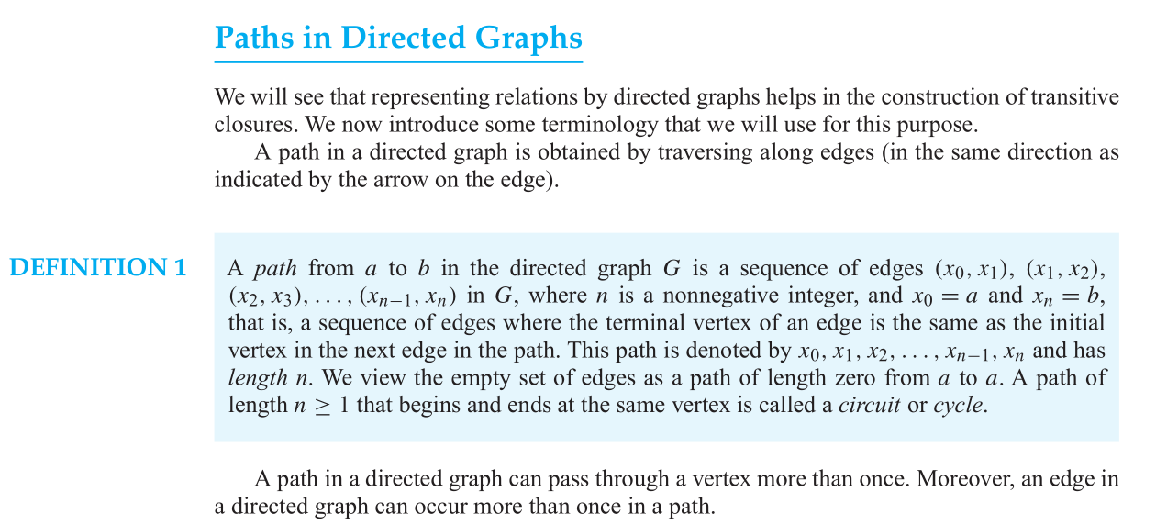
Relations
8. Determine whether these sequences of vertices are paths in this directed graph.
a) a, b, c, e
b) b, e, c, b, e
c) a, a, b, e, d, e
d) b, c, e, d, a, a, b
e) b, c, c, b, e, d, e, d
f ) a, a, b, b, c, c, b, e, d
In each case, the sequence is a path if and only if there is an edge from each vertex in the sequence to the vertex following it.
Answer:
a) This is a path. b) This is not a path (there is no edge from e to c.
c) This is a path. d) This is not a path (there is no edge from d to a.
e) This is a path. f) This is not a path (there is no loop at b).

Slide 6
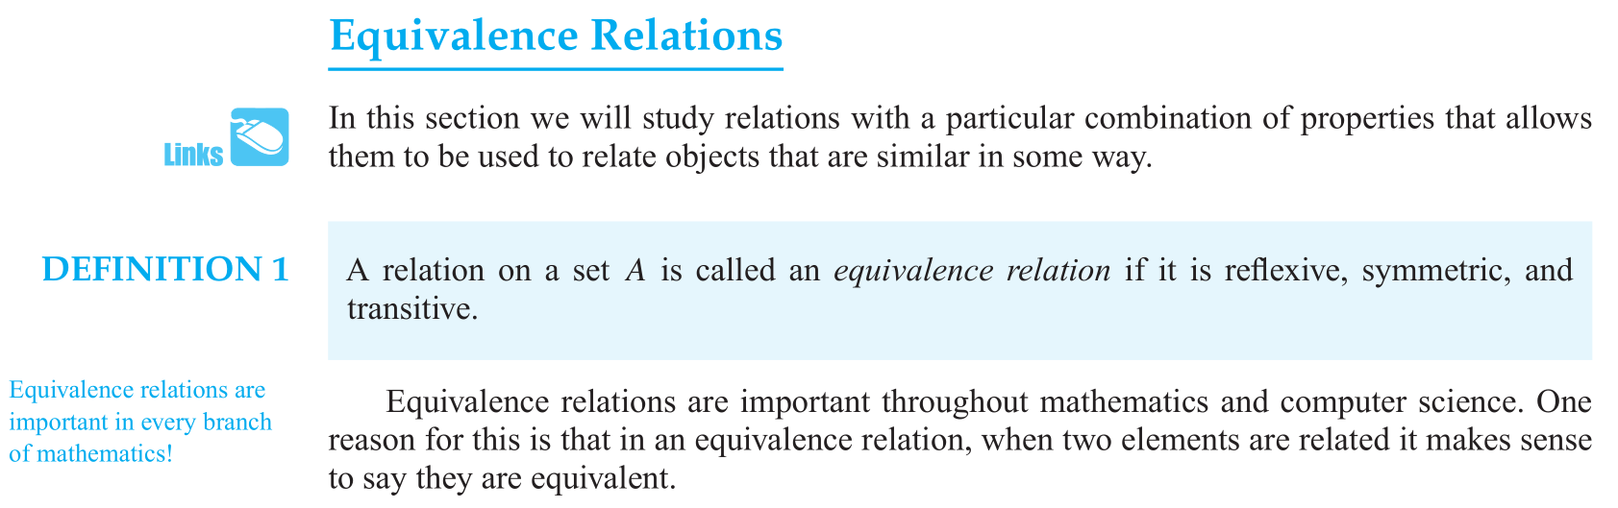
Relations
9. Which of these relations on {0, 1, 2, 3} are equivalence relations? Determine the properties of an equivalence relation that the others lack.
a) {(0, 0), (1, 1), (2, 2), (3, 3)}
b) {(0, 0), (0, 2), (2, 0), (2, 2), (2, 3), (3, 2), (3, 3)}
Answer:
a) Equivalence relation
b) Not reflexive, not transitive
Not reflexive: do not contain the ordered pair (1, 1)
Not transitive: do not contain the ordered pair (0, 3), (3, 0)
Notes:
等价关系：满足自反性、对称性、传递性

Slide 7
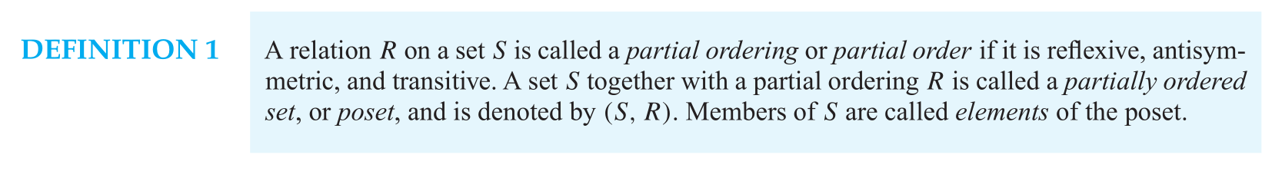
Relations
10. Which of these relations on {0, 1, 2, 3} are partial orderings? Determine the properties of a partial ordering that the others lack.
a) {(0, 0), (1, 1), (2, 2), (3, 3)}
b) {(0, 0), (1, 1), (2, 0), (2, 2), (2, 3), (3, 2), (3, 3)}
Answer:
a) Is a partial ordering
b) Not antisymmetric, not transitive
Not antisymmetric: contain (2, 3) and (3, 2)
Not transitive: do not contain the ordered pair (3, 0)
Notes:
等价关系：满足自反性、反对称性、传递性

Slide 8
Induction and Recursion
Chapter 5

Slide 9
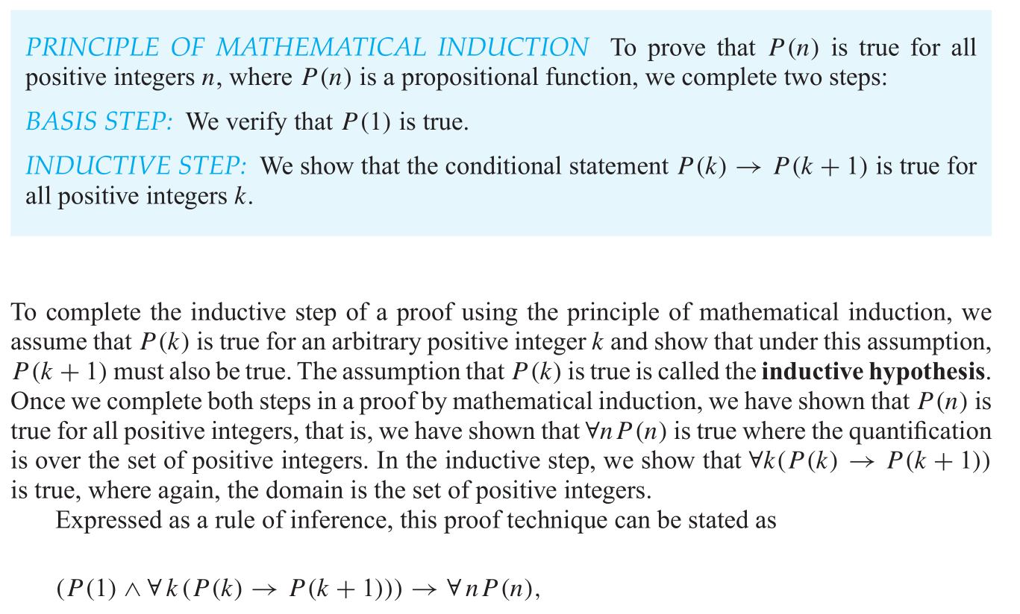
Induction and Recursion
1. Let P (n) be the statement that 1² + 2² + ··· + n² = n(n + 1)(2n + 1)/6 for the positive integer n.
a) What is the statement P(1)?
b) Show that P(1) is true, completing the basis step of the proof.
c) What is the inductive hypothesis?
Answer:
a) 1² = 1 · 2 · 3/6
b) Both sides of P(1) shown in part a) equal 1.
c) 1² + 2² + ··· + k² = k(k + 1)(2k + 1)/6
Notes:
归纳基础，归纳步骤
归纳步骤包含归纳假设和归纳证明

Slide 10
Induction and Recursion
1. Let P (n) be the statement that 1² + 2² + ··· + n² = n(n + 1)(2n + 1)/6 for the positive integer n.
d) What do you need to prove in the inductive step?
e) Complete the inductive step, identifying where you use the inductive hypothesis.
f) Explain why these steps show that this formula is true whenever n is a positive integer.
Answer:
d) For each k ≥ 1 that P(k) implies P(k + 1);
in other words, that assuming the inductive hypothesis [see part (c)] we can show 1² + 2² + ··· + (k + 1)² = (k + 1)(k + 2)(2k + 3)/6
e) (1² + 2² + ··· + k²) + (k + 1)²
= [k(k + 1)(2k +1)/6] + (k + 1)² we use the inductive hypothesis
= [(k + 1)/6][k(2k + 1) + 6(k + 1)]
= [(k + 1)/6](2k² + 7k + 6)
= [(k + 1)/6](k + 2)(2k + 3)
= (k + 1)(k + 2)(2k + 3)/6
f) We have completed both the basis step and the inductive step, so by the principle of mathematical indection, the statement is true for every positive integer n.
Notes:
归纳基础，归纳步骤
归纳步骤包含归纳假设和归纳证明

Slide 11
Induction and Recursion
2. Prove that 1² + 3² + 5² + ··· + (2n + 1)² = (n + 1)(2n + 1)(2n + 3)/3 whenever n is a nonnegative integer.
Answer:
Propositional function:
Let P(n) be “1² + 3² + ··· + (2n+1)² = (n+1)(2n+1)(2n+3)/3.”
Basis step: P(0) is true because 1² = 1 = (0 + 1)(2·0 + 1)(2·0 + 3)/3.
Inductive step: Assume that P(k) is true.
Then1² + 3² + ··· + (2k + 1)² + [2(k + 1) + 1]²
= (k + 1)(2k + 1)(2k + 3)/3 + (2k + 3)²
= (2k + 3)[(k + 1)(2k + 1)/3 + (2k + 3)]
= (2k + 3)(2k² + 9k + 10)/3
= (2k + 3)(2k + 5)(k + 2)/3
= [(k + 1) + 1][2(k + 1) + 1][2(k + 1) + 3]/3.
Notes:
从0开始，n是非负整数

Slide 12
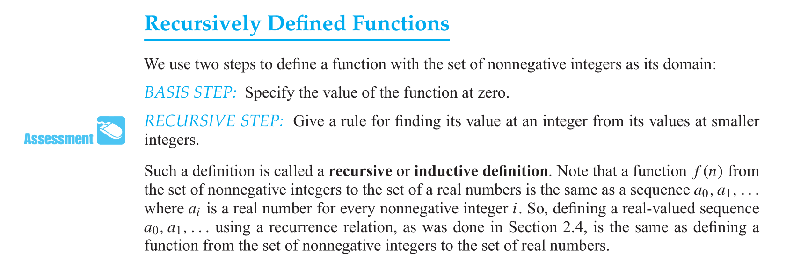
Induction and Recursion
3. Give a recursive definition of the sequence {a_{n}}, n = 1, 2, 3,... if
a) a_{n} = 6n.
b) a_{n} = 2n + 1.
Answer:
There are many possible correct answers.
a) a_{n+1} = a_{n} + 6 for n ≥ 1 and a₁ = 6
the first part of the recursive definition is a₁ = 6·1 = 6
the second part is a_{n+1} - a_{n} = 6(n + 1) - 6n = 6
b) a_{n+1} = a_{n} + 2 for n ≥ 1 and a₁ = 3
the first part of the recursive definition is a₁ = 2·1 + 1= 3
the second part is a_{n+1} - a_{n} = 2(n + 1) + 1 - (2n + 1) = 2

Slide 13
Counting
Chapter 6

Slide 14
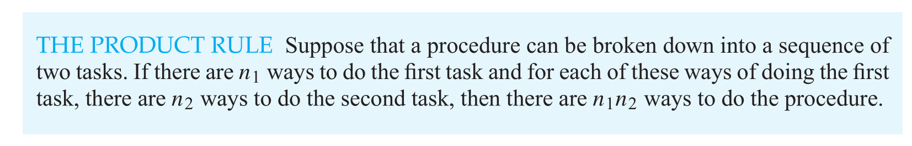
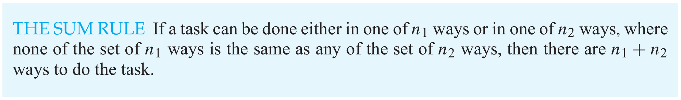
Counting
1. There are 18 mathematics majors and 325 computer science majors at a college.
a) In how many ways can two representatives be picked so that one is a mathematics major and the other is a computer science major?
b) In how many ways can one representative be picked who is either a mathematics major or a computer science major?
Answer:
a) 5850
using the product rule: 18·325 = 5850
b) 343
using the sum rule: 18 + 325 = 343
Notes:
加法原理 乘法原理

Slide 15
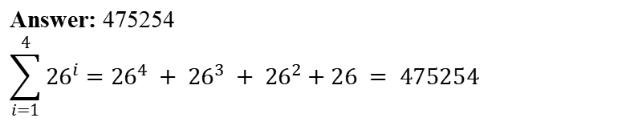
Counting
2. How many strings are there of lowercase letters of length four or less, not counting the empty string.
Answer: 475254
$$\sum_{i=1}^{4}{{26}^{i}}={26}^{4} + {26}^{3} + {26}^{2}+26 = 475254$$

Slide 16
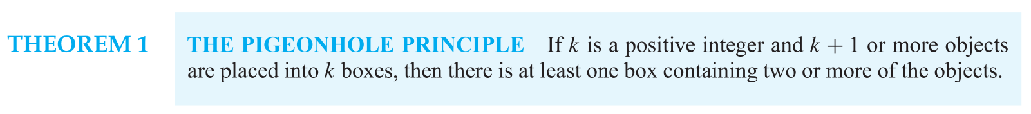
Counting
male | female | all
0 | 9 | 9
1 | 8 | 9
2 | 7 | 9
3 | 6 | 9
4 | 5 | 9
5 | 4 | 9
6 | 3 | 9
7 | 2 | 9
8 | 1 | 9
9 | 0 | 9
3. Suppose that there are nine students in a discrete mathematics class at a small college.
a) Show that the class must have at least five male students or at least five female students.
b) Show that the class must have at least three male students or at least seven female students.
Answer:
a) ⌈9/2 ⌉= 5
9 pigeons(students) and 2 pigeonholes(genders),
directly using the generalized pigeonhole principle
when you have assigned gender to 8 students, you either already have a group (pigeonhole) with 5 students of the same gender, or you have two groups, each with four students. Therefore, regardless of the gender of the 9th student, one of the groups must end up with 5.
Answer:
b) 言之成理即可
argument1: If not, then there would be 2 or fewer male students and 6 or fewer female students, so there would be 2 + 6 = 8 or fewer students in all, contradicting the assumption that there are 9 students in the class.
argument2: after you've assigned gender to 6 students, either there were already 3 males, or there were 0, 1 or 2 males. You still have 3 more students, so if there were 0 males, there must have been 6 females, and either the 3 remains students are all males (in which case, there will be 3 males) or one of the student is a female (in which case, there will be at least 7 females). The argument for 1 or 2 males out of the 6 is similar.
Notes:
一定程度上的穷举，理解
语言组织写一种就可以了

Slide 17
Advanced Counting Techniques
Chapter 8

Slide 18
Advanced Counting Techniques
1. Issues:
a) Find a recurrence relation for the number of bit strings of length n that contain three consecutive 0s.
b) What are the initial conditions?
c) How many bit strings of length seven contain three consecutive 0s?
Answer:
Reduce the scale of the problem. (e.g. n→n-1)
Draw a tree to help thinking.
f(n) = f(n-1) + ?
start with bits :
0 ?
1
f(n) = f(n-2) + ?
00?
01
f(n) = f(n-1)
a) the recurrence relation, valid for all n ≥ 3:
a_{n} = a_{n−1} + a_{n−2} + a_{n−3} + 2^{n−3}.
b) a₀ = a₁ = a₂ = 0
c) a₇ = 47
f(n) = f(n-2)
000
001
f(n) = 2^{n-3}
f(n) = f(n-3)
(already satisfy the condition.)
Notes:
递归 分治
原问题的解和子问题的解之间的关系 如果不清楚就继续划分
最后是囊括所有情况的
一定有个终止条件，当问题规模足够小时，能轻易解出来

Slide 19
Graphs
Chapter 10

Slide 20
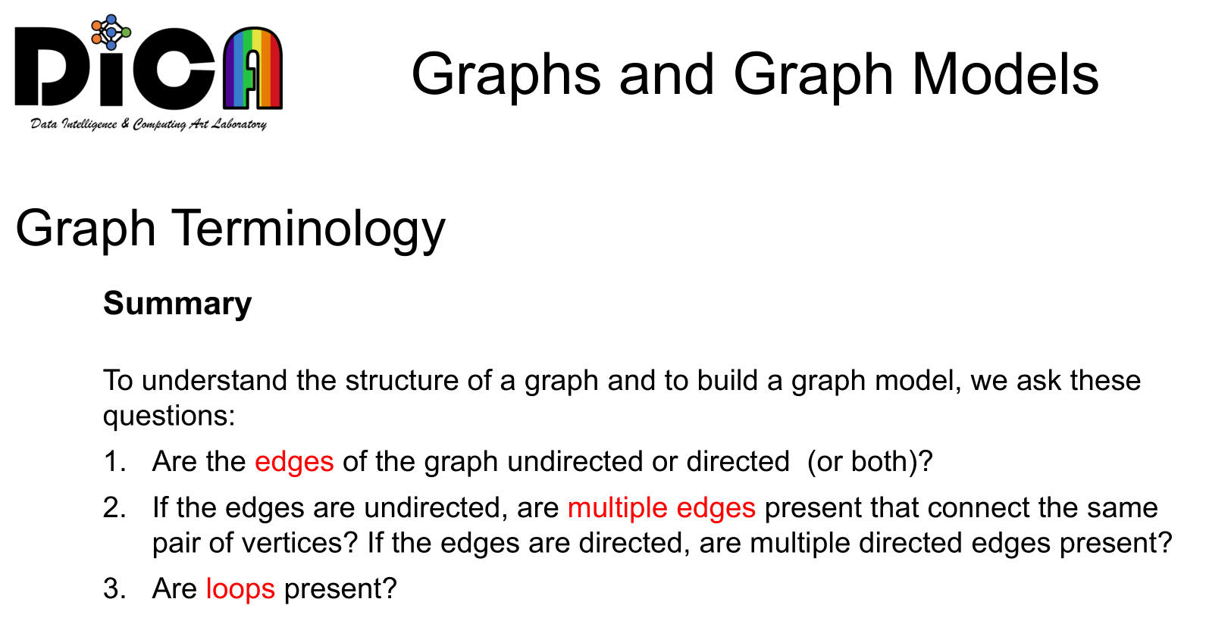
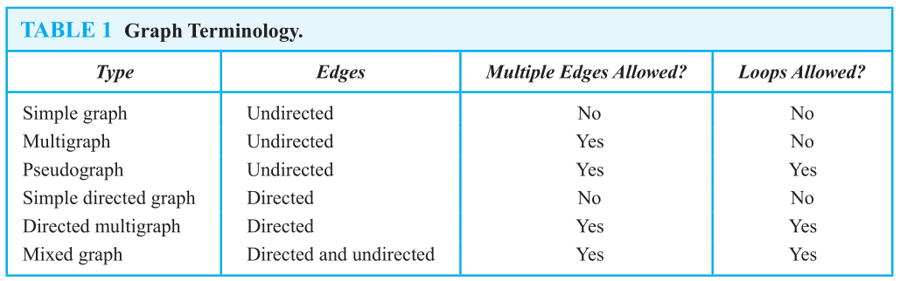
Graphs
1. What kind of graph (from Table 1) can be used to model a highway system between major cities where
a) there is an edge between the vertices representing cities if there is an interstate highway between them?
b) there is an edge between the vertices representing cities for each interstate highway between them?
c) there is an edge between the vertices representing cities for each interstate highway between them, and there is a loop at the vertex representing a city if there is an interstate highway that circles this city?
Answer:
First and foremost, understand the meaning of vertice and edges. Thus, we choose three undirected graph models:
a) a simple graph would be the model here, since there are no parallel edges or loops, and the edges are undirected.
b) a multigraph, since there may be more than one interstate highway between the same pair of cities.
c) a pseudograph is needed here, to allow for loops.
Notes:
平行边和环
简单图 多重图 伪图 简单有向图 有向多重图 混合图
没有涉及权重

Slide 21
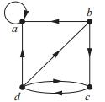
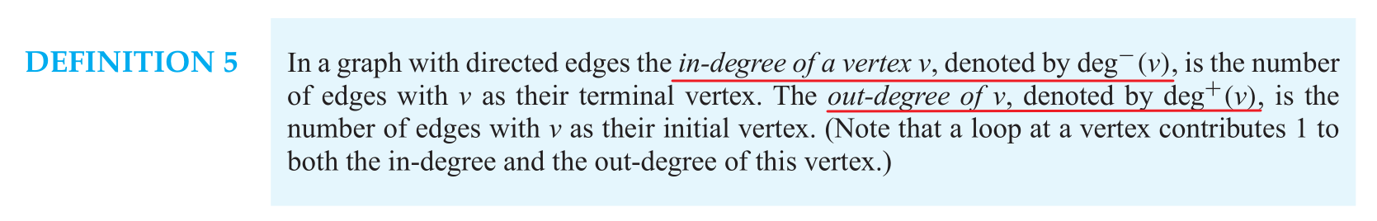
Graphs
2. Determine the number of vertices and edges and find the in-degree and out-degree of each vertex for the given directed multigraph.
Answer:
v = 4; e = 7;
deg⁻(a) = 3, deg⁺(a) = 1,
deg⁻(b) = 1, deg⁺(b) = 2,
deg⁻(c) = 2, deg⁺(c) = 1,
deg⁻(d) = 1, deg⁺(d) = 3

Slide 22
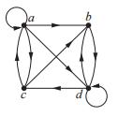
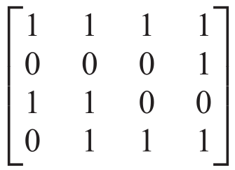
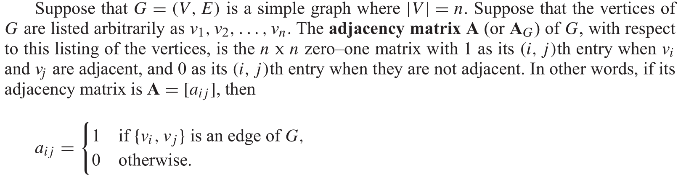
Graphs
3. Represent following graph with an adjacency matrix.
Pay attention to out-degrees of each vertex
Answer:

Slide 23
Thanks
2022.12.14

