Slide 1
第二部分 一阶谓词逻辑
知识点：
含有量词的公式的解释
7.设论域为整数集Z，试判定下面各公式是否是永真式、矛盾式或可满足公式。
（3）(∀x) (∃y)[x + y = 1024]
永真式
因对任意的x∈Z，存在y=1024-x∈Z，使得x+y=1024成立
所以，对任意x∈Z，都有(∃y)[x + y = 1024]为“真”
即有：(∀x) (∃y)[x + y = 1024]
该公式对应的命题为：对任意整数x，存在整数y，使得x+y=1024.
显然，该命题是正确的

Slide 2
第二部分 一阶谓词逻辑
知识点：
谓词公式等价：充分必要条件 P↔Q是D上的永真公式
① 公式推演；② 基本等价式
9.证明下列各式成立：
（2）(∃x) (∃y)[P(x) → Q(y)] ⇔ (∀x)P(x) → (∃y)Q(y)
公式推演
(∃x)(∃y)[P(x) → Q(y)]
⇔ (∃x)(∃y)[~P(x) V Q(y)] （蕴含律）
⇔ (∃x)[~P(x)] V (∃y)Q(y) （量词辖域的收缩与扩张）
⇔ ~[(∀x)P(x)] V (∃y)Q(y) （量词否定）
⇔ (∀x)P(x) → (∃y)Q(y) （蕴含律）
Notes:
命题逻辑是一阶谓词逻辑的特殊情形，所以命题逻辑的推理规则都可以用于谓词逻辑的推理，只不过要加上处理量词的规则

Slide 3
第二部分 一阶谓词逻辑
知识点：
谓词公式等价：充分必要条件 P↔Q是D上的永真公式
① 公式推演；② 基本等价式
10.判别(∃x)[P(x) → Q(x)] ⇔ (∃x)P(x) → (∃x)Q(x) 是否成立。如果成立，请给出证明；如果不成立，找一个解释予以说明。
P(a) | P(b) | P(c)
0 | 1 | 1
不成立
(∃x)[P(x) → Q(x)]
⇔ (∃x)[~P(x) V Q(x)] （蕴含律）
⇔ (∃x)[~P(x)] V (∃x)Q(x) （量词辖域的收缩与扩张）
⇔ ~[(∀x)P(x)] V (∃x)Q(x) （量词否定）
⇔ (∀x)P(x) → (∃x)Q(x) （蕴含律）
不等于右式(∃x)P(x) → (∃x)Q(x)
找一个解释说明不成立
例 D={a, b, c}
则(∃x) [P(x) → Q(x)]
⇔(P(a) →Q(a)) V (P(b) →Q(b)) V (P(c) →Q(c))
= (0→0) V (1→0) V (1→0) = 1
而(∃x)P(x) → (∃x)Q(x)
⇔ (P(a) V P(b) V P(c)) → (Q(a) V Q(b) V Q(c))
= (0 V 1 V 1) → (0 V 0 V 0) = 0
所以左右不等价
Q(a) | Q(b) | Q(c)
0 | 0 | 0
Notes:
命题逻辑是一阶谓词逻辑的特殊情形，所以命题逻辑的推理规则都可以用于谓词逻辑的推理，只不过要加上处理量词的规则

Slide 4
第二部分 一阶谓词逻辑
知识点：
谓词公式蕴含：充分必要条件 P→Q是D上的永真公式
① 公式推演；② 基本蕴含式
13.证明下列各式成立。
（3）(∀x)[~P(x) → Q(x)] ∧ (∀x)[~Q(x)] ⇒ P(x)
(∀x)[~P(x) → Q(x)] ∧ (∀x)[~Q(x)]
⇔ (∀x)(P(x) V Q(x)) ∧ (∀x)[~Q(x)] （蕴含律）
⇔ (∀x)[(P(x) V Q(x)) ∧ ~Q(x)] （基本等价式）
⇔ (∀x)[P(x)] （析取三段论）
⇒ P(x) （全称指定规则US）
(∀x)(P(x) ∧ Q(x)) ⇔ (∀x)P(x) ∧ (∀x)Q(x)
Notes:
命题逻辑是一阶谓词逻辑的特殊情形，所以命题逻辑的推理规则都可以用于谓词逻辑的推理，只不过要加上处理量词的规则

Slide 5
第二部分 一阶谓词逻辑
知识点：
谓词公式的等价和蕴含
15.下面给出了对(∀x)[P(x) V Q(x)] ⇒ (∀x)P(x) V (∀x)Q(x)的证明：
(∀x)[P(x) V Q(x)] ⇔ ~ (∃x) [ ~(P(x) V Q(x)) ]
⇔~ (∃x) [ ~P(x) ∧ ~Q(x) ]
⇒ ~ ((∃x) [ ~P(x) ] ∧ (∃x)[ ~Q(x) ])
⇔(~ (∃x) [ ~P(x) ]) V (~(∃x)[~Q(x)])
⇔(∀x)P(x) V (∀x)Q(x)
试判断这个证明是否正确。你能给出一个证明吗？
该证明不正确
~ (∃x) [ ~P(x) ∧ ~Q(x) ]
~ ((∃x) [ ~P(x) ] ∧ (∃x)[ ~Q(x) ]) 错误
否定是单目联结词，优先级高于存在量词（析取）
不能割裂最开头的否定
例子：
(∀x)[P(x) V Q(x)] = 1
(∀x)P(x) V (∀x)Q(x) = 0
左边为1，右边为0
不符合蕴含的定义，该式不成立
P(a) | P(b)
0 | 1
Q(a) | Q(b)
1 | 0
Notes:
命题逻辑是一阶谓词逻辑的特殊情形，所以命题逻辑的推理规则都可以用于谓词逻辑的推理，只不过要加上处理量词的规则

Slide 6
HW2 & HW3
TA Zhang, Hanwen
College of Computer Science, Sichuan University
2022.12.12

Slide 7
Outline
The Foundations: Logic and Proofs
Relations
Induction and Recursion
Counting
Advanced Counting Techniques
Graphs

Slide 8
The Foundations: Logic and Proofs
Chapter 1

Slide 9


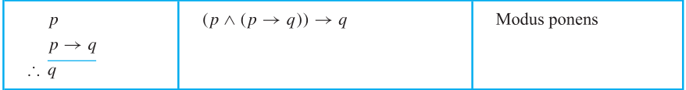
The Foundations: Logic and Proofs
1. Find the argument form for the following argument and determine whether it is valid. Can we conclude that the conclusion is true if the premises are true?
If Socrates is human, then Socrates is mortal.
Socrates is human.
∴ Socrates is mortal.
Answer:
Modus ponens
the conclusion is true, because the hypotheses are true.
Notes:
假言推理

Slide 10
The Foundations: Logic and Proofs
2.What rule of inference is used in each of these arguments?
a) Kangaroos live in Australia and are marsupials. Therefore, kangaroos are marsupials.
b) Linda is an excellent swimmer. If Linda is an excellent swimmer, then she can work as a lifeguard. Therefore, Linda can work as a lifeguard.
Answer:
a) Simplification
b) Modus ponens
Notes:
简化法则
假言推理

Slide 11
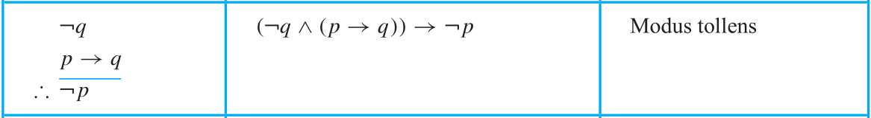
The Foundations: Logic and Proofs
3. For each of these sets of premises, what relevant conclusion or conclusions can be drawn? Explain the rules of inference used to obtain each conclusion from the premises.
a) “If I play hockey, then I am sore the next day.” “I use the whirlpool if I am sore.” “I did not use the whirlpool.”
Answer:
a) conclusions: I am not sore. I did not play hockey.
rule: Modus tollens
This argument form shows that the premises lead to the desired conclusion.
Step Reason
1. q → r Premise
2. ¬r Premise
3. ¬q Modus tollens using (1) and (2)
4. p→q Premise
5. ¬p Modus tollens using (3) and (4)
p: I play hockey
q: I am sore
r: I use the whirlpool
p→q
q→r
¬r
Notes:
拒取式

Slide 12
The Foundations: Logic and Proofs
3. For each of these sets of premises, what relevant conclusion or conclusions can be drawn? Explain the rules of inference used to obtain each conclusion from the premises.
b) “Every student has an Internet account.” “Homer does not have an Internet account.” “Maggie has an Internet account.”
Answer:
b) conclusions: Homer is not a student.
rules: Universal Instantiation, Modus tollens
The following steps can be used to establish the conclusion from the premises.
Step Reason
1. (∀x)P(x)→Q(x) Premise
2. P(Homer)→Q(Homer) Universal instantiation from (1)
3. P(Maggie)→Q(Maggie) Universal instantiation from (1)
4. ~Q(Homer) Premise
5. ~P(Homer) Modus tollens using (2) and (4)
6. Q(Maggie) Premise
7. P(Maggie) ? Attention that we have no rules of
(P→Q) ∧ Q =×=> P ×
P(x): x is a student
Q(x): x has an Internet account
(∀x)P(x)→Q(x)
~Q(Homer)
Q(Maggie)
Notes:
全称实例 拒取式

Slide 13
The Foundations: Logic and Proofs
4. What is wrong with this argument? Let H(x) be “x is happy.” Given the premise ∃xH(x), we conclude that H(Lola). Therefore, Lola is happy.
Answer:
We know that some x exists that makes H(x) true, but we cannot conclude that Lola is one such x.
We cannot select an arbitrary value of c here, but rather it must be a c for which P(c) is true. Usually we have no knowledge of what c is, only that it exists. Because it exists, we may give it a name (c) and continue our argument.——Existential instantiation

Slide 14
The Foundations: Logic and Proofs
5. Identify the error or errors in this argument that supposedly shows that if ∀x(P(x) ∨ Q(x)) is true then ∀xP(x) ∨∀xQ(x) is true.
1. ∀x(P(x) ∨ Q(x)) Premise
2. P(c) ∨ Q(c) Universal instantiation from (1)
3. P(c) Simplification from (2)
4. ∀xP (x) Universal generalization from (3)
5. Q(c) Simplification from (2)
6. ∀xQ(x) Universal generalization from (5)
7. ∀x(P(x) ∨∀xQ(x)) Conjunction from (4) and (6)
Answer:
Steps 3 and 5 are incorrect; simplification applies to conjunctions(∧), not disjunctions(∨).
This exercise is similar to question No.15, Chapter 2 in Discrete Mathematics written by Weisen Feng, et al.

Slide 15
Relations
Chapter 9

Slide 16
Relations
1. List the ordered pairs in the relation R from A={0, 1, 2, 3, 4} to B= {0, 1, 2, 3}, where (a, b)∈R if and only if
a) a = b. b) a + b = 4. c) a > b. d) a | b. e) gcd(a, b) = 1. f ) lcm(a, b) = 2.
Choose a subset of A×B satisfying the equation.
Remember that relation pairs have order, which means (a, b) ≠ (b, a).
Answer:
a) {(0, 0), (1, 1), (2, 2), (3, 3)}
b) {(1, 3), (2, 2), (3, 1), (4, 0)}
c) {(1, 0), (2, 0), (3, 0), (4, 0), (2, 1), (3, 1), (4, 1), (3, 2), (4, 2), (4, 3)}
d) {(1, 0), (1, 1), (1, 2), (1, 3), (2, 0), (2, 2), (3, 0), (3, 3), (4, 0)}
e) {(0, 1), (1, 0), (1, 1), (1, 2), (1, 3), (2, 1), (2, 3), (3, 1), (3, 2), (4, 1), (4, 3)}
f) {(1, 2), (2, 1), (2, 2)}
divisibility relation:
1 is the divisor of any integer.
for any integer a, there is always 1 | a;
0 is a multiple of any non-zero integer.
for any integer a ≠ 0, there is always a | 0.
gcd = 1 (relatively prime):
gcd(a, b) = gcd(b, a)
gcd(a, 0) = |a| gcd(1, 0) = 1
lcm (judge with Prime factorization...)

Slide 17
Relations
2. For each of these relations on the set {1, 2, 3, 4}, decide whether it is reflexive, whether it is symmetric, whether it is antisymmetric, and whether it is transitive.
a) {(2, 2), (2, 3), (2, 4), (3, 2), (3, 3), (3, 4)}
b) {(1, 1), (1, 2), (2, 1), (2, 2), (3, 3), (4, 4)}
Of course you can use other methods: Relation matrices, Relation digraphs
Answer:
a) Transitive
Not reflexive: do not contain the ordered pair (1, 1)
Not symmetric: do not contain (4, 2)
Not antisymmetric: contain (2, 3) and (3, 2)
Transitive: because (1, 1) and (1, 2), (1, 2) and (2, 1), (1, 2) and (2, 2), (2, 1) and (1, 1), (2, 2) and (2, 1) are belong to the relation, and (1, 2), (1, 1) and (2, 1) are also belong to it.
Answer:
b) Reflexive, symmetric, transitive
Reflexive: contain all pairs of the form (a,a), namely, (1, 1), (2, 2), (3, 3), and (4, 4)
Symmetric: both (1, 2) and (2, 1) belong to the relation
Not antisymmetric: contain (1, 2) and (2, 1)
Transitive: because (1, 1) and (1, 2), (1, 2) and (2, 1), (1, 2) and (2, 2), (2, 1) and (1, 1), (2, 1) and (1, 2), (2, 2) and (2, 1) are belong to the relation, and (1, 2), (1, 1), (2, 1) and (2, 2) are also belong to it.
Notes:
a) 不是自反 没有(1,1)，不是对称 没有(4, 2)，不是反对称 有(2,3)和(3,2) 是传递性
b) 是自反 是对称 不是反对称 有(1,2)和(2,1) 是可传递

Slide 18

Relations
1. Ø
2. {(0,0)}
3. {(0,1)}
4. {(1,0)}
5. {(1,1)}
6. {(0,0),(0,1)}
7. {(0,0),(1,0)}
8. {(0,0),(1,1)}
9. {(0,1),(1,0)}
10. {(0,1),(1,1)}
11. {(1,0),(1,1)}
12. {(0,0),(0,1),(1,0)}
13. {(0,0),(0,1),(1,1)}
14. {(0,0),(1,0),(1,1)}
15. {(0,1),(1,0),(1,1)}
16. {(0,0),(0,1),(1,0),(1,1)}
3. List the 16 different relations on the set {0, 1}.
Answer:
How many relations are there on a set with n elements?
Cartesian product = {(0, 0), (0, 1), (1, 0), (1, 1)} 2²=4
Subsets of the Cartesion product: 2⁴=16
Don’t neglect the empty relation (Ø).

Slide 19
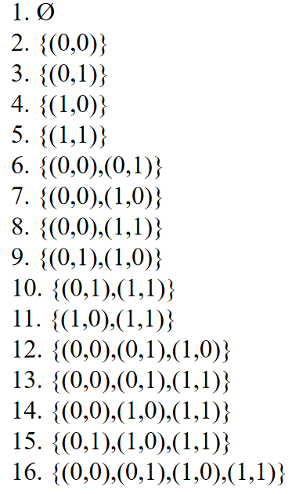
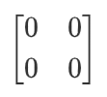
Relations
4. Which of the 16 relations on {0, 1}, which you listed in Exercise 3, are
a) reflexive?
b) irreflexive?
c) symmetric?
d) antisymmetric?
e) asymmetric?
f) transitive?
Example:
1. Ø (think about it in the way of a graph and matrix.)
no self-loop; elements on major diagonal are zeros
symmetric
antisymmetric
transitive
0
1
Tips:
① If a relation does not against the definition of a certain property, then it has the property.
② A relation can be both symmetric and antisymmetric.
Answer:
a) 8, 13, 14, 16
c) 1, 2, 5, 8, 9, 12, 15, 16
d) 1, 2, 3, 4, 5, 6, 7, 8, 10, 11, 13, 14
f) 1, 2, 3, 4, 5, 6, 7, 8, 10, 11, 13, 14, 16

Slide 20
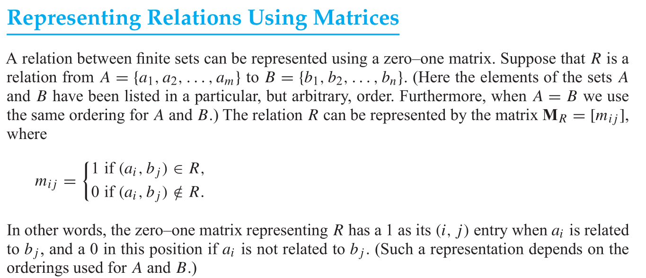
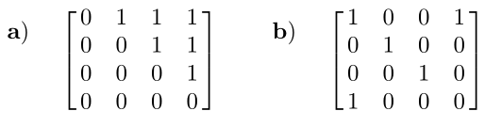
Relations
5. Represent each of these relations on {1, 2, 3, 4} with a matrix (with the elements of this set listed in increasing order).
a) {(1, 2),(1, 3), (1, 4), (2, 3), (2, 4), (3, 4)}
b) {(1, 1), (1, 4), (2, 2), (3, 3), (4, 1)}
Answer:
In each case we use a 4 × 4 matrix, putting a 1 in position (i, j) if the pair (i, j) is in the relation and a 0 in position (i, j) if the pair (i, j) is not in the relation.

Slide 21
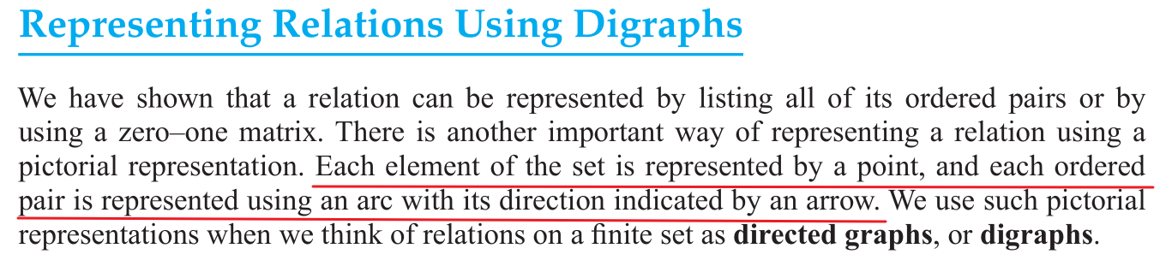
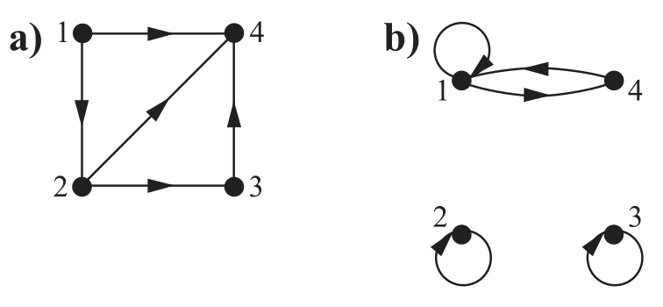
Relations
6. Draw the directed graphs representing each of the relations from Exercise 5. (relations on {1, 2, 3, 4})
a) {(1, 2),(1, 3), (1, 4), (2, 3), (2, 4), (3, 4)}
b) {(1, 1), (1, 4), (2, 2), (3, 3), (4, 1)}
Answer:
The directed graph with vertices 1, 2, 3, and 4, and edges in the a) and b) is displayed separately in the figures below.

Slide 22
Thanks
2022.12.12

