Slide 1
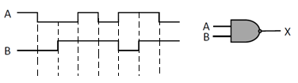
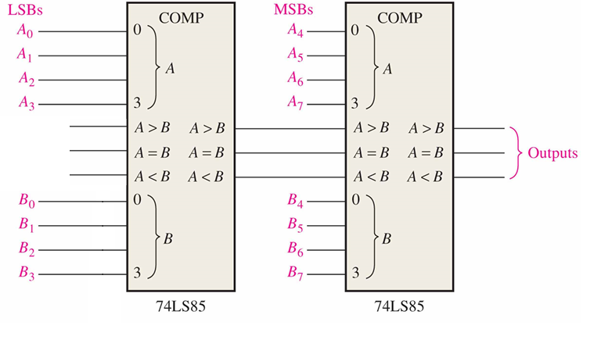
1. (10p) Write the truth table and logic expression of a 1-bit
comparator, draw the circuit, and complete the time diagram.
2. (10p) Give the truth table of a 1-bit full adder, and implement it using 1-of-8 multiplexers.
3. (6p) An 8-bit comparator using 74LS85 is shown. The three input of the lowest order comparator should be F_{A>B}=_____, F_{A=B}=______, F_{A<B}=___.
4. Consider the three-variable function f(a,b,c) = bc’+ab’+abc
1) (10p) Give its canonical SOP and canonical POS.
2) (10p) Implement the function using nand gates only.
3) (12p) Implement the function using 3-line-to-8-line decoder.
4) (12p) Implement the function using 4-16 decoder.
5) (15p) Implement the function using 1-of-4 multiplexer(use a, b as select inputs).
5.(15p) There are 2 control signals: C₁ and C₂，design a circuit using an 1-of-8 MUX.
1) ， ； 2) ， ；
3) ， ； 4) ， 。

Slide 2

一位数值比较器
用来完成两个二进制数的大小比较的逻辑电路称为数值比较器，简称比较器。
设A＞B时L_{A＞B}＝1；A＜B时L_{A＜B}＝1；A＝B时L_{A=B}＝1。得1位数值比较器的真值表。

Slide 3
逻辑表达式
逻辑图

Slide 4
1.(10p) Write the logic expression of a 1-bit comparator, draw the circuit, and complete the time diagram.
L_{A>B}
L_{A<B}
L_{A=B}

Slide 5
2. (10p) Give the truth table of a 1-bit full adder, and implement it using 1-of-8 multiplexers.
a | b | c_{i-1} | s | c_{i}
0 | 0 | 0 | 0 | 0
0 | 0 | 1 | 1 | 0
0 | 1 | 0 | 1 | 0
0 | 1 | 1 | 0 | 1
1 | 0 | 0 | 1 | 0
1 | 0 | 1 | 0 | 1
1 | 1 | 0 | 0 | 1
1 | 1 | 1 | 1 | 1
74LS151
74LS151
D₀
D₁
D₂
D₃
D₄
D₅
D₆
D₇
D₀
D₁
D₂
D₃
D₄
D₅
D₆
D₇
D₀
D₁
D₂
D₃
D₄
D₅
D₆
D₇
D₀
D₁
D₂
D₃
D₄
D₅
D₆
D₇
0
1
1
0
1
0
0
1
0
0
0
1
0
1
1
1
s
Y
c_{i}
Y
G A₂ A₁ A₀
G A₂ A₁ A₀
a b c_{i-1}
a b c_{i-1}

Slide 6
3. (6p) An 8-bit comparator using 74LS85 is shown. The three input of the lowest order comparator should be F_{A>B}=_____, F_{A=B}=______, F_{A<B}=___.
0
1
0

Slide 7
4. Consider the 3-variable function f(a,b,c) = bc’+ab’+abc
1) (10p) Give its canonical SOP and canonical POS.
2) (10p) Implement the function using nand gates.
b
c’
1
a
f

Slide 8
4. Consider the 3-variable function f(a,b,c) = bc’+ab’+abc
3) (15p) Implement the function using 3-line-to-8-line decoder.
0
0
1
E₁E₂ E₃
O₀ O₁ O₂ O₃ O₄ O₅ O₆ O₇
74138
a b c
A₂ A₁ A₀
&
F

Slide 9
4. Consider the 3-variable function f(a,b,c) = bc’+ab’+abc
4) (15p) Implement the function using 4-16 decoder.
0
E
Y₀ Y₁ Y₂ Y₃ Y₄ Y₅ Y₆ Y₇Y₈
Y₉
…
Y₁₅
Decoder
0
a b
c
A₃ A₂ A₁ A₀
&
f
.
.
.

Slide 10
4. Consider the 3-variable function f(a,b,c) = bc’+ab’+abc
5) (15p) Implement the function using 1-of-4 multiplexer(use a, b as select inputs).
MUX
0
c’
1
1
D₀
D₁
D₂
D₃
f(a,b,c)
Y
则，
G A₁ A₀
a b

Slide 11
5. There are 2 contral signals: C₁ and C₂，design a circuit using an 1-of-8 MUX.
1) ， ； 2) ， ；
3) ， ； 4) ， 。
C₂C₁ | AB | F
0 0 0 0 0 0 0 0 | 0 0 0 1 1 0 1 1 | 0 1 1 0
0 1 0 1 0 1 0 1 | 0 0 0 1 1 0 1 1 | 1 1 1 0
1 0 1 0 1 0 1 0 | 0 0 0 1 1 0 1 1 | 1 0 0 0
1 1 1 1 1 1 1 1 | 0 0 0 1 1 0 1 1 | 0 0 0 1
MUX
74LS151
D₀
D₁
D₂
D₃
D₄
D₅
D₆
D₇
D₀
D₁
D₂
D₃
D₄
D₅
D₆
D₇
B
B’
1
B’
B’
0
0
B
F
Y
G A₂ A₁ A₀
C₂ C₁ A

