Slide 1
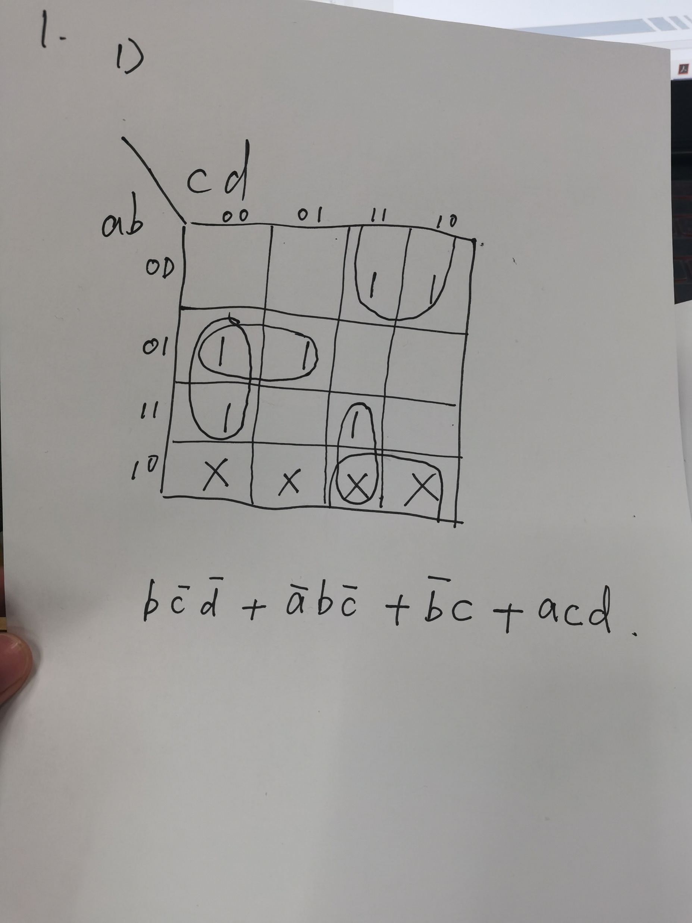

Slide 2
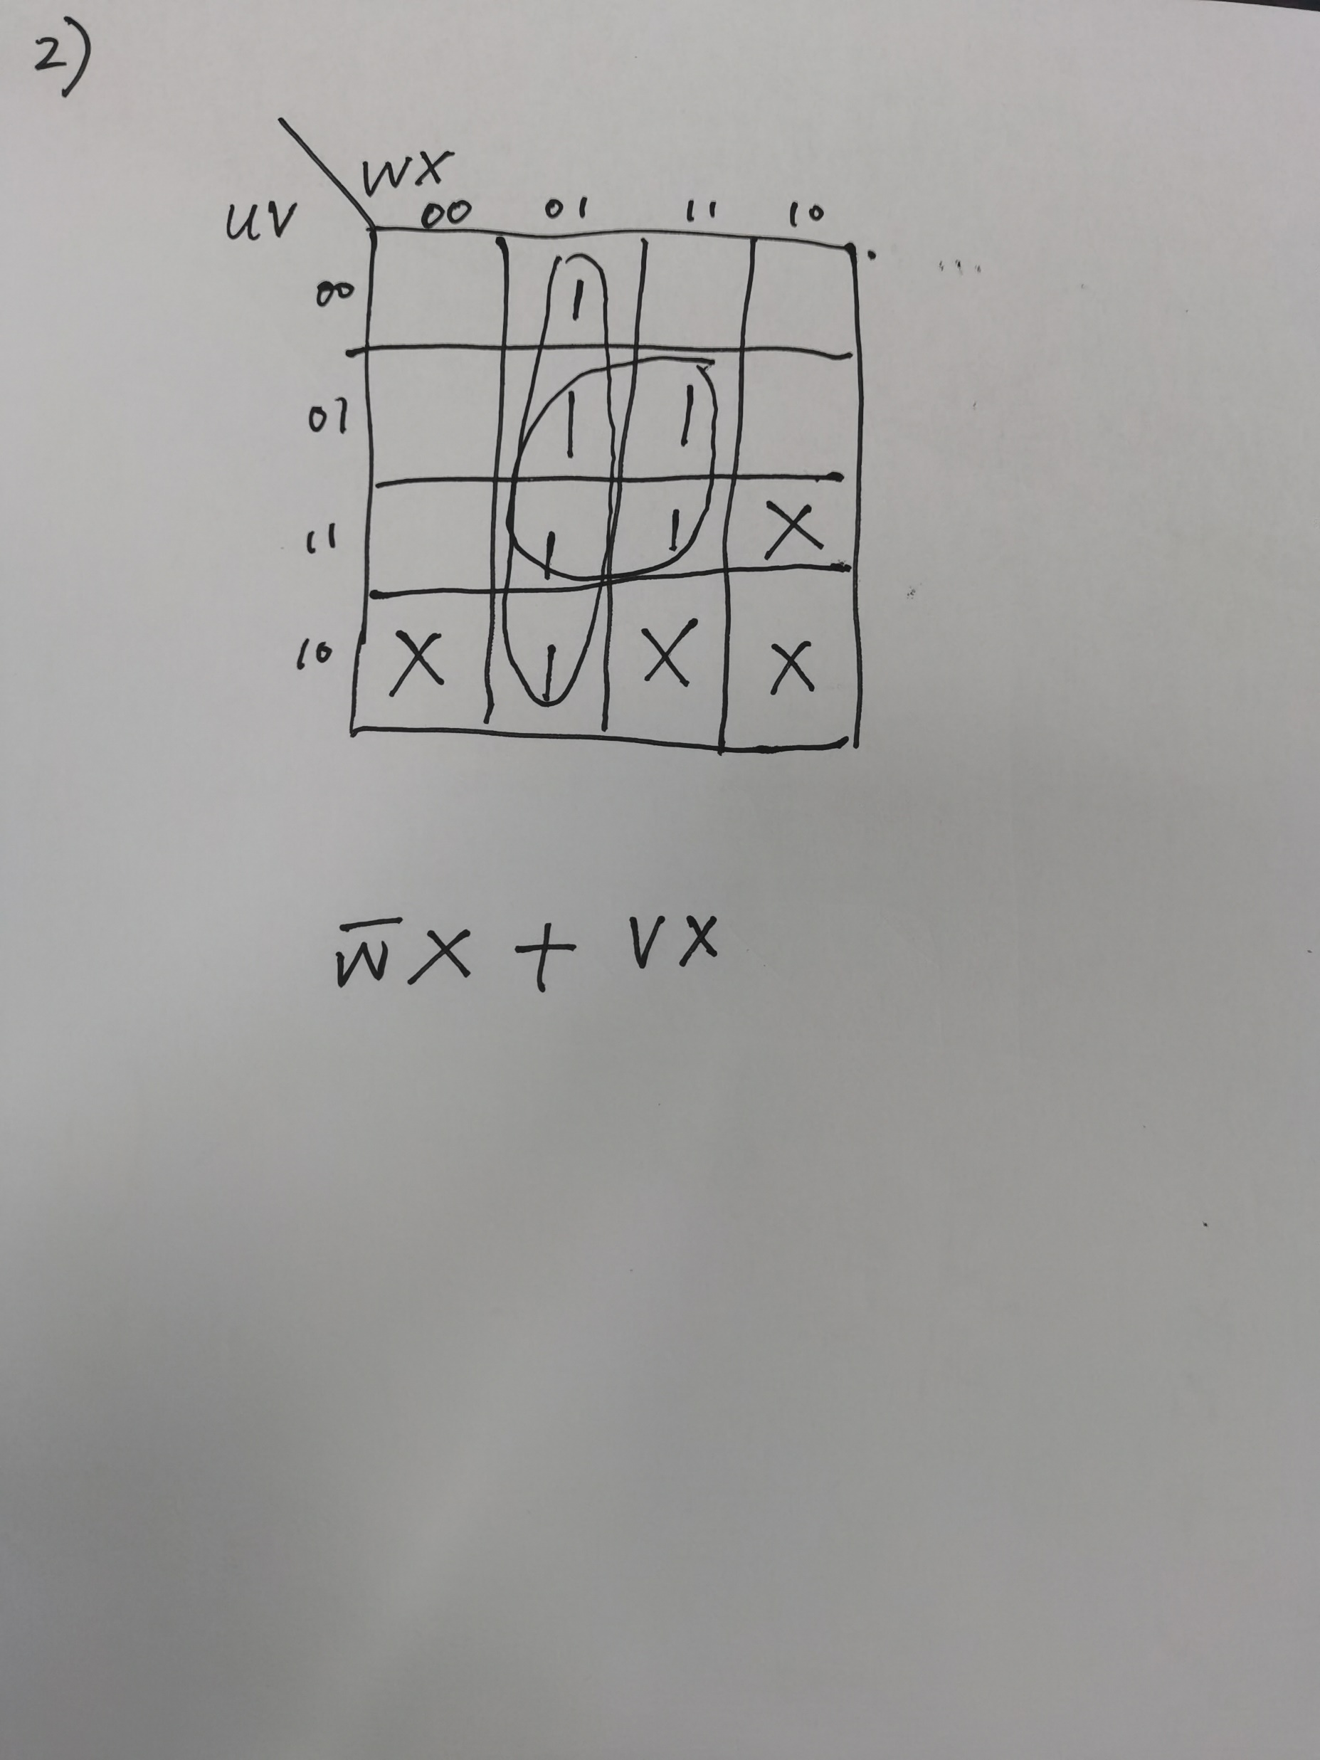

Slide 3
32(a)
a | b | c | d | Out put
0 | 0 | 0 | 0 | 1
0 | 0 | 0 | 1 | 0
0 | 0 | 1 | 0 | 0
0 | 0 | 1 | 1 | 0
0 | 1 | 0 | 0 | 0
0 | 1 | 0 | 1 | 1
0 | 1 | 1 | 0 | 1
0 | 1 | 1 | 1 | 0
1 | 0 | 0 | 0 | 0
1 | 0 | 0 | 1 | 1
1 | 0 | 1 | 0 | 0
1 | 0 | 1 | 1 | 0
1 | 1 | 0 | 0 | 0
1 | 1 | 0 | 1 | 0
1 | 1 | 1 | 0 | 0
1 | 1 | 1 | 1 | 0

Slide 4
32(b)
w | x | y | z | output
0 | 0 | 0 | 0 | 0
0 | 0 | 0 | 1 | 0
0 | 0 | 1 | 0 | 0
0 | 0 | 1 | 1 | 0
0 | 1 | 0 | 0 | 0
0 | 1 | 0 | 1 | 0
0 | 1 | 1 | 0 | 0
0 | 1 | 1 | 1 | 1
1 | 0 | 0 | 0 | 0
1 | 0 | 0 | 1 | 0
1 | 0 | 1 | 0 | 0
1 | 0 | 1 | 1 | 1
1 | 1 | 0 | 0 | 0
1 | 1 | 0 | 1 | 1
1 | 1 | 1 | 0 | 1
1 | 1 | 1 | 1 | 1

Slide 5
33(a)
a | b | c | output
0 | 0 | 0 | 1
0 | 0 | 1 | 0
0 | 1 | 0 | 1
0 | 1 | 1 | 1
1 | 0 | 0 | 0
1 | 0 | 1 | 1
1 | 1 | 0 | 1
1 | 1 | 1 | 0

Slide 6
33(b)
w | x | y | z | output
0 | 0 | 0 | 0 | 1
0 | 0 | 0 | 1 | 1
0 | 0 | 1 | 0 | 1
0 | 0 | 1 | 1 | 1
0 | 1 | 0 | 0 | 0
0 | 1 | 0 | 1 | 1
0 | 1 | 1 | 0 | 1
0 | 1 | 1 | 1 | 0
1 | 0 | 0 | 0 | 1
1 | 0 | 0 | 1 | 1
1 | 0 | 1 | 0 | 1
1 | 0 | 1 | 1 | 1
1 | 1 | 0 | 0 | 0
1 | 1 | 0 | 1 | 1
1 | 1 | 1 | 0 | 1
1 | 1 | 1 | 1 | 1

Slide 7
34(a)
a | b | c | output
0 | 0 | 0 | 0
0 | 0 | 1 | 1
0 | 1 | 0 | 0
0 | 1 | 1 | 1
1 | 0 | 0 | 1
1 | 0 | 1 | 1
1 | 1 | 0 | 1
1 | 1 | 1 | 0

Slide 8
34(b)
w | x | y | z | output
0 | 0 | 0 | 0 | 1
0 | 0 | 0 | 1 | 1
0 | 0 | 1 | 0 | 1
0 | 0 | 1 | 1 | 1
0 | 1 | 0 | 0 | 1
0 | 1 | 0 | 1 | 0
0 | 1 | 1 | 0 | 0
0 | 1 | 1 | 1 | 1
1 | 0 | 0 | 0 | 1
1 | 0 | 0 | 1 | 0
1 | 0 | 1 | 0 | 0
1 | 0 | 1 | 1 | 1
1 | 1 | 0 | 0 | 1
1 | 1 | 0 | 1 | 1
1 | 1 | 1 | 0 | 1
1 | 1 | 1 | 1 | 1

Slide 9
36
(a)A’B’C+AB’C’+AB’C+ABC
(A+B+C)(A+B’+C)(A+B’+C’)(A’+B’+C)
(b)AB’C+ABC’+ABC
(A+B+C)(A+B+C’)(A+B’+C)(A+B’+C’)(A’+B+C)

Slide 10
36
(c)A’B’C’D’+A’B’C’D+A’B’CD+A’BC’D+AB’C’D+ABC’D’+A’BCD’
(A+B+C’+D)(A+B’+C+D)(A+B’+C’+D’)(A’+B+C+D)(A’+B+C’+D)(A’+B+C’+D’)(A’+B’+C+D’)(A’+B’+C’+D)(A’+B’+C’+D’)
(d)A’B’CD’+A’BC’D’+A’BC’D’+A’BCD+AB’CD+ABC’D’+ABCD
(A+B+C+D+)(A+B+C+D’)(A+B+C’+D’)(A+B’+C’+D)(A’+B+C+D+)(A’+B+C+D’)(A’+B+C’+D)(A’+B’+C+D’)(A’+B’+C’+D)

Slide 11
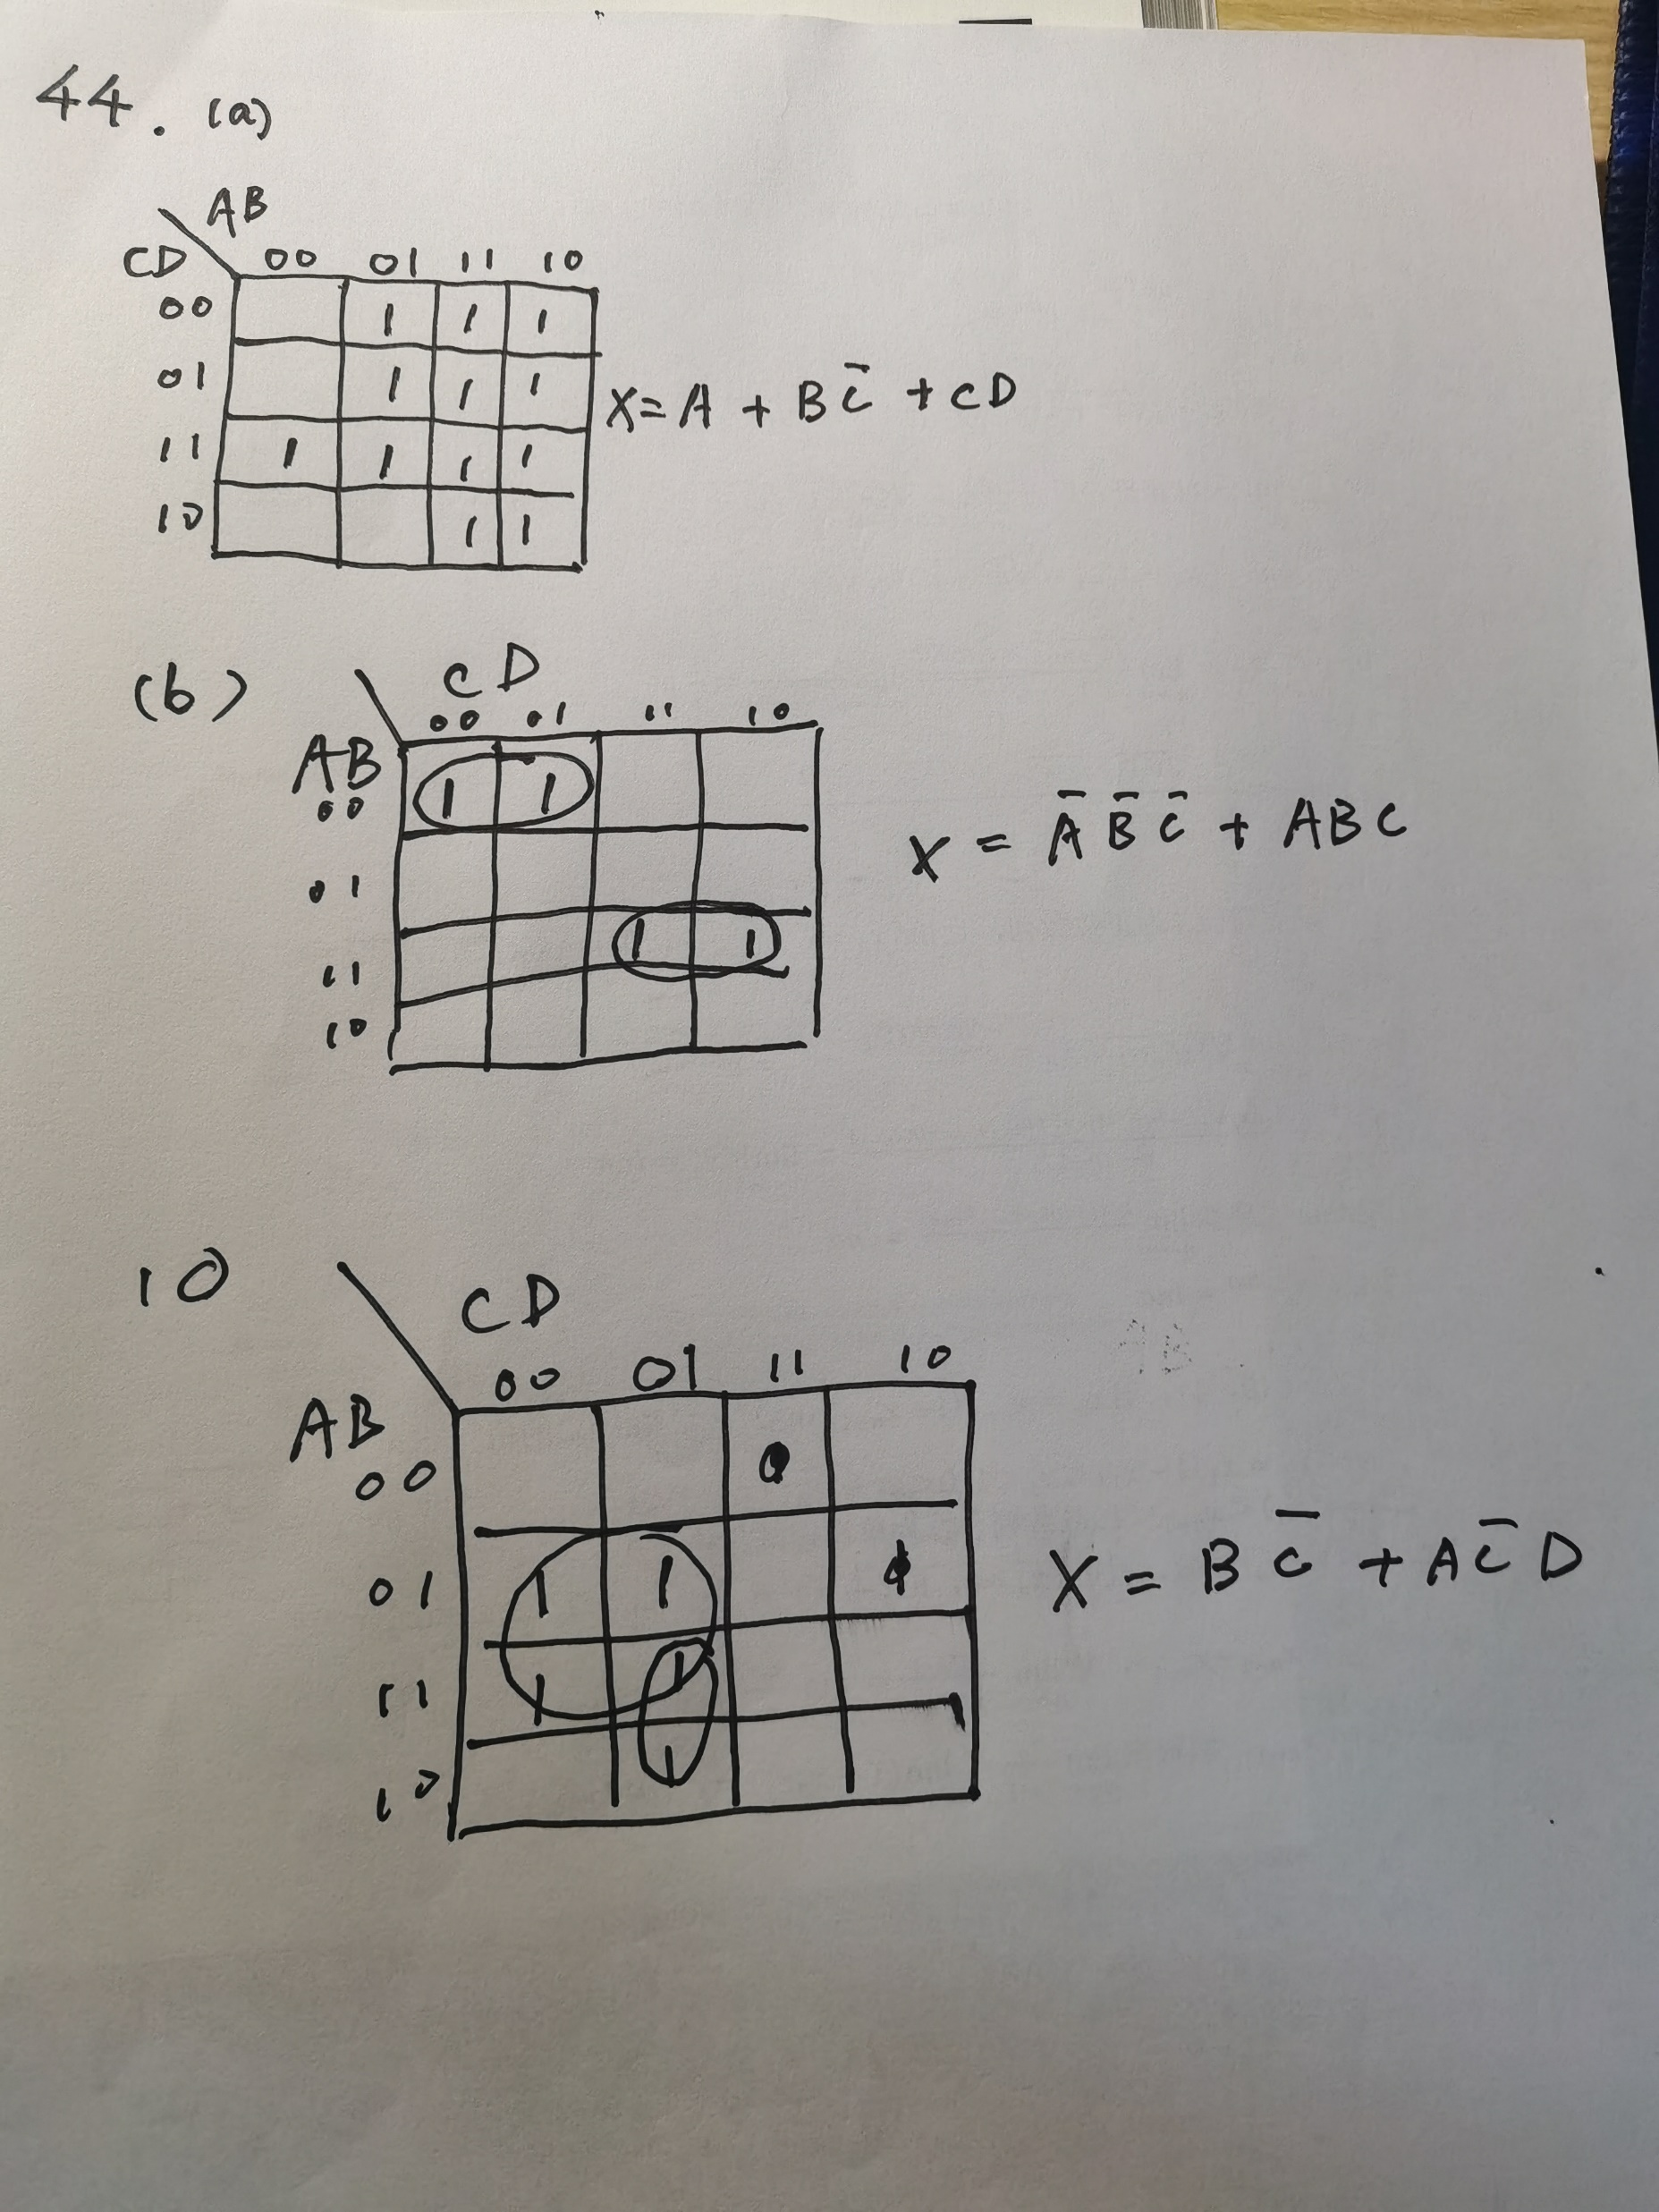
44

Slide 12
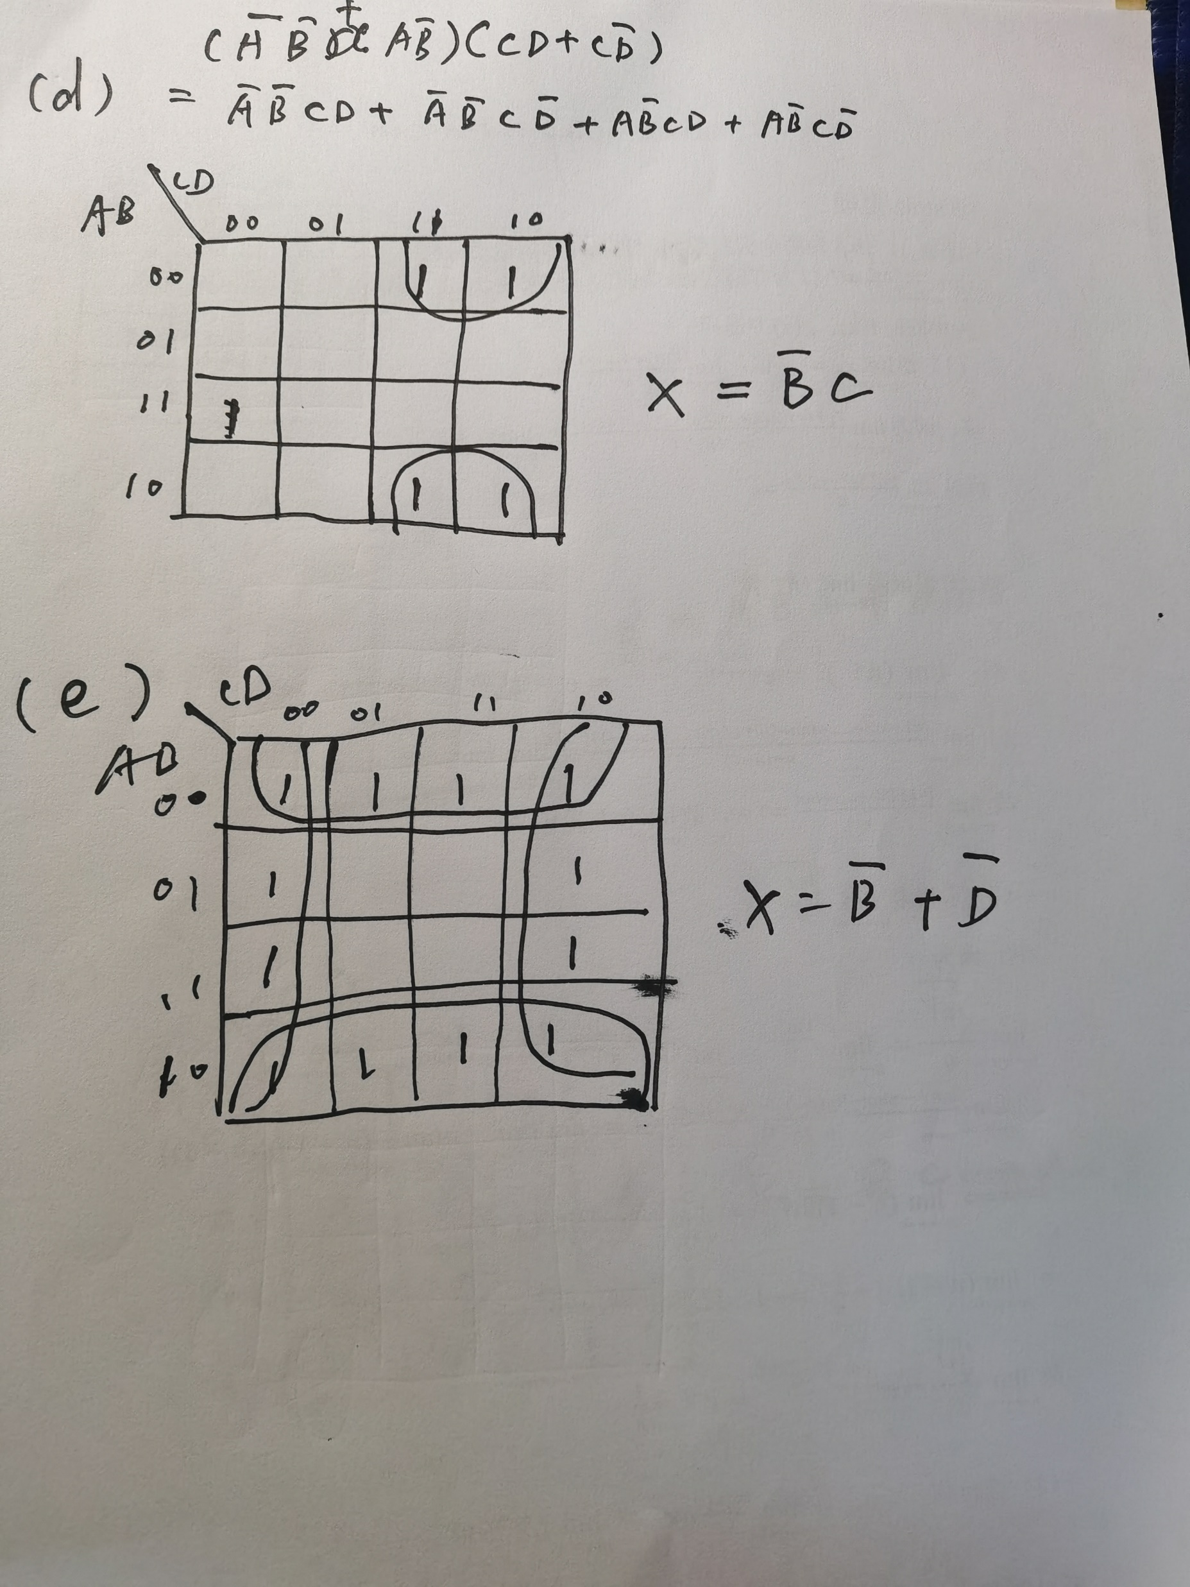

Slide 13
46
 | CD
AB |  | 1 |  | 1
 |  |  | 1 | 1
 | 1 | 1 | 1
 | 1 |  |  | 1
AC’D’+ABD+A’BC+B’CD’+A’B’C’D

Slide 14
