Slide 1
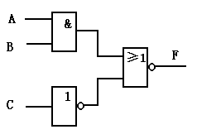
1. (10p)Fill in the numbers with 1 sign bit and 7 magnitude bits.
2. (12p)(2021)₁₀=( )₂=( )₁₆=( )_{8421BCD} .
3. (8p)The standard SOP for expression F=AB+AC is ( ).
4. (12p)Simplify the following logic functions with Karnaugh maps.
i. f(w, x, y, z)= y’z + w’xy’ + w’xy + xy’z ii.
5. (20p)Develop the truth table and write the Boolean expression
of the circuit as shown. Implement it with a 4-1 MUX.
6. (18p)Derive a circuit for ƒ(x₁, x₂, x₃)= x₁’x₂’+x₁x₂’+x₁x₃.
Using a 3-to-8 decoder and external gates.
7. (20p)Develop a logic circuit for detecting whether a 8421BCD
code is a multiple of three.
Decimalnumbers | 1’s complement form | 2’s complement form
-63

