Slide 1
3.
（e）(CB(B’A)’)’=C’+B’+B’A
(f) (A+B)(B’+C)

Slide 2
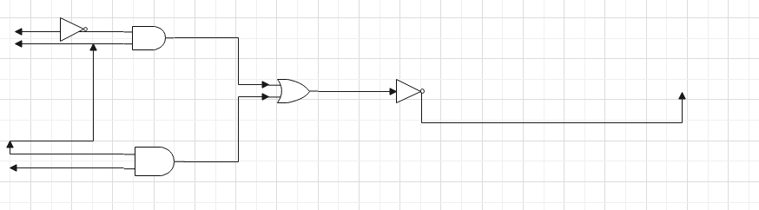
8

Slide 3
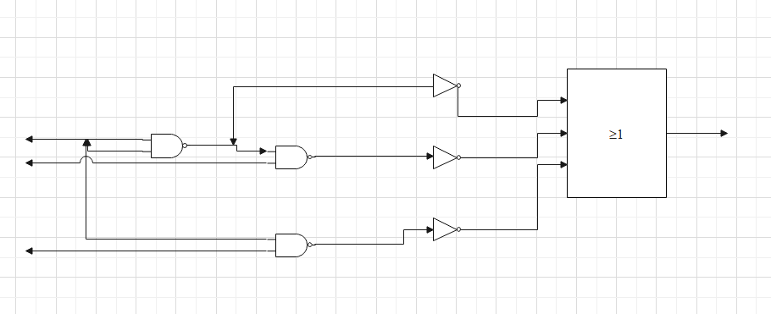
20

Slide 4
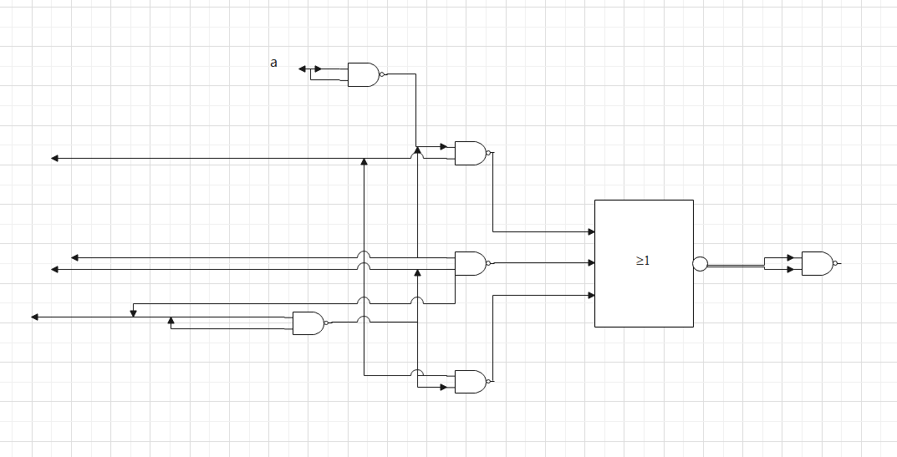

Slide 5
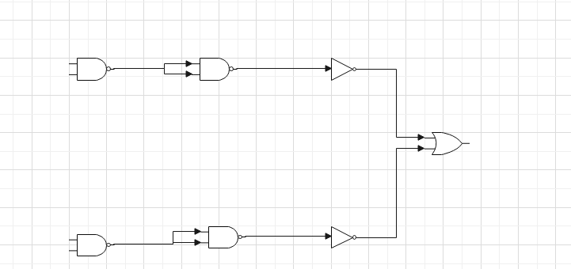
25

Slide 6
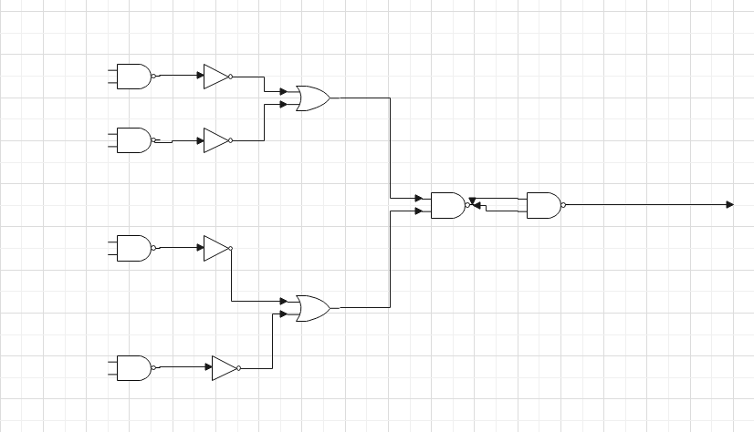

Slide 7
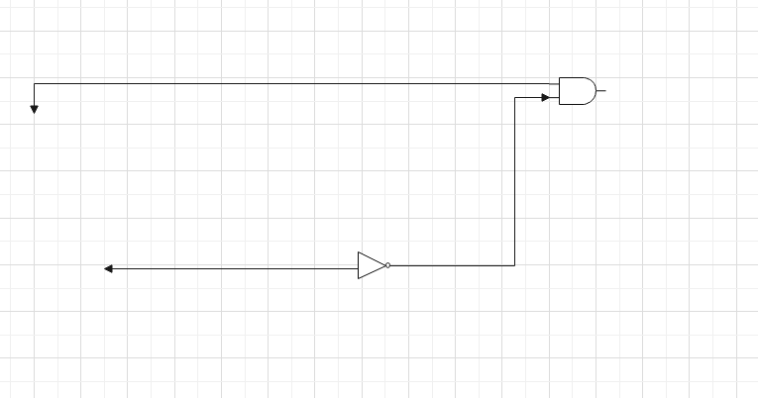
29
A+B’

Slide 8
30
ABC+AB’C’+AB’C’

Slide 9
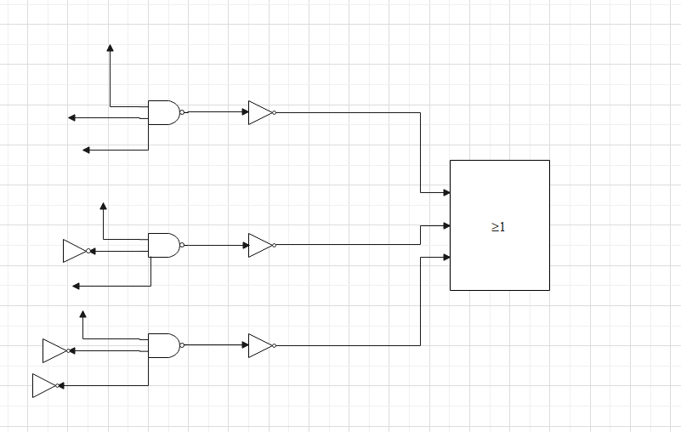

Slide 10
34
A | b | c | d | output
0 | 0 | 0 | 0 | 1
0 | 0 | 0 | 1 | 1
0 | 0 | 1 | 0 | 0
0 | 0 | 1 | 1 | 0
0 | 1 | 0 | 0 | 0
0 | 1 | 0 | 1 | 0
0 | 1 | 1 | 0 | 0
0 | 1 | 1 | 1 | 0
1 | 0 | 0 | 0 | 0
1 | 0 | 0 | 1 | 0
1 | 0 | 1 | 0 | 0
1 | 0 | 1 | 1 | 0
1 | 1 | 0 | 0 | 0
1 | 1 | 0 | 1 | 1
1 | 1 | 1 | 0 | 1
1 | 1 | 1 | 1 | 1

Slide 11
35
异或门即可

Slide 12
表决器
1）主裁a，副裁b，c
2）1代表同意，0代表·不同意

Slide 13
a | b | c | output
0 | 0 | 0 | 0
0 | 0 | 1 | 0
0 | 1 | 0 | 0
0 | 1 | 1 | 0
1 | 0 | 0 | 0
1 | 0 | 1 | 1
1 | 1 | 0 | 1
1 | 1 | 1 | 1

Slide 14

数值表达式：F=${\left(x+a\right)}^{n}=\sum{（5，6，7）}$
卡诺图化简
那么化简结果有ac+ab
 | a | 0 | 1
bc | 00
 | 01 |  | 1
 | 11 |  | 1
 | 10 |  | 1

Slide 15
