Slide 1
Human-robot interaction (HRI)
Autonomous Robotics
ESIIAB – UCLM
Alejandro Martín Simón Sánchez
Jorge Daniel Laborda Sicilia

Slide 2
index
INTRODUCTION …...…………………………… 2
PROCESS ………………………..………………. . . 5
EXAMPLES ……………………………………..…39
CONCLUSIONS ………….…………………..… 43

Slide 3

INTRODUCTION
Navigation using voice commands
Semantic mapping
Notes:
LiveSlide https://www.youtube.com/watch?v=ED18n03WdWw

Slide 4
INTRODUCTION
Voice
1.1 Audio
Google Speech
Recognition
Voice Interface
LU4R
SERVER
2. Transcription hypotheses dictionary
1.2 Transcription dictionary
3.1. Hypothesis + entities
LU4R ROS Interface
3.2. CFR String
4. CFR String
CFR Interpreter
Movements
5.1 Goals / Commands
5.2 State
6.2 State
Robot
rosarnl
6.1 Commands

Slide 5
INTRODUCTION
Used programs
ROS Kinetic in the laptop. ROS Indigo in the real robot.
ARIA 2.9.1
ARNL 1.9.2
MobileSim 0.7.3
ROSARNL. A version modified by Cristina Romero González is used, so the grips can be used.

Slide 6
PROCESS
Voice
1.1 Audio
Google Speech
Recognition
Voice Interface
LU4R
SERVER
2. Transcription hypotheses dictionary
1.2 Transcription dictionary
3.1. Hypothesis + entities
LU4R ROS Interface
3.2. CFR String
4. CFR String
CFR Interpreter
Movements
5.1 Goals / Commands
5.2 State
6.2 State
Robot
rosarnl
6.1 Commands

Slide 7
PROCESS
Voice
1.1 Audio
Google Speech
Recognition
Voice Interface
LU4R
SERVER
2. Transcription hypotheses dictionary
1.2 Transcription dictionary
3.1. Hypothesis + entities
LU4R ROS Interface
3.2. CFR String
4. CFR String
CFR Interpreter
Movements
5.1 Goals / Commands
5.2 State
6.2 State
Robot
rosarnl
6.1 Commands

Slide 8
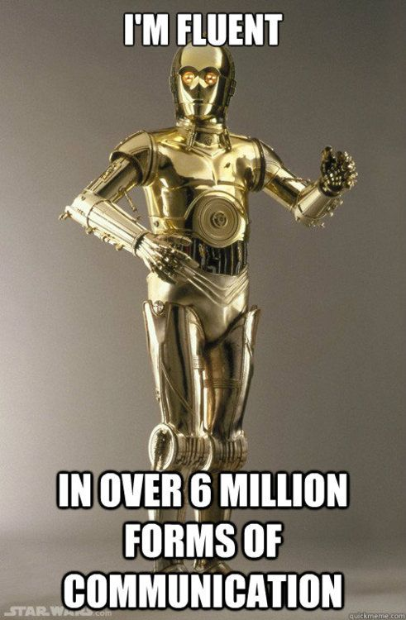
PROCESS
Voice Interface
You introduce a voice command.
It’s sent to Google Speech Recognition service (API).
It replies with a transcription in a dictionary.
It’s given the appropriate format.
Only English.

Slide 9
PROCESS
Voice
1.1 Audio
Google Speech
Recognition
Voice Interface
LU4R
SERVER
2. Transcription hypotheses dictionary
1.2 Transcription dictionary
3.1. Hypothesis + entities
LU4R ROS Interface
3.2. CFR String
4. CFR String
CFR Interpreter
Movements
5.1 Goals / Commands
5.2 State
6.2 State
Robot
rosarnl
6.1 Commands

Slide 10
PROCESS
Voice
1.1 Audio
Google Speech
Recognition
Voice Interface
LU4R
SERVER
2. Transcription hypotheses dictionary
1.2 Transcription dictionary
3.1. Hypothesis + entities
LU4R ROS Interface
3.2. CFR String
4. CFR String
CFR Interpreter
Movements
5.1 Goals / Commands
5.2 State
6.2 State
Robot
rosarnl
6.1 Commands

Slide 11
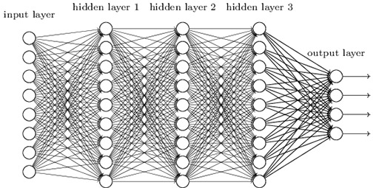
PROCESS
Google Speech Service
It recognizes patterns.
It splits the audio in parts, so it can pre-process it.
It uses neuronal networks. Each layer is specialized in doing something. For example, one can identify vocals and consonants. The next one can identify phonemes, and so on…

Slide 12
PROCESS
Voice
1.1 Audio
Google Speech
Recognition
Voice Interface
LU4R
SERVER
2. Transcription hypotheses dictionary
1.2 Transcription dictionary
3.1. Hypothesis + entities
LU4R ROS Interface
3.2. CFR String
4. CFR String
CFR Interpreter
Movements
5.1 Goals / Commands
5.2 State
6.2 State
Robot
rosarnl
6.1 Commands

Slide 13
PROCESS
Voice
1.1 Audio
Google Speech
Recognition
Voice Interface
LU4R
SERVER
2. Transcription hypotheses dictionary
1.2 Transcription dictionary
3.1. Hypothesis + entities
LU4R ROS Interface
3.2. CFR String
4. CFR String
CFR Interpreter
Movements
5.1 Goals / Commands
5.2 State
6.2 State
Robot
rosarnl
6.1 Commands

Slide 14
PROCESS
Voice
1.1 Audio
Google Speech
Recognition
Voice Interface
LU4R
SERVER
2. Transcription hypotheses dictionary
1.2 Transcription dictionary
3.1. Hypothesis + entities
LU4R ROS Interface
3.2. CFR String
4. CFR String
CFR Interpreter
Movements
5.1 Goals / Commands
5.2 State
6.2 State
Robot
rosarnl
6.1 Commands

Slide 15
PROCESS
Voice
1.1 Audio
Google Speech
Recognition
Voice Interface
LU4R
SERVER
2. Transcription hypotheses dictionary
1.2 Transcription dictionary
3.1. Hypothesis + entities
LU4R ROS Interface
3.2. CFR String
4. CFR String
CFR Interpreter
Movements
5.1 Goals / Commands
5.2 State
6.2 State
Robot
rosarnl
6.1 Commands

Slide 16
PROCESS
LU4R ROS Interface
When the transcription and the entities are sent to the server a CFR String is got as a response.
Examples:
BRINGING(beneficiary:"me",theme:"the bottle")
MOTION(goal:"to the bathroom")
RELEASING(theme:"the Kraken")

Slide 17
PROCESS
Voice
1.1 Audio
Google Speech
Recognition
Voice Interface
LU4R
SERVER
2. Transcription hypotheses dictionary
1.2 Transcription dictionary
3.1. Hypothesis + entities
LU4R ROS Interface
3.2. CFR String
4. CFR String
CFR Interpreter
Movements
5.1 Goals / Commands
5.2 State
6.2 State
Robot
rosarnl
6.1 Commands

Slide 18
PROCESS
Voice
1.1 Audio
Google Speech
Recognition
Voice Interface
LU4R
SERVER
2. Transcription hypotheses dictionary
1.2 Transcription dictionary
3.1. Hypothesis + entities
LU4R ROS Interface
3.2. CFR String
4. CFR String
CFR Interpreter
Movements
5.1 Goals / Commands
5.2 State
6.2 State
Robot
rosarnl
6.1 Commands

Slide 19
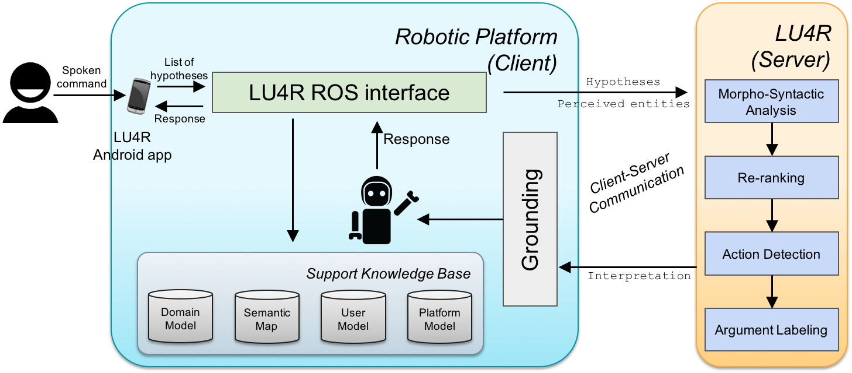
PROCESS
LU4R SERVER

Slide 20
PROCESS
LU4R SERVER
The robot must know the language and be context-aware.
Robot interactions need to be Grounded. The meaning of any command depends on the current state of the physical world.
Interpretation of a command interacts with the perception of the surroundings.
LU4R uses a SLU (Spoken Language Understanding) that integrates both perception and linguistic information.
LU4R has been trained by using the HuRIC (Human Robot Interaction Corpus)
Commands separated into Semantic Frames.
Understands 18 different frames.

Slide 21
PROCESS
LU4R SERVER
“Take the book on the table” [take]_{Taking}[the book on the table]_{THEME}

Slide 22
PROCESS
Voice
1.1 Audio
Google Speech
Recognition
Voice Interface
LU4R
SERVER
2. Transcription hypotheses dictionary
1.2 Transcription dictionary
3.1. Hypothesis + entities
LU4R ROS Interface
3.2. CFR String
4. CFR String
CFR Interpreter
Movements
5.1 Goals / Commands
5.2 State
6.2 State
Robot
rosarnl
6.1 Commands

Slide 23
PROCESS
Voice
1.1 Audio
Google Speech
Recognition
Voice Interface
LU4R
SERVER
2. Transcription hypotheses dictionary
1.2 Transcription dictionary
3.1. Hypothesis + entities
LU4R ROS Interface
3.2. CFR String
4. CFR String
CFR Interpreter
Movements
5.1 Goals / Commands
5.2 State
6.2 State
Robot
rosarnl
6.1 Commands

Slide 24
PROCESS
Voice
1.1 Audio
Google Speech
Recognition
Voice Interface
LU4R
SERVER
2. Transcription hypotheses dictionary
1.2 Transcription dictionary
3.1. Hypothesis + entities
LU4R ROS Interface
3.2. CFR String
4. CFR String
CFR Interpreter
Movements
5.1 Goals / Commands
5.2 State
6.2 State
Robot
rosarnl
6.1 Commands

Slide 25
PROCESS
Voice
1.1 Audio
Google Speech
Recognition
Voice Interface
LU4R
SERVER
2. Transcription hypotheses dictionary
1.2 Transcription dictionary
3.1. Hypothesis + entities
LU4R ROS Interface
3.2. CFR String
4. CFR String
CFR Interpreter
Movements
5.1 Goals / Commands
5.2 State
6.2 State
Robot
rosarnl
6.1 Commands

Slide 26
PROCESS
CFR Interpreter
Once the CFR string is received, the action has to be determined.
Examples:
BRINGING(beneficiary:"me",theme:"the bottle")
MOTION(goal:"to the bathroom")
RELEASING(theme:"the Kraken")
These actions are BRINGING, MOTION, RELEASING.

Slide 27
PROCESS
CFR Interpreter
Lists of goals are used:
[[Reference_in_the_map – Goal0, name of the real place, synonymous1, synonymous2…],
[Reference_in_the_map – Goal0, name of the real place, synonymous1, synonymous2…],
[Reference_in_the_map – Goal0, name of the real place, synonymous1, synonymous2…],
[Reference_in_the_map – Goal0, name of the real place, synonymous1, synonymous2…]]
Example:
MOTION(goal:"to the bathroom")
It’s checked if one word of “to the bathroom” coincides with one word of the list of goals. Then the robot is sent to the referenced goal in the map.

Slide 28
PROCESS
CFR Interpreter
Lists of objects are used:
[[Object1, Object2, Object3…],
[Object1, Object2, Object3…],
[Object1, Object2, Object3…],
[Object1, Object2, Object3…]]
Example:
BRINGING(beneficiary:"me",theme:"the bottle")
It’s checked if one word of “the bottle” coincides with one word of the list of objects. Then the robot is sent to the referenced goal in the map taking into account the index of the object list, so it’s sent to the goal which occupies the list with that index.
Finally, the robot takes object from that goal and returns to the last visited goal.

Slide 29
PROCESS
Voice
1.1 Audio
Google Speech
Recognition
Voice Interface
LU4R
SERVER
2. Transcription hypotheses dictionary
1.2 Transcription dictionary
3.1. Hypothesis + entities
LU4R ROS Interface
3.2. CFR String
4. CFR String
CFR Interpreter
Movements
5.1 Goals / Commands
5.2 State
6.2 State
Robot
rosarnl
6.1 Commands

Slide 30
PROCESS
Voice
1.1 Audio
Google Speech
Recognition
Voice Interface
LU4R
SERVER
2. Transcription hypotheses dictionary
1.2 Transcription dictionary
3.1. Hypothesis + entities
LU4R ROS Interface
3.2. CFR String
4. CFR String
CFR Interpreter
Movements
5.1 Goals / Commands
5.2 State
6.2 State
Robot
rosarnl
6.1 Commands

Slide 31
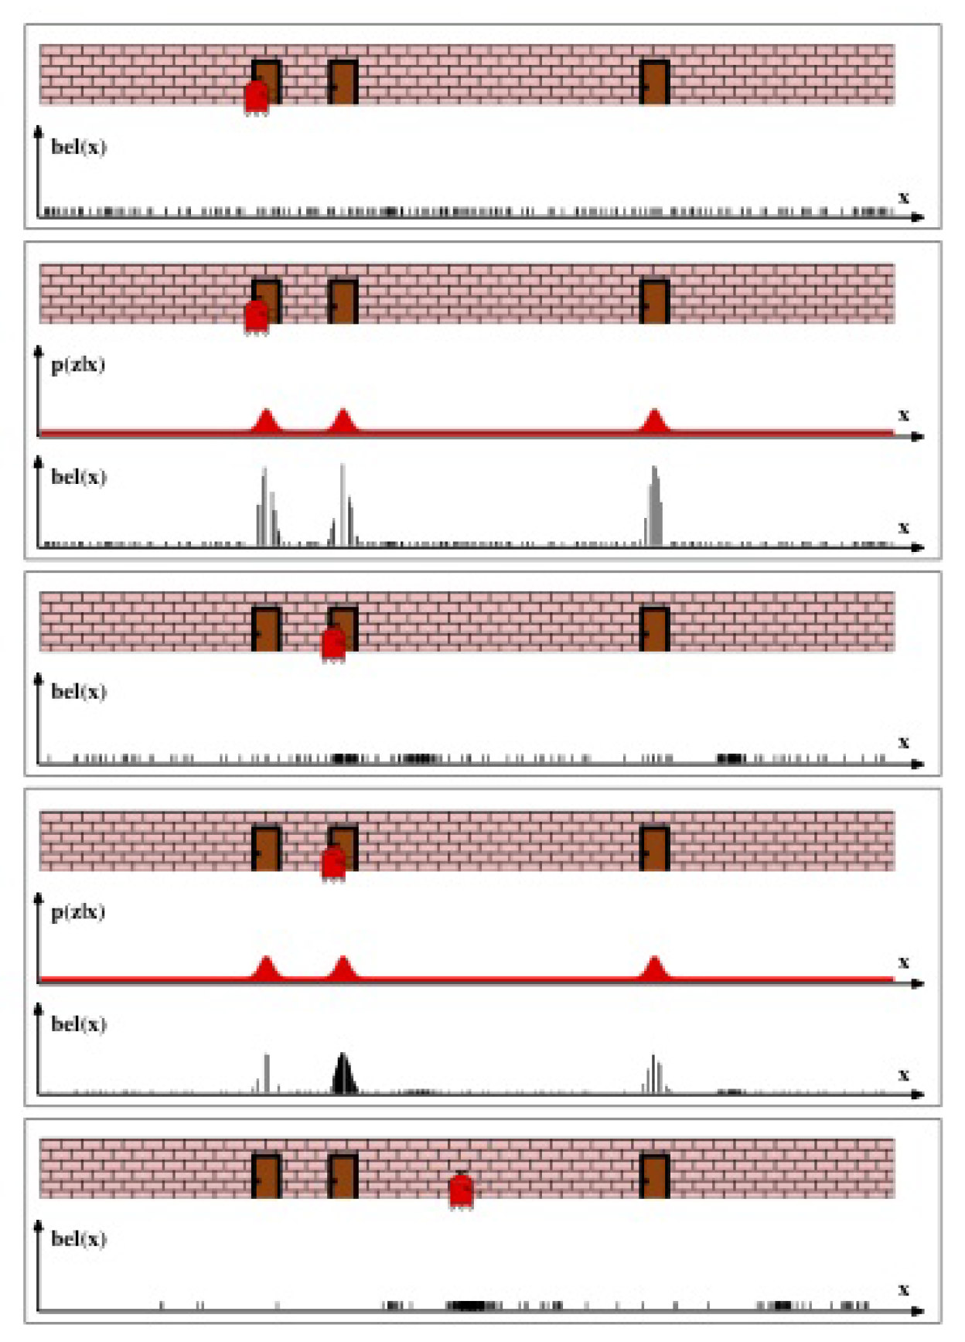
PROCESS
ROSARNL
Uses Monte Carlo localization algorithm
Controls the motions of the Pioneer 3-DX
Uses a map of the environment to locate the robot
Uses ROS. Publishes the state of the robot, listens for commands.

Slide 32
PROCESS
Voice
1.1 Audio
Google Speech
Recognition
Voice Interface
LU4R
SERVER
2. Transcription hypotheses dictionary
1.2 Transcription dictionary
3.1. Hypothesis + entities
LU4R ROS Interface
3.2. CFR String
4. CFR String
CFR Interpreter
Movements
5.1 Goals / Commands
5.2 State
6.2 State
Robot
rosarnl
6.1 Commands

Slide 33
PROCESS
Voice
1.1 Audio
Google Speech
Recognition
Voice Interface
LU4R
SERVER
2. Transcription hypotheses dictionary
1.2 Transcription dictionary
3.1. Hypothesis + entities
LU4R ROS Interface
3.2. CFR String
4. CFR String
CFR Interpreter
Movements
5.1 Goals / Commands
5.2 State
6.2 State
Robot
rosarnl
6.1 Commands

Slide 34
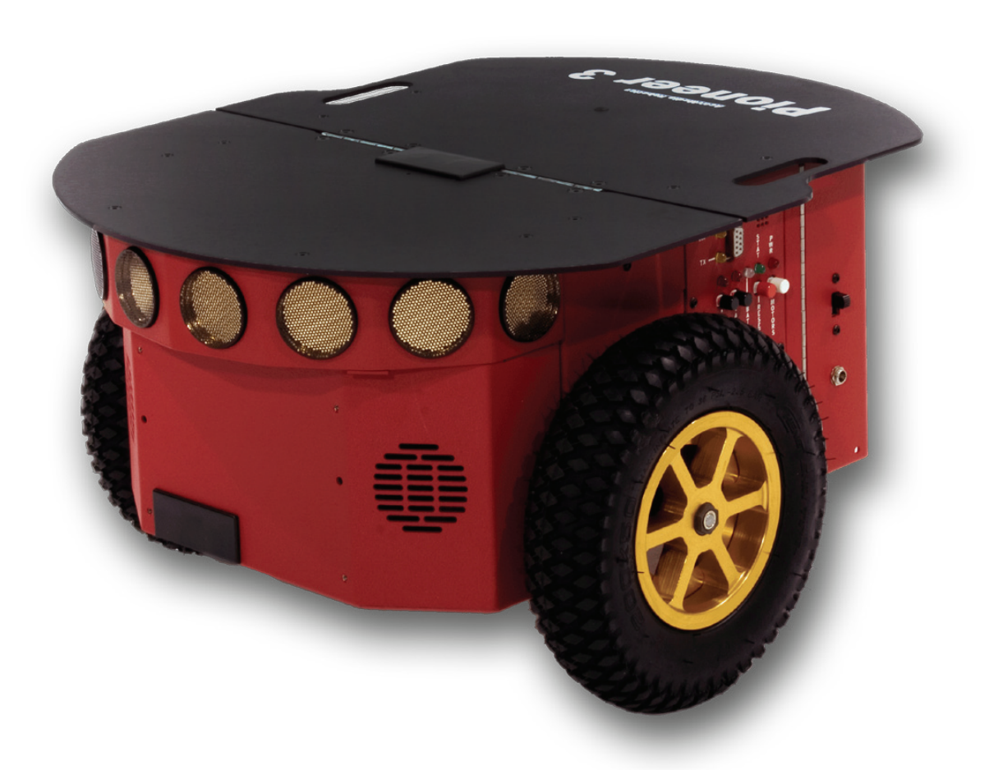
PROCESS
PIONEER 3-DX
Small lightweight robot
Two wheels
Two motor differential drives
Front SONAR
Battery
Wheel encoders
Microcontroller with ARCOS firmware

Slide 35
PROCESS
Voice
1.1 Audio
Google Speech
Recognition
Voice Interface
LU4R
SERVER
2. Transcription hypotheses dictionary
1.2 Transcription dictionary
3.1. Hypothesis + entities
LU4R ROS Interface
3.2. CFR String
4. CFR String
CFR Interpreter
Movements
5.1 Goals / Commands
5.2 State
6.2 State
Robot
rosarnl
6.1 Commands

Slide 36
PROCESS
Voice
1.1 Audio
Google Speech
Recognition
Voice Interface
LU4R
SERVER
2. Transcription hypotheses dictionary
1.2 Transcription dictionary
3.1. Hypothesis + entities
LU4R ROS Interface
3.2. CFR String
4. CFR String
CFR Interpreter
Movements
5.1 Goals / Commands
5.2 State
6.2 State
Robot
rosarnl
6.1 Commands

Slide 37
PROCESS
Voice
1.1 Audio
Google Speech
Recognition
Voice Interface
LU4R
SERVER
2. Transcription hypotheses dictionary
1.2 Transcription dictionary
3.1. Hypothesis + entities
LU4R ROS Interface
3.2. CFR String
4. CFR String
CFR Interpreter
Movements
5.1 Goals / Commands
5.2 State
6.2 State
Robot
rosarnl
6.1 Commands

Slide 38
PROCESS
Voice
1.1 Audio
Google Speech
Recognition
Voice Interface
LU4R
SERVER
2. Transcription hypotheses dictionary
1.2 Transcription dictionary
3.1. Hypothesis + entities
LU4R ROS Interface
3.2. CFR String
4. CFR String
CFR Interpreter
Movements
5.1 Goals / Commands
5.2 State
6.2 State
Robot
rosarnl
6.1 Commands

Slide 39
PROCESS
Voice
1.1 Audio
Google Speech
Recognition
Voice Interface
LU4R
SERVER
2. Transcription hypotheses dictionary
1.2 Transcription dictionary
3.1. Hypothesis + entities
LU4R ROS Interface
3.2. CFR String
4. CFR String
MORE COMMANDS?
CFR Interpreter
Movements
5.1 Goals / Commands
5.2 State
6.2 State
Robot
rosarnl
6.1 Commands

Slide 40
Using the robot
GO COMMAND
Notes:
LiveSlide https://www.youtube.com/watch?v=pJQY3ACw7CI

Slide 41
Using the robot
RELEASE THE KRAKEN COMMAND
Notes:
LiveSlide https://www.youtube.com/watch?v=q8lmomugFuw

Slide 42
Using the robot
BRING COMMAND
Notes:
LiveSlide https://www.youtube.com/watch?v=4rOS8xjmGmI

Slide 43
Using the robot
STOP COMMAND
Notes:
LiveSlide https://www.youtube.com/watch?v=Oe5Zi_e1zEo

Slide 44
conclusions
Natural language is a big computational problem.
As it is obvious, the simulation done by computer is not the same done by a real robot. The robot commits more errors.
For future improvements, a prolog facts database could indeed make the robot understand better it’s surrounding and establish a little dialogue with the user to better understand what it’s purpose is.

Slide 45
Questions time

