Slide 1
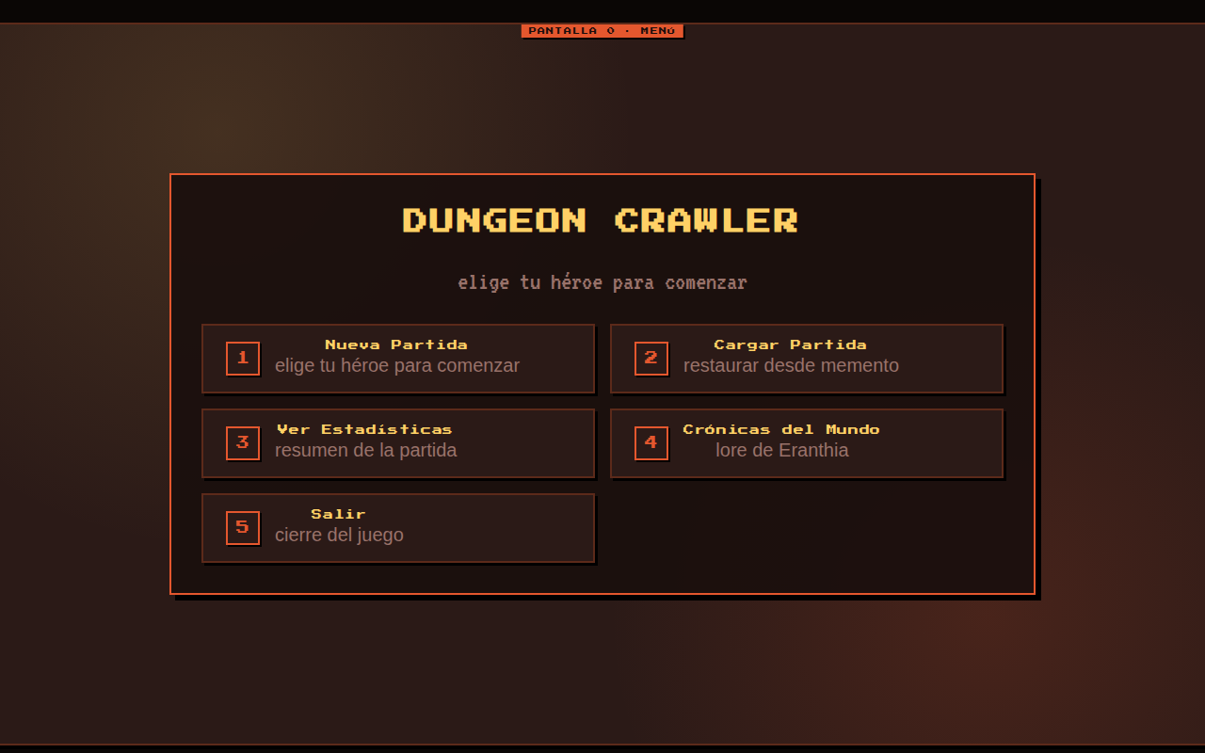
Vista Mockup: screen-menu

Slide 2
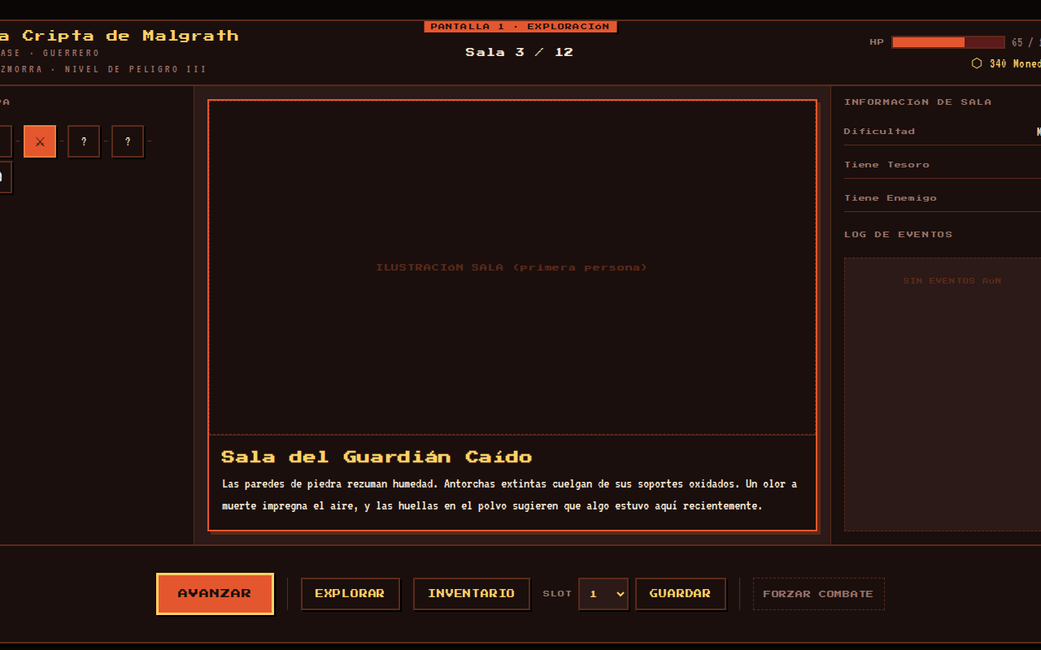
Vista Mockup: screen-exploration

Slide 3
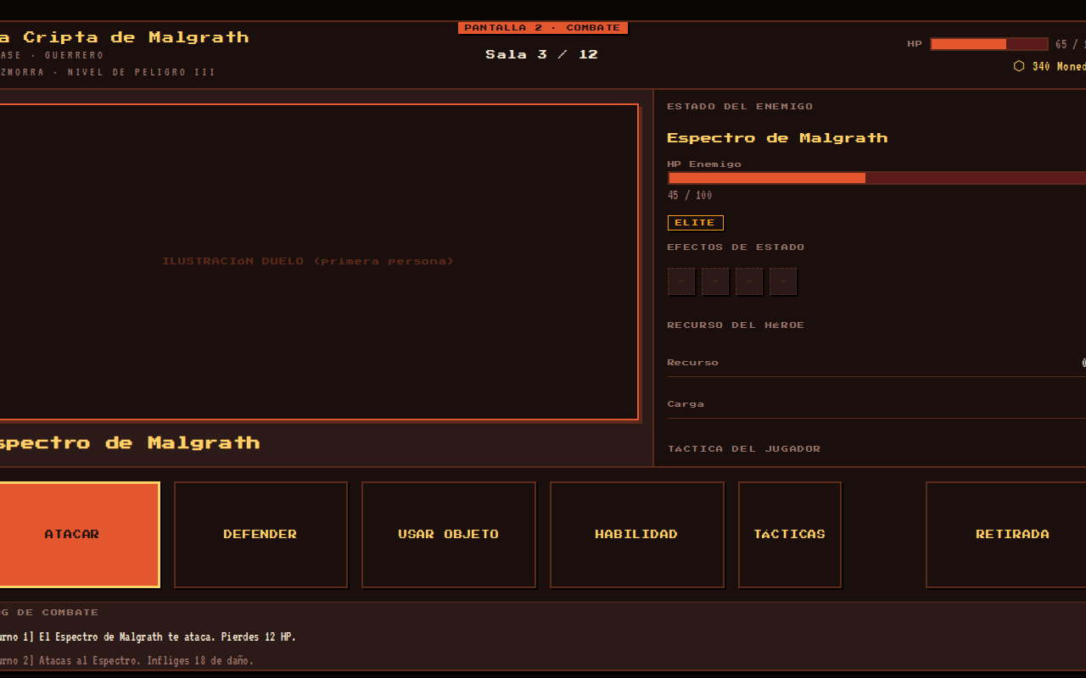
Vista Mockup: screen-combat

Slide 4
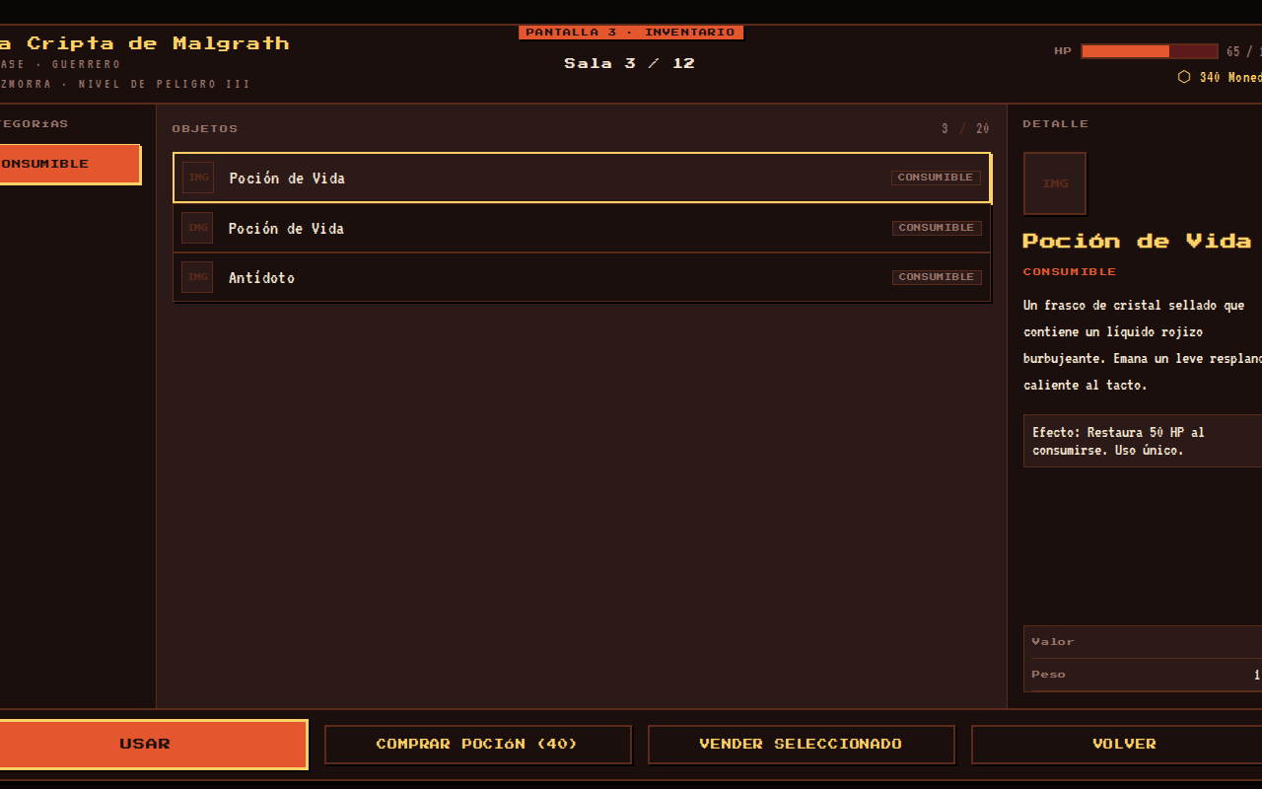
Vista Mockup: screen-inventory

Slide 5
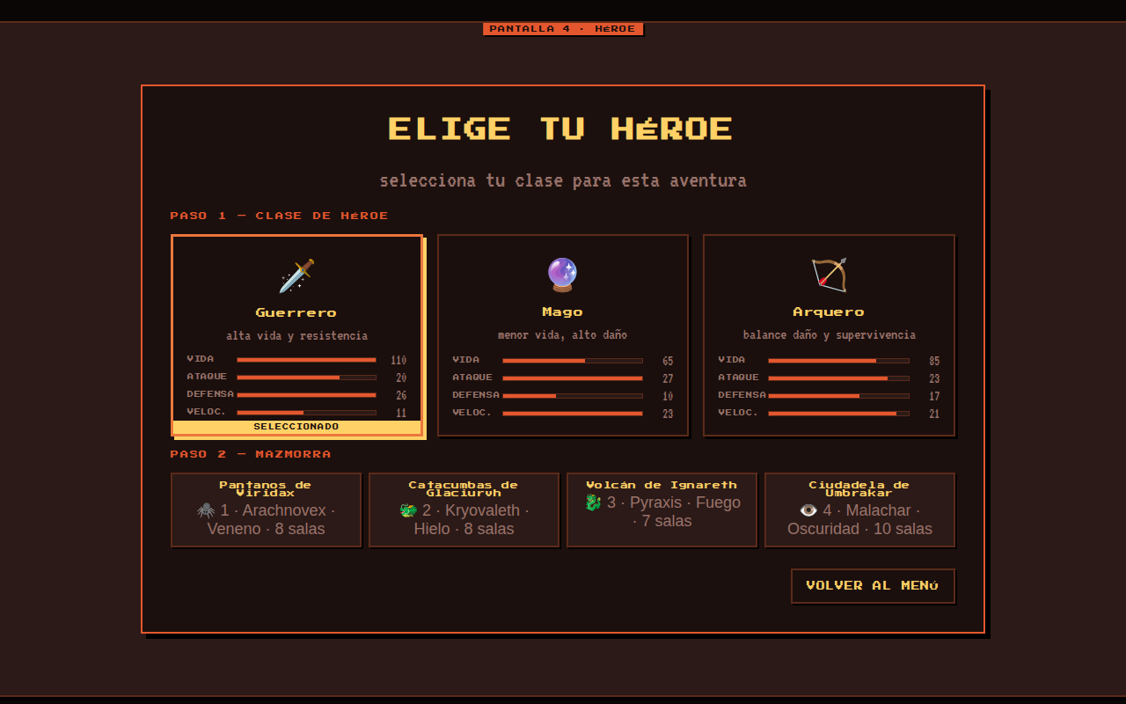
Vista Mockup: screen-hero

Slide 6
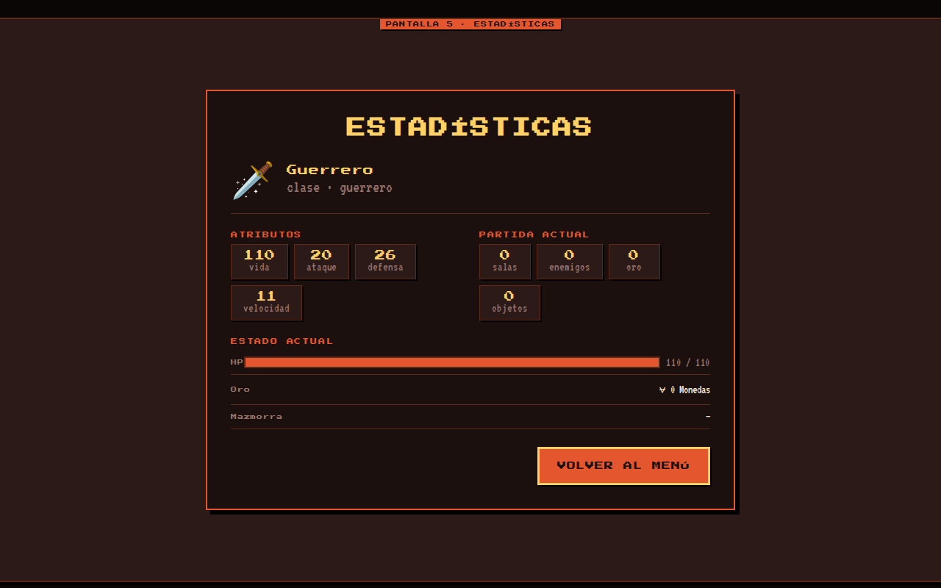
Vista Mockup: screen-stats

Slide 7
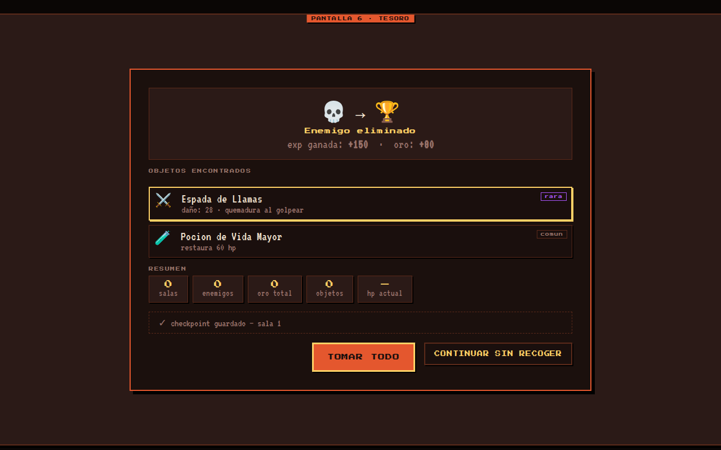
Vista Mockup: screen-treasure

Slide 8
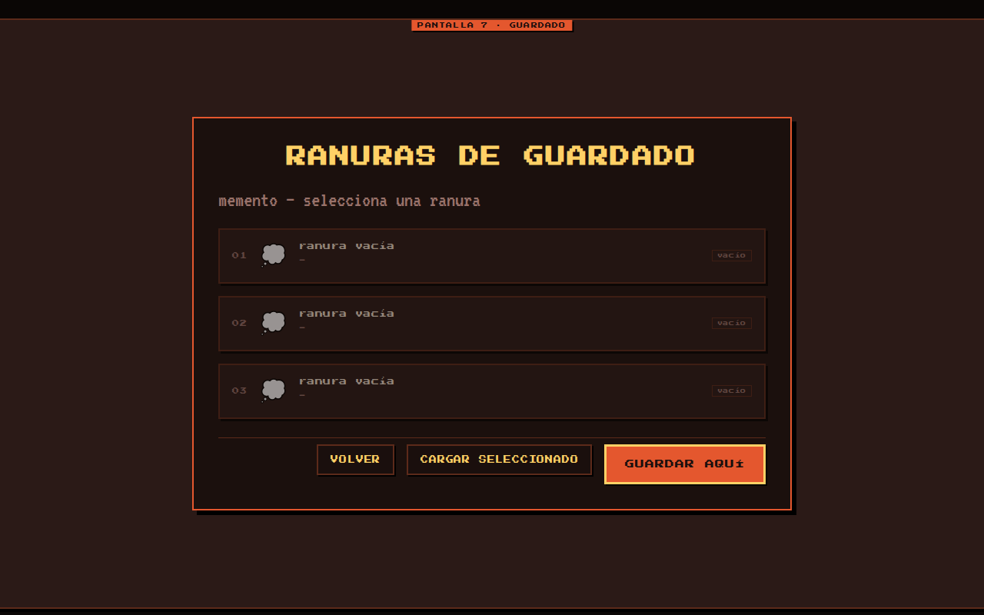
Vista Mockup: screen-saves

Slide 9
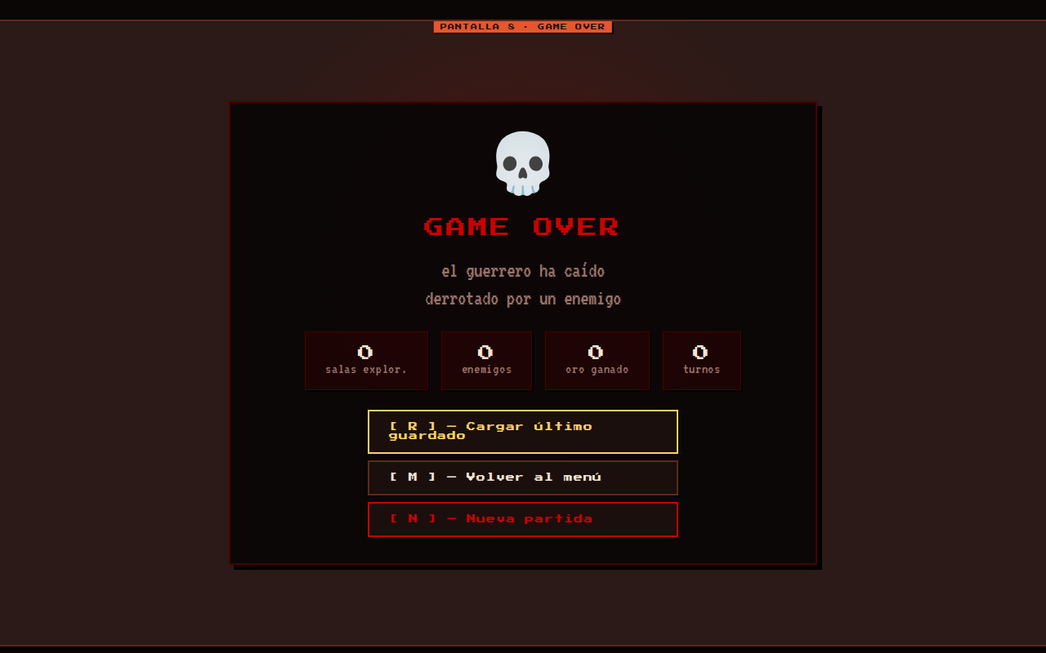
Vista Mockup: screen-gameover

