Slide 1
EDES 301 AquaTrac Proposal
9-30-2024
Juan Aizprua

Slide 2
Background Information
What is being proposed?
A gadget that can be added to water bottles that allows you to track your intake of water throughout the day and can tell you if you need to drink more or if you’re right on track.
Pictures
Links to existing projects / libraries
hidratespark.com/products/hidratespark-pro-32oz-smart-water-bottle
us.water.io/
hackster.io/Teenenggr/bottle-that-keeps-you-hydrated-fdf535
hackster.io/magicbit0/smart-water-bottle-with-magicbit-99f64a
hackster.io/mweber17/smart-water-14cb33
What improvements / additions over existing project
Make it available to use on any water bottle with some initial set up. Planning on keeping track of water volume with a sensor at the bottom that measures how much force it is under .Some user interaction so they can check if they are on track either through an application on their computer or pressing a button on the gadget on bottle.

Slide 3
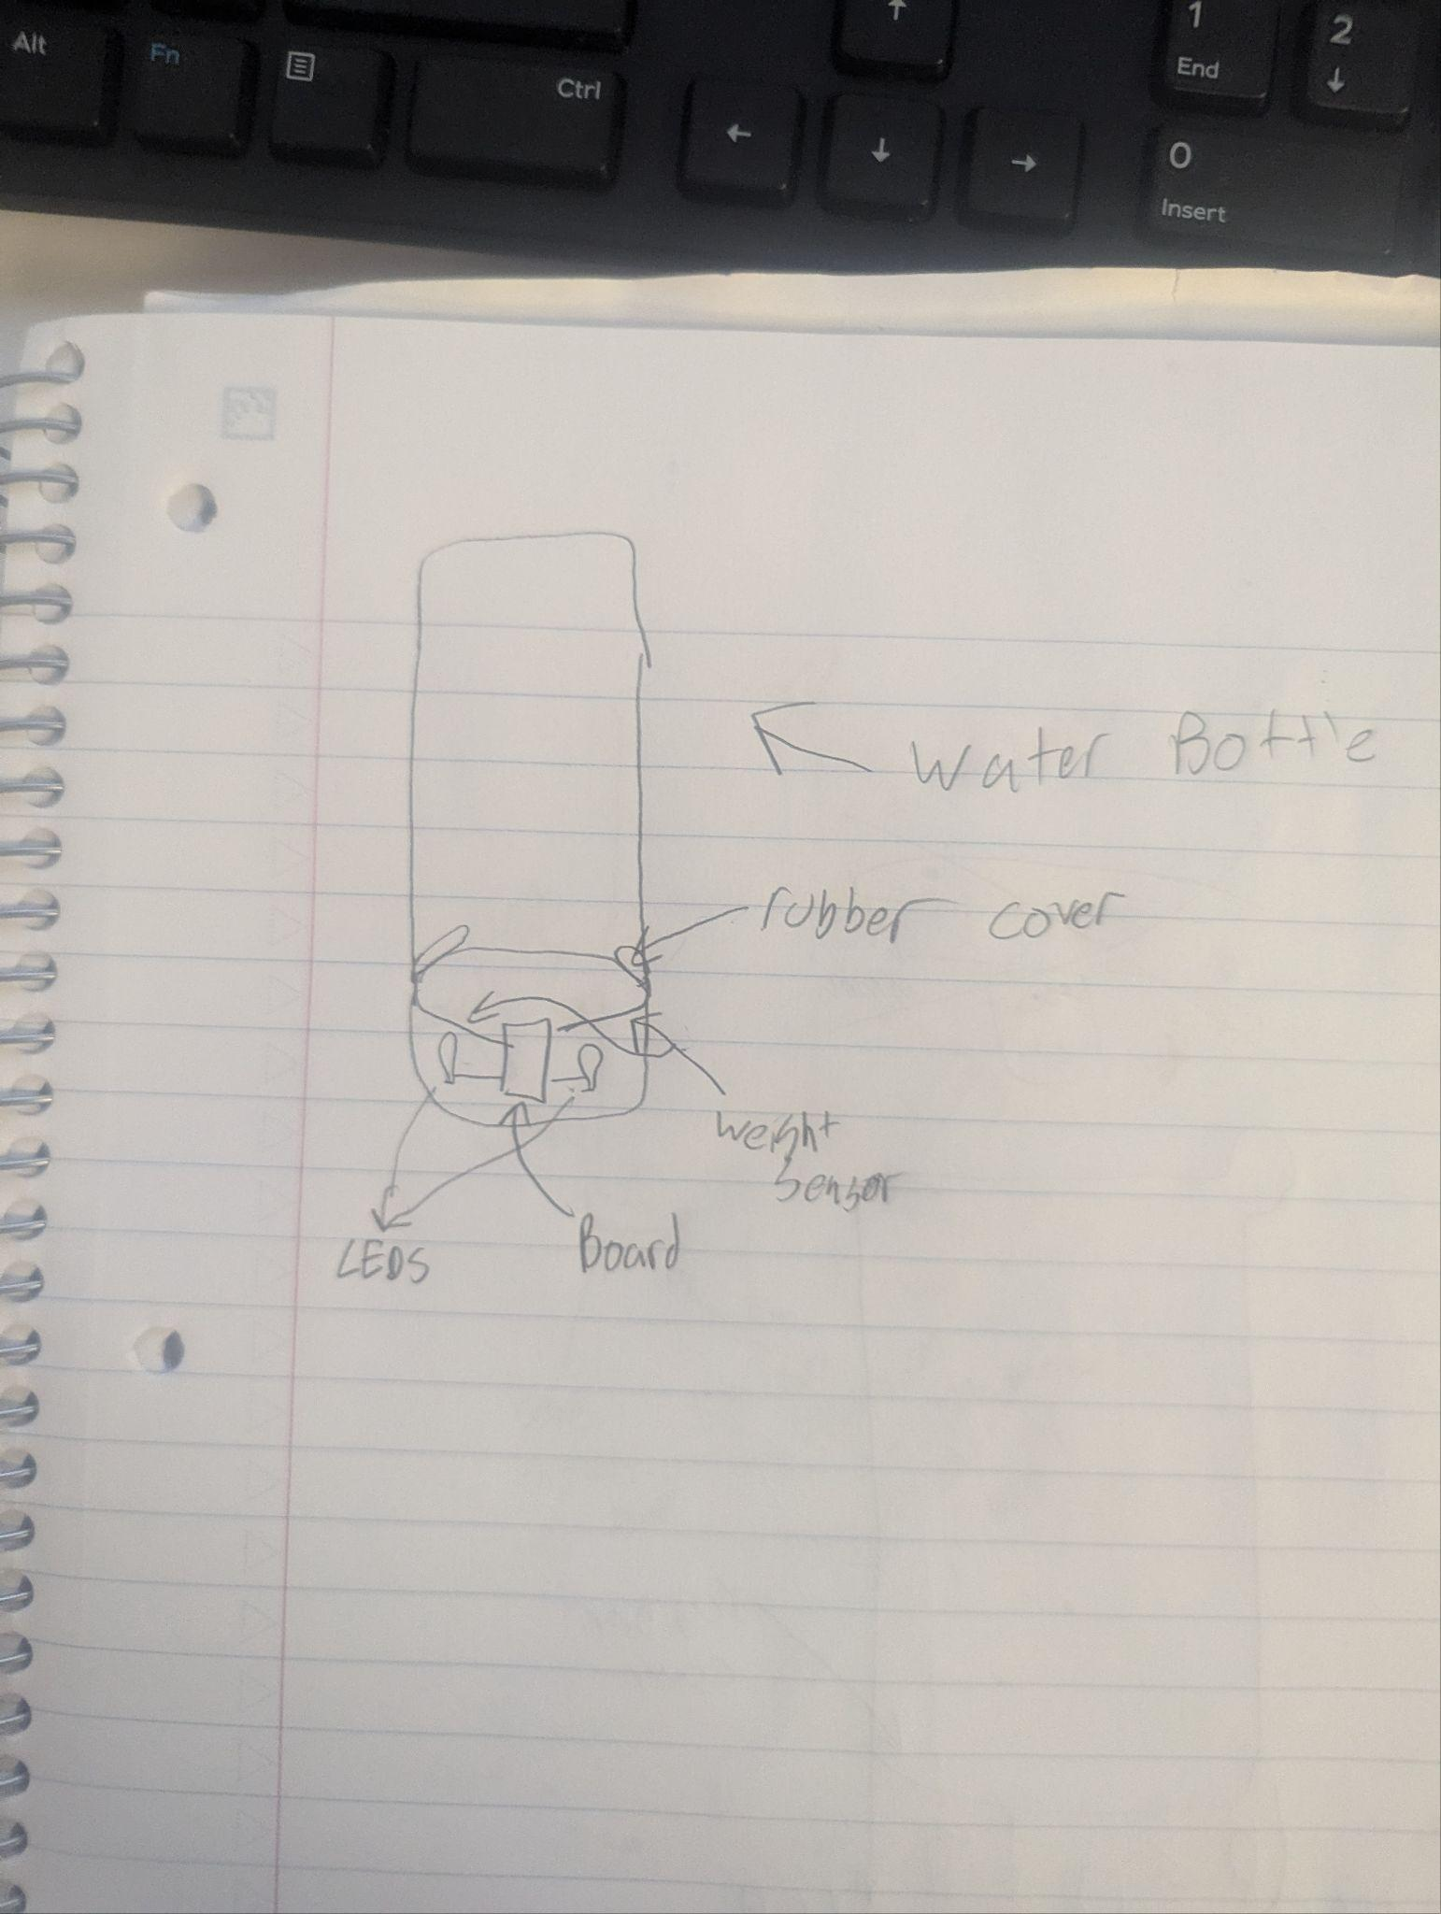
System Block Diagram
A rubber cover near the bottom of the water bottle meant to
protect electrical components below. 2 weight sensors
above the rubber cover that measure the weight of the
water. Beagle Board that receives the weight information from
the sensors, records data every set time interval. Can send
information to a computer and light up green/red LEDS when
prompted depending if the amount of water drunk is adequate
level

Slide 4
Power Block Diagram
I do not know how to create a power block diagram or how one would look like for my cas
But the power would be provided by a battery, and there would be power outputs at the LEDS and the beagle board

Slide 5
Components / Budget
Component | EDES301 to Buy? | Cost
Weight sensors https://www.adafruit.com/product/166 | Yes | 4
Green/Red LEDs | No | Already Have?
Rubber cover amazon.com/Prescott-Plastics-Round-Flexible-Rubber/dp/B07RDMNGP4?th=1 | Yes | 10
Beagle Board | No | already have
Bluetooth usb? amazon.com/Bluetooth-Adapter-SIP-T27G-Raspberry-Windows10/dp/B07S8PT7J6 | Yes | 9
Water Bottle | No | already have

