Slide 1

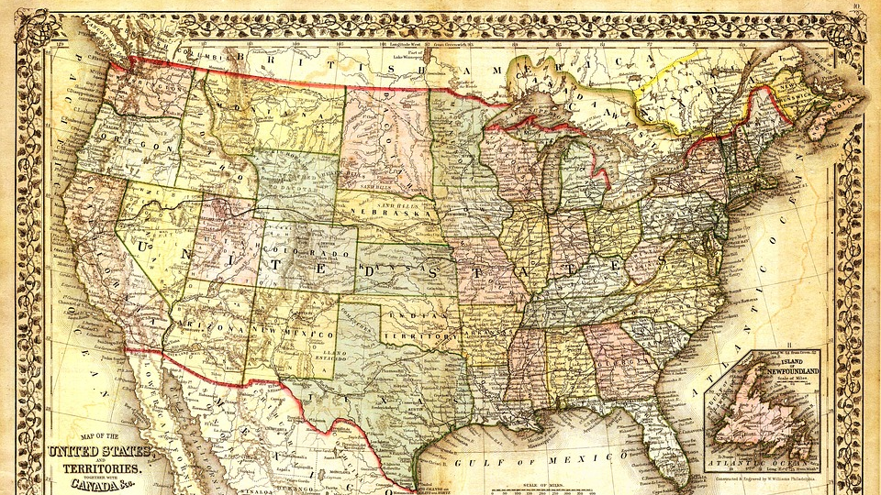
Wages by Education in USA
1973-2022

Slide 2

Questions
Are female earnings trending towards as much as males with an Advanced degree?
Does the increase in Education affect the increase in salary for both men and women equally?
In the last 5 years for those with an Advanced Degree is there a difference between the groups based on race?

Slide 3
In the last 5 years, for those with an Advanced Degree, is there a difference between the groups based on race?
Question 3

Slide 4
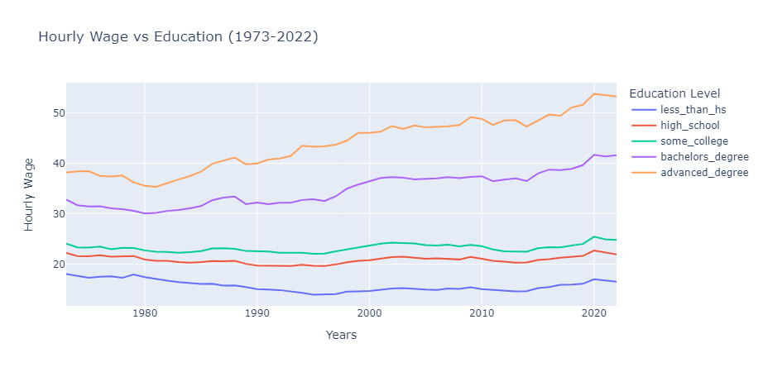
Throughout the Years an Advanced Education has always correlated with an increase in Wages

Slide 5
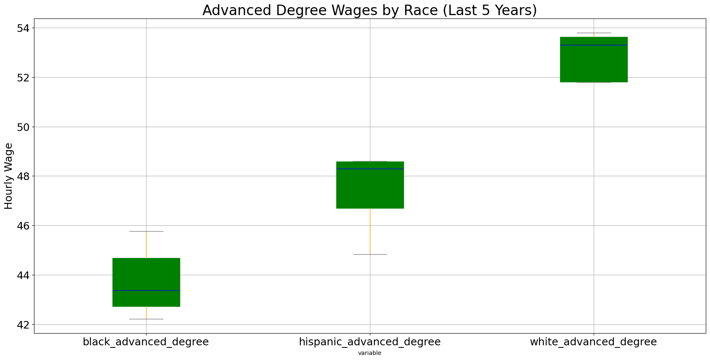
Last 5 years shows the discrepancies of wages between the races
Anova: pvalue = 9.22e-07 shows statistically difference between the wages
Ttest: pvalue = 0.0059 show statistically difference between Black Advanced Degree and Hispanic Advanced Degree

Slide 6
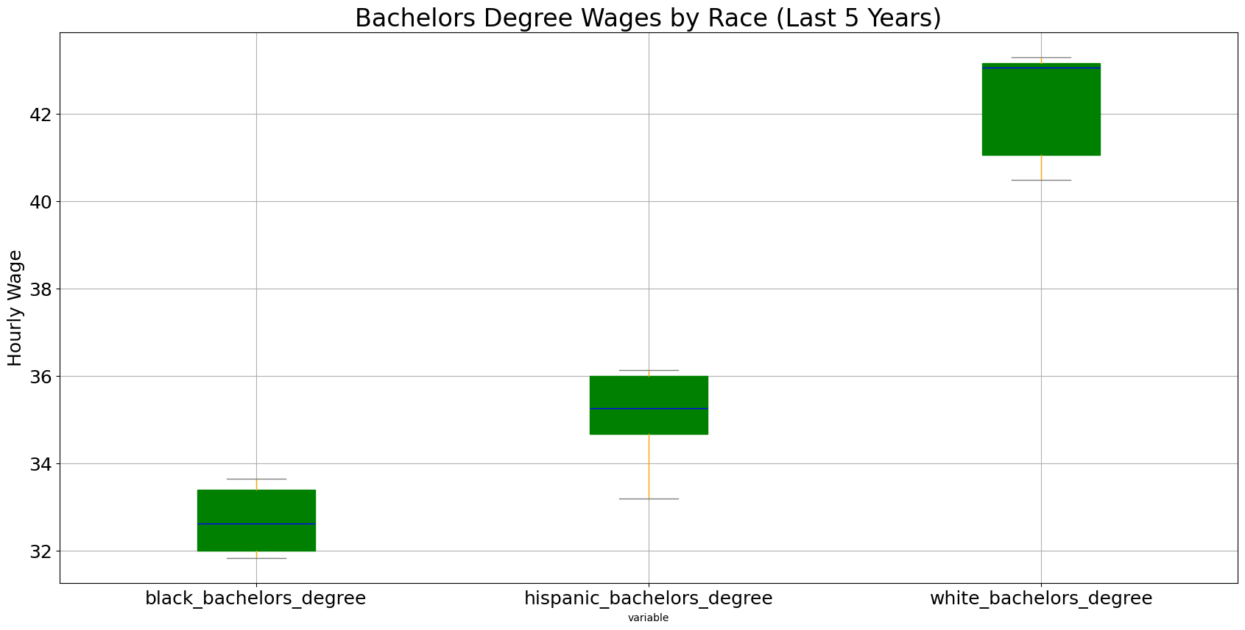
Last 5 years shows the discrepancies of wages between the races
Anova: pvalue = 4.24e-08 shows statistically difference between the wages
Ttest: pvalue = 0.0082 show statistically difference between Black Bachelors Degree and Hispanic Bachelors Degree

